Slide 1

KSI Project
Group 7
Members:
Ronald Saenz Huerta
Ripudaman
Karan Maria
Manipal Sidhu
Mahpara Rafia Radmy

Slide 2
Objective
Main objective of this project is to predict the condition which is responsible for a fatal accident
There are various types of features present in the dataset like the physical and environmental condition of the accident location, geometric coordinate, collision vehicle, driver condition, time of day, and many more which can play an important role in defending the probability of survival

Slide 3
Data modeling
We check for Null values
We have checked the data set if it’s balanced and found it to be highly imbalanced
We’ve extracted the months and years from the date to find seasonal trends
Removed duplicate columns like neighborhood and Division
We’ve assumed that columns with very few values will not affect our model much
They were too many classes in some columns which were grouped to improve performance

Slide 4
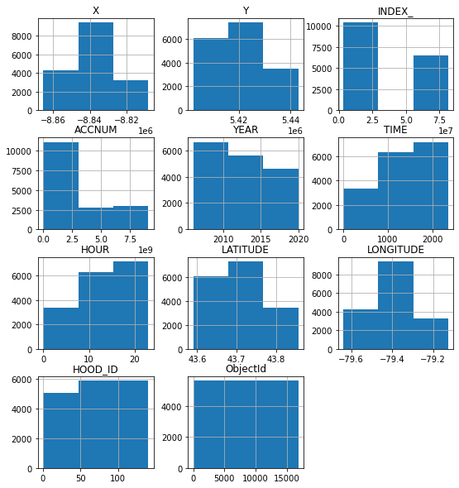
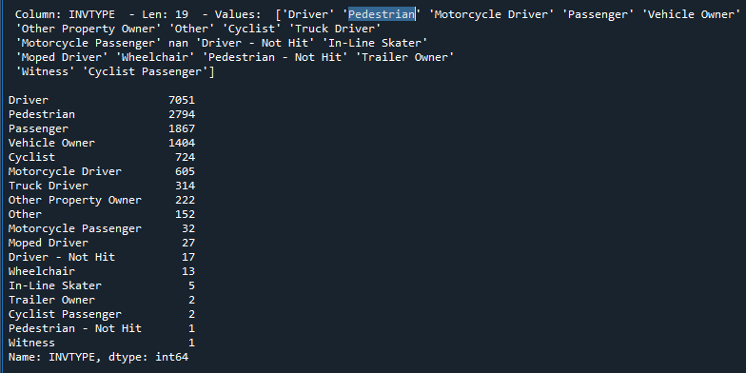
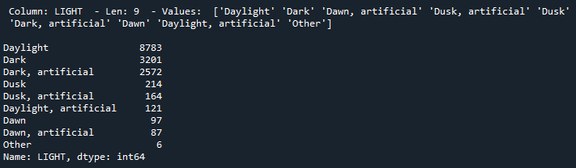

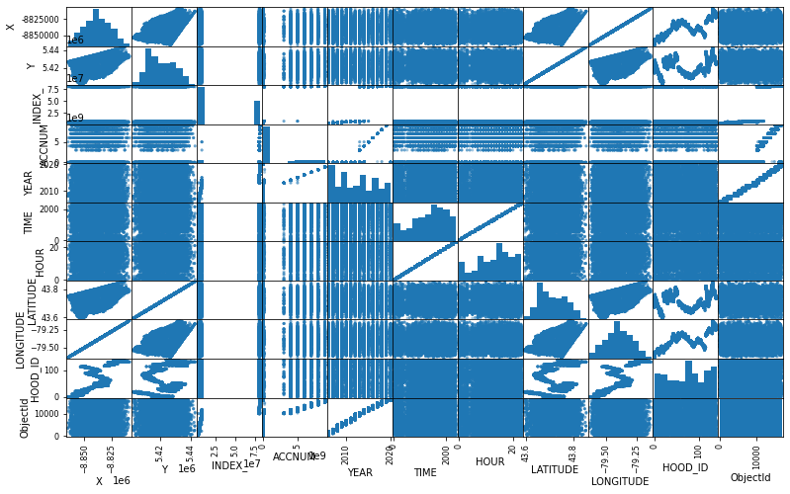
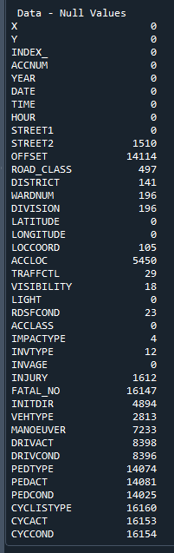
Data Exploration Features
Clean values
Null Values
Plots
Distribution with
Histograms
Correlation with
Scatter Plot

Slide 5
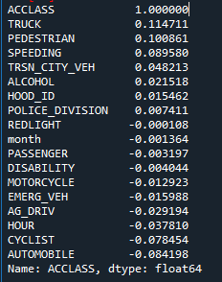
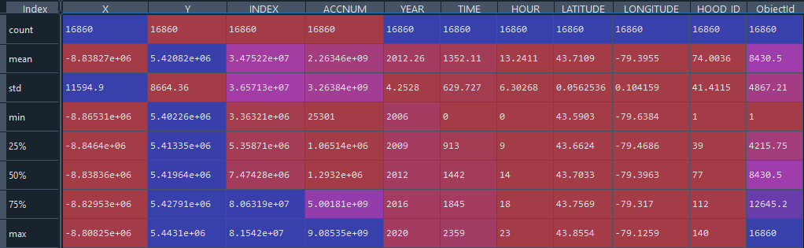
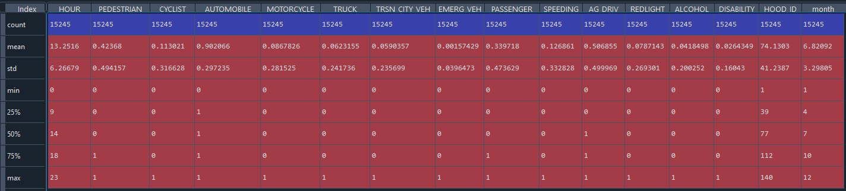
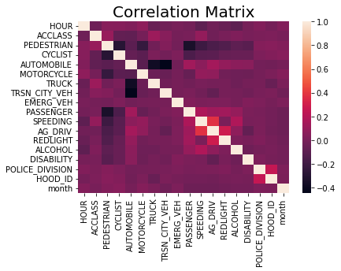
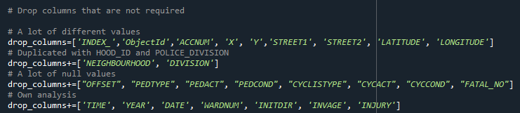
Data Exploration Features
Stats to analyze mean, standard deviation
Correlation with ACCLASS
We drop those columns, and finally we worked with 28 features

Slide 6
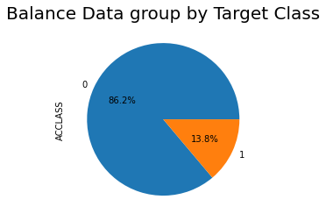
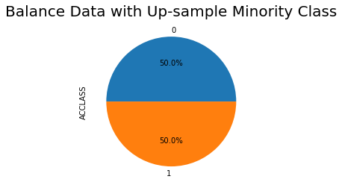
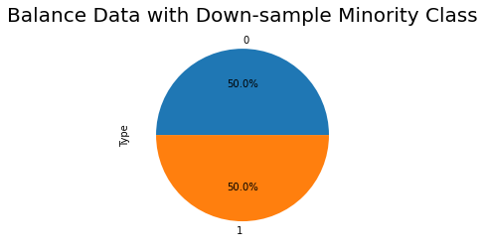
Imbalanced Data
Logistic Regression Model | Imbalanced Data | Balanced with up-sample minority | Balanced with down-sample minority
Accuracy | 0.8646377770426729 | 0.6719781907541085 | 0.6731963688485427
Precision | 0.05207835642618251 | 0.6896022116418369 | 0.6779741997133302
Recall | 0.6374269005847953 | 0.6661226911950152 | 0.6715570279223853
ROC AUC | 0.7523322939754811 | 0.6721921264619507 | 0.6732121849693933
ACCLASS – VALUE 0 | 13022 | 13022 | 2093
ACCLASS – VALUE 1 | 2093 | 13022 | 2093

Slide 7

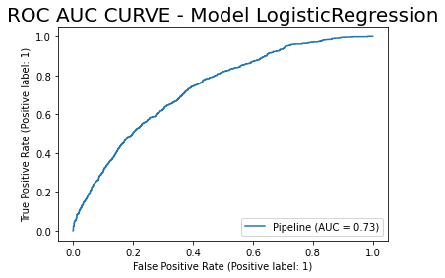
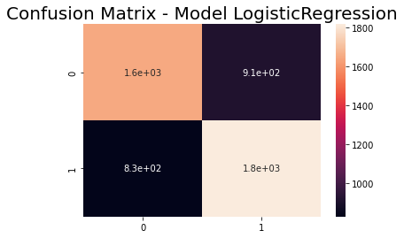
Logistic regression
Test Precision: 0.6658116526200073
Test Recall: 0.6864374763883642
Test F1 Score: 0.6759672619047619
Test ROC AUC Score: 0.6652327897164303
Test Accuracy Score: 0.6655788059128431

Slide 8

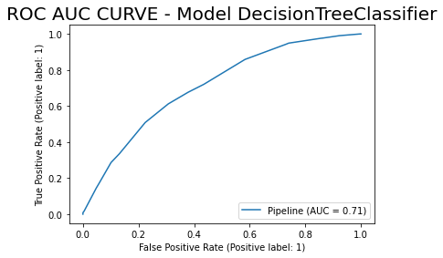
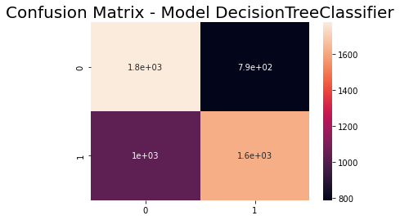
Decision tree classifier
Test Precision: 0.6730369754881596
Test Recall: 0.612013600302229
Test F1 Score: 0.6410763751483973
Test ROC AUC Score: 0.6524158555765633
Test Accuracy Score: 0.6517565751583797

Slide 9
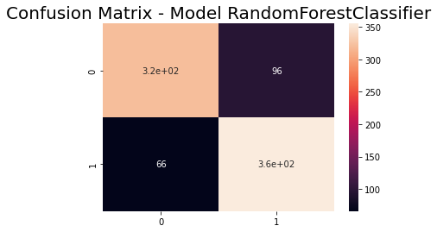
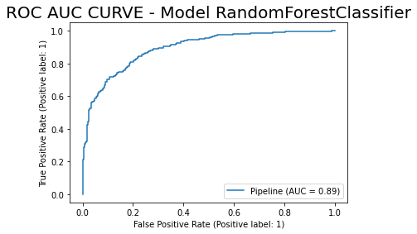
Random forest classifier
Test Precision: 0.7871396895787139
Test Recall: 0.8432304038004751
Test F1 Score: 0.8142201834862386
Test ROC AUC Score: 0.8065072882311728
Test Accuracy Score: 0.8066825775656324

Slide 10
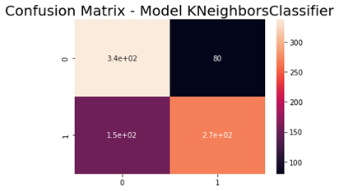
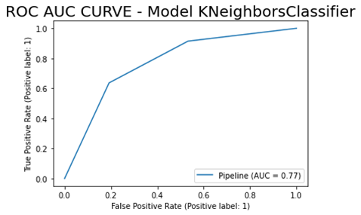
K Neighbors Classifier
Test Precision: 0.7701149425287356
Test Recall: 0.6365795724465558
Test F1 Score: 0.6970091027308193
Test ROC AUC Score: 0.7223665248323906
Test Accuracy Score: 0.7219570405727923

Slide 11
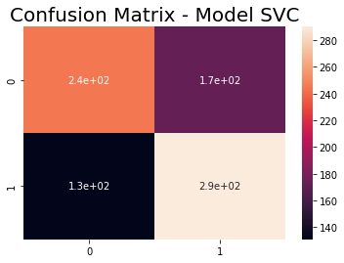
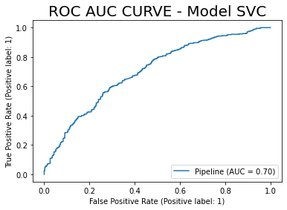
SVM
Test Precision: 0.6277056277056277
Test Recall: 0.6888361045130641
Test F1 Score: 0.6568516421291052
Test ROC AUC Score: 0.6381830402661244
Test Accuracy Score: 0.6384248210023866

Slide 12
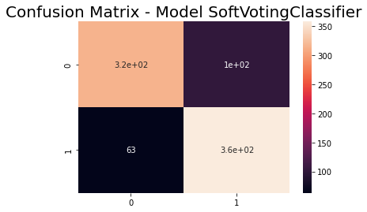
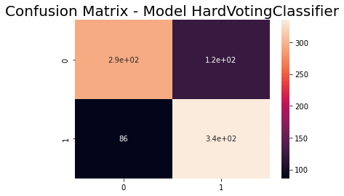
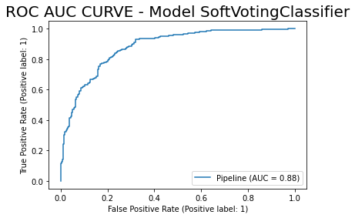
Hard Voting
Test Precision: 0.7314410480349345
Test Recall: 0.7957244655581948
Test F1 Score: 0.7622298065984072
Test ROC AUC Score: 0.7503802183906082
Test Accuracy Score: 0.7505966587112172
Soft Voting
Test Precision: 0.7782608695652173
Test Recall: 0.850356294536817
Test F1 Score: 0.8127128263337116
Test ROC AUC Score: 0.8028759889950272
Test Accuracy Score: 0.8031026252983293

Slide 13
Model Stats
 | Logistic Regression | Random Forest | Decision Tree | K Neighbors | SVC | Hard Voting | Soft Voting
Accuracy | 66.55% | 80.67% | 65.18% | 72.20% | 63.84% | 75.06% | 80.31%
Precision | 66.58% | 78.71% | 67.30% | 77.01% | 62.77% | 73.14% | 77.83%
Recall | 68.64% | 84.32% | 61.20% | 63.66% | 68.88% | 79.57% | 85.04%
F1 | 67.60% | 81.42% | 64.11% | 69.70% | 65.69% | 76.22% | 81.27%
ROC AUC | 66.52% | 80.65% | 65.24% | 72.24% | 63.82% | 75.04% | 80.29%

Slide 14
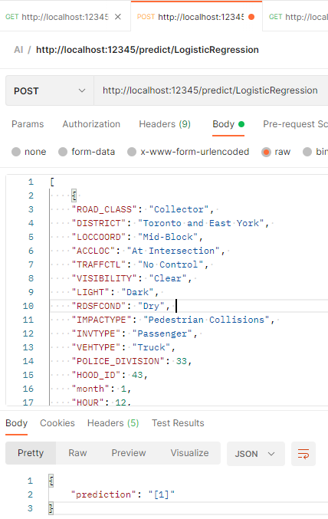
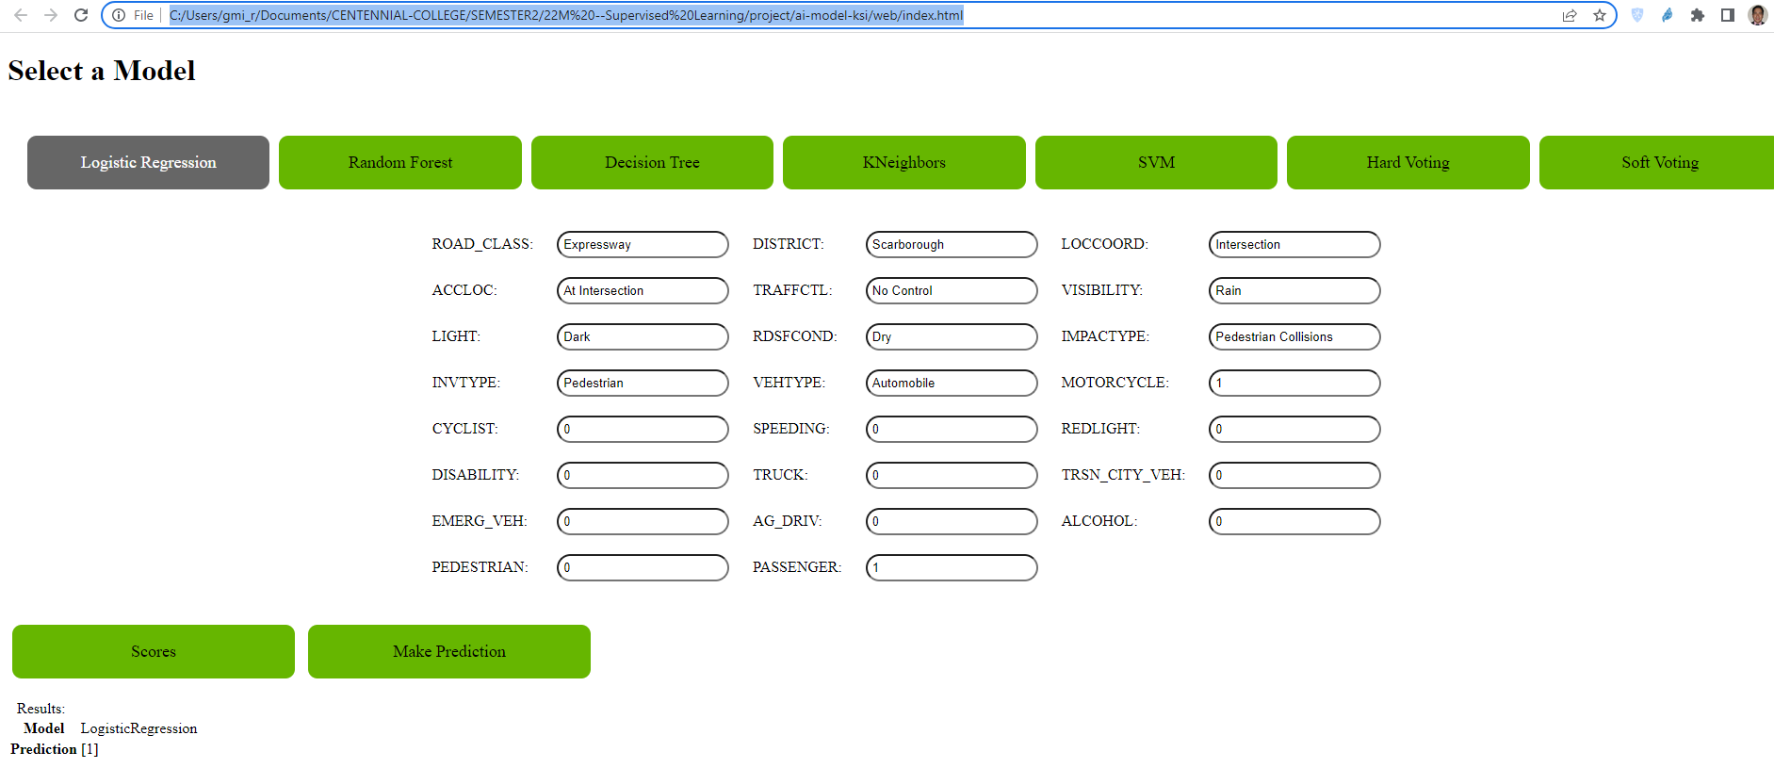
DEMO
API
Flask
Python
Website
HTML, JavaScript, jQuery, CSS

