Slide 1
Take-Home Challenge

Slide 2
Datasets
Patient demographics
Clinical data
Billing identifiers
Billing amount

Slide 3
Data Pre-Processing – Patient Demographics
Gender column
Change “f” and “m” to “Female” and “Male” respectively.
Race column
Change “India” to “Indian”.
Change “chinese” to “Chinese”.
Resident status column
Change “Singaporean” to “Singapore citizen”

Slide 4
Data Pre-Processing – Clinical Data
Change “Yes” to 1 and “No” to 0.
Create a new variable called “cgis_change” – the percentage change of cgis between admission and discharge.

Slide 5
Data Pre-Processing
Combine Clinical Data and Patient Demographics tables based on patient_id.

Slide 6
Study Design
Research Question: is there any correlation between the patient outcomes and combination of antidepressants with adjunctive medications (anxiolytics, anticonvulsants, SSRI and others).
Purpose: to find out whether combining adjunctive medications with antidepressants would lead to better outcomes.
Possible implications: reduction in adverse events and medication cost.
Inclusion criteria: patients who are prescribed with antidepressants.
Notes:
antidepressant prescribing patterns

Slide 7
Baseline Characteristics – Categorical Variables (N=3,400)
Variables |  | Count of adjunctive medications |  | Total
 |  | ≤2 | >2
Gender | Female | 908 | 794 | 1702
 | Male | 965 | 733 | 1698
Race | Chinese | 1216 | 950 | 2166
 | Indian | 187 | 157 | 344
 | Malay | 373 | 334 | 707
 | Others | 97 | 86 | 183
Substance use disorder | Yes | 1232 | 949 | 2181
 | No | 515 | 471 | 986
Anxiety disorder | Yes | 1402 | 1132 | 2534
 | No | 471 | 395 | 866
Other mood disorders | Yes | 1411 | 1124 | 2535
 | No | 462 | 403 | 865
Chi-square tests show no statistically significant differences between both groups across different categorical variables

Slide 8
Baseline Characteristics – Numerical Variables (N=3,400)
Variables | Total | Count of adjunctive medications |  | p-value
 |  | ≤2 | >2
Age (mean, SD) (years) | 63.0, 14.6 | 63.1, 14.6 | 62.9, 14.7 | 0.45
BMI (mean, SD) (kg/m²) | 29.0, 4.1 | 28.9, 4.1 | 29.0, 4.2 | 0.24
CGIS at admission (mean, SD) | 4.3, 1.3 | 4.3, 1.3 | 4.4, 1.3 | 0.08
CGIS at discharge (mean, SD) | 3.9, 1.1 | 3.9, 1.1 | 3.9, 1.0 | 0.21
CGIS change (mean, SD) (%) | -0.8, 45.3 | -1.5, 45.6 | 0, 45.0 | 0.09
Shapiro-Wilk tests p<0.05 – Data are not normally distributed.
Levene’s tests p>0.05 – Data have similar amount of variation.
Non-parametric test Mann-Whitney U test is chosen.

Slide 9
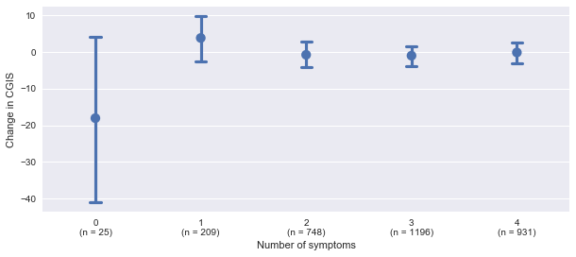
Number of Symptoms VS Change in CGIS
Kruskal-Wallis test shows no statistically significant difference between groups of different number of symptoms in terms of change in CGIS
(p-value=0.18)

Slide 10
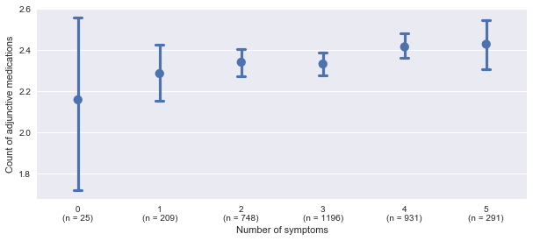
Number of Symptoms VS Count of Adjunctive Medications
Kruskal-Wallis test shows no statistically significant difference between groups of different number of symptoms in terms of count of adjunctive medications
(p-value=0.19)

Slide 11
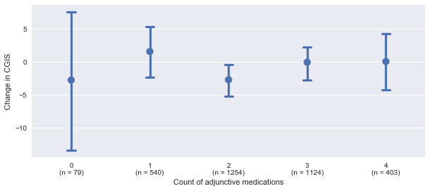
Count of Adjunctive Medications VS Change in CGIS
Kruskal-Wallis test shows no statistically significant difference between groups of different count of adjunctive medications in terms of change in CGIS
(p-value=0.23)

Slide 12
Conclusions
No significant effect of different number of symptoms on CGIS.
No significant effect of different number of symptoms on prescribed adjunctive medications.
No significant effect of different count of adjunctive medications on CGIS.

Slide 13
Possible Further Analysis
Relationship between different types of medications and symptoms.
The effect of different types of medications on CGIS.

