Slide 1





Africans Society of Strathcona County
STRATEGIC PLAN
2025 -2027
“Celebrating Culture, Empowering Africans, Driving Change”
Presented by
BUSAYO DISU
1

Slide 2

Africans Society of Strathcona County
Who We Are
ASOSC is a vibrant, community-driven nonprofit empowering Africans to enrich the social, economic,and cultural fabric of Strathcona County and Alberta through advocacy, education, talent development, and cultural initiatives
2

Slide 3

Africans Society of Strathcona County
Vision and Mission
VISION
MISSION
Celebrate African Culture
Foster active community participation
Support African talent and innovation
Promote well-being and inclusion of members
Build a united and empowered African Community
A future where Africans play a vital and visible role in enriching Alberta’s social, economic, and cultural prosperity
3

Slide 4
Africans Society of Strathcona County
Our Core Values
Excellence &
Innovation
Community Engagement
Integrity & Accountability
Inclusion & Belonging
Cultural Pride
At the Africans’ Society of Strathcona County (ASOSC), our work is grounded in a set of core values that guide our mission, vision, and daily interactions within the community. These values reflect who we are, what we stand for, and the future we strive to build
4

Slide 5

Africans Society of Strathcona County
Strategic Priorities 2025- 2027
Cultural Celebration & Preservation
Community Integration & Support
Health, Wellness & Financial Empowerment
Talent Development & Youth Empowerment
Organizational Sustainability & Governance
5

Slide 6


Africans Society of Strathcona County
African Festival & Summer BBQ
Cultural Celebration & Preservation
Events and Trainings on African art, music, cuisine, haircare, storytelling etc
Tech Africa
6

Slide 7

Africans Society of Strathcona County
Community Integration Programs for African Newcomers, Married Couples & Parents
Community Integration & Support
Charity and Volunteerism Drives
Legal Literacy Seminars for African Families
7

Slide 8

Africans Society of Strathcona County
Culturally Relevant Health Talks
Health, Wellness & Financial Empowerment
Wellness campaigns and programs
Financial Literacy Seminars for Adults and Youth
8

Slide 9

Africans Society of Strathcona County
Art, Sports and Coding Summer Camps
Talent Development & Youth Empowerment
ASOSC Youth Innovation Council
Talent Showcase and Youth Mentorship
9

Slide 10

Africans Society of Strathcona County
Fundraising activities & events
Organizational Sustainability & Governance
Membership & Partnership Drives
Board & Volunteers Trainings,
Office Setup
10

Slide 11

Africans Society of Strathcona County
Implementation Roadmap
2025
2026
2027
Expand all events and programs
Grow membership, funding, and partnerships.
Establish operational infrastructure
Evaluate Community Impact
Publish Community Report
Scale successful initiatives across Alberta
Host Cultural Events
Launch Youth Programs
Strengthen health/ Finance/Integration talks
Grow ASOSC’s digital presence
11

Slide 12

Africans Society of Strathcona County
Evaluation Metrics
Track participation and attendance in cultural events and programs - at least 20% increase yearly
Satisfaction of programs & events attendees - at least 80% improvement rate over the years
Number of sustainable projects over the years.
Monitor the number of African Youth innovation & leadership roles in the community - 20% increase over the years
Track steady growth in membership, partnerships and operational funding.
12

Slide 13
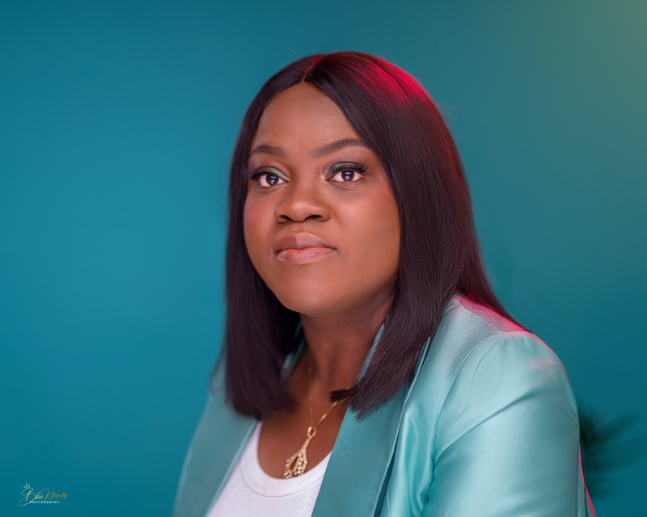
Africans Society of Strathcona County
THANK YOU!
Get involved and make a difference!
Register as a member.
Join our team of passionate volunteers as a guest speaker or trainer, or in organizing events, facilitating educational sessions, mentoring youth, and supporting community development projects.
Volunteering with ASOSC is a meaningful way to give back to our community while celebrating African heritage
BUSAYO DISU
Founding President,
ASOSC
13

