Slide 1
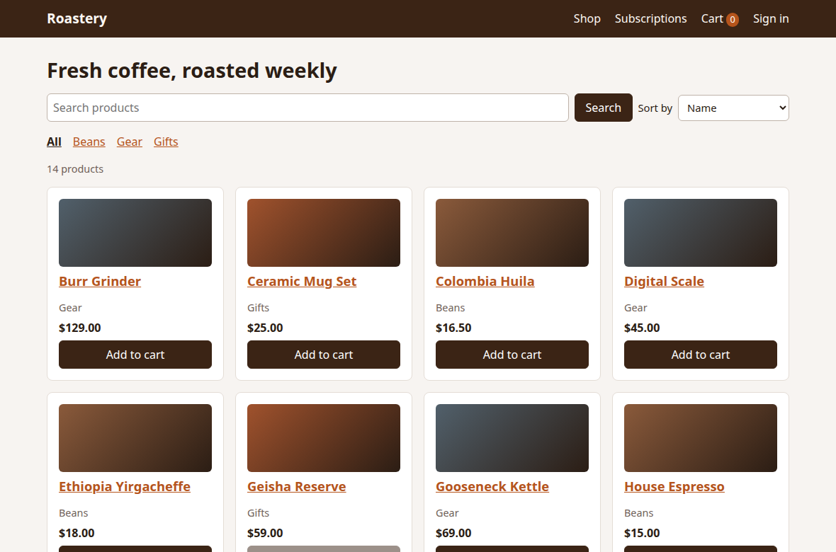
Playwright Commerce E2E
A test framework for a shop with a cart, payments and subscriptions
Roastery, the demo shop the tests run against
Playwright | TypeScript | Node.js
Notes:
WHAT TO SAY: This is a complete end-to-end test framework, built with Playwright and TypeScript. It tests Roastery, a demo coffee shop with a cart, checkout, three ways to pay and subscription billing.
HOW TO USE THIS DECK: Each slide makes one point. The notes on every slide hold what to say, so you can read them to learn the project and use them to present it. Slides 18 and 19 give you a 60-second version and answers to likely questions.

Slide 2
A test framework that proves it catches bugs
What was built
103
14 of 14
A Playwright and TypeScript test suite
A demo shop to test, included in the repo
A report that says what needs attention
Pipelines ready for GitHub
tests across 14 spec files
planted bugs caught
Why it matters
109 of 109
0
Passing tests alone prove little. Every test here also runs against a build with planted bugs, so the suite shows it can fail for the right reasons.
passed on the clean build, including the phone run
flaky tests in 5 recorded runs of each build
Notes:
WHAT TO SAY: Most test projects only show that tests pass. That proves very little, because a test that can never fail also passes. So this project runs every test twice. On the clean build, everything must pass. On a build with 14 planted bugs, the right tests must fail.
THE NUMBERS: 103 tests in 14 spec files. All 14 bugs were caught. The clean build passed 109 of 109, which is the 103 tests plus the 6 critical tests repeated on a phone-sized screen. No test was flaky in the 5 recorded runs of each build.

Slide 3
Why the app lives inside the repo
Public demo sites
A demo shop in this repo
Practice sites checked had no subscriptions
Sites with subscriptions are vendor sales demos
Not built for nightly test traffic
Can change or go offline overnight
Cart, payment and subscriptions in one app
The same result on every run
Free, with no accounts, keys or paid services
14 real bugs that can be switched on
The tests only use the browser and the API, so the same approach works on a hosted site.
Notes:
WHAT TO SAY: The first decision was what to test against. The stable practice sites that were checked have shopping but no subscriptions. The sites that do have subscriptions are vendors' sales demos, which aren't meant for automated traffic every night, and any public site can change overnight, which makes test results unreliable.
So the demo shop ships inside the repo. It's free, needs no accounts, gives the same result every time, and it can plant bugs on demand, which no public site could do.
IF ASKED: The tests never reach inside the app. They only use the browser and the API, the same way they would on a real hosted site.

Slide 4
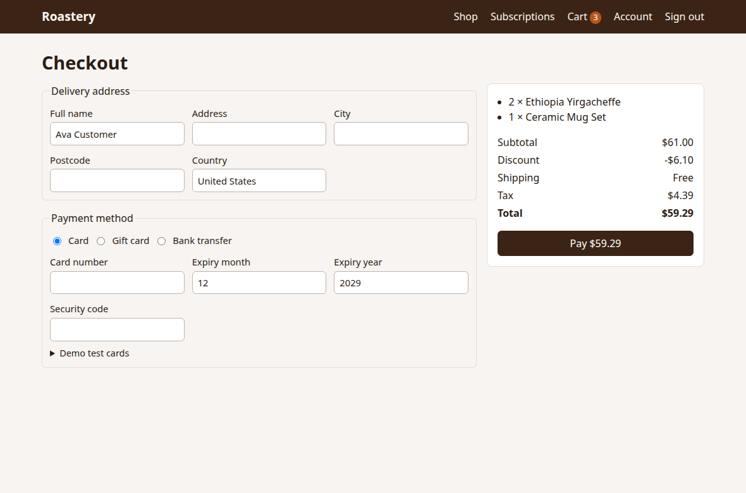




Roastery: a shop with real payment flows
Shopping
Payment
Search, filters, cart, coupons, shipping and tax
Card with 3-D Secure, gift card, bank transfer
Subscriptions
Admin
Trials, renewals, upgrades, pausing, failed payments
Refunds, products, coupons and revenue
Payments use a mock gateway. Only test cards work, so no real money is involved.
Notes:
WHAT TO SAY: Roastery is a coffee shop, chosen because coffee suits both one-off orders and monthly subscriptions. It covers the four areas that matter in e-commerce.
Shopping: search, filters, cart, coupons, shipping and tax. Payment: card, including a 3-D Secure bank confirmation step, gift card, and bank transfer. Subscriptions: free trials, renewals, upgrades and downgrades, pausing, cancelling, and what happens when a renewal payment fails. Admin: refunds, products, coupons and revenue.
PAYMENTS: There's no real payment provider. A mock gateway inside the app decides the outcome from the card number, the same way Stripe's test mode works. Real cards are refused.

Slide 5
How the pieces fit together
Page objects
Specs
browser
Roastery shop
How to use each screen
What to check. One test per case, each with an ID such as PAY-01.
Clean build on port 4173. Seeded-bug build on port 4174.
API client
web API
Fast set-up, and checks on the server
Fixtures wrap every test: a new customer, the admin session, cleanup and the console guard
Report turns the results into a one-word signal, the causes of each failure and a trend
Notes:
WHAT TO SAY: There are clear layers, and each has one job.
Specs say what to check. They read like the customer journey, and each test has an ID.
Page objects know how each screen works. If the checkout layout changes, one file changes and every test keeps working.
The API client sets up data quickly. A checkout test shouldn't spend its time clicking through the catalogue, so it fills the cart through the API and only tests checkout in the browser.
Fixtures wrap every test. They create a new customer, sign in, clean up afterwards and watch for hidden errors.
The report reads the results and says what needs attention.

Slide 6
Anatomy of one test
1
Ask for what it needs
1
test('PAY-01 > an approved card places the order',
{ tag: '@smoke' }, async ({ shop, customer }) => {
Here, the page objects and a new customer.
2
Set up through the API
2
await customer.api.addToCart(yirgacheffe.id);
The cart is filled quickly, with no clicking.
3
await shop.checkout.open();
await shop.checkout.payByCard(goodCard());
3
Act in the browser
This is the part being tested.
4
await expect(shop.order.status).toHaveText('Paid');
await expect(shop.order.total).toHaveText('$24.39');
4
Check the screen
What the customer sees.
5
expect(await customer.api.orders()).toHaveLength(1);
});
5
Check the server
Simplified from e2e/specs/checkout/card-payment.spec.ts
What really happened.
Notes:
WHAT TO SAY: Every test follows the same pattern, so here's one, in five parts.
One: the test asks for what it needs. It wants the page objects and a customer, and the framework builds them.
Two: set-up happens through the API, because it's fast.
Three: the action happens in the browser, because this is the thing being tested.
Four: it checks what the customer sees.
Five: it checks what really happened on the server. That last check matters. A screen can look right while the server did the wrong thing, as you'll see with one of the planted bugs.
The test ID, PAY-01, is how the report, the defect list and the inventory all refer to this test. The @smoke tag marks it as a critical journey.

Slide 7
Every test gets its own customer
Tests running at the same time
What a test can ask for
PAY-01
New customer 1
Own cart, orders, subscription
shop
all the page objects
customer
CART-03
New customer 2
Own cart, orders, subscription
a new signed-in account
newCustomer()
more people, for tests that need two
SUB-09
New customer 3
Own cart, orders, subscription
admin
the API as staff
guestApi
No test can affect another, so they run in parallel and in any order.
the API with no session
newProduct()
a throwaway product
Notes:
WHAT TO SAY: Shared test data is the main cause of flaky tests. If two tests use the same account at the same time, one changes the cart while the other is checking it.
So every test that needs a customer gets a brand-new one, created through the API and signed in to the browser automatically. When the test ends, even if it failed, the fixture deletes the customer and everything they created.
That isolation is why the suite can run on four workers at once, in any order, and still give the same answer every time.
The list on the right is what a test can ask for. Fixtures are the core of the framework: the test states what it needs, and Playwright builds it and cleans it up.

Slide 8
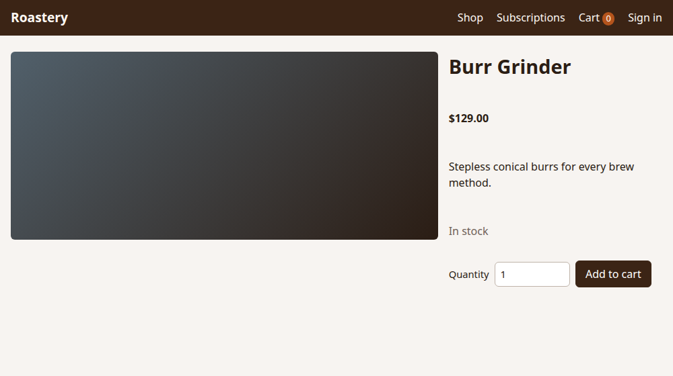
The console guard sees what the screen hides
What a person sees
What the guard sees
CAT-10 > a gear product page loads with no script errors
The page reported errors a user would never see
Script error: Cannot read properties of undefined (reading 'slice')
A normal product page with a working button.
Real output from the seeded-bug build.
It runs on every test, and fails on script errors, console errors and server errors.
Notes:
WHAT TO SAY: This is one of the planted bugs, BUG-12. On the left is a gear product page. It looks completely normal, and the button works. No check on the visible page could fail here.
Behind the page, though, a script has crashed. On the right is the real output from the test run.
That's caught by the console guard. It runs automatically on every test, watching for script errors, console errors and server errors, and fails the test if any appear, even when the page looks fine.
A small list of expected errors stops false alarms. For example, the browser logs a message every time a request is refused, which is normal behaviour in tests of refused cards and coupons. That list is kept short on purpose, because each entry is something no test will ever notice again.

Slide 9
103 tests, weighted toward the money
54
tests cover cart, checkout and subscriptions, where a bug costs real money
6
critical journeys tagged @smoke, which also run on a phone-sized screen
Notes:
WHAT TO SAY: Test effort should follow risk. In a shop, the biggest risk is money, so more than half the tests, 54 of 103, sit on cart, checkout and subscriptions.
The 15 API contract tests check things a browser can't easily show: response shapes, permission rules, and that card numbers never come back from the server.
Six tests are tagged @smoke. They're the critical journeys: sign up, browse, add to cart, pay, subscribe and refund. They run first on any change, and they repeat on a phone-sized screen.
The full list of tests is in docs/TEST-INVENTORY.md. It's generated from the code, so it can't go out of date.

Slide 10
Same tests, two builds, two answers
Clean build
HEALTHY
Seeded-bug build
DEGRADED
109 of 109
21 of 103
tests passed in 18 seconds
tests failed, each one because of a planted bug
Proves there are no false alarms.
Proves the suite detects real defects.
One switch, SEEDED_BUGS, turns the bugs on. The app code and the tests are otherwise identical.
Notes:
WHAT TO SAY: This slide is the heart of the project. The same tests run against two builds of the same shop.
On the clean build, all 109 pass in 18 seconds. That shows the suite doesn't raise false alarms.
On the seeded-bug build, 21 tests fail, and every failure traces back to a planted bug. The other 82 tests stay green, which shows one bug doesn't set off unrelated failures. It takes 43 seconds, because failing checks wait for their timeouts.
The only difference between the two builds is one setting called SEEDED_BUGS. This is the same idea as mutation testing: break the code on purpose and confirm the tests notice.

Slide 11
All 14 planted bugs were caught
14 of 14
The three critical ones
BUG-01
A declined card still books the order
Shop gives goods away, and the customer sees a failure
realistic e-commerce bugs, modelled on mistakes real shops make
Caught by PAY-02, PAY-03
BUG-06
A failed renewal leaves the subscription active
3
Critical
Customer keeps getting coffee without paying
Caught by SUB-18 to SUB-21
7
High
BUG-09
A customer can read another customer's order
4
Medium
Private data leaks to other customers
Caught by ACC-04
Notes:
WHAT TO SAY: There are 14 planted bugs, and they're the sort of thing that really happens in shops: 3 critical, 7 high and 4 medium.
Here are the critical ones. BUG-01: a declined card still books the order. The customer sees a clear decline message, so the screen looks right, but an order exists anyway. BUG-06: when a renewal payment fails, the subscription stays active, so the customer keeps getting coffee for free. BUG-09: a customer can open someone else's order, which is a privacy problem.
All 14 were caught. The complete list is in the appendix slides, and in docs/SEEDED-BUGS.md.

Slide 12






Each bug needs a different kind of check
Boundary values
The server, not just the screen
A second user
BUG-03 only shows at exactly $50.00, the free-shipping limit.
BUG-01 shows the right message. Only the order list reveals it.
BUG-09 needs two customers, one reading the other's order.
The arithmetic
Hidden errors
Time-based flows
BUG-08 charges without error. Only the invoice amount is wrong.
BUG-12 is invisible on screen. The console guard finds it.
BUG-06 appears at renewal, which a test hook triggers on demand.
Notes:
WHAT TO SAY: The interesting part isn't that bugs were caught. It's that each one needs a different testing technique, and that's what good test design is about.
Boundary values: free shipping starts at $50, so the test uses exactly $50.00. BUG-03 only shows at that exact amount.
The server, not just the screen: BUG-01 shows the correct decline message. Only checking the order list finds it.
A second user: BUG-09 needs two customers, which the newCustomer fixture makes easy.
The arithmetic: BUG-08 charges successfully, so nothing looks wrong. Only checking the invoice amount shows it charged too much.
Hidden errors: BUG-12 is invisible, and the console guard finds it.
Time-based flows: a test can't wait a month, so a test hook runs what the end of a billing period would run.

Slide 13
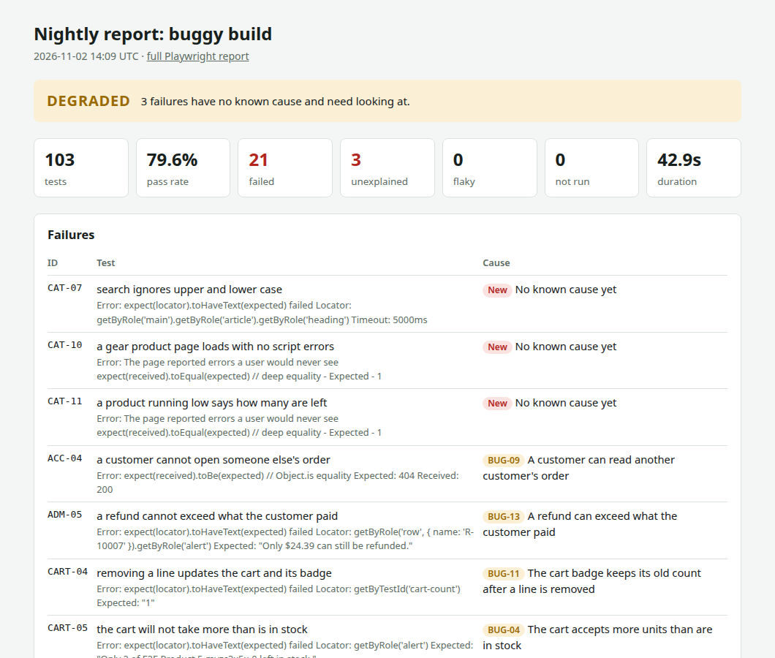
The report answers one question first
Do I need to do anything today?
HEALTHY
Everything passed, or every failure is a known defect.
DEGRADED
At least one failure has no known cause.
BLOCKED
A critical journey failed with no known cause, or most tests never ran.
Also shows the causes, the trend, coverage by area, and flaky tests.
Notes:
WHAT TO SAY: Playwright has a good detailed report for engineers. But the person reading results in the morning needs one answer first: do I need to do anything today?
So there's an executive report on top, with a one-word signal. HEALTHY means everything passed, or every failure is a known defect. DEGRADED means something failed with no known cause. BLOCKED means a critical journey failed with no known cause, or most of the suite didn't run.
The important idea: a test failing on a known bug is doing its job, so it shouldn't cause alarm every morning. Only something new should.
The screenshot is the real report for the seeded-bug build. It's DEGRADED because 3 failures were left unknown on purpose, to show what a new problem looks like. Below that, each failure lists its cause.

Slide 14
Failures are explained, not hidden
A test fails
Is it in the known-defect map?
Listed with its cause, and no alarm
The rules
yes
One issue per failing test
At most 5 in a run
Nothing filed if GitHub is down
A closed issue failing again is a regression
no
Every failure goes through two questions.
Does an open issue carry its signature?
yes
no
New: the report says DEGRADED and files one issue
Tests are never bent around a bug. They fail, and the failure gets explained.
Notes:
WHAT TO SAY: When a product bug makes a test fail, it's tempting to change the test so it passes. That hides the bug. Here, tests always fail on bugs, and the failure gets explained instead.
Each failure goes through two questions. Is it in the known-defect map? If so, it's listed with its cause. If not, is there an open GitHub issue with this test's signature? The signature is a short code made from the test's name, written into the issue. If there's one, the failure is explained.
If neither, it's new. The report says DEGRADED and files one issue. Tomorrow's run finds that issue by its signature, so a test that fails every night only ever files once.
There are safety rules. It files at most 5 in a run, because that many new failures usually have one cause. If GitHub can't be reached, it files nothing, to avoid duplicates. And a closed issue that fails again is called a regression.
NOTE: Issue filing only works when the repo is on GitHub with a token. On your machine, the report contacts nothing. These rules have their own automated tests, using a fake GitHub on your machine. They haven't yet run against the real GitHub.

Slide 15
One command runs everything
npm run nightly
1
Start
2
Test
3
Report
4
Read
Both builds of the shop start by themselves
The suite runs against each build
Each build gets a signal and a report
Open report/index.html
CI workflow
Nightly workflow
Types, lint, the inventory check, report tests, then the 6 smoke tests.
Runs the same npm run nightly, then uploads the reports.
Both GitHub workflows start by hand. A small edit puts them on a schedule.
Notes:
WHAT TO SAY: Everything runs from one command, npm run nightly. It starts both builds of the shop, runs the suite against each, builds a report for each, and writes one page to open.
The important design choice: GitHub uses the same script. So a run on your machine and a run on GitHub do exactly the same thing. There's no "works locally but not in CI" gap.
There are two workflow files. CI runs the fast checks and the smoke tests. Nightly runs the whole thing and uploads the reports.
Both start by hand at the moment, because this is a showcase and doesn't need to run every night. The automatic triggers are in the files, commented out, so a schedule is a small edit away.
NOTE: The workflows passed a linter, and the same command passed here in CI mode, but they haven't yet run on GitHub itself.

Slide 16




Checks that protect the framework itself
Strict TypeScript
Lint rules
Mistakes in tests are found before they run.
No skipped tests, no .only and no fixed waits.
Generated inventory
15 report tests
The test catalogue comes from the code, so it stays correct.
The report logic has tests too, using a fake GitHub.
npm run check
Runs all four. The project was also tested on a fresh copy, set up from nothing, to prove it works for someone who only has the repo.
Notes:
WHAT TO SAY: A test framework is code too, so it needs its own quality checks. One command, npm run check, runs four.
Strict TypeScript finds mistakes in tests before they run.
Lint rules ban the habits that weaken a suite: skipped tests, a stray .only that silently runs one test, and fixed waits, which make suites slow and flaky.
The test inventory is generated from the code. Every test is listed with its ID, and the check fails if the list is out of date, so the catalogue can't drift.
The report has 15 tests of its own. It decides what people act on, so it needs to be right. Those tests use a fake GitHub running locally, so nothing leaves the machine.
Lastly, the project was cloned into an empty folder and set up from nothing, which proves it doesn't depend on anything left on the build machine.

Slide 17
Problems solved along the way
Admin tests failing in bulk
A running shop could break tests
Tests passed, layout was wrong
Cause
Cause
Cause
Playwright gives a file's saved session to every new API client. New customers took over the admin session.
Tests would reuse a shop left open on their port, and that shop lacked the test hooks.
Checkout fields ran into each other. The tests had no way to see that.
Fix
Fix
Fix
Guests and customers now always start with an empty session.
Browsing now uses port 3000. Tests keep 4173 and 4174.
Looked at real screenshots, then fixed the styles.
Notes:
WHAT TO SAY: These are real problems from building this, and they make good interview stories.
One: on an early run, 67 of 104 tests failed. It looked like a huge problem, but the failures shared one cause. In a test file that runs as admin, Playwright passes the saved admin session to every new API client it creates. So creating a customer quietly switched the shared admin session to that customer. The fix was to start guests and customers with an explicitly empty session. The lesson: when many tests fail at once, look for one shared cause first.
Two: Playwright reuses a server already running on its port. If someone left the shop open there, the tests would connect to it, and it wouldn't have the test hooks, so renewal tests would fail with a confusing error. The fix was to keep browsing and testing on separate ports.
Three: every test passed while the checkout fields were visibly crowded. Functional tests don't check appearance. It was only found by looking at screenshots. The lesson: automation doesn't replace looking at the product.

Slide 18
How to explain it in 60 seconds
1
The goal
Show a real test framework on an app with payments and subscriptions.
2
The app
No suitable free site had it all, so a demo shop ships in the repo.
3
The framework
Page objects, an API client, isolated data and a console guard.
4
The proof
Same tests on two builds: 109 of 109 pass, and all 14 planted bugs are caught.
5
The report
A one-word signal, so only new problems need attention.
Notes:
THE 60-SECOND VERSION, READ THIS ALOUD:
"This is a complete test framework built with Playwright and TypeScript, for a shop with a cart, payments and subscriptions. There wasn't a suitable free public site with all of those, so a demo shop is included in the repo. The framework uses page objects and a typed API client, gives every test its own customer so they can run in parallel, and has a guard that fails a test on hidden script errors.
To prove it works, the same tests run against two builds. The clean build passes all 109. The second has 14 planted bugs, and all 14 are caught. A report then gives a one-word signal, separating known defects from new problems, so people only look at what's changed."
TIP: If you only have 20 seconds, say the first sentence and the part about the two builds.

Slide 19
Questions you may be asked
Why build an app instead of testing a public site?
How do you avoid flaky tests?
No suitable free site had subscriptions. A local app gives the same result every run, and it can plant bugs.
Each test has its own data, nothing waits on a fixed clock, and locators follow what users see.
Why let tests fail on known bugs?
How would this work on a real site?
A workaround hides the bug. The test stays honest, and the defect map stops it causing alarm.
Replace the page objects and API client. The fixtures, report and pipelines carry over.
Notes:
MORE DETAIL ON EACH ANSWER:
Why build an app? The public practice sites that were checked have no subscriptions. Sites that do are vendors' sales demos, not meant for nightly automated traffic. A local app is free, stable and can plant bugs.
How do you avoid flakiness? Three things. Isolation: each test has its own customer. Waiting properly: Playwright's assertions retry until the condition is met, and fixed waits are banned by a lint rule. Stable locators: they use roles and labels, what users actually see. The result was 0 flaky tests across the recorded runs.
Why let tests fail on known bugs? If a test is changed to pass around a bug, nobody finds out when the bug gets worse. The defect map records the cause, and the report stays calm unless something is new. If a known defect stops failing, the report points that out too.
How would this work on a real site? Point the config at the site, replace ShopApi and the page objects, and write specs in the same style. The structure, report and pipelines don't change. The steps are in docs/GUIDE.md.
OTHER LIKELY QUESTIONS:
Why Playwright? Automatic waiting, parallel runs, API testing in the same tool, and traces that show what happened in a failed run.
Why both UI and API tests? The browser proves what the customer sees. The API is faster for set-up, and it checks things a screen can't show, such as permissions.
What isn't covered? Other browsers, since the suite runs on Chromium only. Also load testing, visual comparison, and a real payment provider.

Slide 20
Try it yourself
Where to read more
npm ci
Install
docs/GUIDE.md
npx playwright install chromium
How it was built, step by step
Install the browser
docs/DEMO-APP.md
npm test
Shop features, accounts, test cards
Run the suite on the clean build
docs/SEEDED-BUGS.md
npm run test:bugs
Each bug and what catches it
Run it on the seeded-bug build
docs/TEST-INVENTORY.md
npm run nightly
Every test, generated from the code
Run everything, with reports
npm run app
Needs Node.js 20 or newer. Runs entirely on your own machine.
Browse the shop, on port 3000
Notes:
WHAT TO SAY: To run it, install, then npm test. Playwright starts the shop by itself and stops it afterwards. For the full picture, npm run nightly runs both builds, then open report/index.html. To click around the shop yourself, npm run app, then open localhost:3000.
A GOOD LIVE DEMO: Run npm run test:bugs in a terminal, so people see tests failing on real bugs. Then open the report and show how it explains each failure. It takes under a minute.
For anyone who wants more, docs/GUIDE.md explains how everything was built and how to add a test.

Slide 21
All seeded bugs: critical and high
Bug | Severity | What goes wrong | Caught by
BUG-01 | Critical | A declined card still books the order | PAY-02, PAY-03
BUG-06 | Critical | A failed renewal leaves the subscription active | SUB-18 to SUB-21
BUG-09 | Critical | A customer can read another customer's order | ACC-04
BUG-02 | High | Applying the same coupon twice doubles the discount | CPN-06
BUG-03 | High | An order of exactly $50.00 misses free shipping | CART-09
BUG-04 | High | The cart accepts more units than are in stock | CART-05, CAT-12
BUG-05 | High | An expired coupon is accepted | CPN-04
BUG-07 | High | Cancelling at period end cancels straight away | SUB-11, SUB-12
Notes:
Reference slide. The first 8 of the 14 planted bugs, most severe first, with the tests that catch each one. The same list is in docs/SEEDED-BUGS.md. To try one alone, see that file.

Slide 22
All seeded bugs: high and medium
Bug | Severity | What goes wrong | Caught by
BUG-08 | High | An upgrade charges the full price, not the prorated difference | SUB-09
BUG-13 | High | A refund can exceed what the customer paid | ADM-05
BUG-10 | Medium | Sort by price compares prices as text | CAT-04
BUG-11 | Medium | The cart badge keeps its old count after a line is removed | CART-04
BUG-12 | Medium | Gear product pages throw a hidden script error | CAT-10, CAT-11
BUG-14 | Medium | Product search is case-sensitive | CAT-07
BUG-12 and BUG-14 are left out of the known-defect map on purpose, so the report shows how it treats a new problem.
Notes:
Reference slide. The other 6 planted bugs. BUG-12 and BUG-14 are deliberately left out of the known-defect map. That gives 3 failures with no known cause, which is why the seeded-bug build reports DEGRADED rather than HEALTHY. Add them to e2e/reporting/known-defects.json and it reports HEALTHY.

