Slide 1
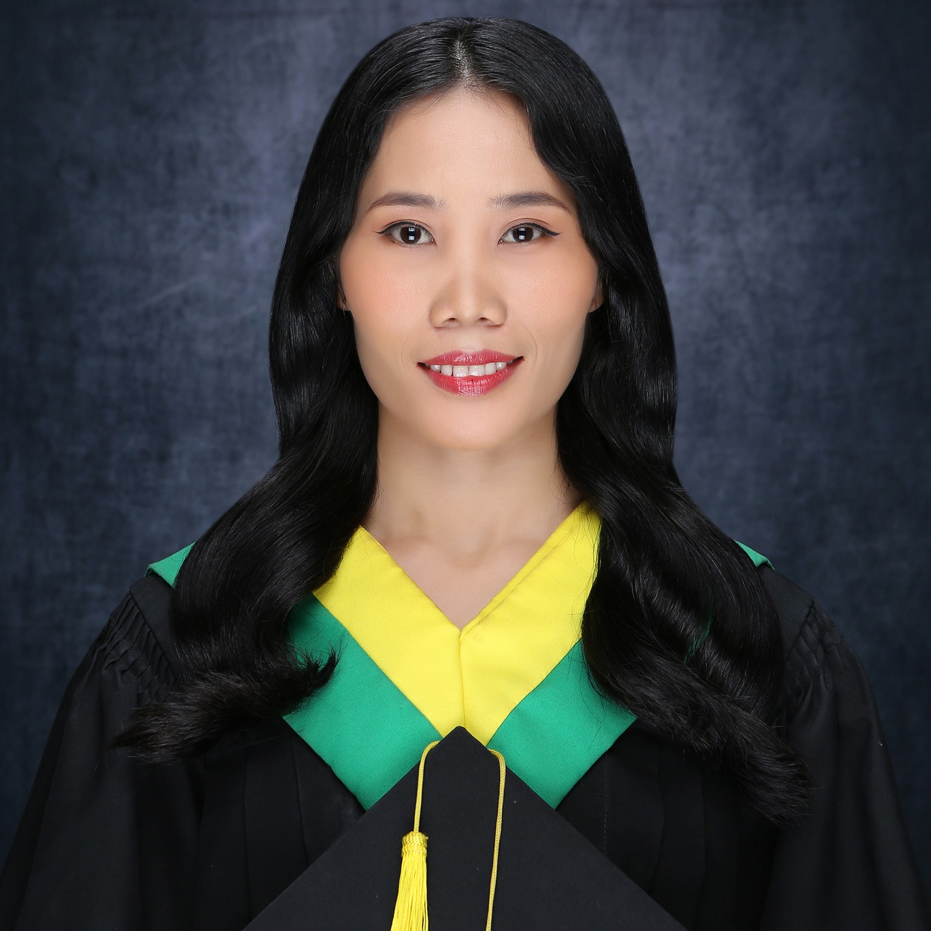




Giducos, Ronalyn Derder
Quality Engineering Associate
Career Level 12
BACKGROUND
PROFESSIONAL EXPERIENCE
As a newbie in the field, I focus on developing and executing test scripts, documenting issues, and collaborating with teams to ensure product quality gained through the company’s training courses and through coursework at bootcamp. While I don’t have project experience yet, I’m continuously upskilling and growing my expertise in software testing through effective test automation and functional testing.
In addition to my strong focus on testing, I am a full-stack web developer experienced in building responsive, user-centric websites using ReactJS and NodeJS, as well as ASP.Net Web Form-based applications gained through academic projects and internship.
My background in backend development with C# further complements my skill set, enabling me to understand both the development and testing aspects of software projects.
I am committed to delivering innovative solutions that exceed client expectations while driving technology initiatives to success. Continuous learning is essential to my approach, and I actively seek to expand my knowledge of programming languages and methodologies, including C#, C, Java, HTML, CSS, and JavaScript.
Quality Engineering Associate – Accenture Cebu
ATAS Completer – September 2024
Tricentis Tosca Fundamentals − Automation Specialist Level 1 & 2 (AS1 and AS2) Completer – October 2024
Automated Testing ASE Bootcamp (w/ Selenium) Completer – October 2024
CONTACT
OTHERS
ronalyn.giducos@accenture.com
FULL STACK WEB DEVELOPER – Internship (Non - Accenture)
Role: Full Stack Web developer
Technology Platform: ReactJS, Postman, MSSQL
Responsibilities:
Developed backend systems ensuring seamless data integration for HR applications, enabling the upload and management of employee databases.
Maintained frontend elements and monitored system performance.
Managed server updates and client communications. Gained hands-on experience in ERP implementation and support.
Independently handled all project tasks development
Cebu City, Ebloc Tower 2
Basak San Nicolas, Cebu City
TECHNICAL EXPERTISE
Selenium Web Automation
SKILLS
Functional Automation Testing
TOSCA Test Automation
Test Plan and Test Case development
Analyzing the Requirement Analysis
Client Service
Selenium Web Driver
Software Development Life Cycle (SDLC)
Accenture Delivery Methods (ADM)
Accenture Delivery Suite
FORM Methodology
Collaboration and Communication
Code Debugging
WEB DEVELOPER – Capstone Project (Non – Accenture)
Role: Web Developer
Technology Platform: ASP.Net Web- based Application, Firebase
Responsibilities:
Developed backend systems ensuring seamless data integration.
Maintained frontend elements and monitored system performance.
Managed server updates and client communications. Gained hands-on experience in ERP implementation and support.
Collaborated with the team on project tasks.
Manual Testing
TOSCA Test Automation
Basic Java
ASP.Net C#
(Web Form-based
Application)
Languages: HTML, CSS, JavaScript, C#, C, Basic Java
Framework: ReactJS, ASP.Net (Web - based Application)
Tools: Tosca Commander, Selenium, GitHub, Figma, VS Code, Visual Studio, Sublime Text, Postman, Git
Database: MySQL, MSSQL, NoSQL(Firebase)
ReactJS
CERTIFICATION
API Testing (Postman)
Tricentis Tosca Fundamentals – Automating Web Applications Testing (AS1)
October 2024
Tricentis Tosca Fundamentals − Optimizing Test Automation with Centralized Test Data (AS2)
October 2024
Tosca Badge (AS1 & AS2): https://academy.tricentis.com/legacy/lms/index.php?r=GamificationApp%2FGamificationApp%2FMyBadges
Javascript Programming
March 2023
Bayan Academy Supported by J.P. Morgan
LANGUAGE
LinkedIN
English
https://www.linkedin.com/in/giducos-ronalyn-0794922b0/
Tagalog
GITHUB – PROJECT REPO
PORTFOLIO
Cebuano
https://github.com/ronalyn05
https://ronalyn05.github.io/RG-DevFolio/

