Slide 1
Final Project Presentation
Daniel Jakab, Ronan Hwang
Applying Data Science to the Tufts Baseball Dataset

Slide 2
Data Selected
Contents of Data:
Multiple measurements of Pitch Physics Data (Velocities, spin rates, spin axes, etc)
Multiple measurements of Hit Physics Data (Exit velocities, spin, launch angles, etc)
Game Situation
All players on the field
Tufts Baseball Trackman Data

Slide 3
Analysis Questions
Question 1: What underlying factors explain the variance in pitch characteristics, and how do pitch characteristics relate to pitch/at bat outcomes?
Use PCA and Clustering to identify pitches and pitch characteristics
Analyze the variance in the dataset to derive pitching insights
Question 2: Can we predict if a batter will swing and miss at a pitch?
Use Random Forest and Neural Networks to create a model that takes in pitch data and game context to predict whiffs
Analyze features to derive insights into most valuable pitch attributes

Slide 4
Methods Selected
Methods Selected
PCA Motivation + Variables
Identified key variables that define pitch characteristics
(velocity, spin rate, IVB, HB, extension, spin axis, release height)
Applied PCA to reduce dimensionality and compare pitchers in a shared feature space
Goal: understand how pitchers differ and how pitch characteristics group together
Variation in these features helps evaluate pitching strategies and identify successful pitch profiles
Question 1

Slide 5
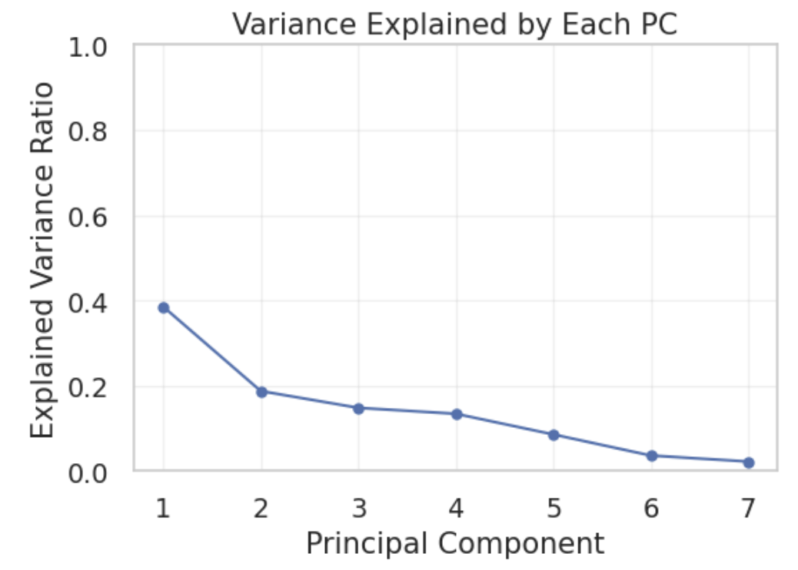
Variance Using PCA
PC1 explains 38.54%, PC2 18.76%, PC3 14.82% of variance
First three PCs capture 72.12% of total variation
These components represent the core structure of pitch characteristics

Slide 6
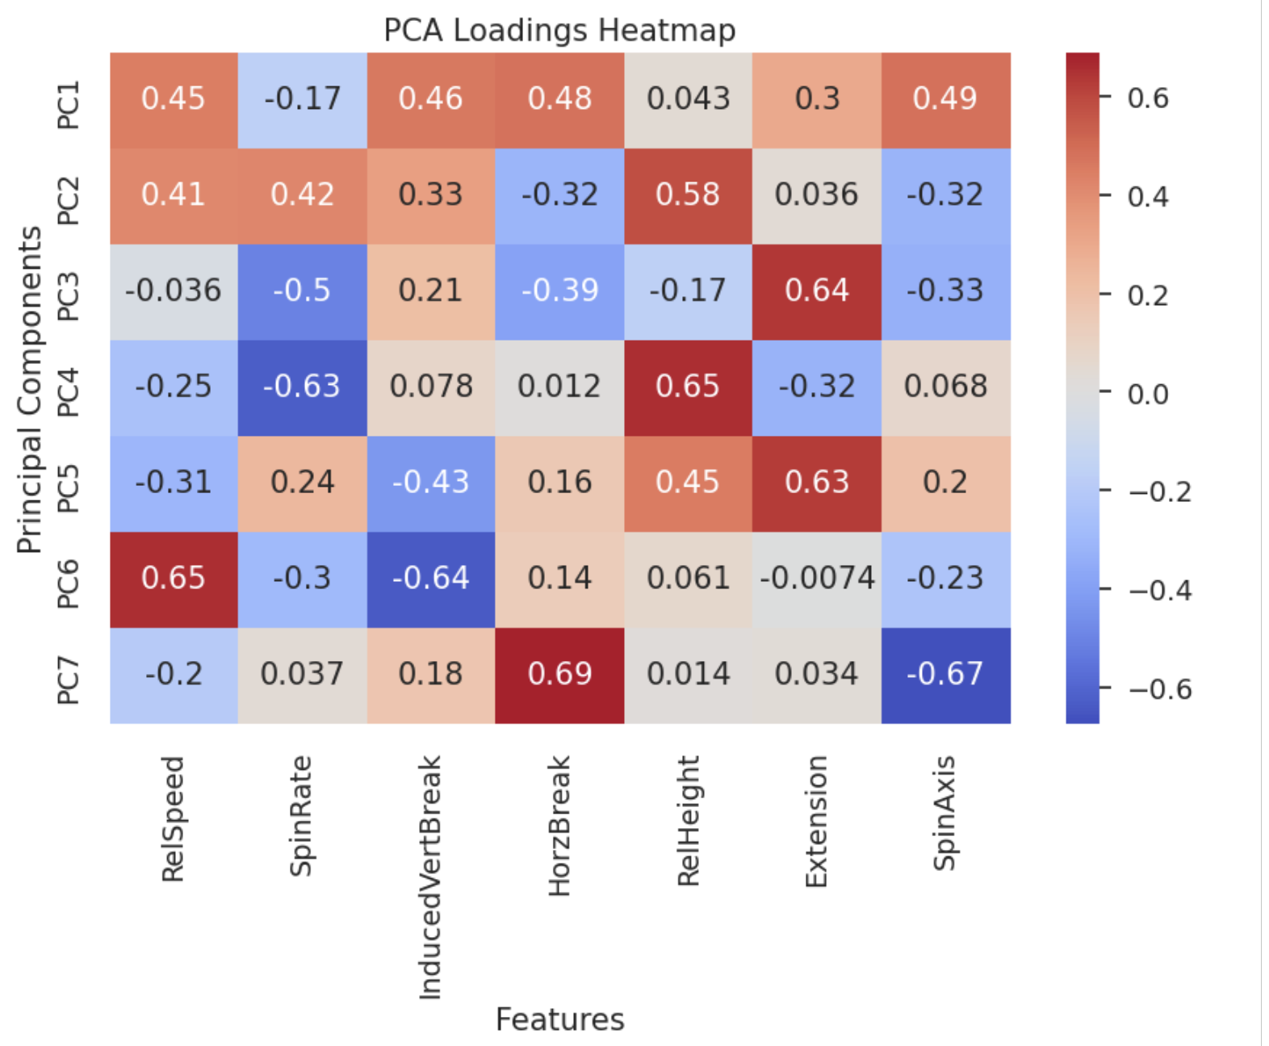
PCA Heatmap
Found most influential variables
3 separators of pitch types - Velocity, movement, and spin
Loadings show how each feature contributes to the underlying pitch‑shape dimensions

Slide 7
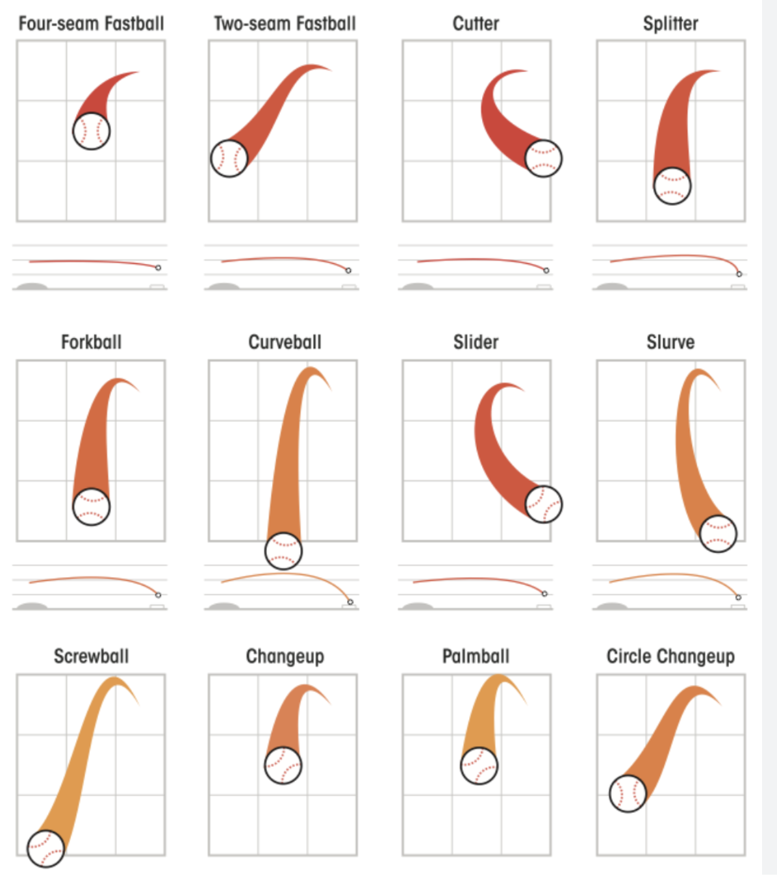
K Means Clustering
Concern: LHP and RHP pitches have mirrored horizontal movement
(e.g., RHP slider breaks right‑to‑left; LHP slider breaks left‑to‑right)
PCA aligns these mirrored shapes in the same feature space
Flipping horizontal break for LHPs had minimal effect on PCA or cluster assignments

Slide 8
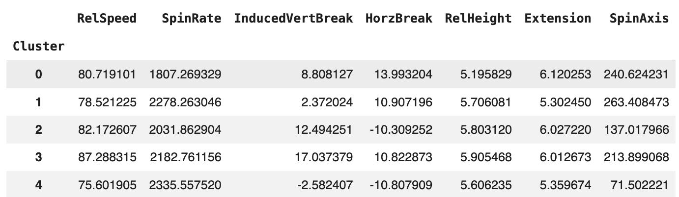
Cluster Profiles
Cluster identities based on MLB + Tufts pitch characteristics:
Clusters driven by pitch shape
Slight right‑handed bias likely due to dataset
Cluster 0: Sweepers
Cluster 1: Gyro sliders/ cutters
Cluster 2: Sinkers
Cluster 3: Ride fastballs
Cluster 4: Curveballs

Slide 9
Cluster Profiles
Cluster 3: (≈87 mph), high IVB, positive HB
Cluster 2: (≈82 mph), high IVB, negative HB
Cluster 4: Lowest velocity, negative IVB + HB, high spin
Cluster 1: Moderate movement, high spin, sharp late break
Cluster 0: Mikely sweepers, possibly mixed with changeups
Overlap reflects natural inconsistency and pitch variability at the DIII level
Cluster 0: Sweepers
Cluster 1: Gyro sliders/ cutters
Cluster 2: Sinkers
Cluster 3: Ride fastballs
Cluster 4: Curveballs

Slide 10
Methods Selected
Methods Considered
Neural Network
Random Forest
Regression
Method Selected
We selected a Random Forest model due to the nature and inherent variance of pitch types
Question 2

Slide 11
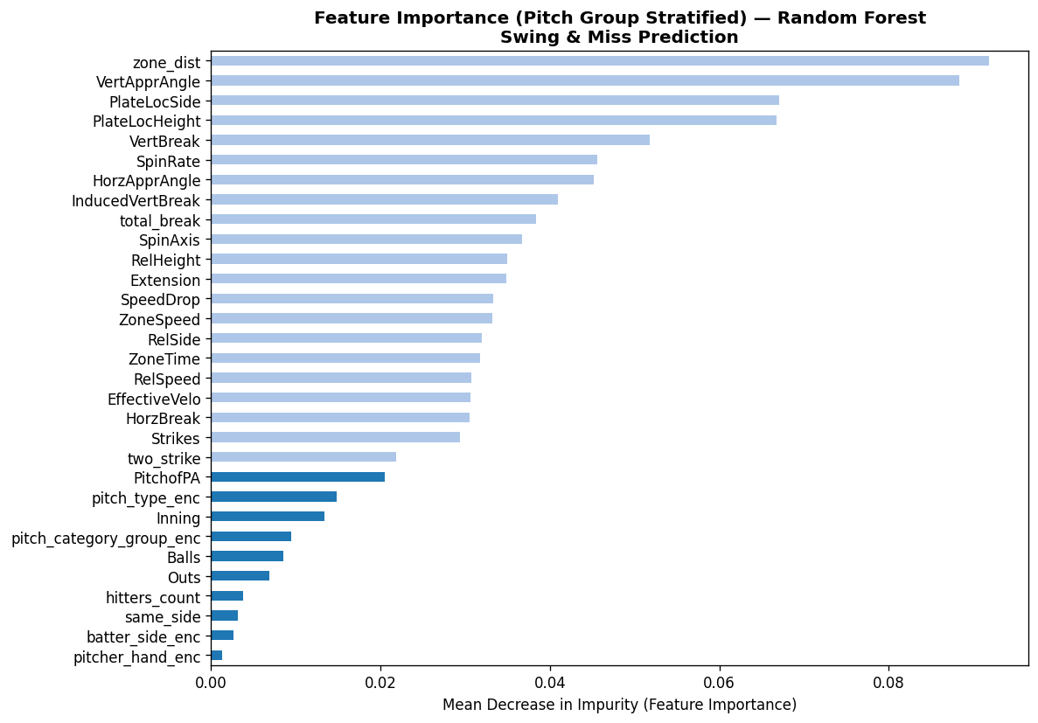
Random Forest Model
Train a model based on all pitch and context related features we have at our disposal

Slide 12
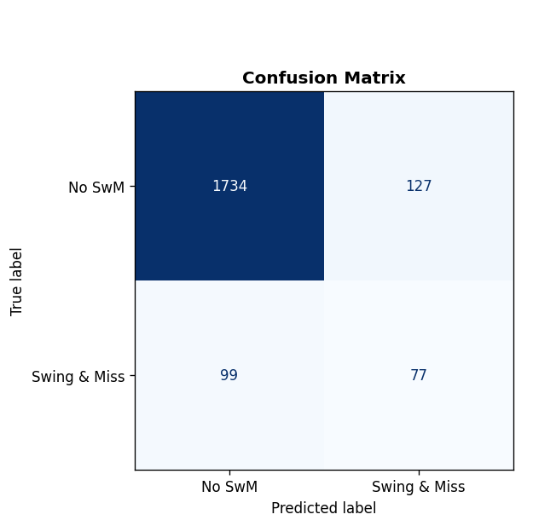
Random Forest Model
The model is fairly accurate given the limitations of the task

Slide 13
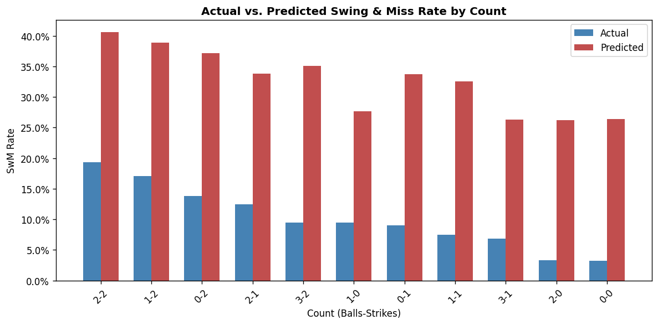

Slide 14
Limitations of Predicting Swing and Misses
Incredibly hitter dependent
High degree of randomness
Not pitcher arsenal specific

Slide 15
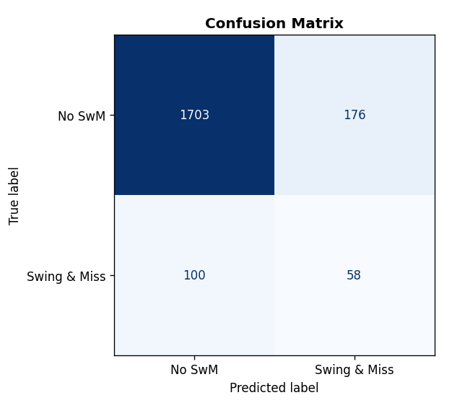
Stratifying by Pitch Type
Model stratified into breaking, offspeed, and fastballs is slightly but not significantly less accurate

Slide 16
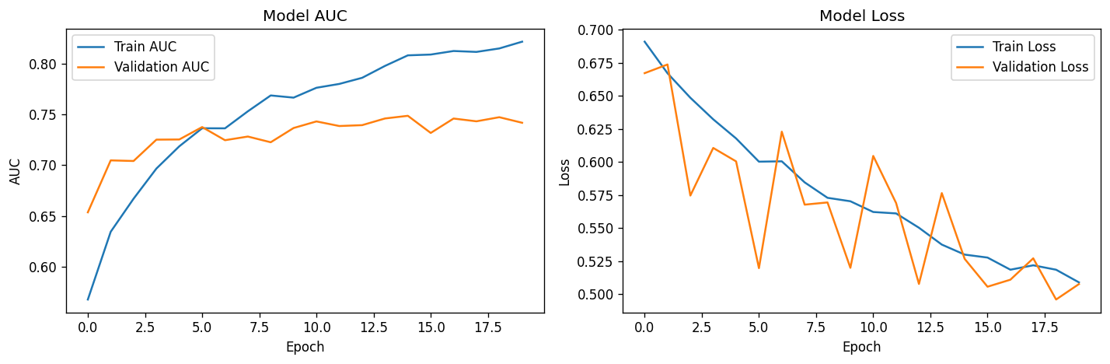
Neural Network
Testing to see if we can get more accuracy via a neural network

Slide 17
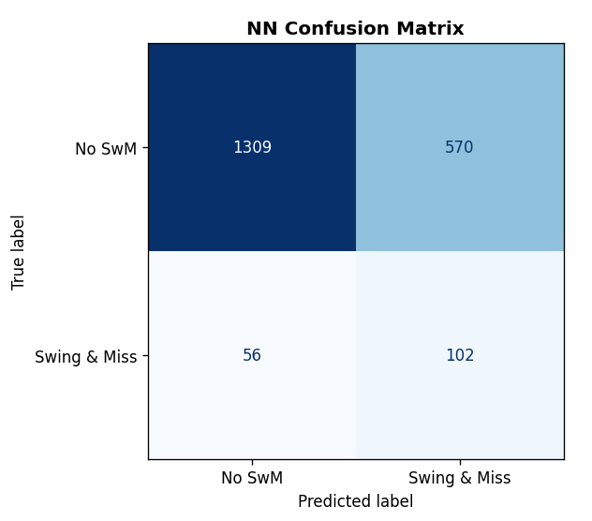
Neural Network
No significant increase in accuracy, inflated swing and miss rate in predictions still present

Slide 18
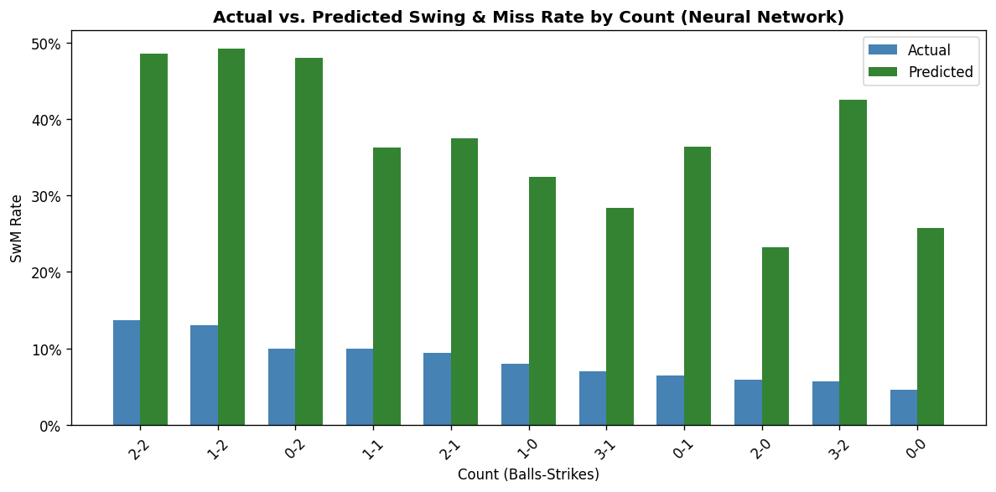

Slide 19
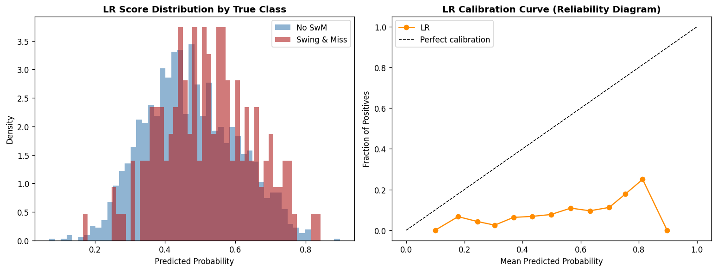
Logistic Regression
Trying Logistic Regression to see if we can enhance accuracy from the Random Forest

Slide 20
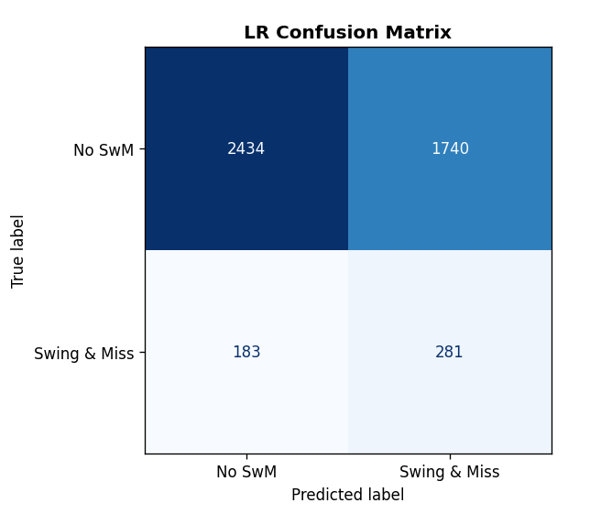
Logistic Regression
Most inaccurate model yet, highest rate of false negatives out of any other model by a large margin

Slide 21
Moving forward with non-stratified Random Forest
We feel relatively satisfied with the results achieved with our initial random forest model
Although overly optimistic, the feature importance aligns with our baseball intuition
Integrate Hitter Data?

Slide 22
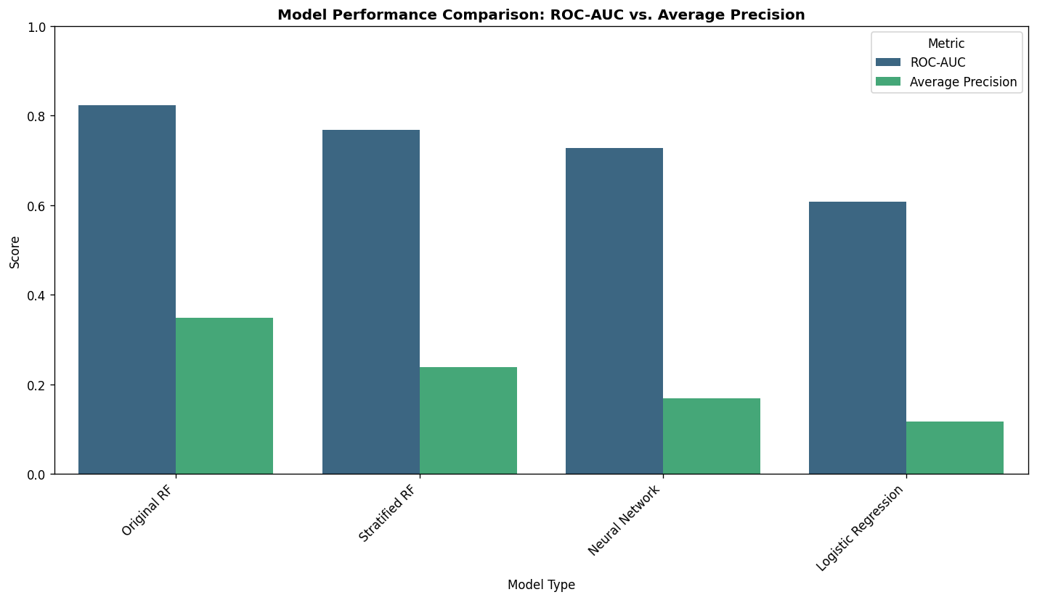

Slide 23
Thank you!

