Slide 1
Quotr
Ronan Dillon
Supervisor: Fred Mtenzi

Slide 2
Project
Mobile application to give users details about the TV show or movie they are watching.

Slide 3



Background
Shazam Entertainment – Tag TV live.
Viggle – Watch TV to get rewards.
NASA Jet Propulsion Laboratory Tube – Video Transcripts

Slide 4
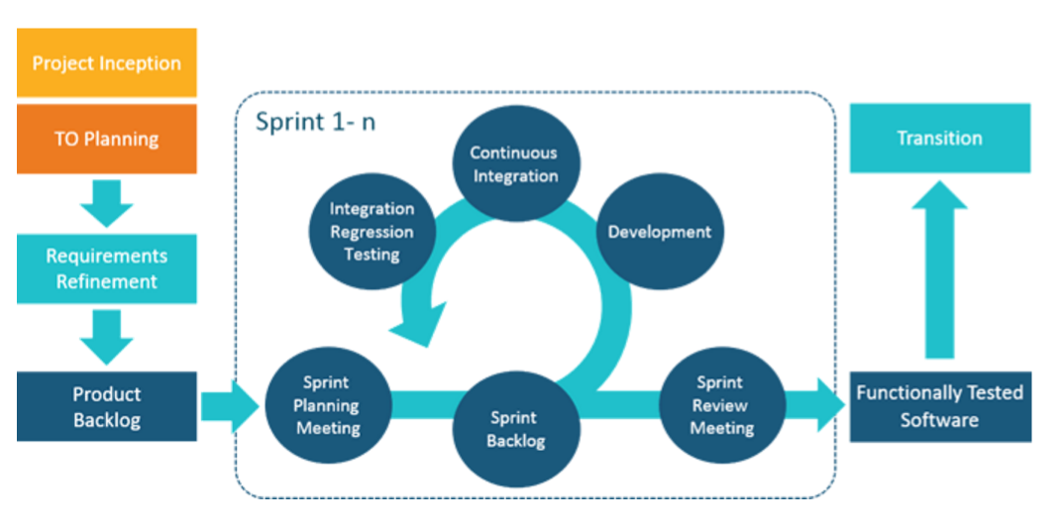
Methodology
Agile Scrum Methodology

Slide 5
Technologies
Framework: PhoneGap
Server: Elastic Compute Cloud
Programming Language(s): HTML, JavaScript, CSS and Python
Database(s): Relational Database Service on AWS

Slide 6
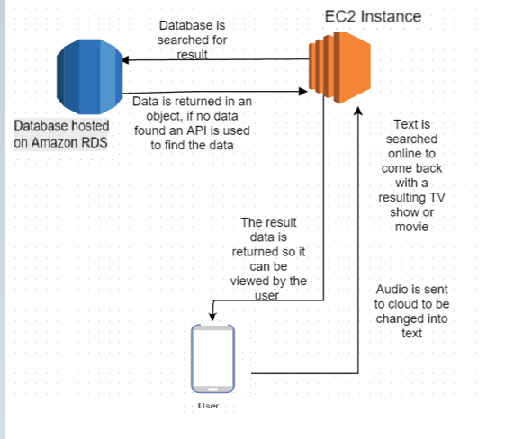
Technical Architecture

Slide 7
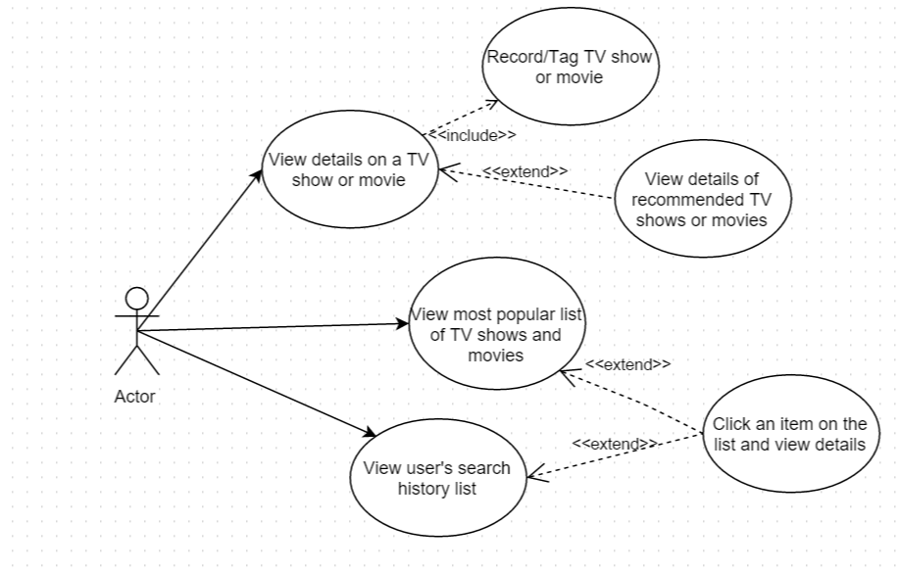

Front End
A user presses the Quotr button to record a segment of the show or movie they are watching.
A result is returned giving the user details about what they are watching.

Slide 8
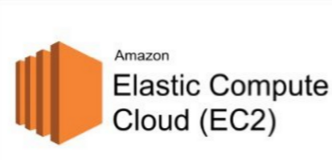

Middle Tier
Instance on Amazon Elastic Compute Cloud
Python Scripts
Speech-to-Text
API Calls
Access/Post to Database

Slide 9

Back End
Amazon Rational Database Service
TV show and movie data
Number of times searched
Links between searches for recommendations

Slide 10

Risk Management and Mitigation
Speech-to-text accuracy is around 90%
Cross talk and interference affecting results

Slide 11

Evaluation Criteria
Unit Testing - QUnit
Usability Testing

Slide 12
Future Work
Present-Christmas
Set up Server on AWS
Set up Database on AWS
Application with returns result from predefined show
January-February
Working search algorithm
Post object returned from OMDb API to database

Slide 13
Thank you!
???
Questions
???

