Slide 1
Who’s who? Towards automatically disambiguating mentions of people in Ancient Greek texts by linking to a domain specific Knowledge Base
DH Benelux 2025, 04-06-2025
Marijke Beersmans, Evelien de Graaf & Tim Van de Cruys

Slide 2
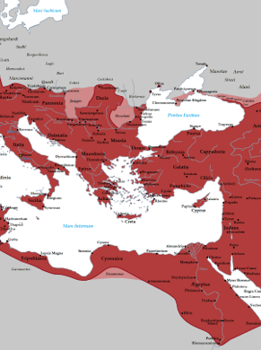
NIKAW Networks of Ideas and Knowledge in the Ancient World
What?
Using the mentions of people in Ancient Greek and Latin texts to understand the dynamics of knowledge circulation in the Greek and Roman world (7th century BCE- 4th century CE)
How?
Natural Language Processing
Social Network Analysis
When?
2023-2027

Slide 3
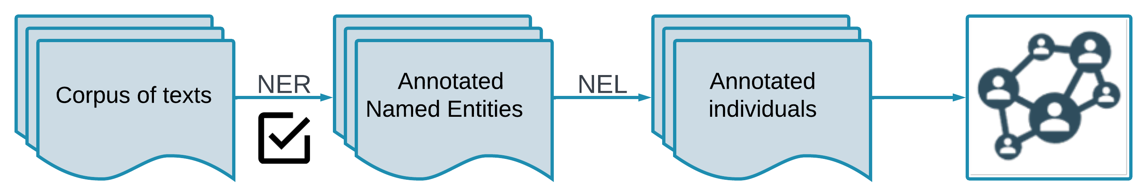
Our goal
Automatically create networks based on co-occurrence in Greek and Latin literature to study co-occurrence of individuals in text
KB selection: de Graaf, Depauw, Fantoli (2024)
Latin: Beersmans et al., 2023
Greek: Beersmans et al., 2024

Slide 4

Named Entity Linking
Entity linking aims to map each mention in a collection of texts to the corresponding entity in a set of entities contained in a Knowledge Base (KB) (Shen et al., 2015)
Domain specific KB : Paulys Realencyclopädie der classischen Altertumswissenschaft (RE)

Slide 5
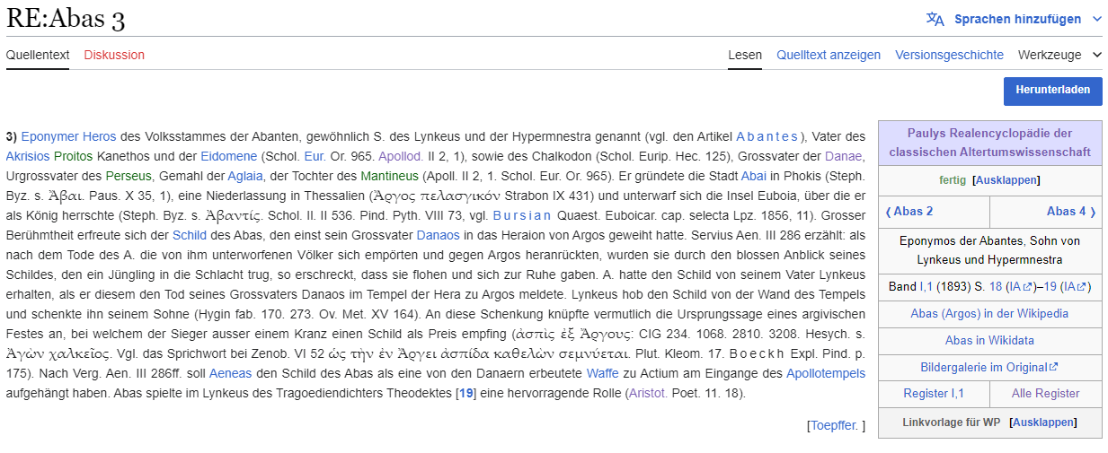
Paulys Realencyclopädie der classischen Altertumswissenschaft
"Abas 3" in the Wikisource edition, highlighting Volltext in red and Kurztext in green.

Slide 6
Gold Data: Plato Case study
Author | Work | Period | Christian work
Greek [GLAUx corpus]
[Plato] | Epistulae | BCE | ☐
Aristoteles | Metaphysica | BCE | ☐
Strabo | Geographica | BCE | ☐
Dionysius Halicarnassensis | De Demosthenis dictione | BCE | ☐
Plutarchus | Quaestiones convivales | CE | ☐
Claudius Aelianus | Varia historia | CE | ☐
Clemens Alexandrinus | Stromata | CE | ☑
Origenes | Contra Celsum | CE | ☑
Diogenes Laertius | Vitae philosophorum | CE | ☐

Slide 7
Gold Data: Famous authors
396 manually annotated mentions of famous authors
Author (RE artikel) | Mentions | Volltext in our local copy?
Pythagoras 1 | 104 | No
Xenophon 6 | 85 | No
Thukydides 1 | 75 | No
Homeros 1 | 58 | No
Herodotos 7 | 50 | No
Hippokrates 16 | 17 | No
Hesiodos | 7 | Yes
Notes:
Another test set we introduced during this first run was a smaller test set.
This one was created pretty quickly. Find mentions of unique names that could belong to some famous author, if it was correct, link it.
This is good way to create some training data quickly, but volltext was more often than not not in our local copy.

Slide 8
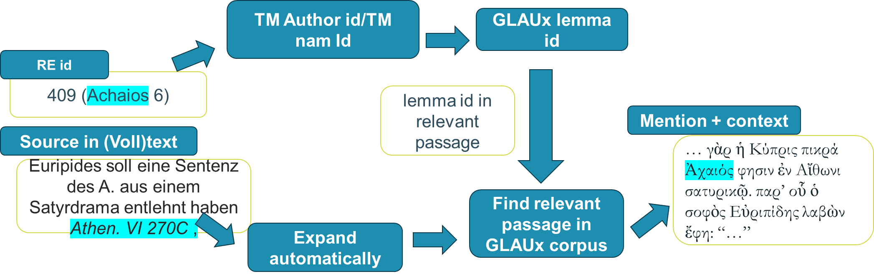
Silver Data Pipeline
Notes:
When we started this process, there was no training data.
We tried creating some working backwards from the RE.
To quickly summarize, sources to Ancient works were automatically extracted from the RE entries and expanded, to find this relevant passage in our corpus.
The find the correct mention in the passage, various GLAUx and Trismegistos IDs were linked.

Slide 9
Silver Data Pipeline
Loss of datapoints throughout
Exact relevant passage often not found
In that case: look for lemma in the entire text
If lemma occurs more than 50 times; drop datapoint
Notes:
.
Silver Data Pipeline
Problem: there are losses of datapoints thorough
Exact passage not found, sometimes book, sometimes text
If this was the case: check the entire text
If lemma occurs more than 50 times, drop it, otherwise keep it
Evelien will explain in a bit why this was a bad idea.

Slide 10
Silver Data counts
Overlap
 | Train (75%) | Valid (12,5%) | Test (12,5%) |  | Total
# mentions | 10472 | 1746 | 1745 | 895 | 13963
# unique entities | 2313 | 896 | 881 |  | 2620
# unique entities not in train | n/a | 173 | 171 |  | n/a
Notes:
Silver data counts
Here is an overview of how many silver datapoints were created this way
Important things:
Still fairly small
Also note that while all the mentions are unique, there is overlap in which entity they are linked to

Slide 11
Silver Data Evaluation
Is the full reference extracted from the RE Volltext in its entirety and correctly?
Does the passage of the GLAUx of the retrieved mention match the reference from the RE?
Is the established link correct, i.e. is the individual identified in the RE article the individual mentioned in the text?

Slide 12
Silver Data Evaluation
 | Passage found | Passage not found | Total (of 80)
Reference fully extracted | 28 | 27 | 55
Correct mention identified | 35 | 8 | 43
Correct link established | 38 | 16 | 54
Notes:
Is the full reference extracted from the RE Volltext in its entirety and correctly?
For more than half of the cases, whether the correct passage was found or not, at least the full reference was correctly extracted from the RE Volltext. Several causes for the passage not being found:
First, cited works with only a reference to the author, either due to references incompletely extracted or due to editorial choices of the RE, are impossible to link to a correct passage: Examples: the reference in the Volltext of Alexandros 32 to “Appian. Mak. 9, 1” was extracted as “Appian.”, or in Philoxenos 5 where the reference is simply “Ael.”
Differences in the citation system employed by the RE and the GLAUx, e.g. the RE uses of Casaubon pages for referencing in Strabo, where the GLAUx uses books, chapters and sections: Example: e.g. Sempronius 53 where 3.136 Casaubon should have been linked to book 3, section 1 which was not possible because the GLAUx does not record the Casaubon pages.
in some cases the RE references a source where the individual identified by the article is not mentioned, but, for example, a person related to the individual is referenced or a story relevant to the individual is narrated, ie. Volltexts contain multiple individuals and multiple individuals can thus be references: e.g. in Dionysios 30, the reference to “Demosth. XXI 64” actually concerns his son “Φιλόστρατος Κολωνῆθεν”, in Alkmaion 3, the reference to “Herod. I 19” does contain a story relevant to Alkmaion, but he is not mentioned by name).
2. Does the passage of the GLAUx of the retrieved mention match the reference from the RE?
The next step, linking the reference to the correct GLAUx identifier: the low number of correct mentions identified for “passage not found” is in the majority of cases the result of sampling for the evaluation. As all mentions of the individual in the text will be annotated with the link, the correct mention will also be annotated but all others as well. Of the 8 cases mentioned in this table, for 4 cases the lemma only occurred once in the source text and thus no other mentions than the correct one could have been annotated.
3. Is the established link correct, i.e. is the individual identified in the RE article the individual mentioned in the text?
Where the passage is found, almost all were linked correctly. The two cases that were not linked correctly were due to a mistake in the RE and because of the reference being incorrectly extracted. Where the passage is found, less than half of the cases have been linked correctly, this is caused by many same named individuals present in the texts which proves that the “less-than-50” approach was in fact a less than ideal rule to use.

Slide 13
The model: BLINK
“Entity linking with BERT”
Two-stage, transformer-based approach:
Bi-encoder
Encodes mention and context (=mention)
Encodes knowlegde base entries (=entities)
Compares encodings and selects top k most likely entities for any given mention
K=64 --> Evaluated at recall@top64
Cross-encoder
For each entity in k retrieved entities from the biencoder: scores and reranks them
The more powerful desicion-maker, but more resource-intensive
Notes:
I’ve noticed that I tend to lose people at this stage, so I’m going to briefly summarizes the main points to take away
1) the biencoder is shallow and fast. It compares your entity mention to the entire knowledge base and picks out the top k most likely ones. Its performance is evaluated on whether or not it is able to include the correct entity in this top k. Our top k is 64.
2) the crossencoder is deep and slow, takes the top 64 from the biencoder and makes the final decision.

Slide 14
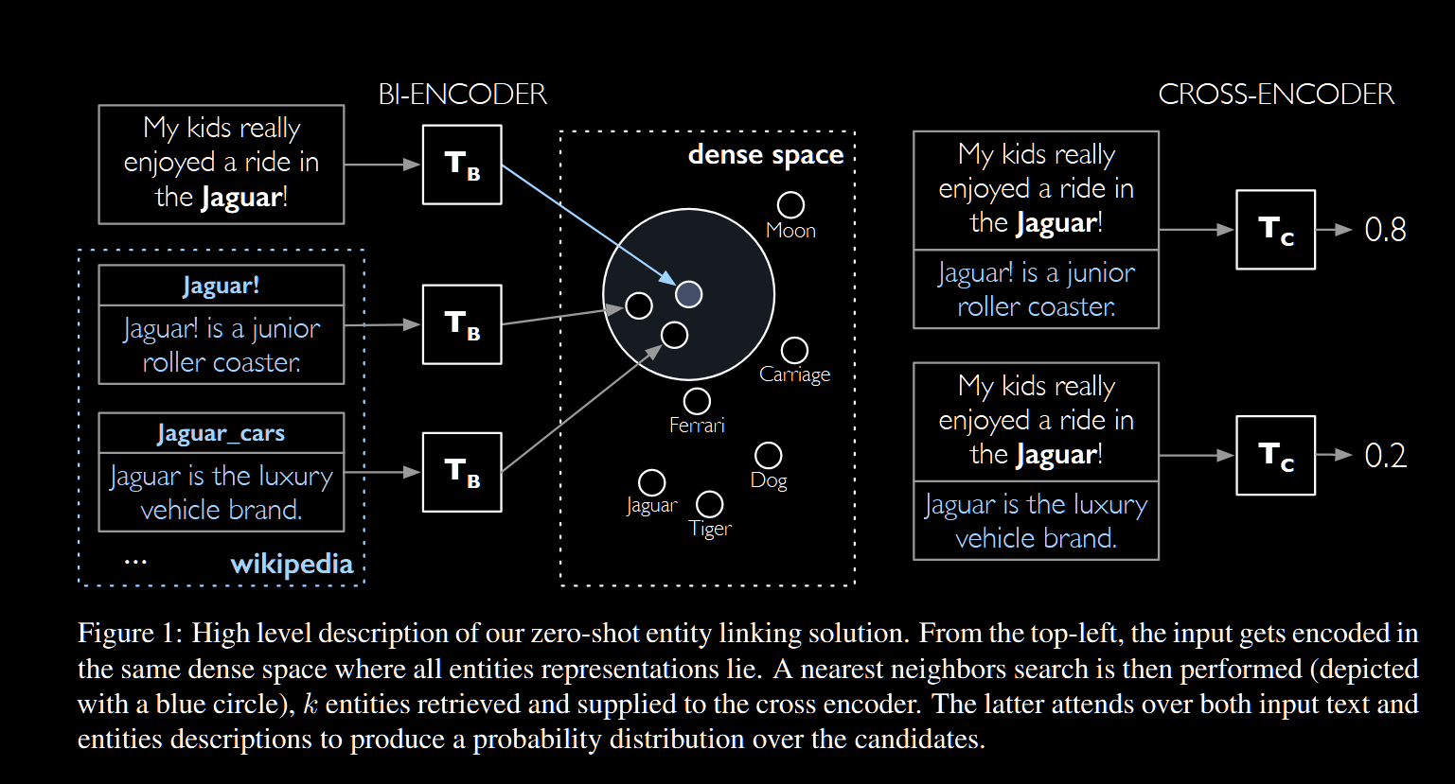
The model: BLINK
Notes:
Here is a schematic straight from the BLINK paper to make it more clear.

Slide 15
Experiments
Two multilingual transformers containing Ancient Greek
UGARIT-grc-alignment (Yousef et al., 2022)
Philberta (Riemenschneider & Frank, 2023)
Using Kurztext/Volltext
“Is the kurztext alone sufficient for this system?”
Notes:
The original BLINK model works with English BERT, but that wouldn’t work to link Ancient Greek to German, therefore I swapped the underlying transformer models to multilingual ones that contained Ancient Greek. For this test, I tested two possible ones: Philberta and UGARIT Greek alignment. We also had two settings: one where I included the volltexts, and one only the kurztext were used Hyperparameters for the TAP if anyone is curious
Philberta:
The following hyperparameters were used during training:
- learning_rate: 5e-05
- train_batch_size: 16
- eval_batch_size: 16
- seed: 42
- optimizer: Adam with betas=(0.9,0.999) and epsilon=1e-08
- lr_scheduler_type: linear
num_epochs: 3.0
Perplexity: 5.45620114512306,
UGARIT
The following hyperparameters were used during training:
- learning_rate: 5e-05
- train_batch_size: 8
- eval_batch_size: 8
- seed: 42
- optimizer: Adam with betas=(0.9,0.999) and epsilon=1e-08
- lr_scheduler_type: linear
num_epochs: 3.0
Perplexity: 1.6398580020140954,

Slide 16
Baseline
Baseline to compare to bi-encoder approach
Possible RE ids
TM nam Id
GLAUx lemma id
35154 (Glaukos 34)
404 (Achaios 1)
405 (Achaios 2)
406 (Achaios 3)
407 (Achaios 4)
408 (Achaios 5)
409 (Achaios 6)
410 (Achaios 7)
95606 (Achaios 8)
Mention + context
… γὰρ ἡ Κύπρις πικρά Ἀχαιός φησιν ἐν Αἴθωνι σατυρικῷ. παρ’ οὗ ὁ σοφὸς Εὐριπίδης λαβὼν ἔφη: “…”
Notes:
Glaukos 34 = Γλαῦκος Ὀλύμπιος Ἀχαιο
We basically use an id-version of the lemma to
Random selection if more than 64.

Slide 17
results first run*
Model | Biencoder recall@top64 | Crossencoder accuracy | Overall accuracy
In domain test-set
UGARIT_kurz | 76.87 | 6.53 | 5.02
UGARIT_long | 89.72 | 76.12 | 68.38
Philberta_kurz | 84.80 | 3.81 | 3.24
Philberta_long | 88.94 | 47.23 | 42.01
Baseline | 88.49 | n/a | n/a
Plato test-set
UGARIT_long (1,541 mentions) | 79.96 | 37.98 | 30.37
UGARIT_kurz (2,929 mentions) | 62.47 | 9.36 | 5.87
Philberta_long (1,541 mentions) | 68.72 | 27.67 | 19.01
Philberta_kurz (2,929 mentions) | 55.24 | 3.27 | 1.81
Baseline (2,929 mentions) | 76.85 | n/a | n/a
Notes:
Long story short: it’s not good. Accuracy drops a lot on new data. The model doesn’t generalize well.

Slide 18
results first run*
Model | Bi-encoder recall@top64 | Cross-encoder accuracy | Overall accuracy
Famous author test-set
UGARIT_kurz | 88.38 | 8.29 | 7.32
Philberta_kurz | 83.33 | 18.48* | 15.40*
Baseline | 100.0 | n/a | n/a
Notes:
Famous author test for completeness sake

Slide 19
Data improvements
Silver pipeline
Only exact passages
Even stricter: only “chapters”, “sections”… not books
41/50 correct links
Gold data
Add it to the training data
Two sets of training
1) Only gold data
2) Gold + new silver (both)

Slide 20
Quantitative overview data
No overlap
 | Train |  | Valid |  | Test |  | Total
subset | gold | both | gold | both | gold | both | gold | both
# mentions | 6421 | 10748 | 1049 | 1533 | 1301 | 1754 | 8771 | 14035
# unique entities | 918 | 2504 | 115 | 314 | 115 | 314 | 1148 | 3132
Notes:
Also note that now we don’t really have anything to test generalization anymore, so we made sure that all the entities were unique in every split. We end up with just as much data as before.

Slide 21
Results second run
Model | Bi-encoder recall@top64 |  | Crossencoder accuracy |  | Overall accuracy
 | Gold | Both | Gold | Both | Gold | Both
UGARIT_voll_both | 82,32 | 79,99 | 28,17 | 33,10 | 23,21 | 26,51
UGARIT_kurz_both | 86,78 | 81,29 | 15,56 | 21,28 | 13,53 | 17,33
UGARIT_kurz_gold | 56,57 | 53,36 | 05,65 | 04,76 | 03,22 | 02,57
UGARIT_long_gold | 40,10 | 44,07 | 40,76 | 30,79 | 16,45 | 13,62
Baseline | 36.43 | 47.89
Notes:
But the results are still not great, worse even.

Slide 22
Conclusion + future work
For the biencoder: more data = better results
For the crossencoder: Volltext = better results
Context alone likely not enough
Adding domain knowledge?
Qualitative analysis
Hyperparameter optimization
Add Latin
Notes:
Although a lot remains to be done, there are a few conclusions.
For the biencoder: more data = better results
For the crossencoder: Volltext = better results
Context alone likely not enough
Adding domain knowledge?
Qualitative analysis
Hyperparameter optimization
Add Latin

Slide 23
References
Trismegistos People: Broux, Y., & Depauw, M. (2015). Developing Onomastic Gazetteers and Prosopographies for the Ancient World Through Named Entity Recognition and Graph Visualization: Some Examples from Trismegistos People. In L. M. Aiello & D. McFarland (Eds.), Social Informatics (pp. 304–313). Springer International Publishing. https://doi.org/10.1007/978-3-319-15168-7_38
GLAUx: Keersmaekers, A. (2021). The GLAUx corpus: Methodological issues in designing a long-term, diverse, multi-layered corpus of Ancient Greek. Proceedings of the 2nd International Workshop on Computational Approaches to Historical Language Change 2021, 39–50. https://doi.org/10.18653/v1/2021.lchange-1.6
Logeswaran, L., Chang, M.-W., Lee, K., Toutanova, K., Devlin, J., & Lee, H. (2019). Zero-Shot Entity Linking by Reading Entity Descriptions. Proceedings of the 57th Annual Meeting of the Association for Computational Linguistics, 3449–3460. https://doi.org/10.18653/v1/P19-1335
Riemenschneider, F., & Frank, A. (2023). Exploring Large Language Models for Classical Philology. Proceedings of the 61st Annual Meeting of the Association for Computational Linguistics (Volume 1: Long Papers), 15181–15199. https://doi.org/10.18653/v1/2023.acl-long.846
Wu, L., Petroni, F., Josifoski, M., Riedel, S., & Zettlemoyer, L. (2020). Scalable Zero-shot Entity Linking with Dense Entity Retrieval. Proceedings of the 2020 Conference on Empirical Methods in Natural Language Processing (EMNLP), 6397–6407. https://doi.org/10.18653/v1/2020.emnlp-main.519
Yousef, T., Palladino, C., Shamsian, F., d’Orange Ferreira, A., & Ferreira dos Reis, M. (2022). An automatic model and Gold Standard for translation alignment of Ancient Greek. Proceedings of the Thirteenth Language Resources and Evaluation Conference, 5894–5905. https://aclanthology.org/2022.lrec-1.634

Slide 24
Thank you!

