Slide 1
Interfeces in Go

Slide 2



Interfeces in Go

Slide 3
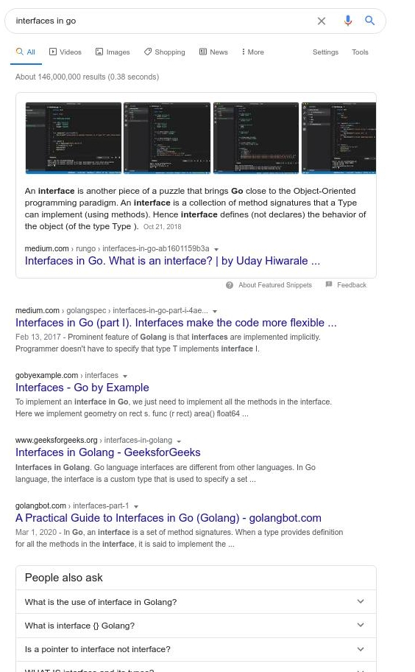
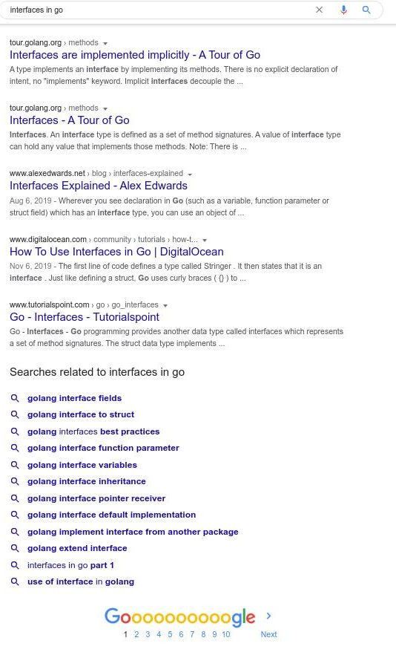

Slide 4
What is Interface?
abstraction
hide implementation details
contract

Slide 5
Why Interface?
allows multiple implementations
limits scope of implementations

Slide 6
Go Interface
implemented implicitly
generally defined in consumer
composition > inheritance

Slide 7
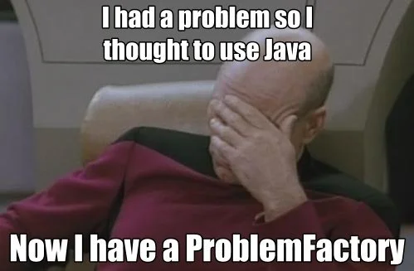
Interface Pollution

Slide 8
Go Proverbs on Interface
the bigger the interface, the weaker the abstraction
interface{} says nothing
accept interfaces, return structs

Slide 9
Takeaways
be lazy whenever you can
refrain from defining interface
if you need, define interface in consumer

