Slide 1
A Brief Intro To SQLite
Relational Databases, Rstudio, and You

Slide 2
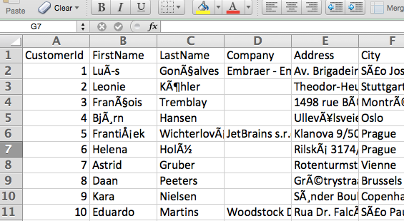
Imagine a spreadsheet
Familiar to most of us
Relational database management systems (RDBMS) are pretty much like spreadsheets hooked together with extra stuff built in.
Multiple users
Transactions (“all-or-nothing”)
etc

Slide 3
SQLite: All good and no bad
SQLite gives us many of the advantages of RDBMSes without a lot of the headache, configuration, etc.
It’s just a file on your computer
This means you can copy it, share it, etc without breaking any server setups

Slide 4
Use A GUI, not the CLI
You can connect via terminal, but GUI is better
I’ve been using Valentina Studio

Slide 5
Quick Example
[what you want to do] [ relevant fields ] [ relevant table ] [ with which rows? ]
SELECT City, State FROM Customer WHERE Country = "USA"

Slide 6
Lets dig in!

