Slide 1
Replication of “Inferring whether officials are corruptible from looking at their faces”(Lin et al. 2018)
Rondeline Williams
PSYCH 251
11/1/2019

Slide 2


Background

Slide 3
Background
Faces are informative (Engell, Haxby, & Todorov, 2007; Todorov, 2017)
Facial judgements affect social outcomes:
Mating/dating (Olivola et al., 2014; Valentine, Li, Penke, & Perrett, 2014)
Earnings and fundraising (Genevsky & Knutson, 2015; Hamermesh, 2011; Ravina, 2012)
Sentencing decisions (Berry & Zebrowitz-McArthur, 1988; Blair, Judd, & Chapleau, 2004; Wilson & Rule, 2015; Zebrowitz & McDonald, 1991)
Leader selections (Todorov, Mandisodza, Goren, & Hall, 2005)

Slide 4





Background

Slide 5

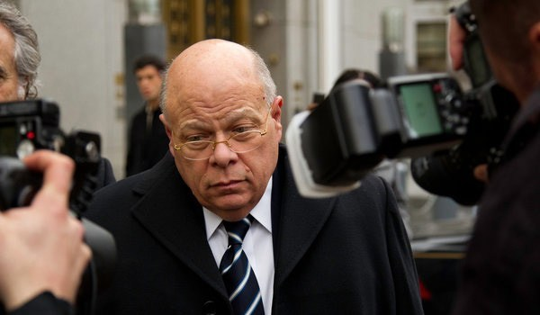
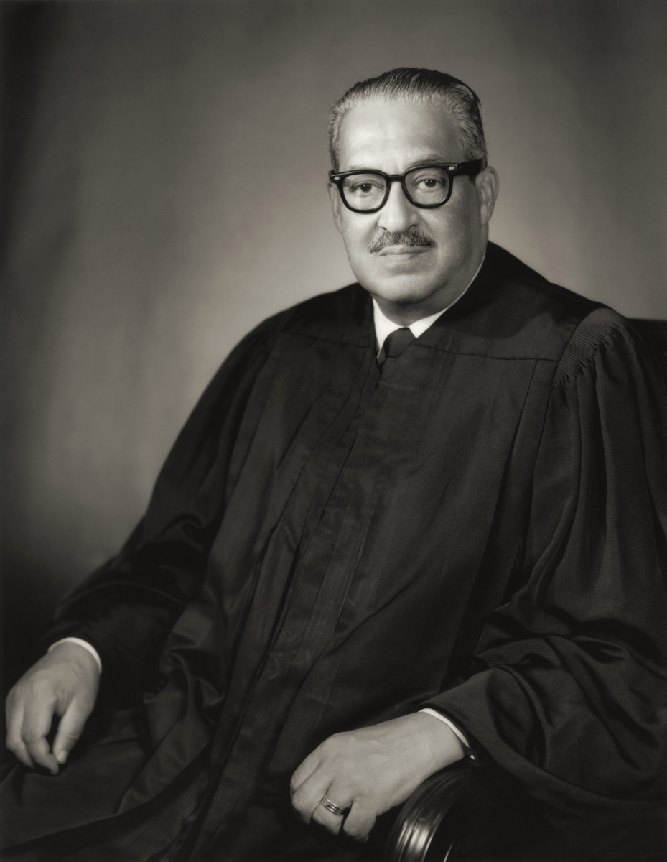

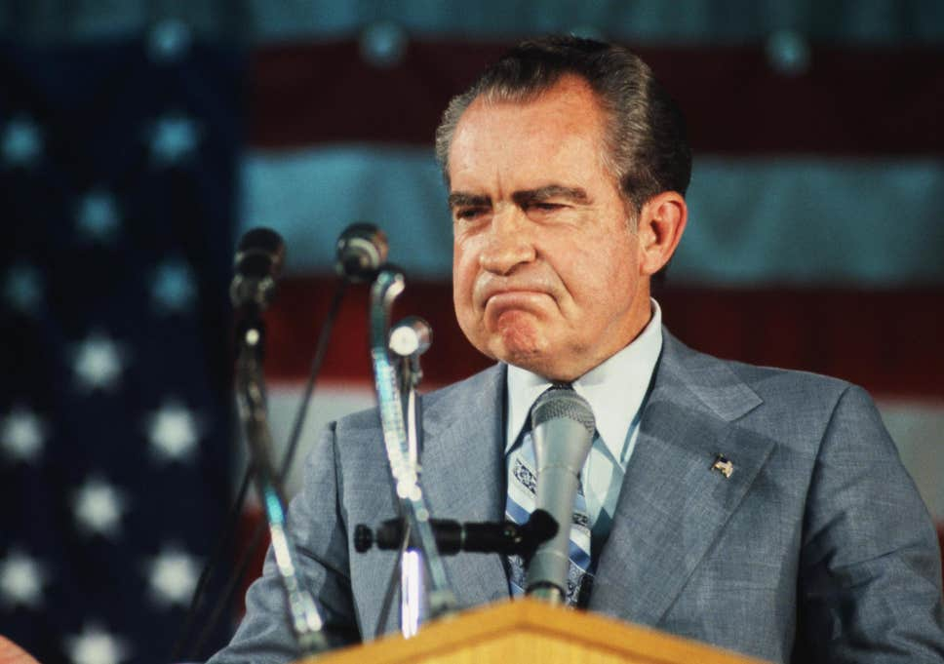
Background

Slide 6
STUDY 1
STUDY 2
STUDY 4
STUDY 3

Slide 7
STUDY 1
To what extent do adults make facial inferences associated with an important real-world outcome closely linked to the face bearer’s behavior: political corruption?

Slide 8
Experimental Design
100 MTurk Participants
d= .75-.83
72 Federal/State Elected Officials
White
Male
~43-67 years
Scales
Corruptible – Incorruptible Honest – Dishonest
Trustworthy – Untrustworthy Generous – Not Generous
Selfish – Selfless

Slide 9
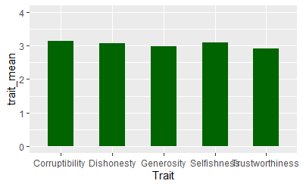
Previous Data
Notes:
58-62% correct

Slide 10
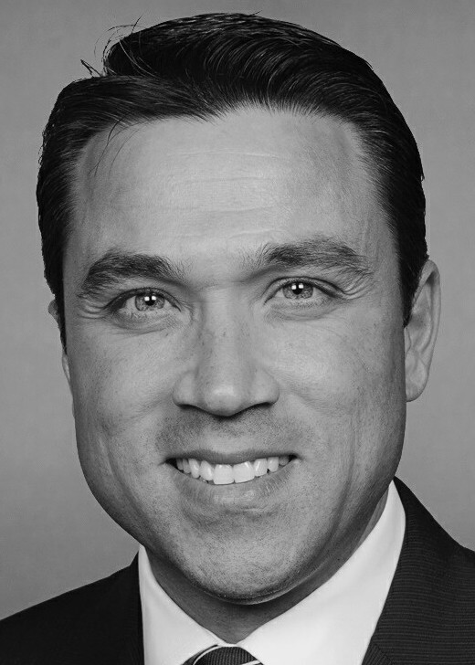
Implementation
MTurk participants
N=16
N_{optimal}=11
18% of original data unusable
Corruptible
Incorruptible

Slide 11







Challenges in collecting data
Sorting through the author’s OSF files
Learning JS and HTML

