Slide 1

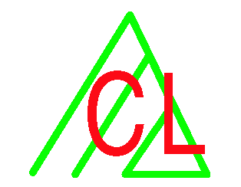

Anaphora Resolution in ExtrAns
  Diego Molla Aliod, Rolf Schwitter
  Centre for Language Technology
  Macquarie University, Sydney (Australia)
  Fabio Rinaldi, James Dowdall, Michael Hess,
  Institute of Computational Linguistics
  University of Zurich (Switzerland)

Slide 2
OUTLINE
  QA for Technical Domains
  ExtrAns
  Terminology
  Minimal Logical Forms
  Anaphora Resolution
  Summary

Slide 3
Technical Domains
Large documents, but still much smaller than the TREC datasets (or the web!)
    [~100MB << GB << TB]
Cannot make use of redundancy
Have to cope with specific formats and sublanguage
Terminology is a key problem
cannot use Web a "last-resort" resource

Slide 4
ExtrAns
A Question Answering system targeted at technical domains
Convert document and queries in a semantic representation (documents are processed off-line)
  [From "bag of words" to "bag of semantic relations"]
Match (sem rep of) queries against documents
Return the matched answers in the context where they originally appear

Slide 5
Projects
ExtrAns (1997-2000, NSF)
  unix manual pages
  English, small volume of data (500 pages, 2.5 MB)
WebExtrAns (2000-2002)
  Airbus A320 Aircraft Maintenance Manual (AMM)
  English, larger volume of data (3000 pages, 120 MB)
LUIS (Little University Information System)
  Administrative documents
  German, small volume of data

Slide 6
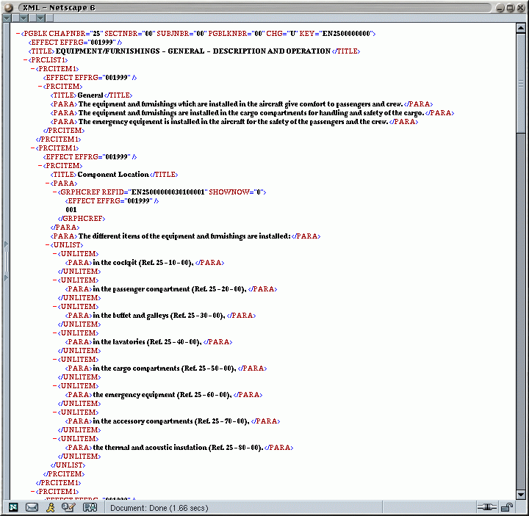
AMM: source format

Slide 7
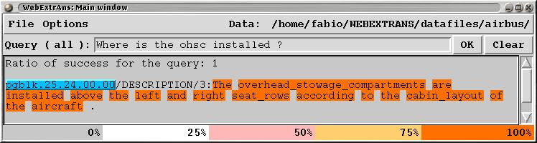
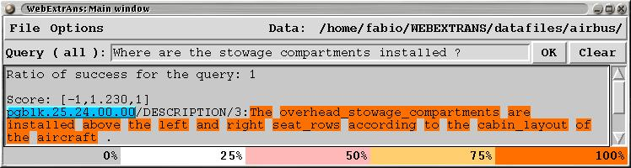
Examples

Slide 8
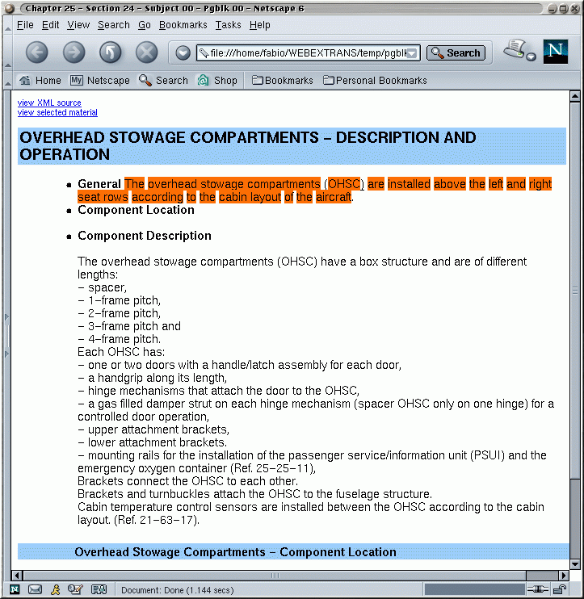
AMM: answer in context

Slide 9
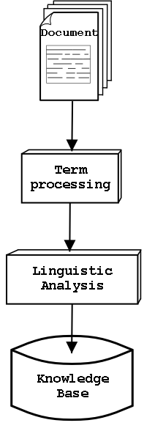
ExtrAns: offline
Terminology Extraction
Automatic Thesaurus Construction
Full syntactic parsing
Minimal Logical Form

Slide 10
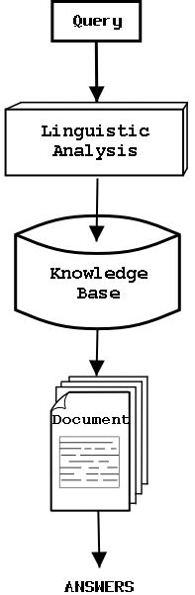
ExtrAns: online
Full syntactic parsing
Minimal Logical Form
Query "matched" against the Knowledge Base
The "matches" are displayed in the document

Slide 11
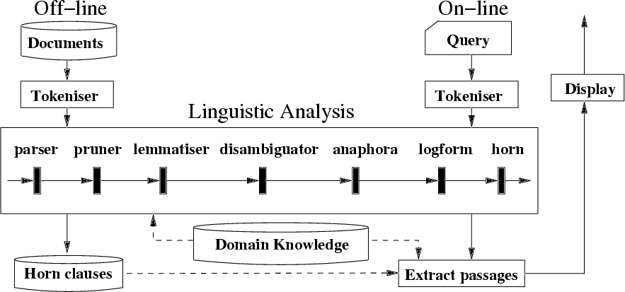
Architecture

Slide 12
Details about architecture
LG parser (dependency -based, robust, good coverage)
Corpus -based approach [Brill] to disambiguation
Documents and queries are represented by MLFs
Queries are matched against documents and retrieved matches returned to the user
Domain terminology (MW) treated as single toks: Positive effect on parsing

Slide 13
Minimal Logical Forms
Simple, flexible, easy to build, yet expressive enough for QA
Encode syntactic dependencies between verbs and their arguments
Reification for different kinds of modifications
Allow incremental addition of information (monotonically)

Slide 14
Minimal Logical Forms
Conjunction of predicates where all variables are existentially bound and have wide scope
A coax cable connects the external antenna to the ANT connection
holds(e1), object(coax_cable,o1,[x1]), object(external_antenna,o2,[x2]), object(ant_connection,o3,[x3]), evt(connect,e1,[x1,x2]), prop(to,p1,[e1,x3]).

Slide 15
Minimal Logical Forms
...evt(connect,e1,[x1,x2]),... prop(direct,p2,e1),
A coax cable directly connects the external antenna to the ANT connection

Slide 16
Minimal Logical Forms
AE is performed by matching the MLF of the query to the MLFs stored in the KB
    (using a prolog representation)
?- object(external_antenna,O2,[X2]),evt(connect,E1,[X1,X2]), object(Anon_object,O1,[X1]).
How is the external antenna connected?

Slide 17
Terminology: the problems
The parsing problem
Multi-word terms "confuse" the parser
(complex internal structure, possible combinations
with external elements)
Domain specific lexical items are NOT included
in generic lexica (as used by the parser)
The paraphrase problem
The query could contain a variant of a term used in the domain (possibly completely new)

Slide 18
Parsing Problem
Words and acronymns not in the parser lexicon:
Coax
Actuator
ANN
APU
SHIM
Terms not identified as a phrase
The result is multiple syntactic possibilities for a single sentence

Slide 19
The parsing problem: solution
Identify all terms in a preprocessing phase and collect them in a domain specific thesaurus
Recognize terms while analyzing the documents and treat them as single lexical items (inheriting syntactic properties from their head word)
Parsing simplified by 46%

Slide 20
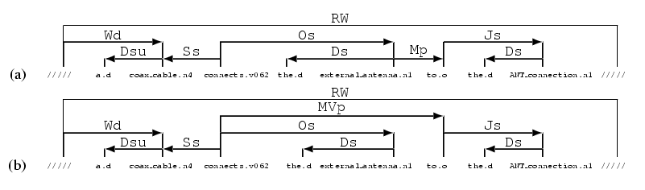
The Parsing Problem
Example: A coax_cable connects the external_antenna to the ANT_connection

Slide 21
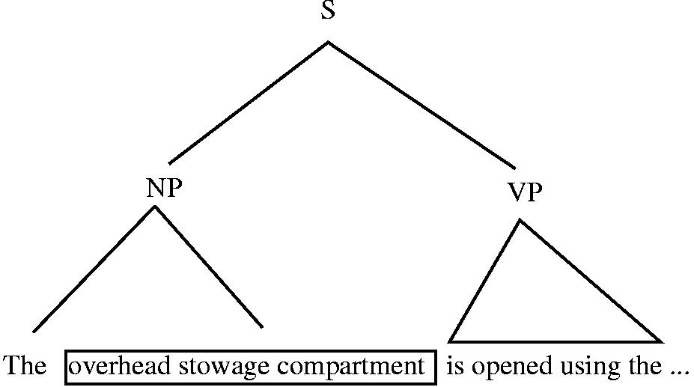
The parsing problem - solution
Terms are parsed as single words

Slide 22
The paraphrase problem
Query: How are the cargo compartment doors opened?
Answer: To open the doors of the cargo compartment use the ...
query and answer must contain the same term

Slide 23
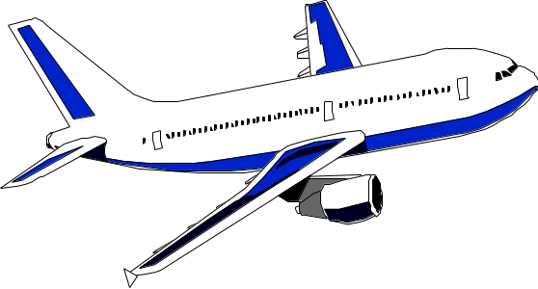
Synonymous Terms
Forward passenger
compartment door

Slide 24
Synonymous Terms
FWD passenger
compartment door
Forward passenger
compartment door

Slide 25
Synonymous Terms
Forward door
of the
passenger comparment
FWD passenger
compartment door
Forward passenger
compartment door

Slide 26
Synonymous Terms
Forward door
of the
passenger comparment
FWD passenger
compartment door
Forward passenger
compartment door
FWD
passenger-compartment
door

Slide 27
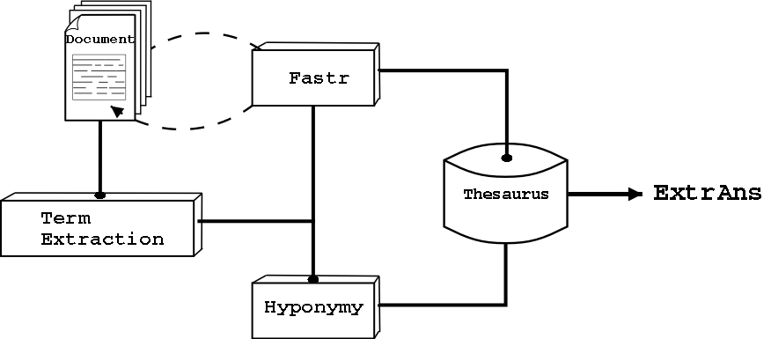
The paraphase problem - solution
A Computational Thesaurus

Slide 28
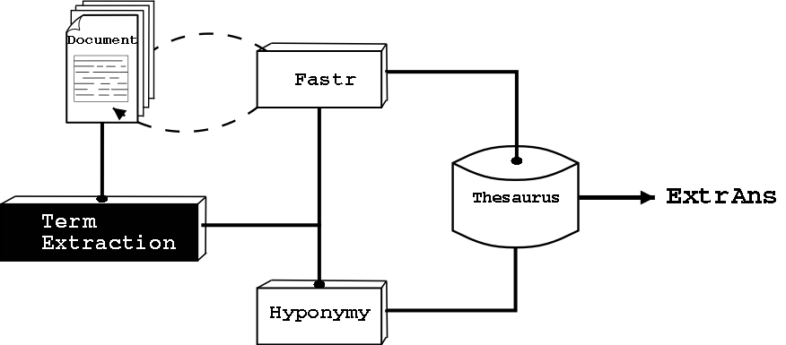
The paraphase problem - solution
A Computational Thesaurus

Slide 29
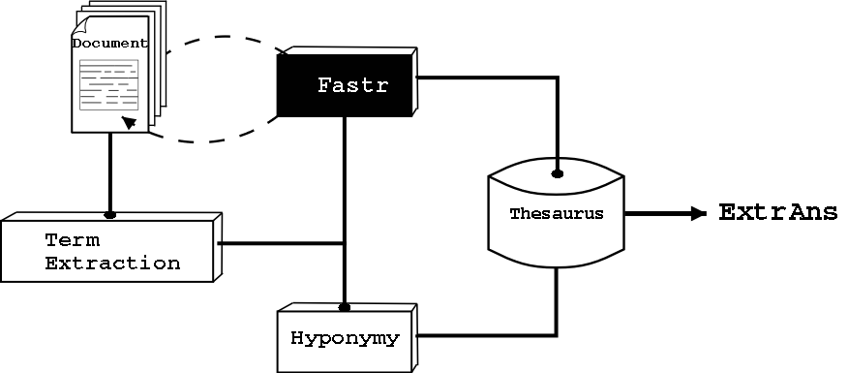
The paraphrase problem
Identifying Synonymy with FASTR

Slide 30
Term Variations producing
Strict Synonymy
Orthographic :
cargo compartment door
Cargo-compartment door(s)
Morpho - syntactic :
Cargo compartment door
Doors of the cargo compartment

Slide 31
Three Weaker Synonymy Relations
Head & Modifier :
Head :
Modifier :
Functional test
Operational check
Electrical cable
Electrical line
Attachment strip
Fastner strip

Slide 32
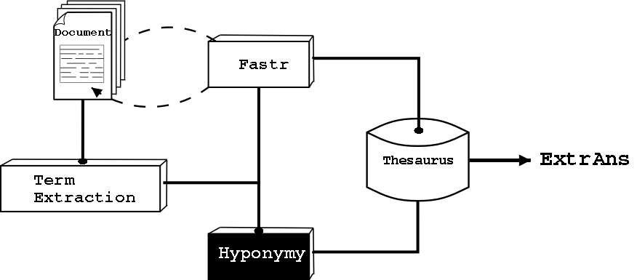
The paraphase problem - solution
Identifying Hyponomy

Slide 33
Hyponymy - composite terms
Terminology:
crew member
access platform
crew member seat
adjustable access platform
[ seat ]
[ access platform ]
[[ crew member ] seat ]
[ adjustable [ access platform ]]

Slide 34
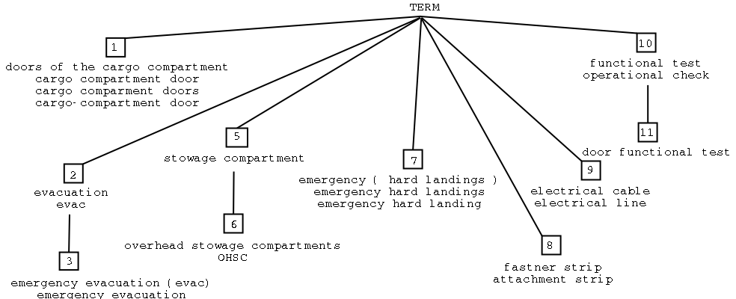
The Thesaurus
6032 terms = 2770 synsets with 1176 hyponymy links

Slide 35
The paraphase problem - solved
Query: How are the cargo compartment doors opened?
Answer: To open the doors of the cargo compartment ...
Query: How are the [ SYNSET1 ] opened?
Answer: To open the [ SYNSET1 ] ...
Any variant of a term is "known" - as long as it is used in the text

Slide 36
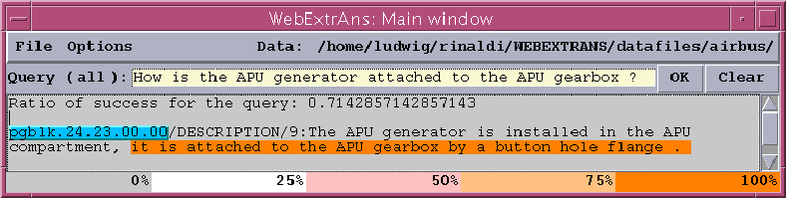
What about Anaphora Resolution?
Lappin & Leass (1994)
Restricted to pronominal anaphora
Restricted to 3rd person

Slide 37
What about Anaphora Resolution?
Originally based on the output of Slot Grammar (Mc Cord et al. 1992)
Extract 'slots' (subject, agent, direct obj, indirect obj, prepositional obj) from output of Link Grammar
Syntactic filter (for intra-sentential anaphora)
Test for agreement (number only!)

Slide 38
What about Anaphora Resolution?
Identification of pleonastic pronouns
Special treatment of lexical anaphors (reciprocal or reflexive pronoun)
Measure of salience
  Independent salience factors (subject, agent, existential emphasis, accusative, indirect object, oblique complement, head noun, non-adverbial)
  Dependent salience factors (cataphora penalty, parallel roles reward, recency reward)

Slide 39
What about Anaphora Resolution?
Equivalence Classes
Detailed Decision procedure
Evaluation
  Accuracy 79% (compared with 86%)
  Very limited scope
Notes on intersential anaphora resolution
Example of Logical Form

Slide 40
The APU Generator is installed in the APU compartment, it is attached to the APU gearbox by a button hole flange
object(APU_generator,o1,[x2]), evt(install,e4,[a4,x2]), object(anonym_object,o5,[a4]), in(e4,x8), object(APU_compartment,o2,[x8]), object(it,o3,[x1]),evt(attach,e3,[x12,x1]), object(button_hole_flange,o4,[x12]), to(e3,x7), object(APU_gearbox,o6,[x7]).
object(APU_generator,o1,[x2]), evt(install,e4,[a4,x2]), object(anonym_object,o5,[a4]), in(e4,x8), object(APU_compartment,o2,[x8]), object(it,o3,[x2]),evt(attach,e3,[x12,x2]), object(button_hole_flange,o4,[x12]), to(e3,x7), object(APU_gearbox,o6,[x7]).

Slide 41
Summary
Answer extraction targeted at technical documentation
Explicit handling of domain specific terminology
Integration of a full parser and semantic interpreter
Use of a logical notations (MLFs)
Anaphora Resolution is essential for Question Answering (in technical domains too)

Slide 42
ExtrAns
Molla et al., ExtrAns: an answer extraction system. Traitement Automatique des Langues 41(2), 2000.
Rinaldi et al., Towards Answer Extraction: An application to Technical Domains., 15th European Conference on Artificial Intelligence (ECAI), 2002.
Rinaldi et al., Answer Extraction in Technical Domains. CICLing-2002.
Rinaldi et al., Knowledge based Question Answering, KES 2003
Molla et al, Answer Extraction for technical manuals, IEEE Information Systems, 2003
Rinaldi et al, Exploiting Paraphrases in a QA system, ACL03 workshop on Paraphrases

Slide 43
Terminology
Dowdall et al., Technical Terminology as a Critical Resource. LREC-2002, Las Palmas, 29-31 May 2002.
Rinaldi et al., Terminology as Knowledge in Answer Extraction. 6th International Conference on Terminology and Knowledge Engineering (TKE), Nancy, 2002.
Rinaldi et al., The role of technical terminology in Question Answering, Terminologie et Intelligence Artificielle, Strassbourg, 2003
Dowdall et al., Multiword Terms, ACL03 workshop on Multi-word expressions.
Minimal Logical Forms
Molla, Ontologically promiscuos flat logical forms for NLP, IWCS4, Tilburg, 2001.

Slide 44
Further Info:
http://www.cl.unizh.ch/
http://www.cl.unizh.ch/extrans
http://www.cl.unizh.ch/webextrans
http://www.cl.unizh.ch/CLpublications

