Slide 1
A German LFG for CALL
Christian Fortmann, Martin Forst
Institut für Maschinelle Sprachverarbeitung
Universität Stuttgart
{fortmann|forst}@ims.uni-stuttgart.de

Slide 2
A German LFG for CALL
Goal: Building a grammar checker as a component of a comprehensive CALL program for German.

Slide 3
A German LFG for CALL
Goal: Building a grammar checker as a component of a comprehensive CALL program for German.
General needs to be met by a CALL grammar checker.

Slide 4
A German LFG for CALL
Goal: Building a grammar checker as a component of a comprehensive CALL program for German.
General needs to be met by a CALL grammar checker.
How to deal with word order in German.

Slide 5
A German LFG for CALL
Goal: Building a grammar checker as a component of a comprehensive CALL program for German.
General needs to be met by a CALL grammar checker.
How to deal with word order in German.
How to deal with agreement.

Slide 6
A German LFG for CALL
Goal: Building a grammar checker as a component of a comprehensive CALL program for German.
General needs to be met by a CALL grammar checker.
How to deal with word order in German.
How to deal with agreement.
Conclusions and outlook on possible future developments.

Slide 7
Needs to be met by a CALL grammar checker
CALL faces specific didactic and technical demands:
Grammar acquisition in L2-learning is a process of conscious rule learning.

Slide 8
Needs to be met by a CALL grammar checker
CALL faces specific didactic and technical demands:
Grammar acquisition in L2-learning is a process of conscious rule learning.
The learner has a native grammar, more or less different from German.

Slide 9
Needs to be met by a CALL grammar checker
CALL faces specific didactic and technical demands:
Grammar acquisition in L2-learning is a process of conscious rule learning.
The learner has a native grammar, more or less different from German.
CALL is learner-oriented – interaction with a competent speaker is less important.

Slide 10
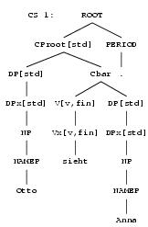
Reasons to use a modified LFG/XLE as a grammar checker
LFG assigns two types of representations to a sentence:
  Context-free trees – c-structures

Slide 11

Reasons to use a modified LFG/XLE as a grammar checker
LFG assigns two types of representations to a sentence:
  Context-free trees – c-structures
  Attribute-value matrices – f-structures

Slide 12

Reasons to use a modified LFG/XLE as a grammar checker
XLE implements a version of OT for robustness and disambuation (Frank et al. 1999).

Slide 13


Reasons to use a modified LFG/XLE as a grammar checker
XLE implements a version of OT for robustness and disambuation (Frank et al. 1999)

Slide 14
Reasons to use a modified LFG/XLE as a grammar checker
XLE implements a version of OT for robustness and disambuation (Frank et al. 1999).
XLE provides head precedence.

Slide 15
The case of word order
Ungrammatical word orders
  *Heute Peter den Kuchen hat gegessen

Slide 16
The case of word order
Ungrammatical word orders
  *Heute Peter den Kuchen hat gegessen
  Independent of context

Slide 17
The case of word order
Ungrammatical word orders
  *Heute Peter den Kuchen hat gegessen
  Independent of context
  Well described (in the GSL literature)

Slide 18
The case of word order
Ungrammatical word orders
  *Heute Peter den Kuchen hat gegessen
  Independent of context
  Well described (in the GSL literature)
  Can be covered by additional rules

Slide 19
The case of word order
Ungrammatical word orders
  *Heute Peter den Kuchen hat gegessen
  Independent of context
  Well described (in the GSL literature)
  Can be covered by additional rules
Marked word orders
  #Heute hat den Kuchen Peter gegessen

Slide 20
The case of word order
Ungrammatical word orders
  *Heute Peter den Kuchen hat gegessen
  Independent of context
  Well described (in the GSL literature)
  Can be covered by additional rules
Marked word orders
  #Heute hat den Kuchen Peter gegessen
  Highly dependent on information structure

Slide 21
The case of word order
Ungrammatical word orders
  *Heute Peter den Kuchen hat gegessen
  Independent of context
  Well described (in the GSL literature)
  Can be covered by additional rules
Marked word orders
  #Heute hat den Kuchen Peter gegessen
  Highly dependent on information structure
  Insuffiently described (in the GSL literature)

Slide 22
The case of word order
Ungrammatical word orders
  *Heute Peter den Kuchen hat gegessen
  Independent of context
  Well described (in the GSL literature)
  Can be covered by additional rules
Marked word orders
  #Heute hat den Kuchen Peter gegessen
  Highly dependent on information structure
  Insuffiently described (in the GSL literature)
  Additional annotations in existing rules

Slide 23
Ungrammatical word orders
More than one constituent in the Vorfeld:
  *heute Peter den Kuchen hat gegessen

Slide 24
Ungrammatical word orders
More than one constituent in the Vorfeld:
  *heute Peter den Kuchen hat gegessen
More than one verbal element in the V2 position:
    *heute hat gegessen Peter den Kuchen

Slide 25
Ungrammatical word orders
More than one constituent in the Vorfeld:
  *heute Peter den Kuchen hat gegessen
More than one verbal element in the V2 position:
  *heute hat gegessen Peter den Kuchen
German as an SVO language:
  *heute hat Peter gegessen den Kuchen

Slide 26
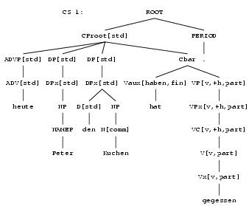
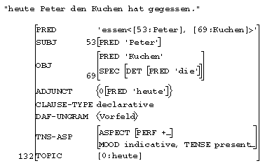
Ungrammatical word orders
*heute Peter den Kuchen hat gegessen

Slide 27
Marked word orders
#OBJ > SUBJ
  #heute hat den Kuchen Peter gegessen

Slide 28
Marked word orders
#OBJ > SUBJ
  #heute hat den Kuchen Peter gegessen
#Full NP > Pronoun
  #heute hat Peter ihn gegessen

Slide 29
Marked word orders
#OBJ > SUBJ
  #heute hat den Kuchen Peter gegessen
#Full NP > Pronoun
  #heute hat Peter ihn gegessen
#Indefinite NP > Definite NP
  #heute hat Peter einen Kuchen dem Mann gegeben

Slide 30
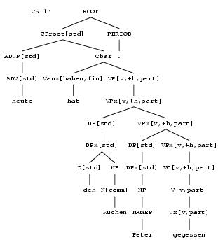
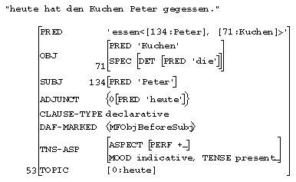
Marked word orders
    #heute hat den Kuchen Peter gegessen

Slide 31
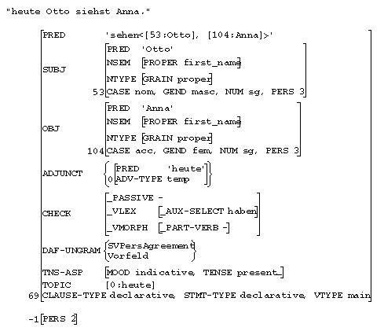
Agreement
    *heute Otto siehst Anna

Slide 32
Implementation
    Malrules, penalized by means of OT-marks
    CP --> XP:(↑TOPIC)=↓
    (↑XCOMP* {SUBJ|OBJ|...})=↓; XP*:(↑XCOMP* {SUBJ|OBJ|...})=↓
    Vorfeld ∈ (↑ DAF-UNGRAM) DAFUngramVF ∈ o::*;
    Cbar:↑=↓.

Slide 33
Implementation
    Malrules, penalized by means of OT-marks
    CP --> XP:(↑ TOPIC)= ↓
    (↑ XCOMP* {SUBJ|OBJ|...})=↓; XP*:(↑ XCOMP* {SUBJ|OBJ|...})= ↓ Vorfeld ∈ (↑ DAF-UNGRAM) DAFUngramVF ∈ o::*;
    Cbar:↑ = ↓.
    V --> V-S
    V-T
    Pers-F: {(↑ SUBJ)= ↓ | ↓ = ↓ SVPersAgr ∈ (↑ DAF-UNGRAM) DAFUngram ∈ o::*;} Num-F: ...

Slide 34
Implementation
    Additional constraints involving head-precedence
    CP --> XP:(↑ TOPIC)=↓
    (↑ XCOMP* {SUBJ|OBJ|...})= ↓ ; XP*:(↑XCOMP* {SUBJ|OBJ|...})= ↓
    Vorfeld ∈ (↑ DAF-UNGRAM) DAFUngramVF ∈ o::*;
    Cbar:↑ = ↓
    {(↓OBJ) <h (↓SUBJ)
    MFObjBeforeSubj ∈ (↑DAF-MARKED)
    DAFMarkMFObjBeforeSubj ∈ o::*
    | (↓SUBJ) <h (↓OBJ)
    |... }.

Slide 35
Conclusions
    Grammar still at experimental level.

Slide 36
Conclusions
    Grammar still at experimental level.
    However, successful wrt. to identification of attested (systematic) errors:
        Ungrammatical word orders
        Violation of agreement

Slide 37
Conclusions
    Grammar still at experimental level.
    However, successful wrt. to identification of attested (systematic) errors:
        Ungrammatical word orders
        Violation of agreement
    Marked, potentially inadequate word orders can be identified.

Slide 38
Conclusions
    Grammar still at experimental level.
    However, successful wrt. to identification of attested (systematic) errors:
        Ungrammatical word orders
        Violation of agreement
    Marked, potentially inadequate word orders can be identified.
    Given a broad-coverage LFG for German, implementation efforts are reasonable.

Slide 39
Outlook
    More corpus work needed:
      To identify more systematic error types
      To classify error types according to learners' native languages => one German LFG for CALL or several LFGs?

Slide 40
Outlook
    More corpus work needed:
      To identify more systematic error types
      To classify error types according to learners' native languages => one German LFG for CALL or several LFGs?
    What about orthography?

Slide 41
Outlook
    More corpus work needed:
      To identify more systematic error types
      To classify error types according to learners' native languages => one German LFG for CALL or several LFGs?
    What about orthography?
    What about morphology?

Slide 42
Outlook
    More corpus work needed:
      To identify more systematic error types
      To classify error types according to learners' native languages => one German LFG for CALL or several LFGs?
    What about orthography?
    What about morphology?
    Integration into a CALL environment.

