Slide 1
Lexical Tone Acquisition through Typed Interactions
Mitchell Peabody, Chao Wang, and Stephanie Seneff
June 19, 2004

Slide 2
Overview
Motivation
Experimental structure
Approach
  Tone analysis
  Lexical tone correction
  Interface
  Experiment
Discussion
Future work

Slide 3
Motivation
Dialogue systems in language learning
  Simulated conversations
  Small domains centered around travel scenarios
    Flight reservations
    Hotel reservations
    Weather
    Wake-up call and reminders
    Navigation assistance
  Feedback on performance
Leverage technology that is mature
Can use existing dialogue systems to enable data collection from non-native speakers

Slide 4
Motivation
Improve pronunciation in Mandarin
  Phonetic and syllable level
  Tone / pitch level
Non-native pitch contours do not conform to native contours in Mandarin
  Affects understanding and interaction with native speakers
  In possibly embarrassing ways (gan1 vs. gan4)
Recent work has focused on tone production
  Perceptual training isolated words (Wang et al., 1999, 2003)
  Production training (Leather, 1990)
What about non-native speakers’ tone production as it relates to their lexical tone knowledge?
  Non-native speakers typically confuse or forget the correct lexical tones for less commonly used words
  How does this affect their ability to speak with proper tones?

Slide 5
Experiment Structure
Experiment conducted in weather domain (Jupiter)
Includes 5 phases
Intention is to introduce student to new, uncommon vocabulary (city names)

Slide 6
Experiment Structure
Speaking
Phase 1
Record 10 read sentences in pinyin
  Can record as many times as desired
  Baseline when student has perfect knowledge of lexical tone

Slide 7
Experiment Structure
Speaking
Phase 1
Typing
Phase 2
Given 10 prompts, e.g., windy – Monday – Los Angeles
  Instructed to create well-formed Mandarin sentences from prompts
    luo1 shan1 ji1 xing1 qi1 yi1 gua1 feng1 ma5 ?
  Sentences typed in pinyin with numeric tone markers
  Only general feedback is given
    “Your sentence is grammatically correct but contains one or more tone mistakes.”

Slide 8
Experiment Structure
Speaking
Phase 1
Typing
Phase 2
Speaking
Phase 3
Record 10 sentences from prompts
  Can record as many times as desired
  Used as a “before” model for pitch

Slide 9
Experiment Structure
Speaking
Phase 1
Typing
Phase 2
Speaking
Phase 3
Typing
Phase 4
Given 10 prompts, e.g., windy – Monday – Los Angeles
  Instructed to create well-formed Mandarin sentences from prompts
    luo1 shan1 ji1 xing1 qi1 yi1 gua1 feng1 ma5 ?
  Specific feedback on tone mistakes is given
    “You input luo1 shan1 ji1 xing1 qi1 yi1 gua1 feng1 ma5 but it should be luo4 shan1 ji1 xing1 qi1 yi1 gua1 feng1 ma5.”
  Student is required to fix mistakes

Slide 10
Experiment Structure
Speaking
Phase 1
Typing
Phase 2
Speaking
Phase 3
Typing
Phase 4
Speaking
Phase 5
Record 10 sentences from prompts
  Can record as many times as desired
  Used as an “after” model for pitch

Slide 11
Overview
Motivation
Experimental Structure
Approach
  Tone analysis
  Lexical tone correction
  Interface
  Experiment
Discussion
Future work
Notes:
The talk is roughly divided into two parts
first I'll talk about speaker modeling techniques, and contrast the use of generic
a framework we use for combining scores from different classifiers
present results on multiple utterances in the Mercury Domain
Second part of the presentation will focus on work done to investigate the use of alternate front end features for speaker ID.

Slide 12
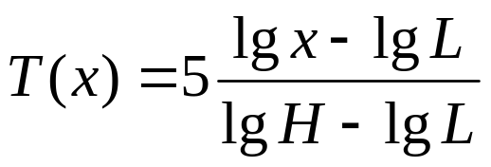
Approach: Tone analysis
Native versus non-native speaker pitch contours
  Pitch extracted using algorithm in (Wang and Seneff, 2000)
  Statistics of each pitch contour over each syllable considered without regard for left or right contexts
Normalization
  Duration normalized by sampling pitch at 10% intervals
  Pitch normalized according to:
Comparisons of pitch based on (Wang et al., 2003)
  Include normalized pitch value, peak, valley, range, peak position, valley position, falling range, and rising range
Example
  One native speaker, one non-native student
  DLI Corpus: corpus contains 4 native (2065 utterances), 20 non-native (4657 utterances)

Slide 13
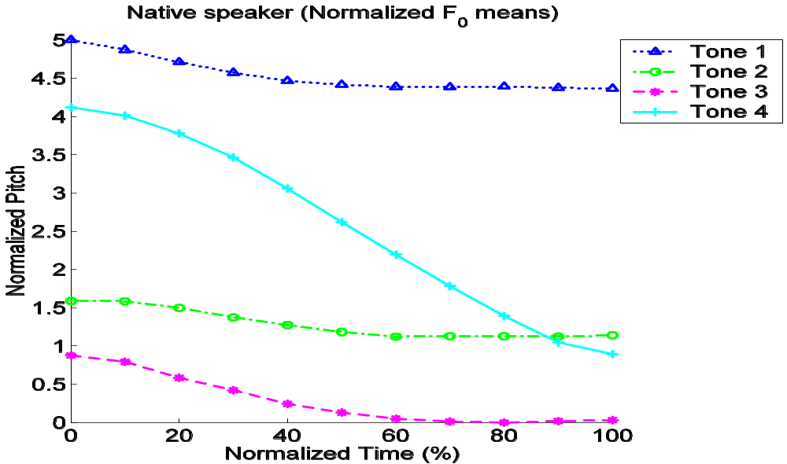
Approach: Tone analysis example

Slide 14
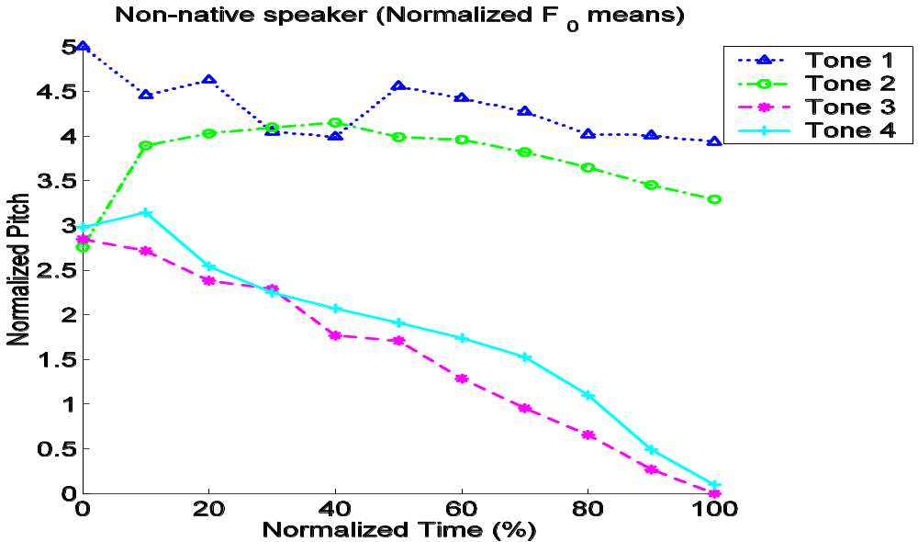
Approach: Tone analysis example

Slide 15
Approach: Lexical Tone Correction
Normally written in characters
  洛杉矶星期一刮风吗？
Pinyin methods
  Diacritic: luò shān jī xīng qī yī guā fēng ma?
  Numeric: luo4 shan1 ji1 xing1 qi1 yi1 gua1 feng1 ma5?
If a student does not know the lexical tone for some word, then this will be reflected in the typed input
  luo3 shan1 ji3 xing1 qi2 yi1 gua4 feng2 ma2?
How do we correct these mistakes?

Slide 16
Approach: Lexical Tone Correction
Exploit some features of Chinese
  Syllable lexicon is small, approximately 420 unique syllables
  5 tones (including neutral tone)
Exploit some abilities of TINA
  Ability to parse weighted word FST using probabilistic models
  FST normally represents a list of recognizer hypotheses
  A path through the FST represents the most likely correct parse
Given some input
  Generate FST of single sentence
  Expand the tones on each syllable
  Attempt to parse FST
  Path through FST represents corrected tones

Slide 17
FST Example: Step 1
Step 1: Generate simple FST
Given: luo3 shan1 ji3 xing1 qi2 yi1 gua4 feng2 ma2

Slide 18
FST Example: Step 2
Step 2: Assign benefit of doubt to items that appear in lexicon
Items that do not appear in lexicon are removed.
Given: luo3 shan1 ji3 xing1 qi2 yi1 gua4 feng2 ma2

Slide 19
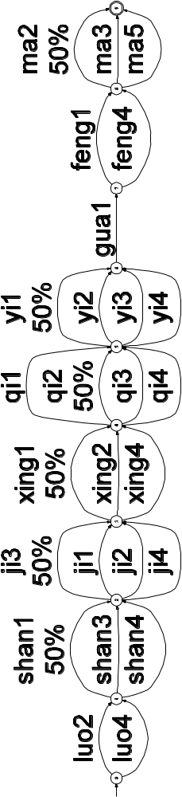
FST Example: Step 3
Step 3: Expand each syllable to alternate tones. More compact than specifying each possible sentence variant.
Given: luo3 shan1 ji3 xing1 qi2 yi1 gua4 feng2 ma2

Slide 20
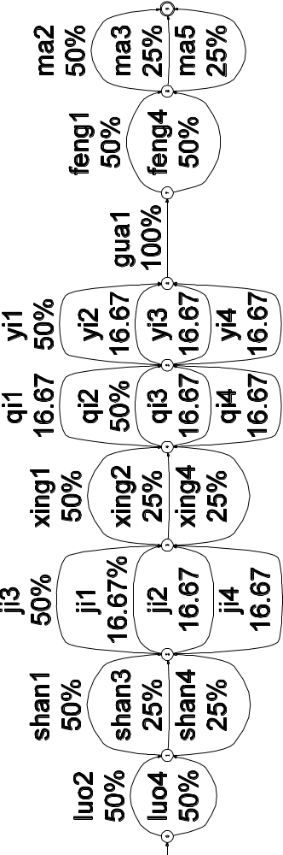
FST Example: Step 4
Step 4: Remaining probability is uniformly distributed among alternate tones
Given: luo3 shan1 ji3 xing1 qi2 yi1 gua4 feng2 ma2

Slide 21
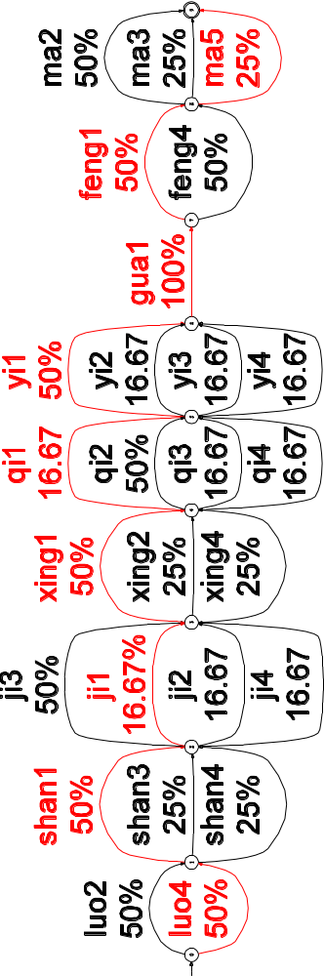
FST Example: Step 5
Step 5: Parsing reveals the correct tones
Given: luo3 shan1 ji3 xing1 qi2 yi1 gua4 feng2 ma2
Correct: luo4 shan1 ji1 xing1 qi1 yi1 gua1 feng1 ma5

Slide 22
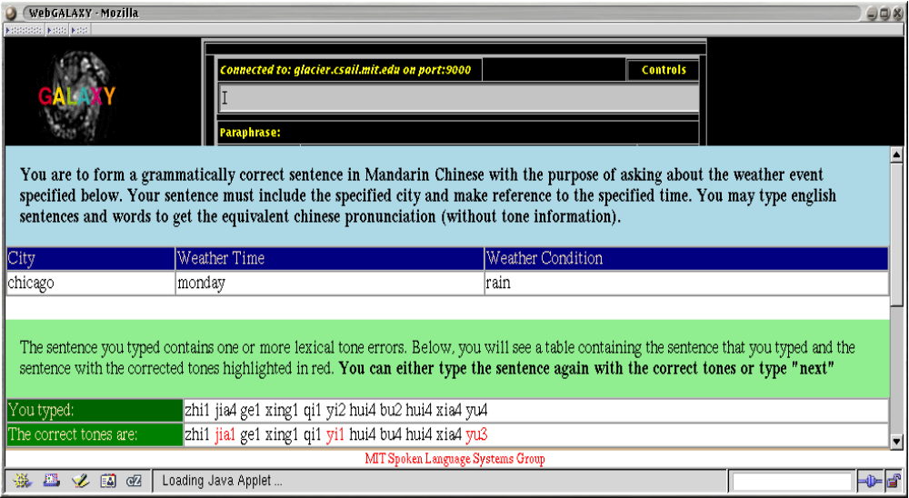
Approach: Web interface

Slide 23
Approach: Web interface
Student is prompted for city, time, and event

Slide 24
Approach: Web interface
Student types in:
A question concerning this topic in Mandarin using pinyin
    OR
An English word or phrase for a translation

Slide 25
Approach: Web interface
Student is given feedback

Slide 26
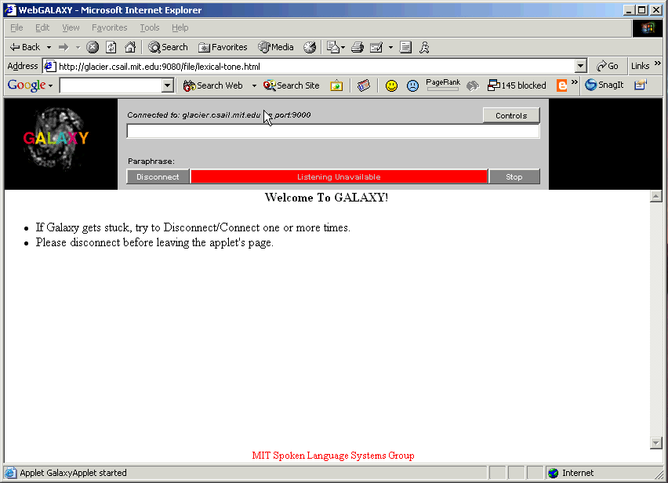
Approach: Web interface

Slide 27
Approach: Experiment
5 phases
  Read speech
  Typed with only general feedback in typed portion
  Recorded prompts
  Typed with specific feedback in typed portion
  Recorded prompts
Students, so far, are all students in their early to mid-20s and in the 1st year of MIT’s Chinese program.
We have made arrangements with the Defense Language Institute to have their students participate in future experiments

Slide 28
Overview
Motivation
Experimental Structure
Approach
  Tone analysis
  Lexical tone correction
  Interface
  Experiment
Discussion
Future work
Notes:
The talk is roughly divided into two parts
first I'll talk about speaker modeling techniques, and contrast the use of generic
a framework we use for combining scores from different classifiers
present results on multiple utterances in the Mercury Domain
Second part of the presentation will focus on work done to investigate the use of alternate front end features for speaker ID.

Slide 29
Discussion
Laid out a framework for a set of exercises to help students acquire competency in a foreign language on a specific topic (weather)
Designed an experiment for examining the effects of lexical tone knowledge in non-native speakers
Implemented a robust method capable of correcting lexical tone errors in typed pinyin
Outlined a method for pitch assessment
Premature to make any claims due to data sparseness
Unforeseen benefits of lexical tone correction
  Can correct erroneous recognizer output with language model
  Enables non-native speakers with imperfect lexical tone knowledge to accurately transcribe user utterances

Slide 30
Future work
Data collection
  Invite a large group of students to participate in the exercise
  Allow students to interact with weather dialogue system
System extensions
  Provide examples of native speech for sentences typed by students with high quality Mandarin from ENVOICE (Yi 2003)
  Automatic pitch correction using phase vocoder techniques (Tang et al., 2001)
Assessment
  Develop context-dependent models to account for tone sandhi and co-articulation effects
  Develop algorithms for tone assessment
  Augment with segmental assessment techniques (Kim et al., 2004)
  Analyze syntactic errors made by non-natives (since prompts require students to form their own sentences)

Slide 31
Thank you!
Thank you!
谢谢！
Questions?

