Slide 1
WinPitch LTL
a Multimodal Pronunciation Software
Philippe Martin
UFR Linguistique
University Paris 7 Denis Diderot
philippe.martin@linguist.jussieu.fr

Slide 2
Why pitch visualizers?
Language learners are deaf…
They (may) like to play
…by themselves
…at a distance
Notes:
Pourquoi visualiser?
Pour les vrais et faux sourds (les phonéticiens)
Jeux d'othophonie pour la rééductaion d'enfants sourds
Apprentissage individuel: plus de peur du prof terroriste
Premiers essais en 1965

Slide 3
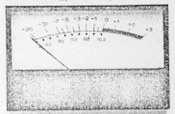
Ancestors...
SAID system
(Ann Arbor, 1967)

Slide 4
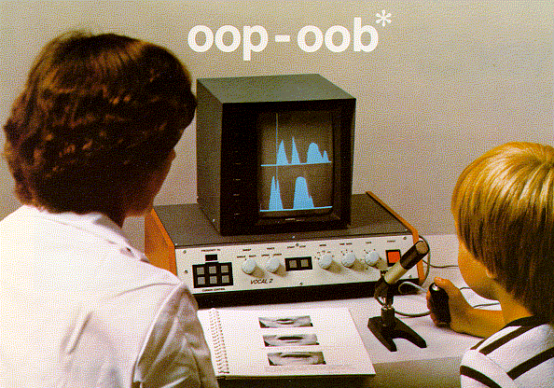
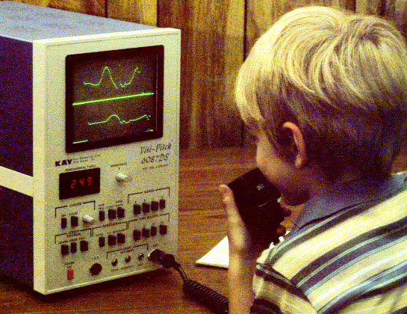
Other ancestors...
Madsen
(Canada, 1973)
Visipitch
(USA, 1975)

Slide 5
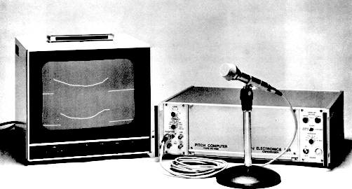
Pitch Computer

Slide 6
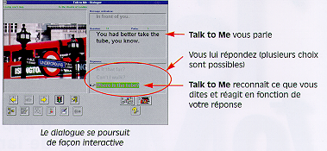
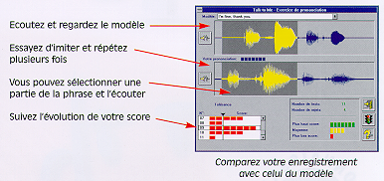
Talk to Me
Imitation du signal
Reconnaissance vocale
Auralog, France

Slide 7
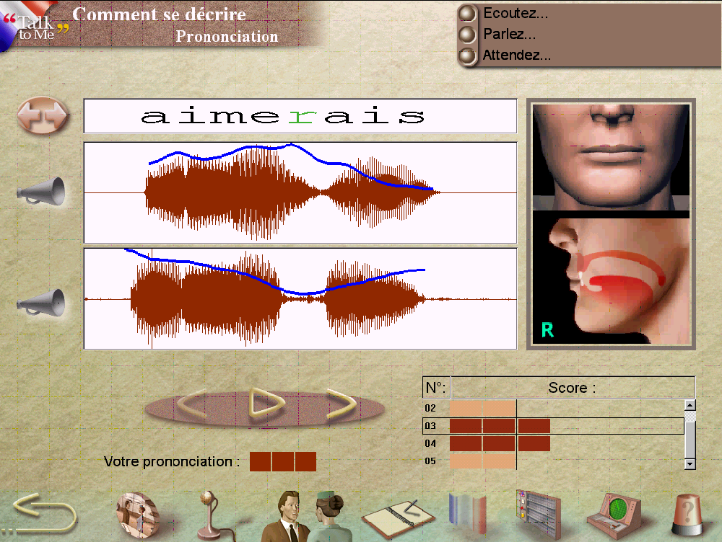
Talk to Me

Slide 8
Potential problems :
Imitation of a pitch curve (+ rhythm)
No linguistic explanation
No prosodic model

Slide 9
The three levels of learning:
I listen and I forget
  slow speed playback
I see and I remember
  visualization
I do and I understand
  re-synthesis
A learning process …

Slide 10
WinPitch LTL
Two user modes
Stand alone for self instruction
Distance learning

Slide 11
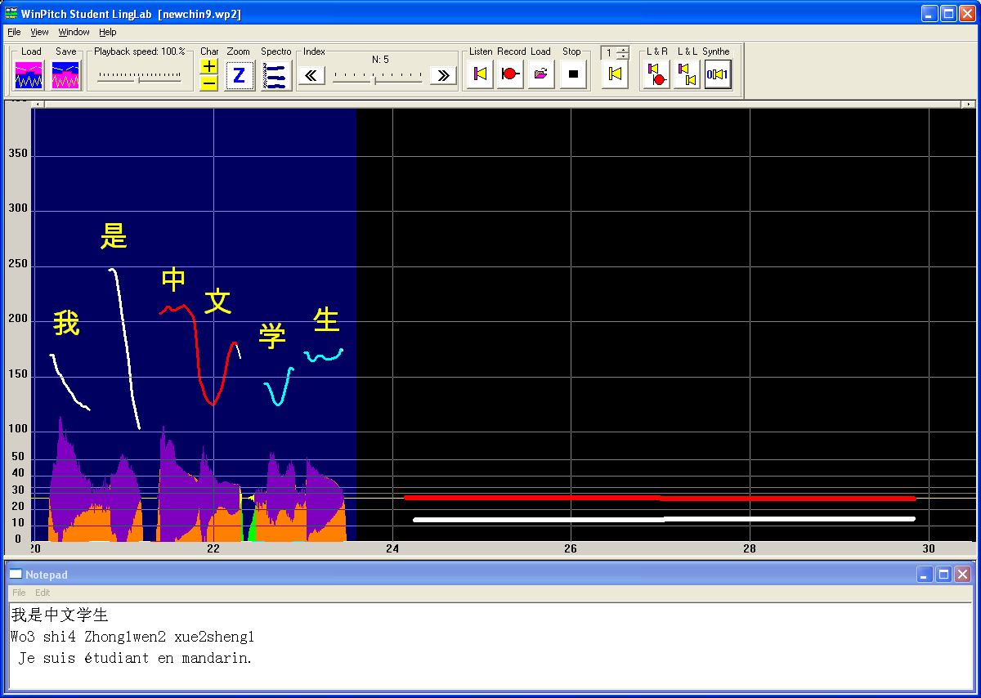
WinPitch LTL
Model
Imitation
Phrase selector
Melodic curves
Notebook

Slide 12
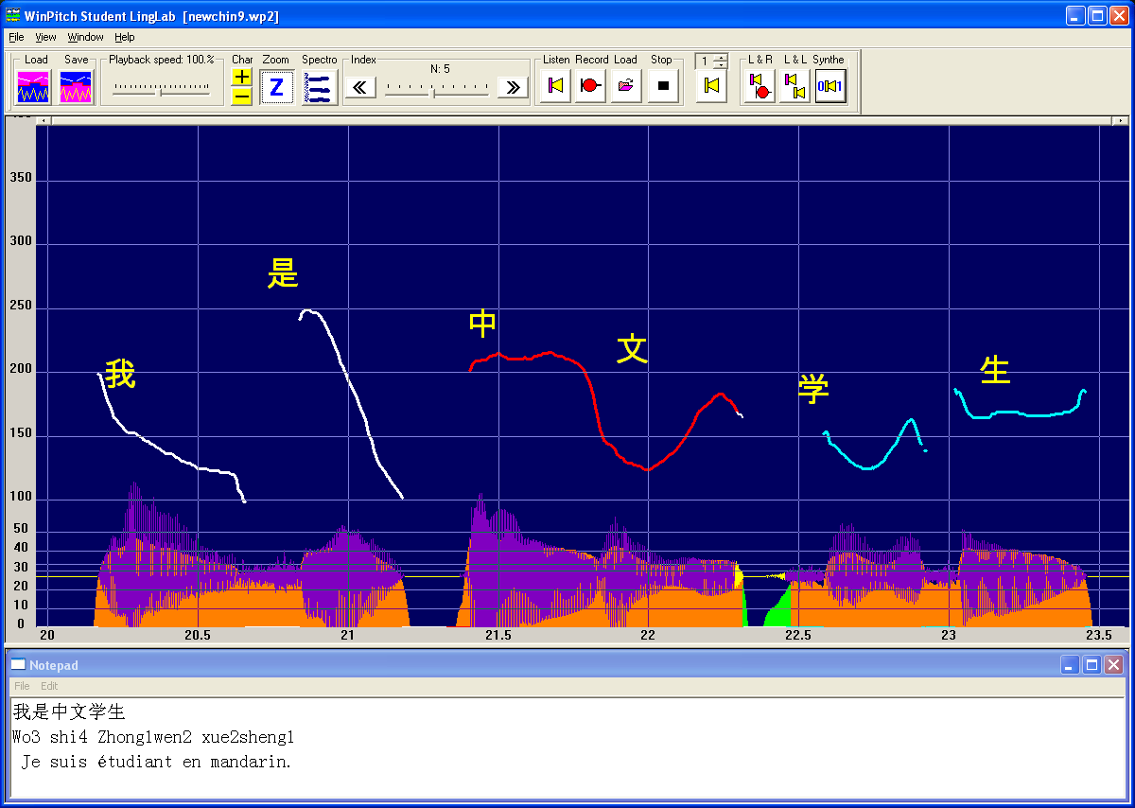
WinPitch LTL
Text
Zoom mode
Melodic curve
Notebook

Slide 13
Toolbar
Load Save lesson
Zoom - Spectrogram
Sentence navigation
Playback speed

Slide 14
Toolbar
Play model
Prosodic morphing
Record imitation
Load imitation
Play imitation
Play and record
Play model + imitation

Slide 15
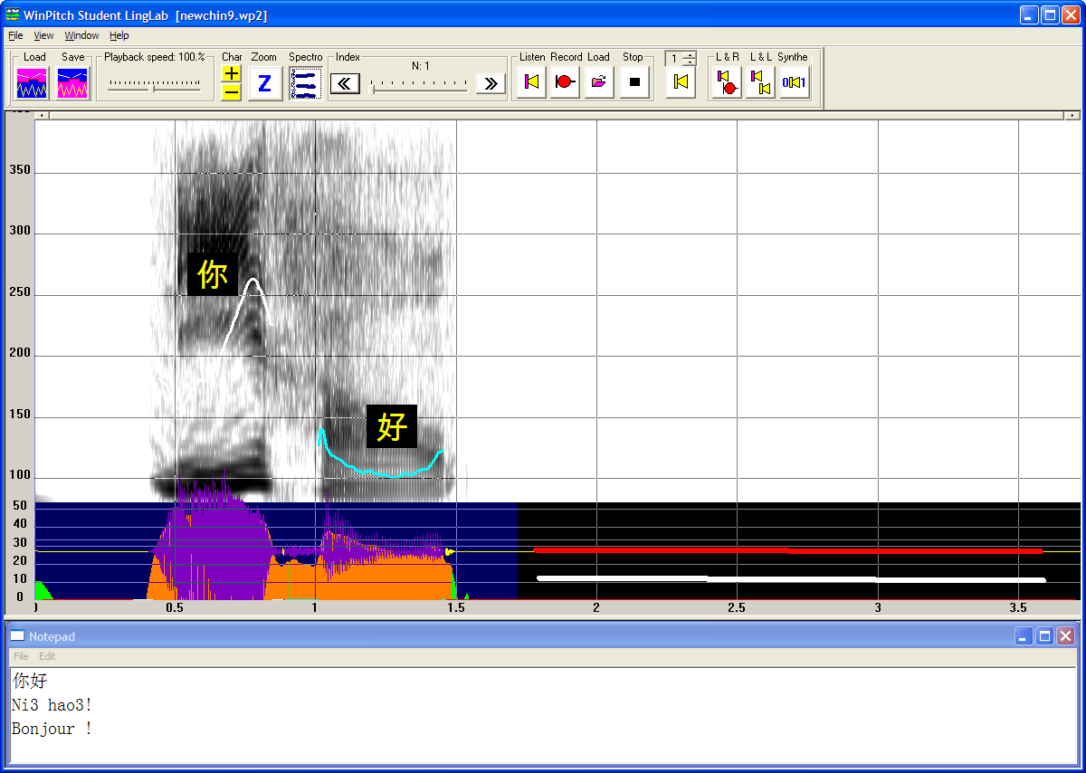
Spectrogram…

Slide 16
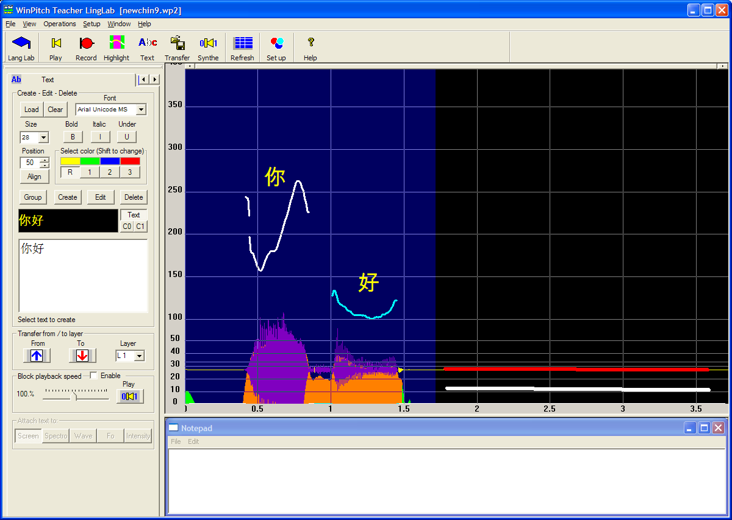
Text
Text (Unicode)

Slide 17
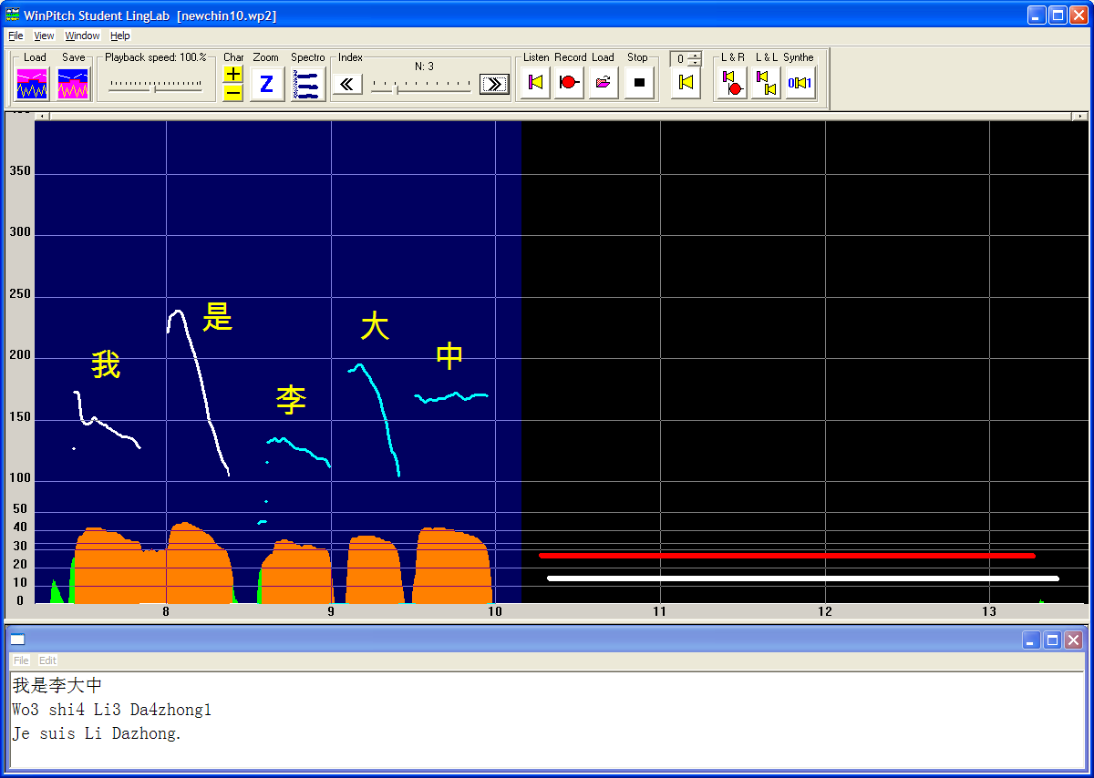
Screen layout
Highlighting of melodic segments
Pre-placed prosodic morphing lines
Comments

Slide 18
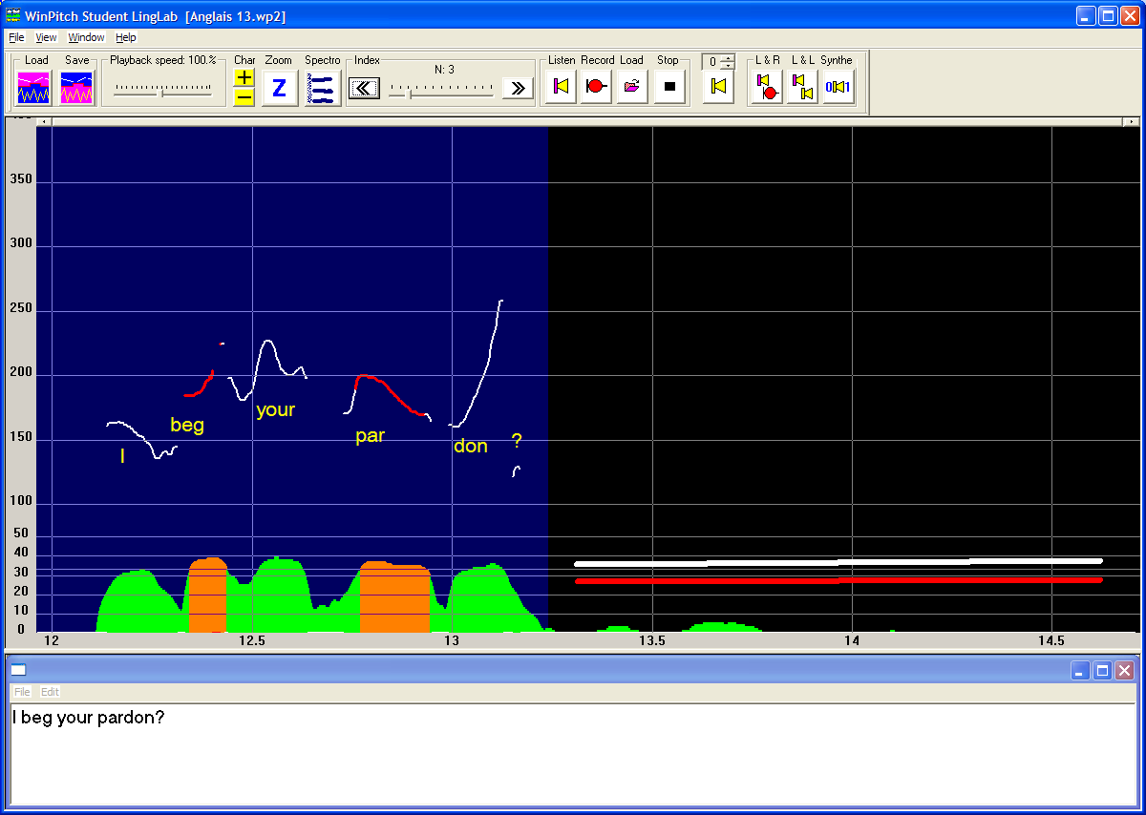
Stressed syllables highlighting
Highlighting of melodic segments

Slide 19
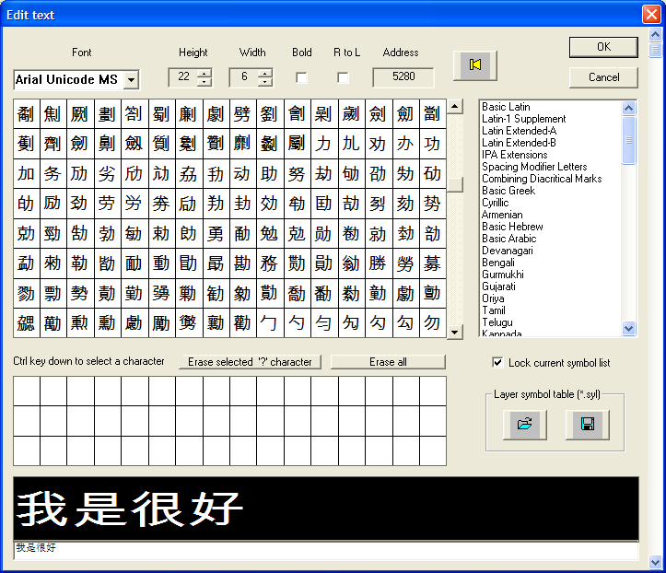
Unicode text font

Slide 20
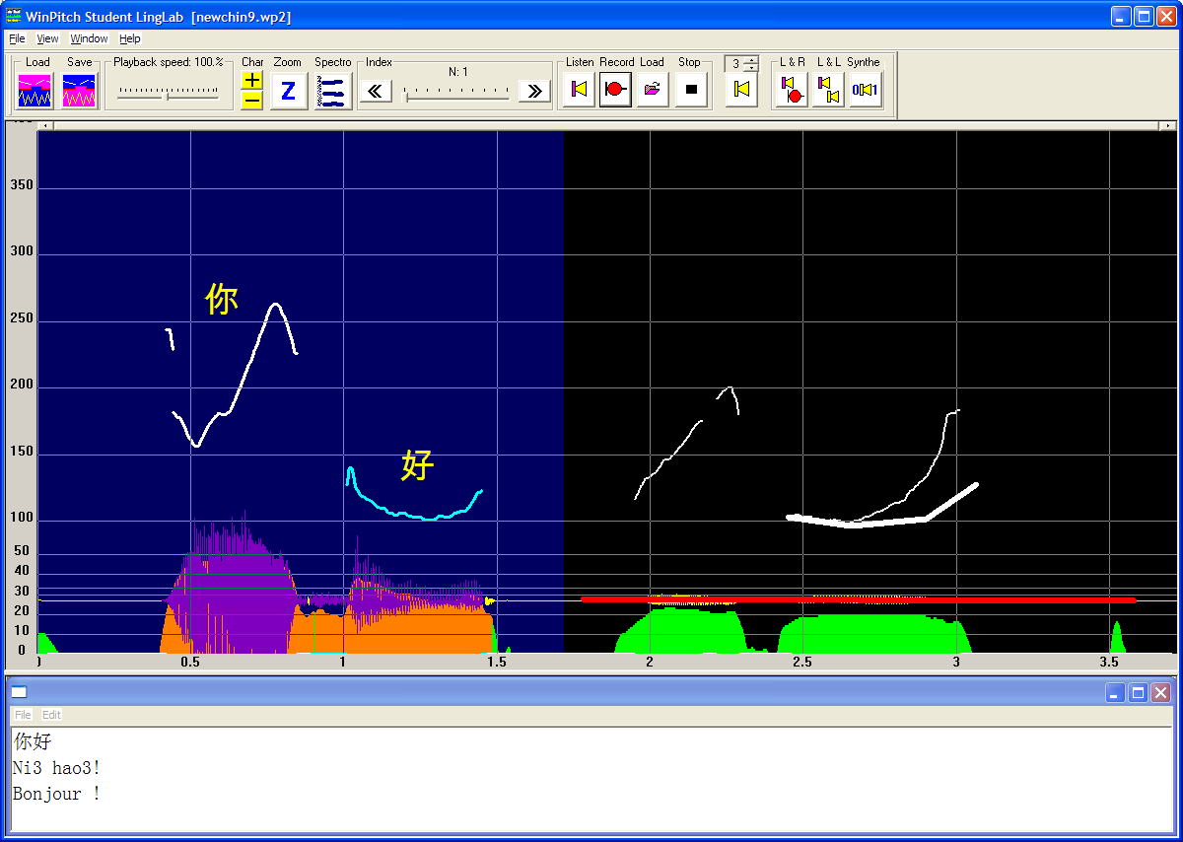
Prosodic morphing

Slide 21
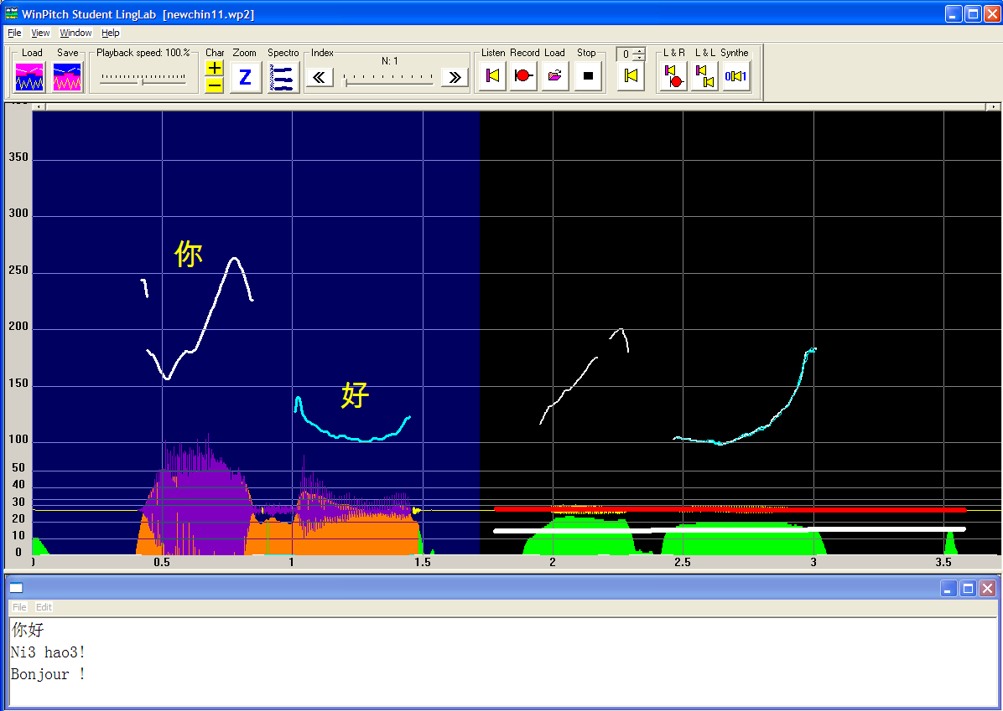
Model – repetition mapping

Slide 22
Learner feedback
Segment too low / high
Segment start / end should fall / rise
Segment should be shorter / longer
…

Slide 23
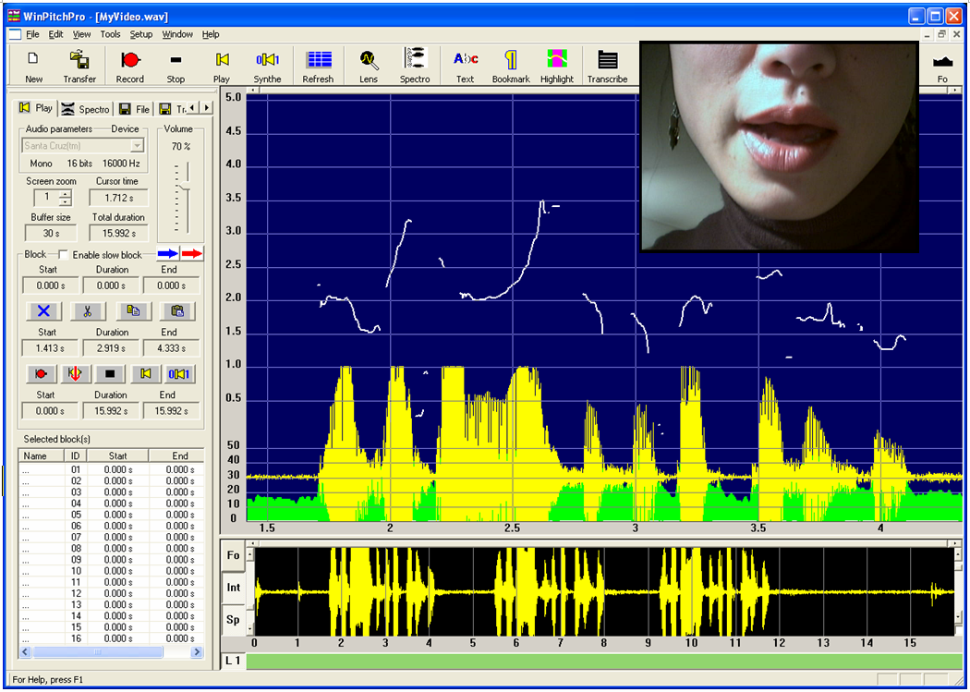
Multimodal display

Slide 24
In summary…
Real time display
Model student alignment
Highlight mapping, automatic pitch correction
Notebook
Multimedia
Variable speed playback
Prosodic morphing

Slide 25
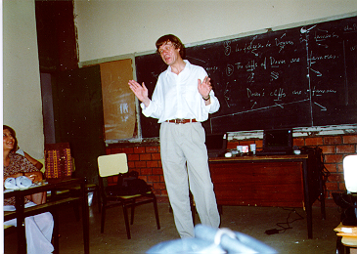
That’s all folks...

