Slide 1
PETRA – the Personal Embedded Translation and Reading Assistant
Werner Winiwarter
University of Vienna
InSTIL/ICALL Symposium 2004
June 17-19, 2004

Slide 2
Introduction
PETRA assists German-speaking language students in reading and translating Japanese documents
PETRA is fully embedded into Microsoft Word so that students can invoke all its features directly from within the text editor
The translation rules are learnt incrementally from translation examples provided by the students

Slide 3
Introduction (2)
The students can customize PETRA‘s translations according to their personal preferences
This encourages a bidirectional knowledge transfer
It fosters a lively interaction and makes learning more interesting and entertaining

Slide 4
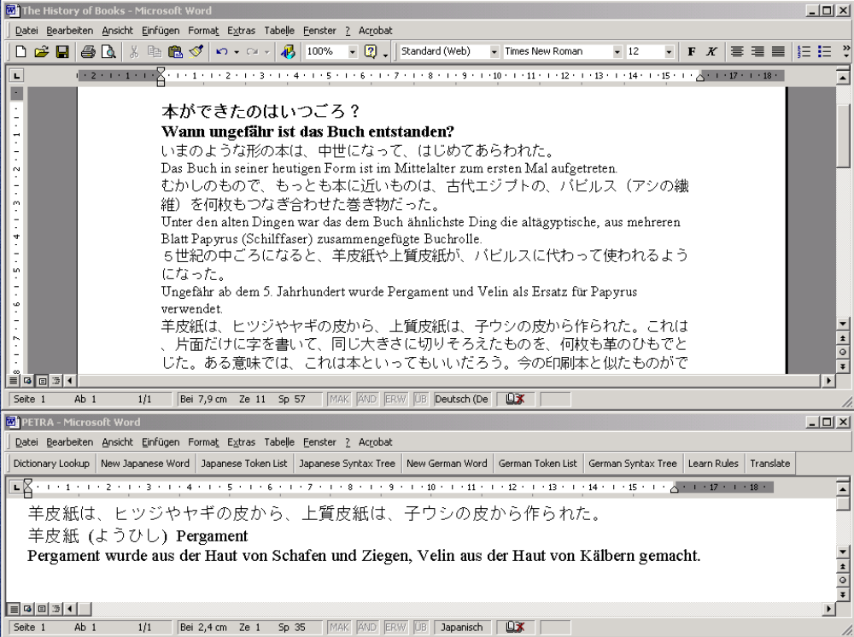

Slide 5
System Description – Reading Assistant
Correct segmentation of Japanese sentences
Dictionary lookup of pronunciations and German meanings based on WaDokuJT (over 190,000 entries)
Stemming of conjugated word forms to compute dictionary form
User-friendly interface to add new entries to the dictionary

Slide 6
System Description – Translation Assistant
Automatic translation of Japanese sentences into German
If the student is not satisfied, he can simply correct the translation and activate the adaptive learning module
This way the students can fully personalize PETRA according to their individual preferences
The students can also ask for the display of token lists and syntax trees for Japanese and German sentences

Slide 7
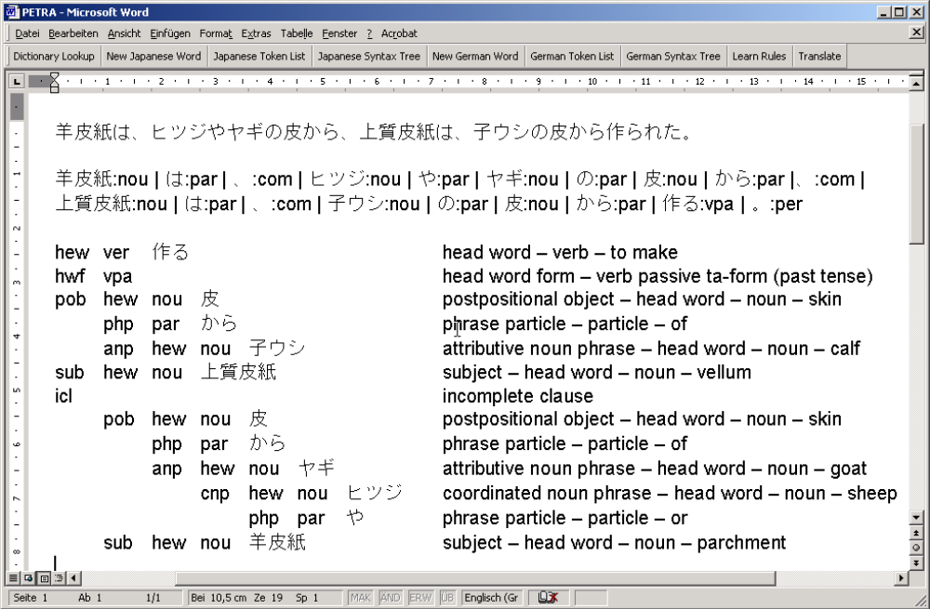

Slide 8
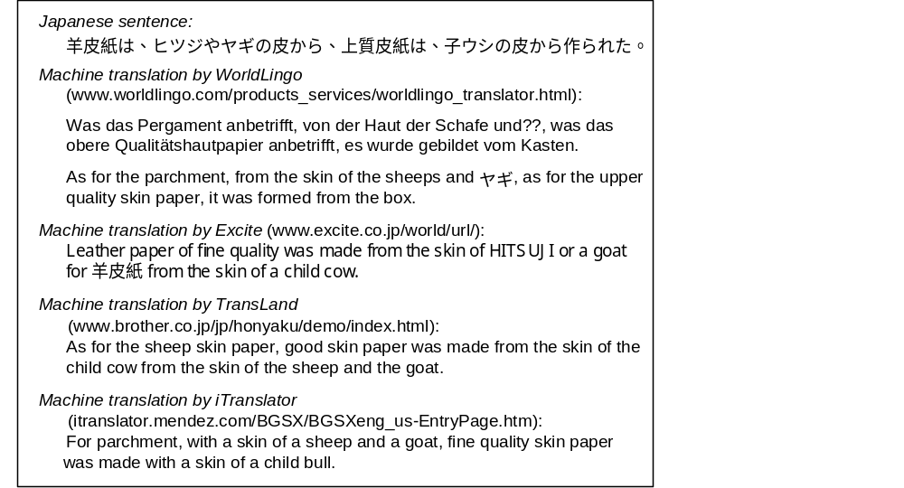
Machine Translation – Existing Systems

Slide 9
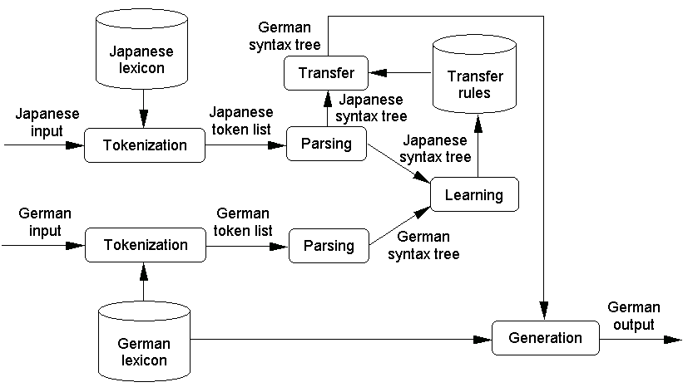
Machine Translation – Architecture

Slide 10
Machine Translation – Tokenization
The tokenizer modules produce the correct segmentation into word tokens associated with their part-of-speech tags
Because of the missing delimiters we have to treat a Japanese sentence as a single string
We retrieve all left substrings from the lexicon to identify the next word
This includes all concatenations of stems and endings for conjugated words

Slide 11
Machine Translation – Parsing
Both Japanese and German token list are transformed into syntax trees by the parsing modules
For specifying the syntax trees, we use a flexible and robust representation by modeling a sentence as a set of constituents
Each constituent is either
  a simple constituent (feature or word) or
  a complex constituent, which consists of a set of subconstituents

Slide 12
Machine Translation – Display of Syntax Trees
For displaying the syntax trees to the students we have developed one generic display module
It can handle both Japanese and German syntax trees as well as mixed representations
The latter can be caused by missing coverage of the transfer rule base
This way we can show the limitations of the translation component to the language students
They can easily fix them with an update of the rule base

Slide 13
Machine Translation – Learning
The learning module traverses both syntax trees and derives new transfer rules, which are added to the rule base
We use generic predicates for the simultaneous navigation in two complex constituents
We start searching for mappings at the top level of the sentence
Then we look for corresponding constituents and continue our search for finer-grained rules recursively

Slide 14
Machine Translation – Transfer
The transfer module incrementally applies the transfer rules stored in the rule base to the Japanese syntax tree
One rule changes only certain parts of a constituent into the German counterpart, other parts are left unchanged to be transformed later on
Thus, our transfer algorithm deals efficiently with a mixture of Japanese and German
This mixture turns gradually into a correct German syntax tree

Slide 15
Machine Translation – Generation
The generation module traverses the German syntax tree in the correct order and produces a list of word tokens along the way
This list is then transformed into a single character string by inserting spaces where necessary
The main difficulty is the generation of the correct inflected word forms at the surface level
The required syntactic information is partly encoded in the syntax tree and partly derived from the German lexicon

Slide 16
Conclusion
We have finished the implementation of the system and are now building the transfer rule base with the help of several language students
So far, the feedback has been very positive
In addition to constantly extending the coverage of our rule base, future work will also concentrate on a detailed evaluation study
We will measure the impact of PETRA on language instruction along the three dimensions engagement, effectiveness, and viability

Slide 17
For further questions please contact:
  Werner Winiwarter
  Faculty of Computer Science
  University of Vienna
  werner.winiwarter@univie.ac.at
  http://www.ifs.univie.ac.at/~ww/

