Slide 1
Retrieval of Authentic Documents for Reader-Specific Lexical Practice
Jonathan Brown
Maxine Eskenazi
Carnegie Mellon University
Language Technologies Institute

Slide 2
The REAP Project Rationale
Students Often Reading Prepared Texts
  Not exposed to examples of language used in everyday written communication
    Students not exposed to authentic documents
  Every student reading the same document
    Students who are having trouble with words have little chance for remediation
    Students who are ahead have little chance for advancing quicker

Slide 3
Goals
To Create a Framework that Presents Individual Students with Texts Matched to Their Own Reading Levels
To Enhance Learning Researchers’ Abilities to Test Hypothesis on How to Improve Student Vocabulary Skills for L1 and L2 Learners

Slide 4
How – Source of Texts
Using the Web as a Source of Authentic Materials
  Large, diverse corpus
  Often exactly the types of texts L2 learners want to read
  The larger the corpus, the more constraints we can apply during retrieval

Slide 5
How – Modeling the Curriculum
Focusing on Vocabulary Acquisition
Curriculum Represented As Individual Levels
  Each Level is a Word Histogram
  Learned Automatically from a Corpus of Texts
  Easily Trainable for Different Student Populations with Different Goals
  Certain Named-Entities Automatically Removed from Curriculum
    Person names, organization names, works of art …

Slide 6
How – Modeling the Student
Student Also Represented Using Word Histogram Models
  Passive Model (Exposure Model)
    All the words the student has read using our system
  Active Model
    Only words for which the student has demonstrated knowledge
  Differences Between Active and Passive Models Indicate Where the Student is Having Trouble
  Differences Between Student Models and Next Level of Curriculum Model Indicate Words Remaining to be Learned

Slide 7
How – Modeling Special Topics
Special Topics Also Modeled as Word Histograms
  Teacher Topics
    Lesson on George Washington
  Upcoming Test
    Extra Exposure of Words to be Tested On
    Built from Specimens of Past Tests
  Student Interests
    Static – Sports LM
    Dynamic – Based on Student Selected Documents

Slide 8
How – Building A Search Index
First Focusing on L1, Grades 1 - 12
Crawled for Web for Appropriate Texts
Documents Annotated with Reading Level
  Language Modeling-Based Classifier - See Next Slide
Other Annotations
  Parts-of-Speech
    To Aid in Word Sense Disambiguation
    Done in Curriculum, Student Models Also
  Named-Entities
    To Aid in Searching for Specific People, etc.
Goal: 10-20 Million Documents at or Below Grade 8

Slide 9
How – Annotating with Reading Level
Most Simple Measures Found to be Inaccurate for Web Pages
Using Previous Work by Jamie Callan and Kevyn Collins-Thompson (2004)
Multiple Statistical Language Models, Trained Automatically from Self-Labeled Training Data
At least As Accurate at Predicting Reading Difficulty of Web Pages as Revised Dale-Chall, Lexile, Flesch-Kincaid Measures

Slide 10
Offline Processes
Building Search Index, Curriculum Level Models, Student Models
Web
Crawler
Part-of-Speech,
Named Entities,
Reading Level
Annotation
Index
Curriculum
Part-of-Speech
Annotation
Named Entity
Removal
Level Curriculum
Model Generation
Level
Models
Active and
Passive Student
Models
Initial Testing
of Student

Slide 11
Online Processes
Document Retrieval, Student Assessment, Model Updates
Models
Student
Interests
Teacher
Model
Criteria Chooser
Passive Student
Model
Active Student
Model
Level Models
Criteria
(Query)
Document
Index
Document
Retrieval
Student
Assessment
Model
Update
Chosen Text

Slide 12
Online Processes Perspectives
Student
Teacher/Experiment Admin
Researcher

Slide 13
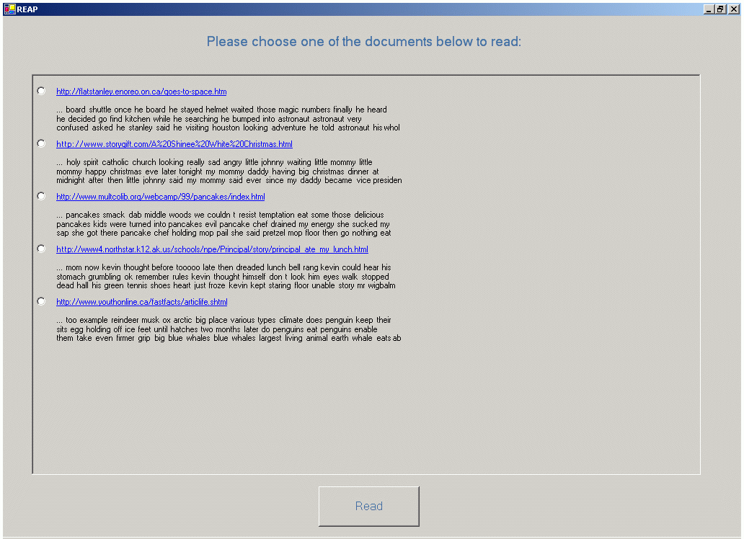
Student Interface

Slide 14
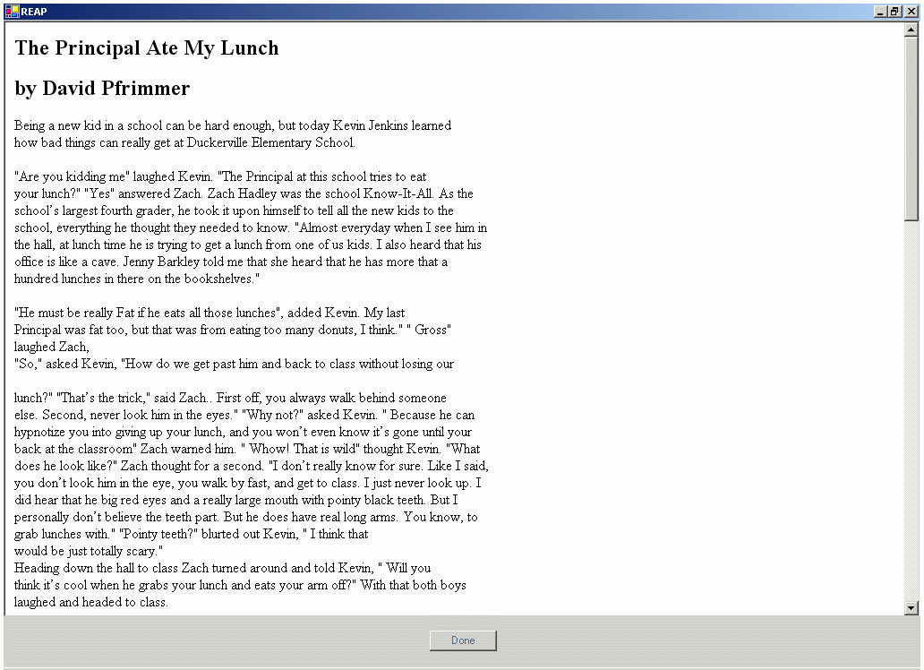
Student Interface

Slide 15
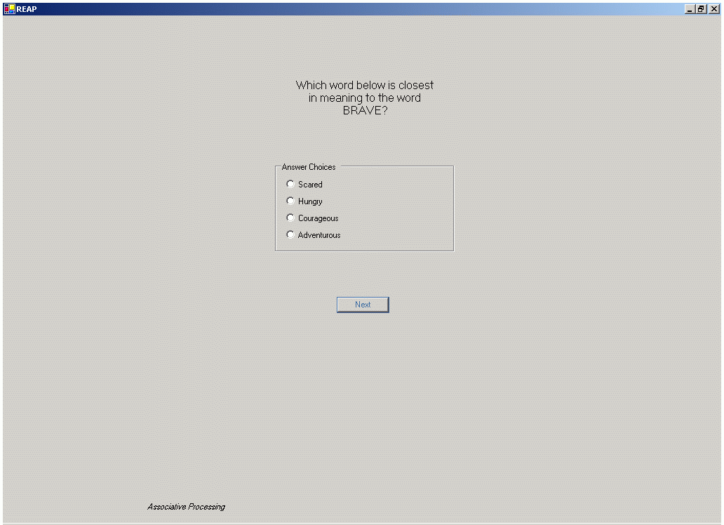
Student Interface

Slide 16
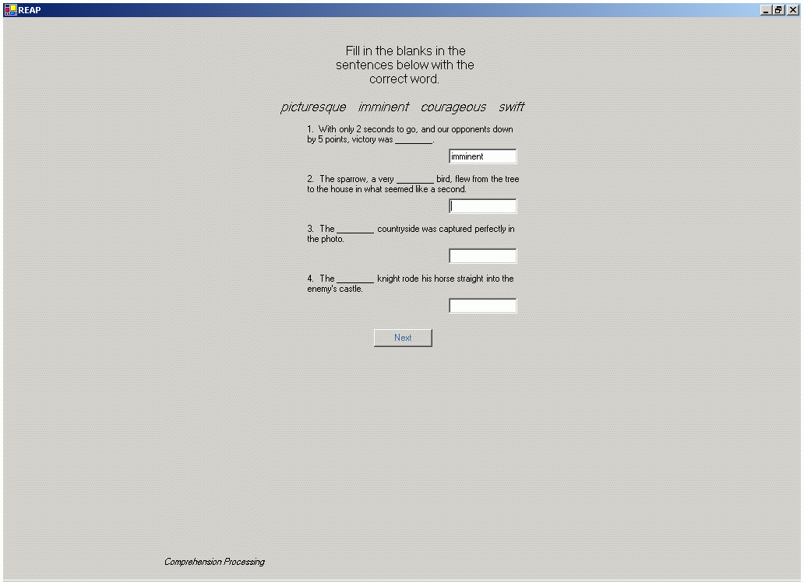
Student Interface

Slide 17
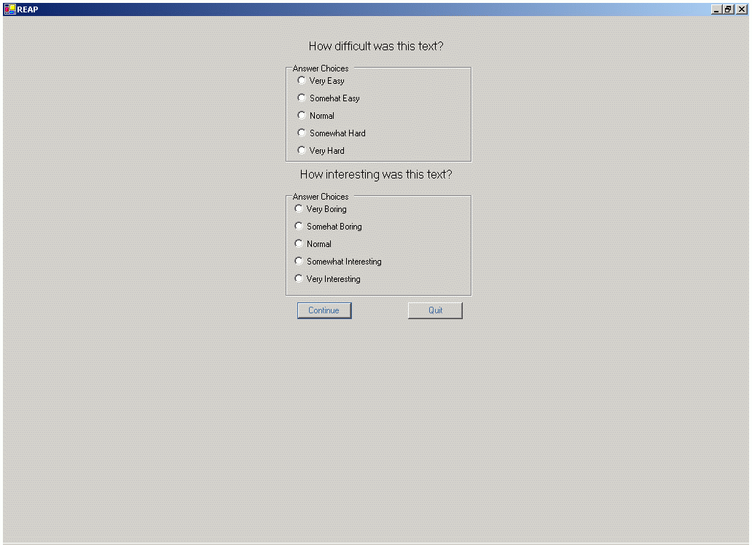
Student Interface

Slide 18
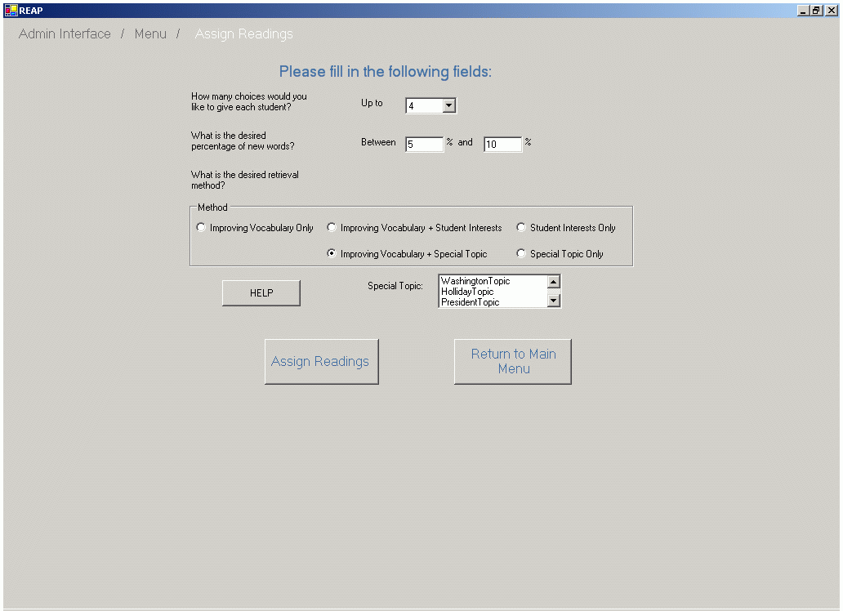
Admin Interface –
Assign Readings

Slide 19
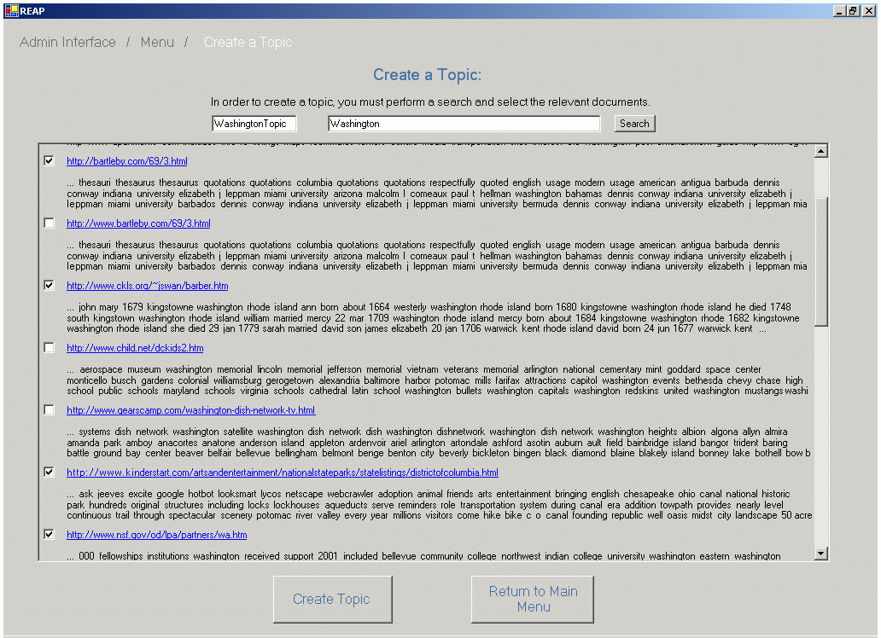
Admin Interface –
Create Topic

Slide 20
Retrieval Process
Find Documents at Student’s Grade Level
  Student Independent
Find Documents with Desired Percentage New Words
  Student Dependent
Re-Rank these Documents Based on Retrieval Criteria
  For Vocabulary Mastery, Rank by New Words
    Highest Frequency Curriculum Words -> Highest Priority
    Hybrid Frequency Method
  For Student Interests and Teacher Topic
    Re-Rank Based on Special Topic Language Model
  For Vocabulary Mastery PLUS Special Topic
    Find Best According to Vocabulary and then Re-Rank by Topic
Present Student with Choice of Top-N Documents

Slide 21
Researcher Interface –
Criteria Modifiable by Researcher
Percentage of New Words
  Rate of introduction of new vocabulary
How to Weight New Words
How to Model Student Interests
  Static or Dynamic
Word Knowledge
  What does it mean for a student to know a word?
    Answered correctly some number of times
    Probabilistic method based on word families

Slide 22
Questions and Comments?

Slide 23
Questions for Student
Based on Stahl’s Three Levels of Word Mastery
  Association Processing
  Comprehension Processing
  Generation Processing
  See The Following Three Questions

Slide 24
Student Interface

Slide 25
Student Interface

Slide 26
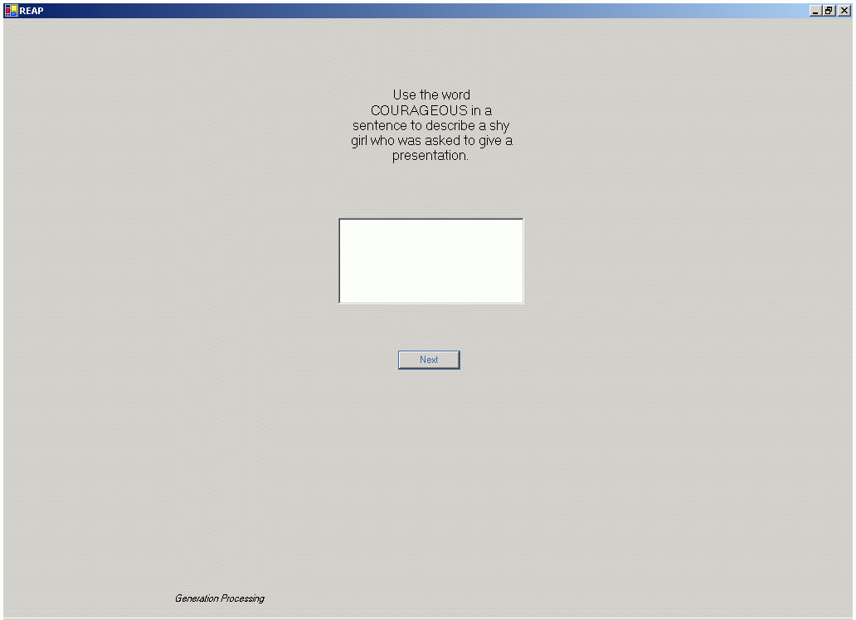
Student Interface

Slide 27
Grade Level Annotation
K. Collins-Thompson and J. Callan, 2004. A Language Modeling Approach to Predicting Reading Difficulty. Proceedings of the HTL/NAACL 2004 Conference, Boston.

