Slide 1
Spoken Conversational Interaction for Language Learning
Stephanie Seneff, Chao Wang, and Julia Zhang
Spoken Language Systems Group
MIT Computer Science and Artificial Intelligence Lab
June 18, 2004

Slide 2
Language Acquisition through Conversational Interaction
Language teachers have limited time to interact with students in dialogue exchanges
Computers provide non-threatening environment in which to practice communicating
We can leverage our extensive prior research in spoken conversational systems to support language learning
Three-phase interaction framework is envisioned:
  Preparation: practice phrases, simulated dialogues
  Conversational Interaction
    Telephone conversation with graphical support
    Seamless translation aid
  Assessment
    Review dialog interaction
    Feedback and fluency scores

Slide 3

SCILL: A Spoken Computer Interface for Language Learning
Leverage from our existing conversational systems to produce interactive environment for language learning
Speaks only target language.
Has access to information sources.
Can provide translations for both user queries and system responses
Domain Expert
Tutor

Slide 4
Technology Requirements
Robust recognition and understanding of foreign-accented speech
  If recognition is too poor, student may become frustrated
  Customize vocabulary and linguistic constructs to lesson plans
High quality language translation (limited domains)
Natural and fluent speech synthesis
Ability to automatically generate simulated dialogues
  System should be able to generate multiple dialogues based on a given lesson topic on the fly
  Allows the student to see example sentence constructs for a particular lesson
Ability to reconfigure quickly and easily to new lessons
Automatic scoring for fluency, pronunciation, tone quality, etc.

Slide 5



Galaxy Conversational System
Architecture
Language
Generation
Speech
Synthesis
Voyager
Jupiter
Pegasus
Mercury
Audio
Server
Hub
Database
GUI
Server
Speech
Recognition
Context
Tracking
Language
Understanding

Slide 6
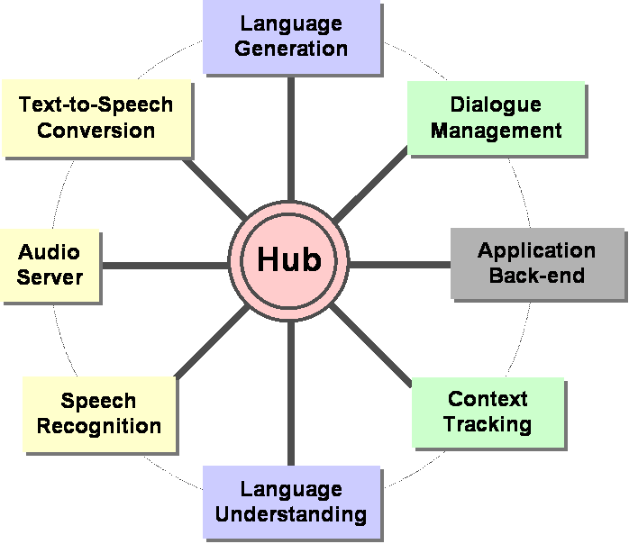
SCILL System Overview
WEB
SERVER
USER INTERFACE

Slide 7
Domains and Languages
Currently focusing on English and Mandarin
System can be configured reversibly to support L1 = English; L2 = Mandarin, or vice versa
Domains center around the travel scenario:
  Flight reservations
  Hotel reservations
  Weather
  Wake-up call and reminders
  Navigation assistance (direction finding)

Slide 8
Graphical and Telephone Interactions
Stage 1: Preparation
  User sees dialogue in both target and native language; mouse clicks support playback of each utterance in target language
  Web page presents different simulated dialogue each time it is visited
Stage 2: Telephone Interaction
  User issues “call me at” request to instantiate telephone conversation
  User can speak in L1 at any time to find out how to say something they forgot
  User can also ask for translation of replies
Stage 3: Assessment
  User views their own dialogue at the Web page
  Mispronounced words are highlighted in red
  Synthetic speech versions of their utterances can be played

Slide 9
Stage 1: Simulated Hotel Dialogues
Simulated hotel is periodically regenerated with different settings for number of rooms and available amenities
At each turn, simulated user randomly chooses among presented options
Once room is selected, simulated user asks specific questions about the room or the hotel
Thousands of different simulated dialogues can be created by running the system in a batch-mode configuration
Synthetic waveforms for both sides of the conversation are automatically generated

Slide 10
Generating Simulated Conversation
Simulated system configured within Galaxy Framework
Intended for Mandarin speaker learning English
Simulated User
User Query Frame
Language Generation
English Dialogue System
English Query
Mandarin Query
Response Frame
Language Generation
English Response
Speech Synthesis
Mandarin Response

Slide 11
Example Simulated Dialogue (in English)
User: I’d like a room next Thursday and Friday
System: I have found 48 rooms. I have rooms with double,
queen, or twin beds.
User: I’d like a queen bed.
System: I have found 13 rooms with a queen bed. There are
both smoking and non-smoking rooms
User: How about a non-smoking room?
. . .
System: How about room 210? It is a non-smoking room with a
queen bed. It comes with a view. The room costs $115.
User: That would be fine.
System: You have reserved a room for Thursday and . . .
User: I’d like a wake-up call tomorrow at 9 a.m.
System: Okay, you’ll get a wake-up call at 9 a.m.

Slide 12
Stage 2: Conversational Interaction
Initial version of end-to-end system is in place for the weather domain
  Rain, snow, wind, temperature, warnings (e.g., tornado), etc.
Recognizer supports both English and Mandarin
  Seamless language switching
English queries are translated into Mandarin
Mandarin queries are answered in Mandarin
  User can ask for a translation into English of the response at any time
Currently using Mandarin synthesizer provided by DELTA Electronics
  Plan to develop high quality domain-dependent Mandarin synthesis using our Envoice concatenative speech synthesizer (Yi, 2003)
System can be configured as telephone-only or as telephone augmented with a Web-based gui interface

Slide 13
Bilingual Recognizer Construction
Parse
Interlingua
Generate
English corpus
Chinese corpus
Recognizer
English
Network
English Recognizer Langage Model
Chinese Recognizer Langage Model
Chinese
Network
Automatically translate existing English corpus into Mandarin
Use NL grammar to automatically induce language model for both English and Mandarin recognizers
Two recognizers compete in common search space

Slide 14
Multilingual Weather Responses
English source:
Some thunderstorms may be accompanied by gusty winds and hail
rain/storm
clause: weather_event
topic: precip_act, name: thunderstorm, num: pl
quantifier: some
pred: accompanied_by
adverb: possibly
topic: wind, num: pl, pred: gusty
and: precip_act, name: hail
Frame indexed under wind, rain, storm, and hail
wind
hail
Japanese:
Spanish: Algunas tormentas posiblement acompanadas por vientos racheados y granizo
Chinese: ¤@ ¨Ç ¹p «B ¥i ¯à ·| ¦ñ ¦³ °} ­· ©M ¦B ¹r

Slide 15
Example Spoken Dialogue Interaction in Weather Domain
User: Bo1 Shi4 Dun4 ming2 tian1 hui4 xia4 yu3 ma5? (Is it going to rain tomorrow in Boston?)
System: Tian1 qi4 yu4 bao4 ming2 tian1 Bo1 shi4 dun4 mei2 you3 yu3. (The forecast calls for no rain tomorrow in Boston)
User: (in English) What is the temperature?
System: (translates) Qi4 wen1 shi4 duo1 shao3?
User: (emulates) Qi4 wen1 shi4 duo1 shao3?
System: Bo1 Shi4 Dun4 ming2 tian1 zui4 gao1 qi4 wen1 er4 she4 shi4 du4, ming2 tian1 ye4 jian1, zui4 di4 qi4 wen1 ling2 xia4 wu3 she4 shi4 du4.
User: Could you translate that?
System: In Boston tomorrow, high 2 degrees Celsius, Tomorrow night, low -5 Celsius.

Slide 16

Example Telephone Interaction in Weather Domain
“Will it be hot in Dallas today?”
System paraphrases query, then replies with temperature information
System translates previous response
User speaks English to find out how to say it in Mandarin
User attempts to repeat what they just heard
“To my knowledge, the forecast calls for no rain in Seattle tomorrow. Is there something else?”

Slide 17
Stage 3: Plans for Assessment
Phonetic aspects
  Study relationship between existing confidence scores and phonetic productions
  Allow realizations of selected phones from native language to compete in recognizer search
Tonal aspects (Mandarin)
  Use tone recognition system (Wang et al., 1998) to score tone productions; highlight worst-scoring words
  Use phase-vocoder techniques (Tang et al., 2001) to repair user’s tone productions by replacing prosodic contour with native speech patterns
  Tabulate frequencies of tone errors in typed inputs (pinyin)
Fluency measures
  Word-by-word speaking rate (Chung & Seneff, 1999)
  Percentage of utterance containing pauses and disfluencies

Slide 18
Future Plans
(Near Term and Long Term)
Build high quality synthesis capability
Improve recognition, understanding, dialogue, and translation performance
Develop various scoring algorithms for quality assessment of student’s speech
Collect and transcribe data from language learners and evaluate both system and students
Refine all aspects of system based on collected data
Develop tools to rapidly port to new domains and languages
  Automatic grammar induction
  Generic dialogue modeling
  Simulated dialogue interactions

Slide 19
Thank you!

Slide 20
Multilingual Translation Framework
Common meaning representation: semantic frame
English
Chinese
Spanish
Japanese
SUMMIT
Models
Recognition
TINA
Generation
Rules
NLU
Semantic
Frame
Parsing
Rules
GENESIS
NLG
ENVOICE
English
Chinese
Spanish
Japanese
Speech
Corpora
Synthesis
Introduction || Multilinguality || Orion || Phrasebook || Summary

Slide 21
Testing the Effectiveness of Training on Typed Input: Proposed Measures
Compare the quality of spoken dialogue recorded before and after a Web-based training session
Measures of fluency:
  Syntactic well-formedness
  Tone production accuracy
  Frequency of pauses, edits, and filler words
  Phonetic quality , etc.
Measures of communication success:
  Frequency of usage of translation assistance
  Understanding error rate
  Task completion
  Time to completion, etc.

Slide 22
Example Telephone Interaction
User asks: “Will it rain tomorrow in Boston?”
System paraphrases query, then responds in Chinese
“Please repeat that” in English or Chinese interpreted identically
System repeats response in Chinese
User speaks query in English: seamless language switching
System paraphrases, then translates query into Chinese
User attempts to repeat translation
  Recognition error: hallucinates an erroneous date (February 30) which will be remembered
System supplies known cities in England
User chooses London
System has no weather for London on February 30
User asks “how about today?”
System provides London’s weather today
User asks for a translation into English, which is provided

