Slide 1
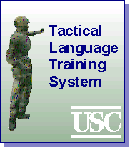
The Tactical Language Training Project
W. Lewis Johnson, Sunhee Choi, Stacy Marsella, Nicolaus Mote, Shrikanth Narayanan, Hannes Vilhjálmsson, Shumin Wu
University of Southern California
Micro Analysis & Design
US Military Academy
UCLA CRESST

Slide 2
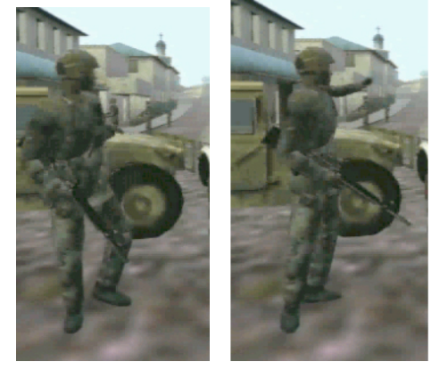
Tactical Language Learning
Help develop a basic functional knowledge of language and culture
  Focus on task-relevant communicative skills
  Includes gestures, culture
  Objective: Basic oral proficiency in narrow domain in approx. eighty hours
Technology toolset:
  Tools to track learner attention and proficiency
  Machine learning and NL tools to automate authoring
  Tools to manage interactive scenarios according to instructional objectives
Approach:
  Engage learners in face-to-face dialog with simulated people
  Provide each learner with tailored scaffolding
Targets: colloquial Arabic dialects, Farsi dialects, Bahasa Indonesia
Deictic gestures coordinated with speech

Slide 3
Major Research Themes
Study role of simulation games and intelligent tutoring in promoting communicative skill
  Simulation motivates, builds fluency
    Intelligent scaffolding built into simulation
  Tutoring provides form feedback
Tailor speech recognition to learner language
Emulate free dialog within narrative structure
Manage learner motivation
  Strong task orientation
  Promote early communicative success
  Employ motivational tutorial tactics
  Adjust level of challenge to maximize engagement

Slide 4
Scenes and Characters
Scenes:
  Mission Skill Builder – study and practice environment
  Mission Practice Environment – for applying knowledge in simulated world
Characters:
  Virtual instructor (provides tailored feedback in MSB, tailored help in MPE)
  Virtual locals (can also help – or challenge)

Slide 5
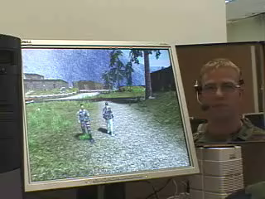
Status
Initial version developed for Levantine Arabic
  4 lessons completed in Skill Builder, 1 scene in Practice Environment, 2 levels of difficulty
  5 more lesson sets, 5 scenes currently under development
Evaluated at West Point, Ft. Bragg, and USC
  Overall approach appears effective, esp. for low confidence learners
  User data used to refine materials, models
Further tests planned at Ft. Bragg next month
USC test subject video

Slide 6
Scenario
Your special ops unit is deployed to a town to assist with postwar recovery
The objectives:
  Establish rapport with locals, describe mission
  Ask for directions to local leader
  Meet leader and discuss recovery needs
  Initiate mission (organize reconstruction)
  Overcome barriers to mission (factions, sabotage, etc.)
Impact of communication failure:
  Failure of mission
  Hostile encounters with locals

Slide 7
Demo

Slide 8
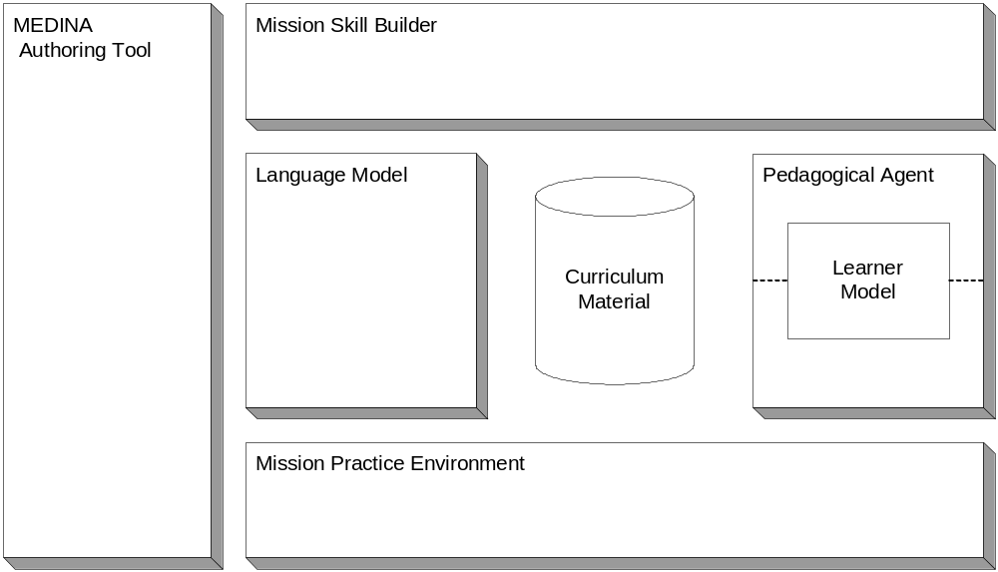
Overall Architecture

Slide 9
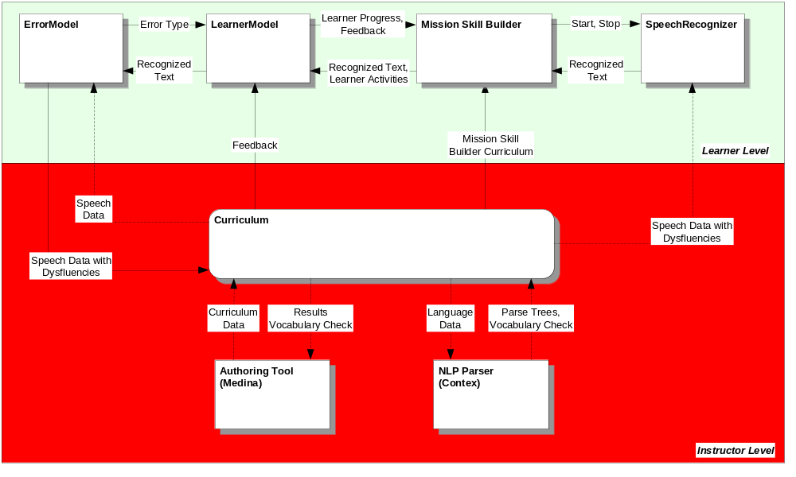
Interaction with Mission Skill Builder

Slide 10
Authoring Issues
Story-oriented authoring poses particular challenges:
  Authoring is a multidisciplinary team activity
    A mixture of top-down and bottom-up design
  Curriculum content is introduced incrementally and opportunistically
  Needed:
    Tools to facilitate incremental construction of materials
    Tools to track curriculum coverage
    Tools to check for validity and completeness
Scene script - HTML
Scene script - XML

Slide 11
Speech Processing
Dual goals of robust recognition and spoken language skill evaluation
Recognition subsystem goals:
  Robustness to non native speech
  Lightweight operation
Pronunciation evaluation system goals:
  Multilevel evaluation ranging from utterance level prosody to segmental cues
  Feedback requirements differ for learner and game AI

Slide 12
Speech Recognition- System Design
HTK based system
  Bootstrapped from modern standard Arabic and adapted to Levantine speech and lexicon
Recognition networks loaded dynamically
  Networks optimized for different stages in schoolhouse and mission training
Mission training mode
  Large vocabulary (LVCSR) like operation
Schoolhouse mode for skill acquisition
  Limited vocabulary with pronunciation variants and hypothesis rejection

Slide 13
Natural Language Processing
Functions of NLP:
  Validate authored learning materials
  Link dialog examples to authored explanations, translations
  Predict & recognize common learner errors

Slide 14
Managing Pedagogical Drama
Want an engaging pedagogical drama
Unfold based on trainee's language & cultural skills
Give trainee a sense of control and responsibility
Provides pedagogically appropriate consequences
Respond robustly to learner communicative actions
Avoid computationally expensive approaches

Slide 15
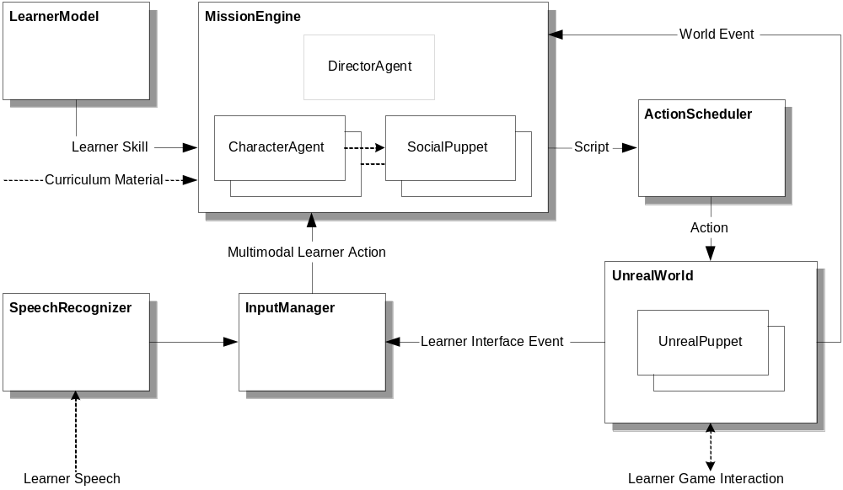
MPE Architecture

Slide 16
Technical Details
Director uses POMDPs to model trainee and characters
  Student model informs trainee capabilities
POMDPs used to predict possible story paths
Fit parameters of character POMDPs to increase likelihood of desirable story path
  Example: Adjust importance of being hospitable
Fitting sensitive to cultural & situational factors
  Example: hospitality for strangers, support for US involvement important goals to adjust

Slide 17
Evaluation Sessions, May 2004
7 learners
6 some prior knowledge of TLTS
All had prior L2 language experience
All experienced gamers
Practice w/ SB ~ 1 hour
MPE session
Post session interview

Slide 18
General comments
TLTS viewed as potentially much better than class instruction
learners readily identify best features (one-on-one, ME), can anticipate benefits
no major interface or navigation concerns
many problems identified are already being solved
  MSB
    speech recognition
    learner feedback
  MPE
    avoidance

Slide 19
Skill Builder Conclusions
Pronunciation accuracy threshold too high for beginners
  Since has been lowered
Tutor feedback sometimes repetitive
  Feedback selection algorithm adjusted
Lack of transfer from MSB to MPE
  New exercises added to MSB to emulate MPE dialog

Slide 20
Practice Environment Conclusions
Learners reluctant to enter MPE
  Learners now explicitly encouraged at multiple points
Learners not sure what to do
  Provide detailed mission briefings
  Aide helps provide guidance

Slide 21
Design for Next Evaluation
~25 subjects, non-Arabic speakers
Four experimental conditions:
  Complete system
  MPE only
  MSB only
  MSB without pronunciation feedback

Slide 22
Backup Slides

Slide 23
Role of Gesture and Culture
Animate gestures in virtual locals:
  To promote learner understanding
  To expose learner to unfamiliar gestures
Allow learner to select gestures:
  To learn appropriate gestures for different social situations
    E.g., to build rapport, manage crowds
Culture training involves:
  Training in face threats, face threat mitigation strategies
  Expectations (etiquette) in different social situations

