Slide 1
Processing the Prosody of Oral Presentations
Rebecca Hincks
KTH, The Royal Institute of Technology
Department of Speech, Music and Hearing
The Unit for Language and Communication

Slide 2
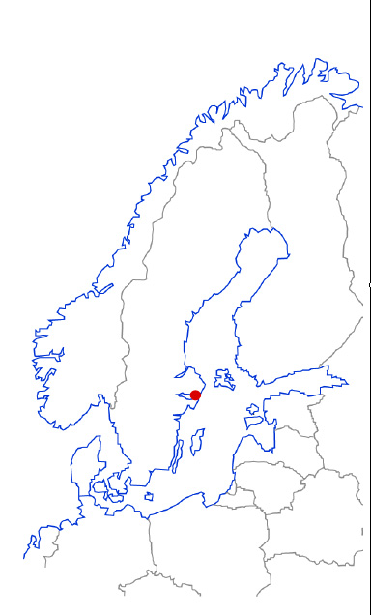
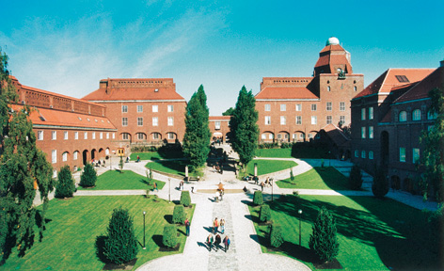
English in Sweden
A second language rather than a foreign language
Nearly all beginners are children
ASR not appropriate or necessary for acquisition of sounds

Slide 3
Support for advanced L2 users?
Vision: Speech checker analogous to a spellchecker or grammar checker
Practice an oral presentation, get feedback on:
  Lexicon
  Pronunciation
  Prosody
Making a presentation can be difficult in a native language, and is even more difficult in an L2
Standard advice for how to deliver a presentation– Use a lively voice, don’t speak too fast, take pauses
These qualities can be processed automatically using speech analysis

Slide 4
What is a lively voice?
A voice that varies in pitch and rhythm
A voice that shows enthusiasm
Difficult for native speakers, but more difficult for non-native speakers
Studies have shown that non-natives use a more narrowed pitch range than natives (Pickering 2004)
Tools for helping speakers increase their liveliness should be welcomed
Research Question: How can we measure liveliness automatically?

Slide 5
Corpus of student speech
Audio recordings of 35 ten-minute presentations in English made by engineering students
Recordings made in the classroom
Selected 10 women and 10 men
  Varied levels of ability in English
  All native speakers of Swedish
Written feedback on the presentations from teachers and classmates
In preparation: listener ratings of liveliness and fluency

Slide 6
Pitch dynamism quotient, PDQ
Standard deviation of F₀ in Hertz
PDQ =
Mean F₀ in Hertz
F₀ = Fundamental frequency = pitch
Necessary to normalize the standard deviation in order to compare voices that are naturally high or naturally low

Slide 7
Time, frequencies and editing
Between 7 and 10 minutes per person
Divided in intervals of (1 min, 30 s, 15 s,) 10 seconds
WaveSurfer’s ESPS settings: 60-400 Hz men, 75-600 Hz women
Have also analyzed at 25-400 Hz men, 25-500 Hz women
Visually inspected every contour and edited away as many errors as possible

Slide 8
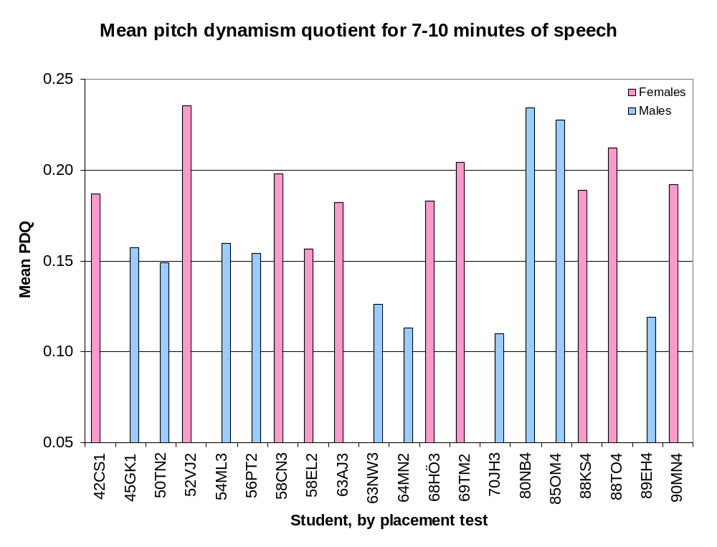

Slide 9
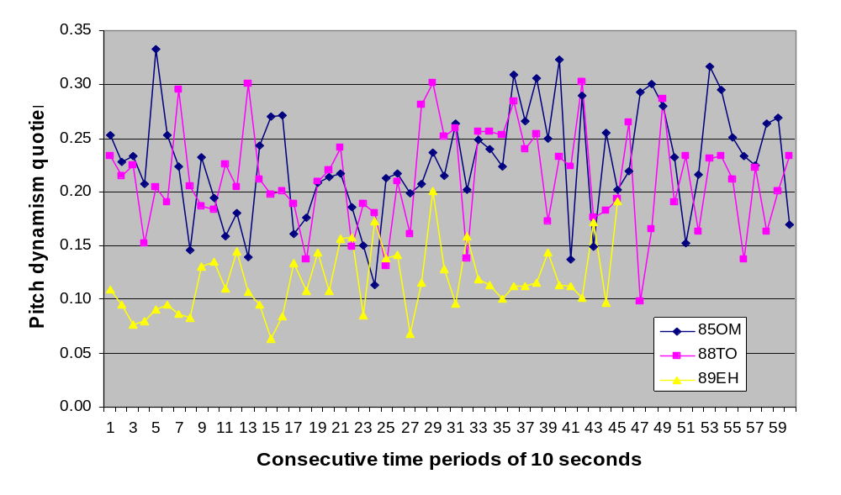
Three proficient speakers

Slide 10
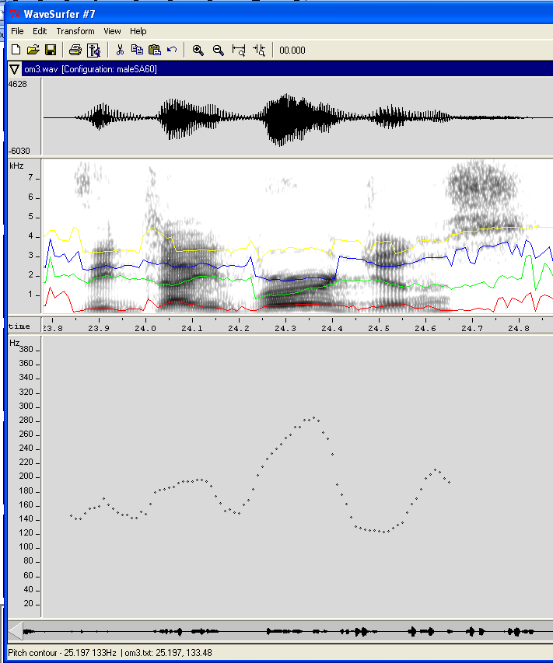
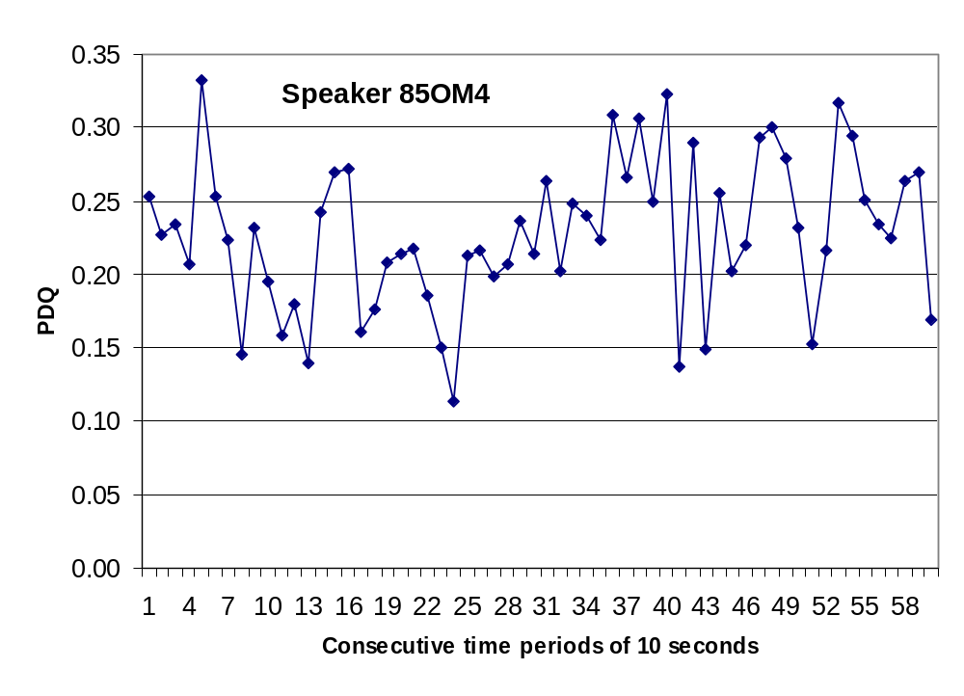

Lively speaker 1
“the divergence”
Mean PDQ: .23
“well-structured,” “confident,” “easy to follow,” “very coherent,” and the speech “well-modulated” and with “varied intonation.”

Slide 11

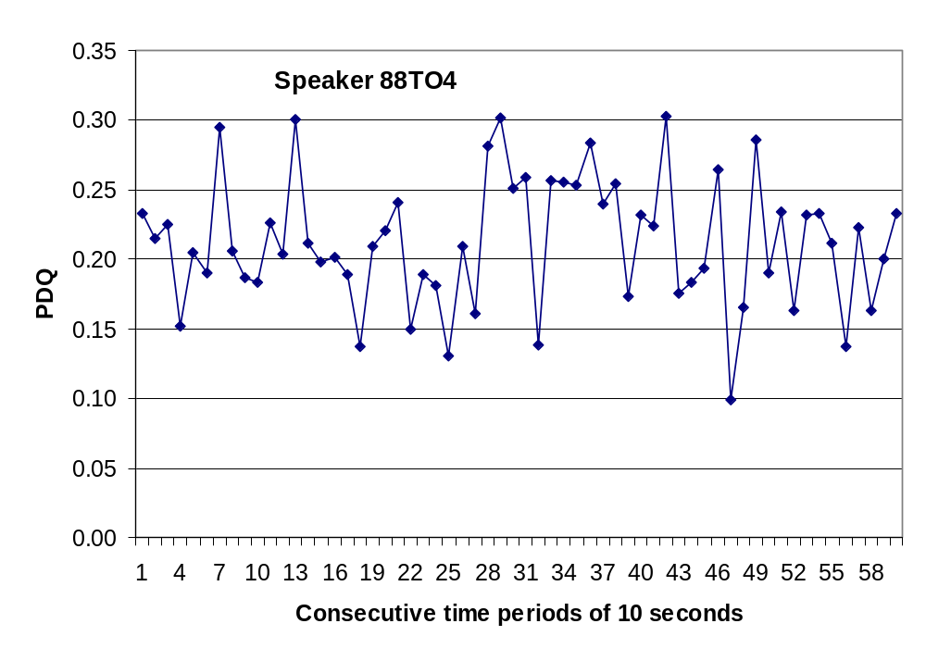
Lively speaker 2
Mean PDQ: .21
Her presentation was “well-rehearsed” and “professional.”

Slide 12
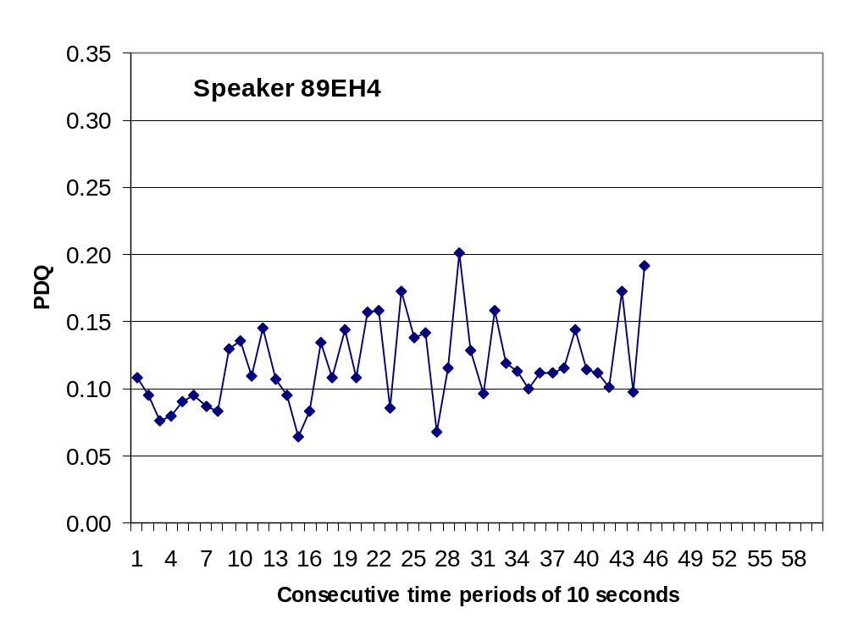
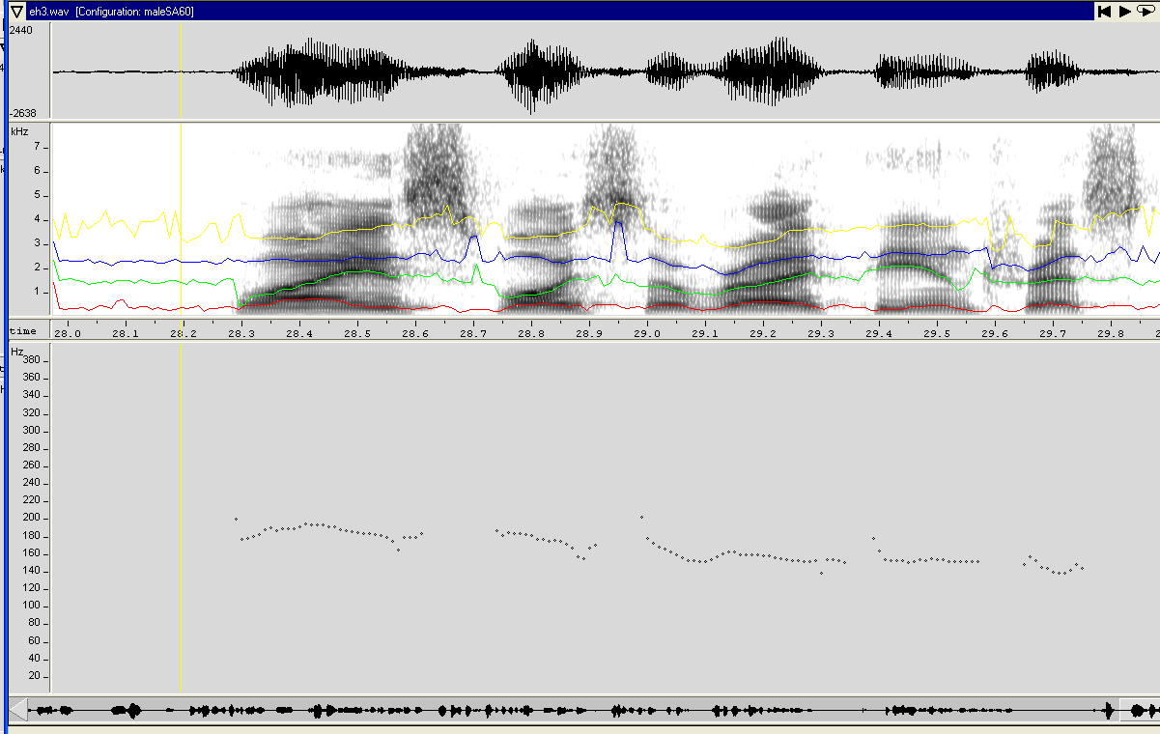
Monotone speaker
Mean PDQ: .12
“why is voice over IP interesting?
Delivery was “a little deadpan,” “more animated facial expressions would be good,” and the presentation would be improved by “showing more enthusiasm.”
Medel PDQ: .12

Slide 13
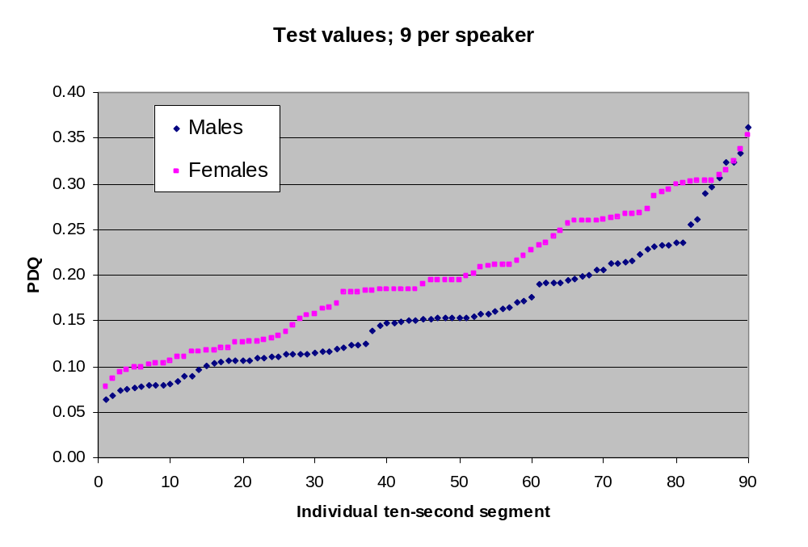
Selection of files for listening test
3 lowest PDQ
3 closest to mean
3 highest

Slide 14
Conclusions
Normalized standard deviation can be used as a measure of liveliness in speaking styles used for oral presentations
Hypothesis: PDQ values over .15 lively, over .30 very lively, between .20 and .25 a good target
  - Different preferences depending on personality and culture?
Unclear effect of Swedish L1 and of proficiency in English
Applications: teaching, presentation skills
Appropriate feedback: not values but a talking head that moves from alert to sleepy

Slide 15
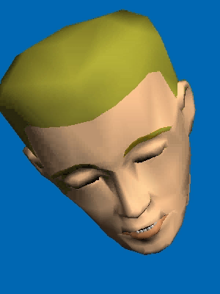
Thank you for your attention…

