Slide 1



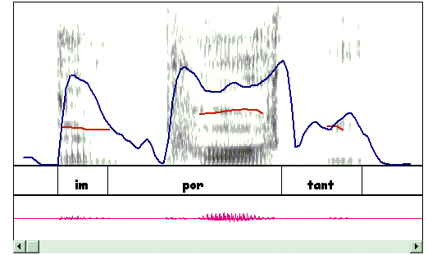

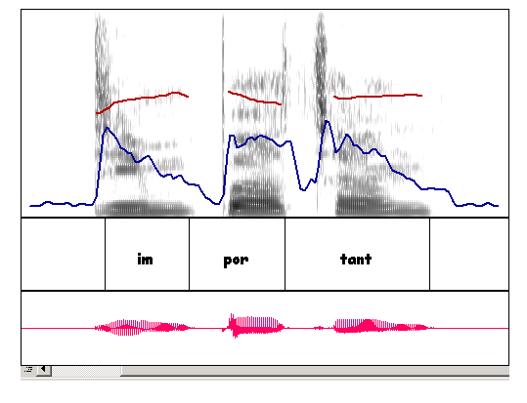


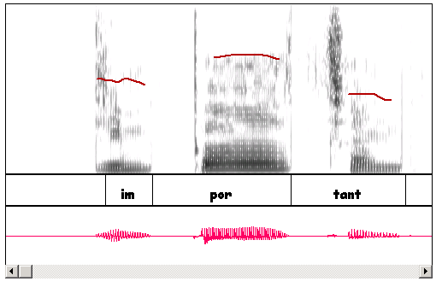
A computer-assisted learning system of English prosody
Anne Bonneau, Matthieu Camus, Yves Laprie, Vincent Colotte
LORIA, CNRS and INRIA, FRANCE
Project
A computer-assisted learning system devoted to the improvement of the perception and production of English prosody by French students
Learning strategy
  . An interactive course of prosody with progressive exercises, exploiting speech tools developed in our team
  . Consistent feedback : the correction is based upon modification of speech signals and is guided by a comparison between L1 and L2 prosody
End users : Teachers (at least during the first steps of learning) and students
Team : Speech specialists and teachers in foreign languages (from universities and colleges) of the Lorraine region
Illustration : Acquisition of English lexical accent
Typology
  French is a syllable-timed language with a fixed accent (on the last syllable of a word or a group of words)
  English is a stress-timed language, with free accents
Acoustical level: large differences between French and English
  French: lengthening of the last syllable of the word
  English: well marked accent:
    stressed syllable longer, more intense and higher
    adjacent syllables undergoes a more or less important degree of reduction
Speech tools
. Speech edition and transformation tools
Functions for editing and modifying speech of WinSnoori : Visualization, edition and transformation of any part of the signal
Modification of F0, intensity and duration (Y.Laprie, V. Colotte)
. Implemented as ActiveX controls, (K. Balci and M. Camus), available from any MS document, so as to design interactive course and compare different signals easily
Pronunciation of the English word "important" by a French learner (12 years old)
Prediction of deviations:
persistence of the French accent : Lengthening of the last syllable
Attenuation of the English accent : Stressed syllable "por" less long, less high, less intense, other syllables not reduced
Realisation : all the predicted deviations are realized
Native speaker
Non-native speaker
.Automatic alignment of phoneme labels with speech signals for non-native speakers (under development)
The automatic alignment for native speakers with HMM models (D. Fohr) will be adapted to non-native speakers from universities and colleges
.Recording of a large corpus of non-native English speakers (as a training corpus) with already1800 sentences in the database
.Aim Segmentation and labelling of the signal from the text
Comparison between the user’s pronunciation and the target
Correction on the non-native speaker production
Modification of F0 contour (second syllable higher, other lower)
Lengthening of the duration of the syllable "por", and shortening of the others -> the learner can appreciate what is expected.
An interactive course of prosody
A set of progressive exercises
Designed by teachers of English as a foreign language
Exploiting our speech tools : including modifications of prosodic cues, filtering of speech signals, and the facilities of SnorriActive X
Aim and content Make learners aware of prosody in general (lexical stress, rhythm and intonation) and French and English prosodies in particular.
A database of sentences uttered by native speakers of English will serve as a support for the lessons and references for the correction of student's productions.
Native speaker
Non-native speaker, after modification
Consistent feedback
Prediction of the most probable deviations and description of their acoustical realizations (guided by a comparison between L1 and L2 prosody)
Detection of the deviations
    Comparison between the production of a learner and a target (a native speaker production)
    Detection of the deviations based upon the theoretical predictions.
Correction : The prosodic cues badly realized are corrected on the user's voice, with speech modification tools
Perspectives
Generation of scripts which allow to copy and modify exercises
Towards automatic detections
Automatic detection of the most important deviations such as F0 curves inversions at the word or IP level
A prosodic model generating the intonation of a simple sentence from a text (with variants), and allowing analysis of spontaneous productions (no reference need)
http://www.loria.fr/~laprie/WinSnoori/index.htm
http://www.loria.fr/equipes/parole/Html/snooriX/index.html

