Slide 1
English Pronunciation Learning System for Japanese Students
Based on Diagnosis of Critical Pronunciation Errors
Yasushi Tsubota, Tatsuya Kawahara, Masatake Dantsuji
Kyoto University, Japan

Slide 2
HUGO
(Pronunciation Learning System)
Goal: Pinpointing the pronunciation errors
which diminish intelligibility and providing effective feedback for improving a student’s pronunciation
Pronunciation practice consists of 2 phases
  Dialogue-based skit (for natural conversation)
  Practice using individual phrases or words
  (for correcting specific errors)

Slide 3
Flow of Pronunciation Learning System
Speech dialogue
（Role-play）
Practice conversation with interesting topics
  Original contents developed at Kyoto University
  Foster ability to explain Japanese history/culture in English to foreign visitors
Speech Recognition Program in background
  Error detection optimized for English pronunciation
  by Japanese students
  Error Profile for the student
Pronunciation
Error Diagnosis
Intelligibility Estimation
  Estimated from the error rates for the different type of errors
Error Priority
  Indicates the student’s performance for a given pronunciation
  Expresses how far behind the students is on one pattern compared to students in the same level
Training on
Specific Errors
Training on Specific Errors
  Practice of individual pronunciation skills
  Error feedback providing both stress and segmental instruction

Slide 4
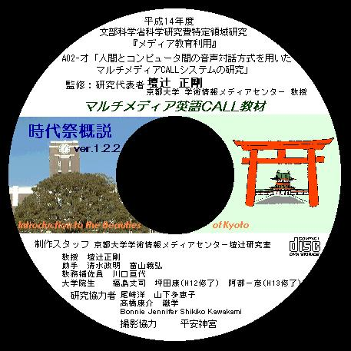
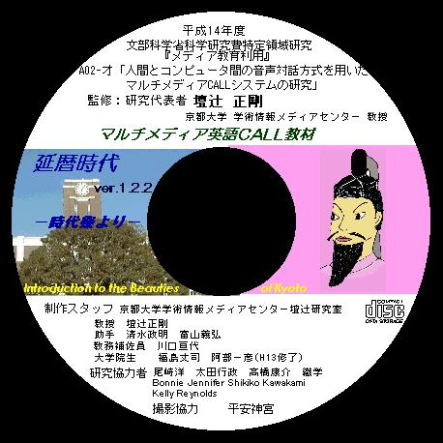
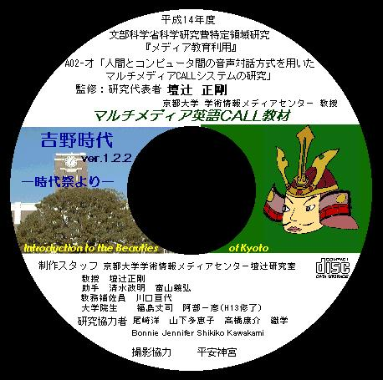
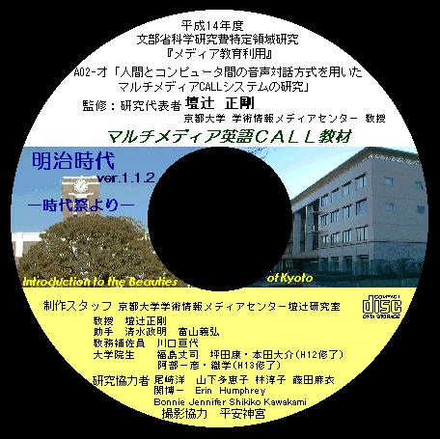
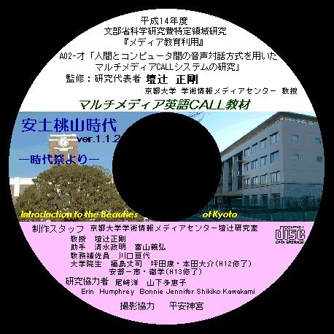
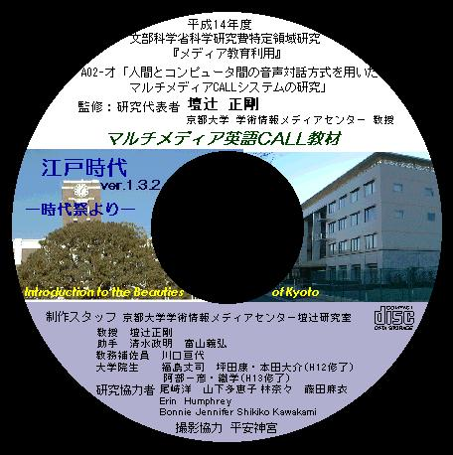
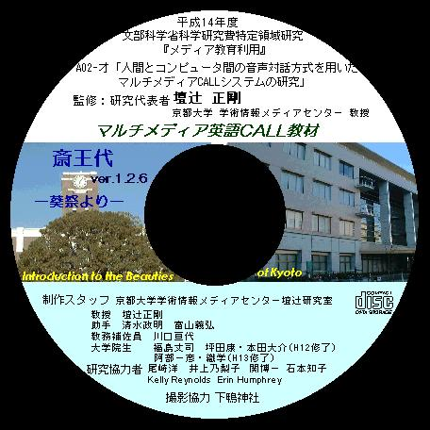
Introduction to the Beauties of Kyoto

Slide 5
Pronunciation Error Prediction
64 rules for pronunciation errors
No equivalent syllable
in L1 language
  e.g. sea → she
No equivalent phoneme
in L1 language
    l vs r, v etc
Vowel insertion
    b-r → b-uh-r
“breath”
Pronunciation
Dictionary
Rules
for error
Pronunciation Error
Prediction
r
th
S
b
eh
E
uh
uh
l
s
Error↑

Slide 6
2. Sentence Stress Error Detection
Two-stage stress error detection
Put it on the desk
CVsC CVx VsC CVs CVsC CVs
Added syllable
By vowel insertion
Pause
H T H M M T
First Stage ST/NS classification
ST
NS
ST
ST
ST
ST
Stress
HMM
NS
ST
NS
NS
NS
NS
NS
NS
Best weight
For ST/NS
Second Stage PS/SS classification
PS
PS
PS
NS
Stress
HMM
NS
NS
SS
SS
SS
NS
Recognition
Result
Best weight
For PS/SS
SS
NS
NS
NS
PS
NS

Slide 7
Pronunciation Errors
W/Y deletion (would)
SH/CH substitution (choose)
R/L substitution (road)
ER/A substitution (paper)
Non-reduction (student)
V/B substitution (problem)
Final vowel insertion (let)
CCV-cluster insertion (active)
VCC-cluster insertion (study)
H/F substitution (fire)
Built from literature in ESL
Errors not accurately detected were removed
Compute error rates of each subject

Slide 8
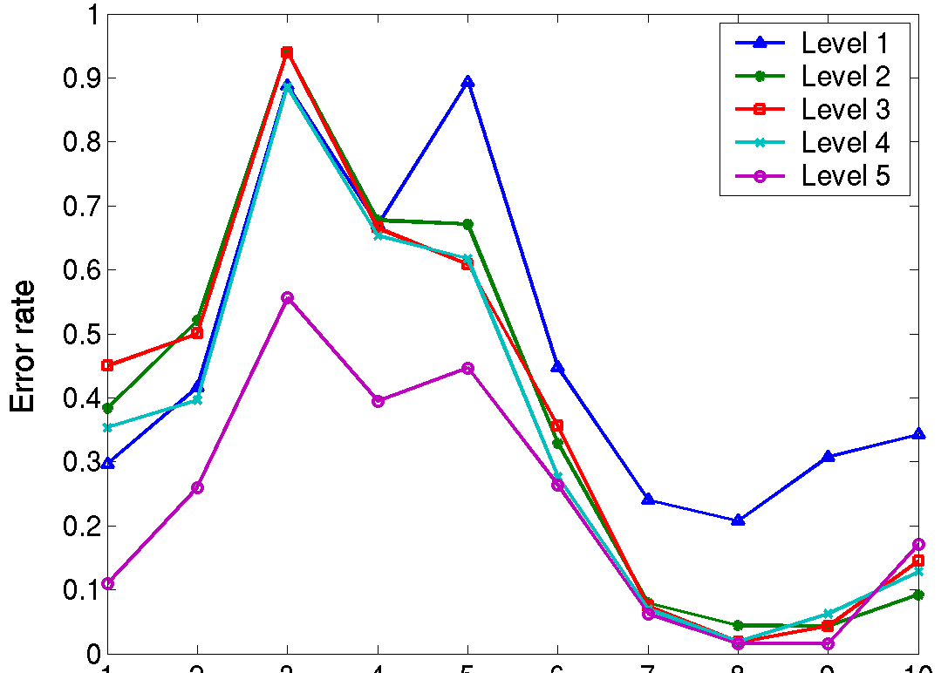
Average Error Rates per Intelligibility Level
WY
SH
ER
RL
VR
VB
FI
CCV
VCC
HF

Slide 9
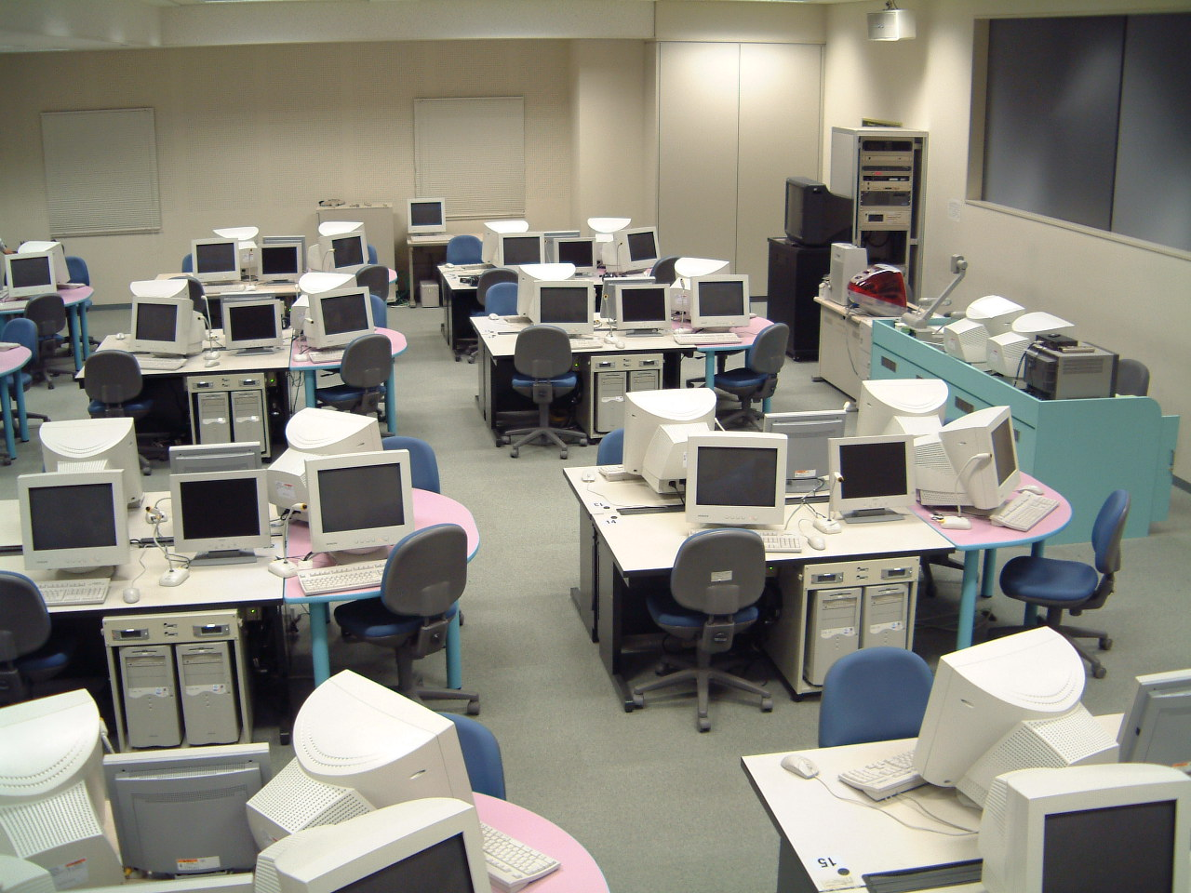
Practice in a university classroom
Implementation
  JAVA for Windows
  HTK
Classroom user
  48 students
  60 min. of pronunciation practice
Machine
  Windows2000
  Pentium4 1.5G
  Memory 512M
CALL room at Kyoto University

Slide 10
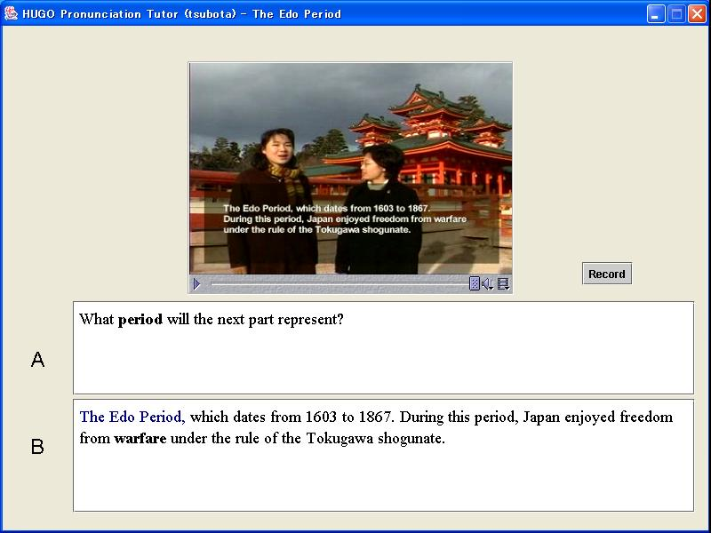
English II Syllabus
Grammar, Vocabulary Building
Pronunciation Learning
Introduction
to Jidai Festival
Introduction
to Jidai Festival
Introduction
to Jidai Festival
Introduction
to Jidai Festival
1st session
1st Semester
5/12
5/19
5/26
6/1
Grammar, Vocabulary Building
Pronunciation Learning
Jidai Festival
-Edo period-
Jidai Festival
-Edo period-
Jidai Festival
-Edo period-
Jidai Festival
-Edo period-
2nd session
1st Semester
6/8
6/15
6/22
6/29
Pronunciation Learning
Pronunciation Learning
Jidai Festival
-Edo period-
Jidai Festival
-Edo period-
16-hours of speech data
in total
2nd Semester
10/27
11/11

Slide 11
Questionnaire
Evaluation by the class
Score | <50 | 51-60 | 61-70 | 71-80 | 81-90 | 91-100
#Students | 2 | 2 | 8 | 11 | 13 | 4
Positive comments
Good practice for pronunciation learning
This practice is effective because Japanese students are not good at pronunciation.
I hope to see further improvement in the performance of this system.
I am for this kind of English learning.
This practice is good for self-study.
Negative comments
Sometimes the diagnosis results were not understandable.
Not enough speech recognition accuracy.
Sometimes it seems to the machine improperly recognized my utterance.
This practice would be better if there were fewer recognition errors.
Satisfied with the concept of the system
But, too many errors in speech recognition

Slide 12
Examples of recorded speech
Good Examples
I’d like to stop now
under
The Edo period
Bad Examples
Yes,that’s right. (noise addition)
Yes,that’s right. (noise addition)
But, do you know what the festival of ages is like ?
(noise addition)
Ah, well, the festival of ages is a series of processions.
(noise addition)
Each representing a different period in Japanese history
and its relation to Kyoto. (noise addition)
which dates from 1603 to 1867,（Speech Error）

Slide 13
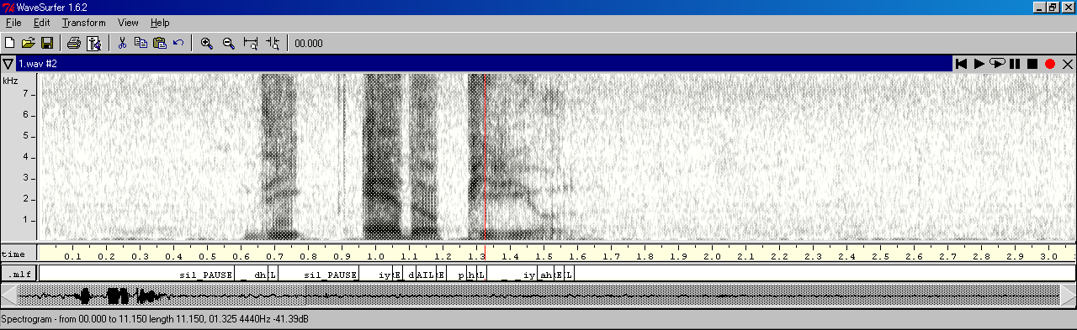
Analysis of logged data
Categorize the causes of misrecognition
  To measure system performance
  If automatically detected, a prompt for re-recording is possible.
Analysis of logged data
  Listen to the logged speech data
  Verify the correctness of speech recognizer’s alignment with spectrogram
  (Wavesurfer)

Slide 14
Analysis of logged data
(1929 utterances)
Cause
Solution
Errors in automatic detection of the end
of a recording session[6.0%,116]
Addition of noise[13.1%,252]
Hesitation[4.2%,81]
Speech errors[1.8%,34]
Misalignment by the speech
recognition system[12.8%,246]
Recognition errors[1.5%,29]
Improper configuration of
recording volume
Directed microphone
did not work well
Instructions on
volume settings
Unfamiliarity with
English sentence
Provide explanation,
prompt for re-recording
Unit of utterance is
too short(Phrase)
Make uttereance longer
e.g. make into a sentence

Slide 15
Analysis of Logged data
 | #Utterance | Error Rate (Recording) | Error Rate (Recognition)
1st trial | 52.1 (Avg.) 1929(Total) | 20.4(Avg.) 755(Total) | 1.24(Avg.) 46（Total）
2nd trial | 111(Avg.) 3982(Total) | 4.9 (Avg.) 176(Total) | 0(Avg.) 0(Total)

Slide 16
Conclusions
Practical Use of Autonomous English Pronunciation Learning System for Japanese Students
  Contents designed to teach students how to explain Japanese tradition and culture
  Phoneme, stress error detection, intelligibility estimation
  Practical use in an English II class ay Kyoto University
Practical use and analysis of logged data
  Satisfied with the concept of the system
  Analysis of improper operation
    Errors in automatic detection of the end of a recording session
    Addition of noise
    Hesitation
    Speech errors
    Misalignment by the speech recognition system
    Recognition errors

