Slide 1
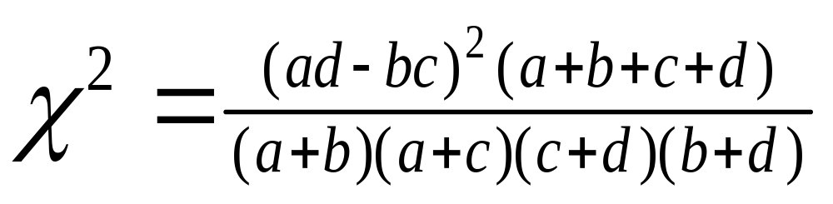
Improving the Help Selection Policy in a
Reading Tutor that Listens
Cecily Heiner, Joseph E. Beck, Jack Mostow
Project LISTEN www.cs.cmu.edu/~listen
Carnegie Mellon University, Pittsburgh, Pennsylvania U.S.A.
Funded by NSF
Overview
Goal: Improve the help selection policy in a Reading Tutor that uses automatic speech recognition (ASR)
Hypothesis: The type of help given for a particular word affects the ASR acceptance at a future encounter of the word.
Data: 189,039 randomized trials
Results: ~ 4% projected improvement in efficacy
Selected Help Types
SayWord plays a recording of the word
  WordInContext plays an extracted recording of the word
  OnsetRime says the first phoneme, and later says the rest of the word
  RhymesWith says “Rhymes with (rhyming word)”
  StartsLike says “starts like (word with the same beginning)”
  Recue reads words in the sentence prior to, but not including, the word
Experimental Design
Student is reading a sentence in the story.
The student clicks for help.
Independent Variable: The Reading Tutor randomly chooses a help type and gives it.
The student continues reading the sentence.
The student reads a new sentence containing the same word.
Outcome variable: ASR acceptance on the student’s first attempt to read the word in the new sentence.
Data Set
  Schools: 9
  Reading Tutors (machines): 200
  Students (ages 6-12): 600
  Hours per student: 8.6
  Word help events: 460,000
  Words read: 5 million
Comparison of Help Types
Picking the Best Help Type
Problem: Efficacy of rare help types is poorly estimated
Solution: Use a confidence measure in addition to efficacy (Chi-Squared)
a= accepted after selected help type
b= rejected after selected help type
c= accepted after all help types
d= rejected after all help types
Type of help | Efficacy ± std. error | χ2
WordInContext | 68.9 ± 0.3% | 73.38
RhymesWith | 69.5 ± 0.4% | 58.43
OnsetRime | 68.3 ± 0.4% | 23.52
SayWord | 66.8 ± 0.2% | 4.85
StartsLike | 67.2 ± 0.4% | 4.08
Overall | 66.4 ± 0.1% | 0.00
Recue | 56.0 ± 0.4% | 709.76
Best Overall
Evaluating the Help Policy
Problem: Evaluate how the help policy will perform with future students
Solution: 20 fold cross-validation
Name | Change
WordInContext (20/20) | + 1.9 %
Best for Word
Best for Student
Comparison of Help Policies
Word Difficulty | Best help type(s) | Change
Grade 1 | OnsetRime (18/20) RhymesWith (2/20) | + 5.0%
Grade 2 | WordInContext (20/20) | + 3.2%
Grade 3 | SayWord (20/20) | + 3.4%
Reading Level | Best help type(s) | Change
Grade 1 | WordInContext (20/20) | + 2.6%
Grade 2 | RhymesWith (20/20) | + 4.8%
Grade 3 | RhymesWith (20/20) | + 5.8%
Grade 4+ | WordInContext (17/18) StartsLike (1/18) | + 0.2%
Name | Change
Best Overall | + 1.9 %
Best for Word | + 3.7 %
Best for Student | + 3.9 %
Best for Student and Word | + 3.1 %
Future Work
Tutor vs. student initiated help
Same vs. later day outcomes
Model multiple help requests
Adapt policy to user
Link to learning gains
Conclusions
To overcome limitations in ASR output, aggregate large quantities of data
Rhyming hints are better for easy words
Whole word hints are better for harder words
Recue is not a useful help type
Measured improvement as an ecologically valid, fine-grained indicator of learning
Notes:
Need new title for Experimental Trial Box.
Is it lying to not use ~ marks?
Should table titles be above?

