Slide 1
Evaluating Summaries with GETARUNS
Rodolfo Delmonte
Ca' Garzoni-Moro, San Marco 3417
Università "Ca Foscari"
30124 - VENEZIA
Tel. 39-41-2349464/52/19
E-mail: delmont@unive.it
Website: http//project.cgm.unive.it

Slide 2
OVERVIEW
NLP AND CALL IN VENICE
TEACHING TEXT UNDERSTANDING
SUMMARIZATION FOR WHOM
WHAT’S A SUMMARY
SHALLOW METHODS
DEEP METHODS
GENRE, DOMAINS, NARRATIONS

Slide 3
NLP activities in Venice
TESTING AND GRAMMAR DRILLS
SENTENCE CREATION
CLOSED Q/A
Text Understanding and Summarization
Notes:
Inserisci qui le note

Slide 7
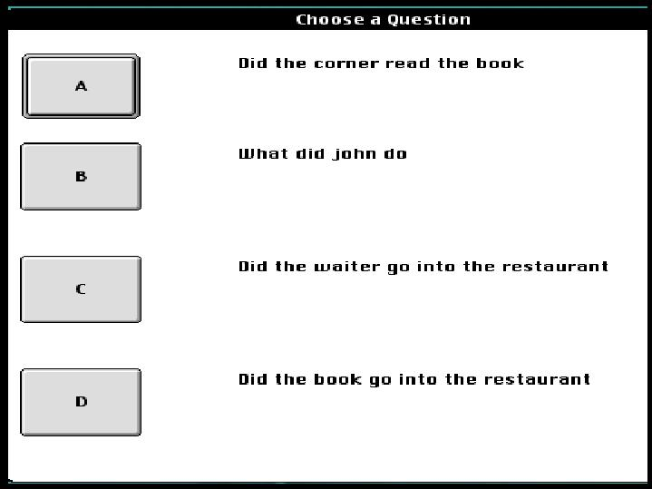
Titolo
dell’Autore
Notes:
Inserisci qui le note

Slide 8
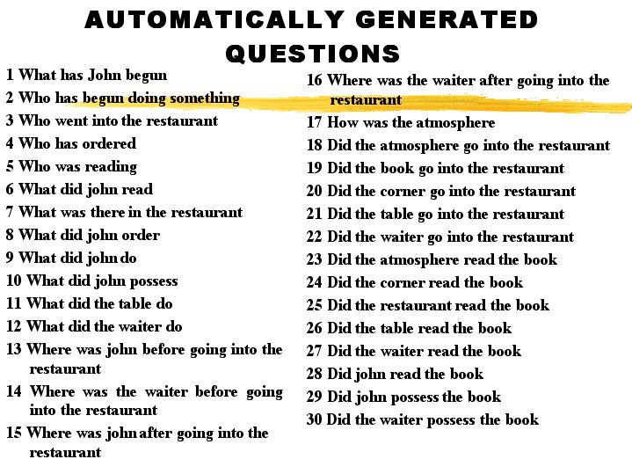
Titolo
dell’Autore
Notes:
Inserisci qui le note

Slide 9
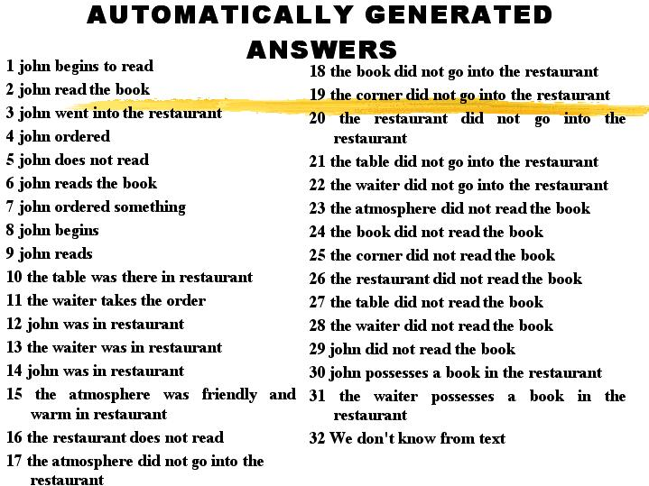
Titolo
dell’Autore
Notes:
Inserisci qui le note

Slide 10
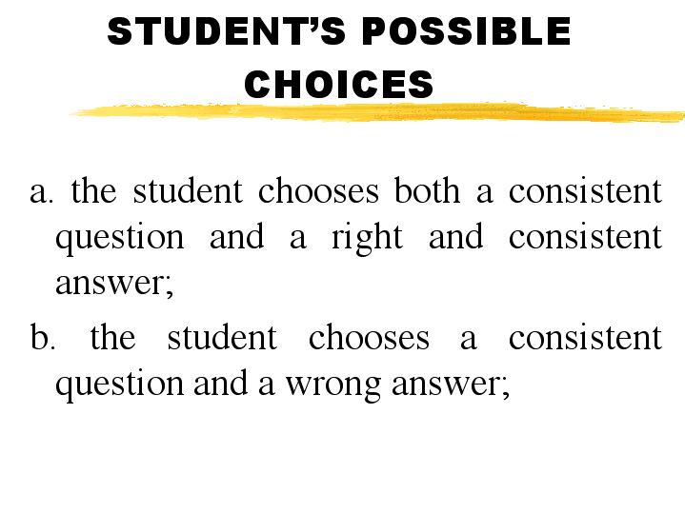
Titolo
dell’Autore
Notes:
Inserisci qui le note

Slide 11
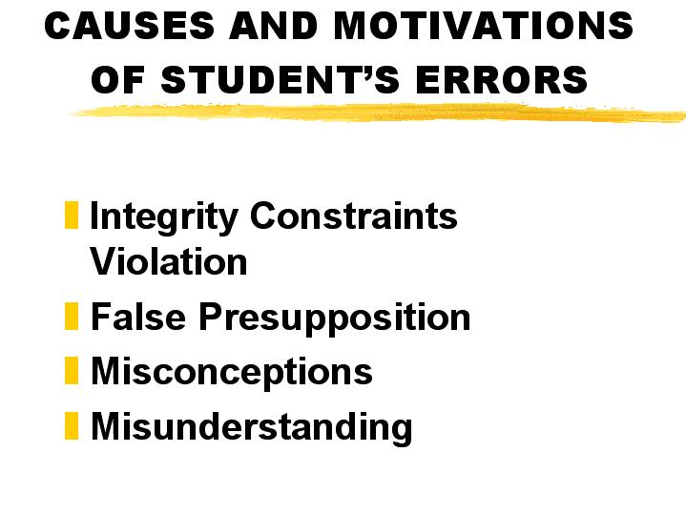
Titolo
dell’Autore
Notes:
Inserisci qui le note

Slide 12
SUMMARY EVALUATION
BUILDING THE PROTOTYPE
NO STUDENT INTERFACE YET
NO EXTENSIVE EVALUATION
CASE STUDY
DIFFERENT TECHNIQUES
C OMPARISON WITH OTHER SYSTEMS

Slide 13
SUMMARIZATION
FOR
SUMMARY CHECKING
IN
ENGLISH AND ITALIAN
Titolo
dell’Autore
NATIVE SPEAKERS
against
NON-NATIVE SPEAKERS
Notes:
Inserisci qui le note

Slide 14
SUMMARIZATION
FOR
SUMMARY CHECKING
IN
ENGLISH AND ITALIAN
Titolo
dell’Autore
Complete System for Stories Understanding and Summarization in Italian for Children
Notes:
Inserisci qui le note

Slide 15
SUMMARIZATION
FOR
SUMMARY CHECKING
IN
ENGLISH AND ITALIAN
Titolo
dell’Autore
Robust Shallow System for Text Understanding and Summarization in English for Italian students of Economics
Notes:
Inserisci qui le note

Slide 16
SUMMARIZATION FOR SUMMARY CHECKING IN ENGLISH FOR ECONOMICS CLASSES
Titolo
dell’Autore
CONTROLLED TEXTS
CONTROLLED LENGTH
PROPORTION OF TEXT 25%
1000 --> 250 (200)
Notes:
Inserisci qui le note

Slide 17
SUMMARIZATION FOR SUMMARY CHECKING IN ENGLISH FOR ECONOMICS CLASSES
Titolo
dell’Autore
STUDENT’s POINT OF VIEW
SYSTEM’s POINT OF VIEW
COMPARISON OF THE STUDENT’s OUTPUT WITH THE SYSTEM’s
Notes:
Inserisci qui le note

Slide 18
WHAT’S A SUMMARY
Student’s pow
Titolo
dell’Autore
A summary text is a derivative of a source text condensed by selection and/or
generalization on important content
Notes:
Inserisci qui le note

Slide 19
WHAT’S A SUMMARY
Student’s pow
Titolo
dell’Autore
EXTRACTION OF MOST RELEVANT PORTION OF TEXT
CONCEPT FUSION
TEXT REDUCTION BY GENERALIZATION & SYNTHESIS
Notes:
Inserisci qui le note

Slide 20
WHAT’S A SUMMARY
System’s pow
Titolo
dell’Autore
A. Interpretation of the source text involving both local sentence analysis and integration of sentence analyses into an overall source meaning representation
B. Generation of the summary by statistically based sentence extraction and subsequent synthesis of the summary text.
Notes:
Inserisci qui le note

Slide 21
SUMMARY CHECKING FOR ECONOMICS STUDENTS:
Using the Discourse Model
Titolo
dell’Autore
RANKING ENTITIES AND THEIR PROPERTIES ACCORDING TO THEIR RELEVANCE IN THE TEXT
STUDENT’S INPUT TEXT IS EVALUATED AGAINST THE SEMANTIC REPRESENTATION OF THE SOURCE TEXT BY MEANS OF ITS SEMANTIC REPRESENTATION
Notes:
Inserisci qui le note

Slide 22
ESSAY RATERS
ESSAY GRADERS INTELLIGENT ESSAY ASSESSORS
Intelligent Essay Assessor or Summary Street
at http://lsa.colorado.edu
E-Rater from the Educational Testing Service
Notes:
Inserisci qui le note

Slide 23
LINGUISTIC COVERAGE… semantic bottleneck
Requirement for efficient, and scalable, technology
Operating from a shallow syntactic base
The fusion process may generate new and unknown lexical items
Processing model which stops short of a fully instantiated semantic representation

Slide 24
LSA SUMMARY STREET
Semantic Similarity
Most frequent content words
Together with notion of surrounding content words
Function words discarded by stoplist
No account for linear order
Discards negation, quantifiers, numbers, modals, adverbs
No notion of grammaticality principles

Slide 25
LSA GUIDELINES
1. Find the most important information that tells what the paragraph or group of paragraphs is about. Write this into a topic sentence.
2. Find 2 - 3 main ideas and important details that support your topic sentence and show how they are related.
3. Combine several main ideas into a single sentence.
4. Substitute a general term for lists of items or events.
5. Do not include trivial information or unimportant details.
6. Do not repeat information.

Slide 26
LSA PROMISES…
Summary Street . . .
will compare your summary to the original text. It
will tell you how well your summary covers the information in the original text.
It will tell you if your summary is too long for a good summary.
It will also give you advice on how to improve your summary.

Slide 27
AN INTENTIONALLY NASTY EXPERIMENT
SUMMARY
The circulatory system's center was the heart that has been a pumping main mechanisms. The heart is round shaped something with a cone top and a flat bottom.
It is held place by few vessels that should carry blood to and from its chamber.
The solid septum so blood can flow forth and back between the right and left halves of the heart. Each half consists of two ventricles and three valves and blood can't flow top to bottom ventricle but only between. Valves help blood from backward flowing in the heart once it has out pumped.

Slide 28
AN INTENTIONALLY NASTY EXPERIMENT
SUMMARY
The heart is a flat pump wall muscle. The veins in turn join with each other to form smaller veins until the blood is finally together into the big veins that drain into the Hart.
Blood vessels carry blood in a circle. The systemic loop when blood from liver enters upper left lung of heart to the left atrium. All of the blood is composed into the three biggest veins: the inferior vena cava that obtains upper body blood and superior vena cava that obtains lower body blood. The fresh oxygen-rich blood returns to the left lung of the heart through the pulmonary veins. Scientists estimated it takes 300 seconds for blood to complete the cycle.

Slide 29
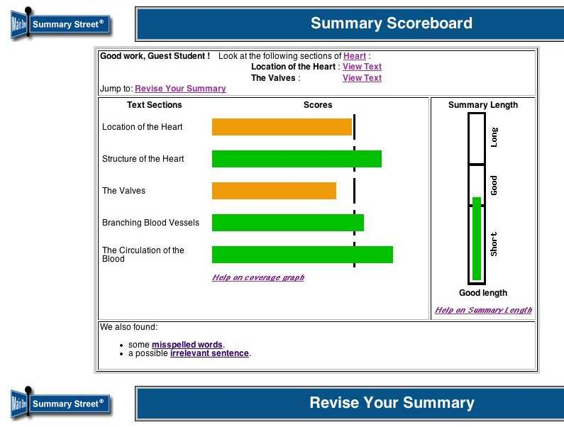

Slide 30
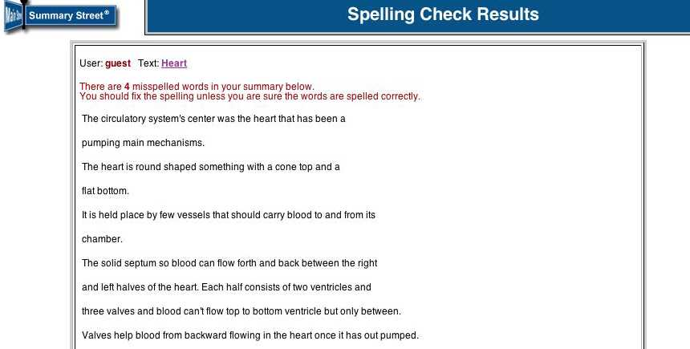

Slide 31
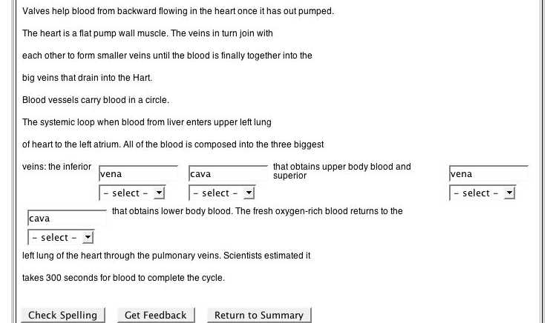

Slide 32
GETARUNS’ ARCHITECTURE
STATISTICAL/
SYNTACTIC
DISAMBIGUATION
TOKENIZER
POLYWORD/
MULTIWORD
MORPHOLOGICAL
ANALYSIS &
LEMMATIZATION
SHALLOW
PARSING
MORPHOLEXICAL
GUESSER
SYNTACTIC
TAGGING
SUMMARIZE
VIA
SENTENCE
EXTRACTION
LINGUISTIC KNOWLEDGE DATABASES,
RULES AND LEXICONS

Slide 33
DEEP PROCESSING IS REQUIRED for...
Building a Discourse Model
Anaphora Resolution
Create Knowledge Databases to allow for Queries about entities, their properties and the relations intervening between them on the basis
of Discourse Model and Discourse Structures automatically extracted from the text

Slide 34
SHALLOW & COMPLETE
Complete Parsing & Semantics
Deep Anaphora Resolution
Complete
Partial
Shallow
Chunks
Shallow & Partial
Parsing... Semantics...
Anaphora Resolution
Shallow Parsing… No Semantics at Propositional Level… Shallow Anaphora Resolution

Slide 36
Complete System pipeline
2 LEVELS
Level One takes care of the Sentential Level Analysis in broad terms
• Produces a complete parse of the sentence
Level 2 works at Discourse Level
• Produces a complete semantic interpretation

Slide 37
Complete System pipeline LOW LEVEL
Produces a complete parse of the sentence or drops those parts that it cannot parse: however the rest is fully consistent and interpretable (it can be a fragment)• Does anaphora resolution at sentence level and binds all syntactic and functional control relations, i.e. relative and interrogative clauses, infinitives and participials etc.

Slide 39
Complete System pipeline
High Level
Takes care of Topic Hierarchy and Anaphora Resolution • Computes temporal reasoning at clause level from temporal information and adjuncts.• Does semantic mapping and takes care of rhetorical structure information, builds the complete semantic interpretation and the Discourse Model. In a final process, Discourse Structure is built.

Slide 42
SYSTEM ARCHITECTURE
TWO
Topic
RESOLUTION
Hierarchy
ENGINES
Stack
1st
Pronominal
by Centering
2nd
Nominal
No Logical
Form ??
Partial Semantic
Interpretation
Creation of New Entities
With their Properties
Discourse
Model
Update
Entities and
Properties
?? Relations
No Temporal
Reasoning

Slide 43
From Shallow to Deep The Summary Produced Changes Focus
Chunk-based Summary focuses on political parties and the report
Partial System Summary focuses on the Survey which is understood as the report
Complete System Summary focuses on the Survey and its authors

Slide 44
A short text from The Guardian
Thursday, 25th June 2001
National Parties and the Internet
by Joanna Crawford
A survey of how national parties used the internet as a campaigning tool during the election will brand their efforts "bleak and dispiriting" - despite the pre-campaign hype of an "e-election".
Researchers from Salford University studied websites from all the major parties during the general election, as well as looking at every site put up by local candidates.
Their conclusions - to be presented tomorrow at a special conference organised by the Institute for Public Policy Research - could influence how future political contests, including the forthcoming Euro debate, are carried out on the web.
The report finds that none of the major three parties allowed message boards or chat rooms for users to post their opinions on the sites. It states: "Parties were accused of simply engaging in online propaganda with boring content and largely ignoring interactivity."

Slide 45
A short text from The Guardian
The report concludes: "The new media is a way for them to get closer to the public without necessarily allowing the public to become overly familiar in return.
The authors - Rachel Gibson and Stephen Ward - go on to state that this may be because parties still regard the web as an electioneering tool, rather than as a democratic device.
They said: "Very few offered original material, or changed their sites noticeably over the course of the campaign. Indeed, a large majority of local sites were really no more than static electronic brochures."
They dub this "rather disappointing", but praise the Liberal Democrats as "clearly the most active" with around 150 sites.
The report concludes: "Parties, as with the general public, need incentives to use the technology. As yet, there seems more to lose and less to gain if they make mistakes experimenting with the technology."

Slide 46
Pronominal Expressions
2-their
4-their
5-none, 5-their
6-it
7-them
8-this
9-they, 9-their
10-majority
11-they, 11-this
13-they

Slide 47
A short text from The Guardian
Thursday, 25th June 2001
National Parties and the Internet
by Joanna Crawford
A survey of how national parties used the internet as a campaigning tool during the election will brand their efforts "bleak and dispiriting" - despite the pre-campaign hype of an "e-election".
Researchers from Salford University studied websites from all the major parties during the general election, as well as looking at every site put up by local candidates.
Their conclusions - to be presented tomorrow at a special conference organised by the Institute for Public Policy Research - could influence how future political contests, including the forthcoming Euro debate, are carried out on the web.
The report finds that none of the major three parties allowed message boards or chat rooms for users to post their opinions on the sites. It states: "Parties were accused of simply engaging in online propaganda with boring content and largely ignoring interactivity."

Slide 48
A short text from The Guardian
The report concludes: "The new media is a way for them to get closer to the public without necessarily allowing the public to become overly familiar in return.
The authors - Rachel Gibson and Stephen Ward - go on to state that this may be because parties still regard the web as an electioneering tool, rather than as a democratic device.
They said: "Very few offered original material, or changed their sites noticeably over the course of the campaign. Indeed, a large majority of local sites were really no more than static electronic brochures."
They dub this "rather disappointing", but praise the Liberal Democrats as "clearly the most active" with around 150 sites.
The report concludes: "Parties, as with the general public, need incentives to use the technology. As yet, there seems more to lose and less to gain if they make mistakes experimenting with the technology."

Slide 49
SEMANTIC INFERENTIAL NETS
internet
tool
website
site
web
interactivity
sites
media
device
material
brochures
technology

Slide 50
CHUNKS-BASED SUMMARY
Thursday , 25/th June 2001 National_Parties and the Internet by Joanna_Crawford .
It states ':' " Parties were accused of simply engaging in online propaganda with boring content and largely ignoring interactivity .
The report concludes ':' " the new media is a way for them to get_closer to the public without necessarily allowing the public to become overly familiar in return .
The authors - Rachel_Gibson and Stephen_Ward - go_on to state that this may be because parties still regard the web as an electioneering tool , rather_than as a democratic device .
The report concludes ':' " Parties , as_with the general public , need incentives to use the technology .

Slide 51
PARTIAL-SEMANTICS SUMMARY
Thursday , 25/th June 2001 National_Parties and the Internet by Joanna_Crawford .
A survey of how national parties used the internet as a campaigning tool during the election will brand their efforts " bleak and dispiriting - despite the pre-campaign hype of an " e-election .
The report finds that none of the major three parties allowed message_boards or chat_rooms for users to post their opinions on the sites .
It states ':' " Parties were accused of simply engaging in online propaganda with boring content and largely ignoring interactivity .
The report concludes ':' " the new media is a way for them to get_closer to the public without necessarily allowing the public to become overly familiar in return .

Slide 52
COMPLETE-SEMANTICS
SUMMARY
Thursday , 25/th June 2001 National_Parties and the Internet by Joanna_Crawford .
A survey of how national parties used the internet as a campaigning tool during the election will brand their efforts " bleak and dispiriting - despite the pre-campaign hype of an " e-election .
Researchers from Salford_University studied websites from all the major parties during the general_election , as_well_as looking_at every site put_up by local candidates .
Their conclusions - to be presented tomorrow at a special conference organised by the Institute for public Policy Research - could influence how future political contests , including the forthcoming Euro debate , are carried_out on the web .

Slide 53
STATE OF THE ART: DUC
DUC: Document Understanding Conference / Competition,1000000 words - 60 clusters
Task 2002: Short Extract (50 words); Middle Extract (100 words); Long Extract (200 words)
Task 2003: Short Title (5 words); Short Subtitle (10 words); Very Short Extract (50 words)

Slide 54
Summarizing Narrative Texts
A plot
Narrative Sequence of Events
Changes of the World affecting Participants
Identifying the right participant
Identifying the spatiotemporal location
Identifying what happens to whom

Slide 55
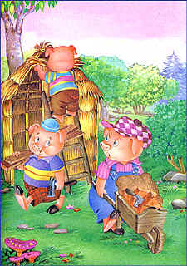
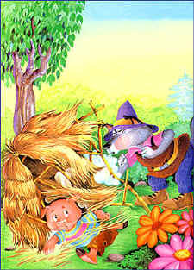
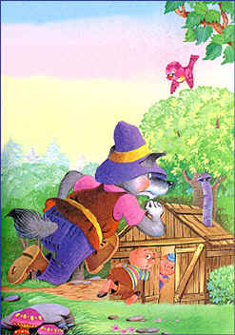
The Story of Three Little Pigs
Once upon a time there were three little pigs who lived happily in the countryside. But in the same place lived a wicked wolf who fed precisely on plump
and tender pigs. The little pigs therefore decided to build a small house each, to protect themselves from the wolf. The oldest one, Jimmy who was wise,
worked hard and built his house with solid bricks and cement. The other two, Timmy and Tommy, who were lazy settled the matter hastily and built their
houses with straw and pieces of wood. The lazy pigs spent their days playing and singing a song that said, "Who is afraid of the big bad wolf?" And one
day, lo and behold, the wolf appeared suddenly behind their backs. "Help! Help!", shouted the pigs and started running as fast as they could to escape
the terrible wolf. He was already licking his lips thinking of such an inviting and tasty meal. The little pigs eventually managed to reach their small house
and shut themselves in, barring the door.

Slide 56
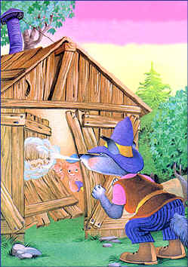
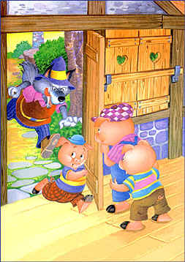
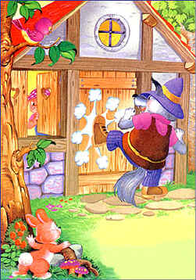
The Story continued
He began to observe the house very carefully and noticed it was not very solid. He huffed and puffed a couple of times and the house fell down completely.
Frightened out of their wits,the two little pigs ran at breakneck speed towards their brother's house. "Fast, brother, open the door! The wolf is chasing us!"
They got in just in time and pulled the bolt. Within seconds the wolf was arriving, determined not to give up his meal. Convinced that he could also blow the
little brick house down, he filled his lungs with air and huffed and puffed a few times. There was nothing he could do.

Slide 57
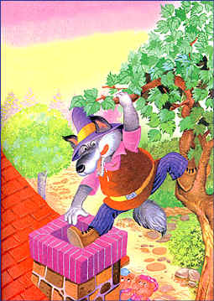
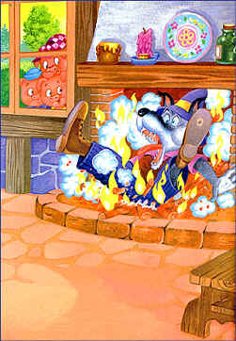
The Story continued

Slide 58
EVALUATION OF SYSTEM COMPONENTS
Parser of Complete System evaluated with GREVAL - task on Grammatical Relations, 10000 words/500 sentences - reached 90% F-measure on most important GRs
Anaphora Resolution Algorithm of Partial System evaluated with a task based on Computer User Manual and Maintainance Manuals (Wolverhampton’s Corpus) - 30000 words - reached 74% F-measure
Summarization task based on DUC corpus - Rachele De Nicola, unpublished dissertation Ca’ Foscari University - 65% acceptable summaries, results compared with judges summaries

Slide 59
Evaluating summaries: what can be evaluated? And how?
Aims and Goals
Simulate as much as possible human assessing abilities
Concentrate more on content (understanting) rather than on form (grammar)
Measure student’s ability at lexical and overall text understanding level
Measure student’s ability at text reduction and cohesion-coherence

Slide 60
Evaluating summaries: what can be evaluated? And how?
From the Discourse Model
Choice of Most Important Topic (entities)
Choice of Most Relevant Facts (events, attributes and properties)
Appropriateness of Semantic Identity
Respected Sequence of Events
Respected Causality Links if any

Slide 61
Evaluating summaries: what can be evaluated? And how?
From the Summarized Text
Overall Intrinsic Coherence
Total Number of Words used and Sentences produced (measured according to suggested proportion)
Ability to reuse concepts of original text in new text (number, and their context)
Ability to express concepts of original text with new linguistic expressions
Ability to fuse concepts belonging to more sentences in original text, in one single sentence in new text

Slide 62
Evaluating summaries: what can be evaluated? And how?
From the Summarized Text
Overall Intrinsic Cohesion
Sentence Level structural appropriateness
Stylistic issues related to sentence typologies
Compare Nested Clauses on the basis of Discourse Structure Representation

Slide 63
CONCLUSIONS & FUTURE WORK
DIFFERENT STRATEGIES FOR DIFFERENT PURPOSES
DIFFERENT ARCHITECTURES FOR EACH TASK
SHALLOW FOR 2nd LANGUAGE
COMPLETE FOR NATIVE SPEAKERS
JUST SIMULATED BEHAVIOUR

Slide 64
CONCLUSIONS & FUTURE WORK
DIFFICULTIES IN CHECKING FOR COHERENCE AND COHESIVENESS
BUILD THE STUDENT INTERFACE
TESTING THE SYSTEM
HOW TO EVALUATE STUDENT’S PERFORMANCE
SCORING SUMMARIES

Slide 65
Thank you

