Slide 1

Text generators, error analysis and feedback
Juan Rafael Zamorano Mansilla
Universität Bremen

Slide 2
Introduction
Part of a three-year project: “Exploration of the applications of text generators in language learning”
Generator used: KPML (Komet Penman Multilingual), University of Bremen. http://www.fb10.uni-bremen.de/anglistik/langpro/kpml/README.html
Project outcome: the Exercise Manager, a tool for the automatic generation of language exercises

Slide 3
Purpose of the talk
Description of how the grammatical resources contained in KPML can be used for error analysis and the results they provide

Slide 4
Information about the results obtained to present
Restricted to fill-in-the-blank exercises
Exercises from English and Spanish coursebooks
Initial tests, no real learners or teachers involved (tests with learners planned for winter semester 2004-05)

Slide 5
Overview of KPML
Systemic-functional grammar: network of meaningful choices connected to realizations (Fig. 1)

Slide 6
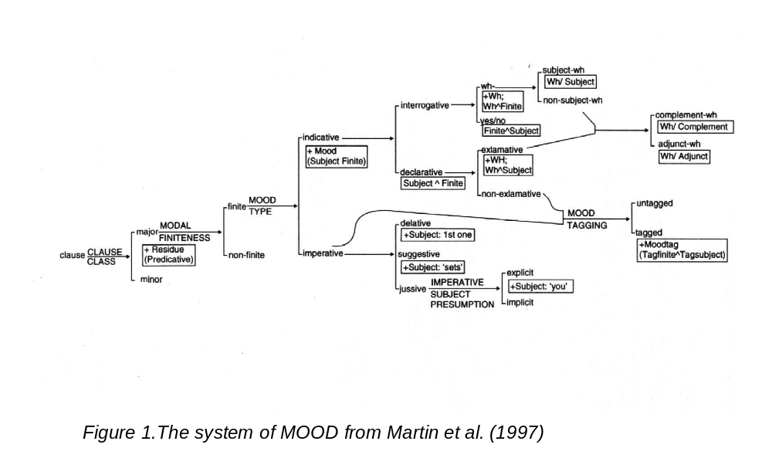

Slide 7
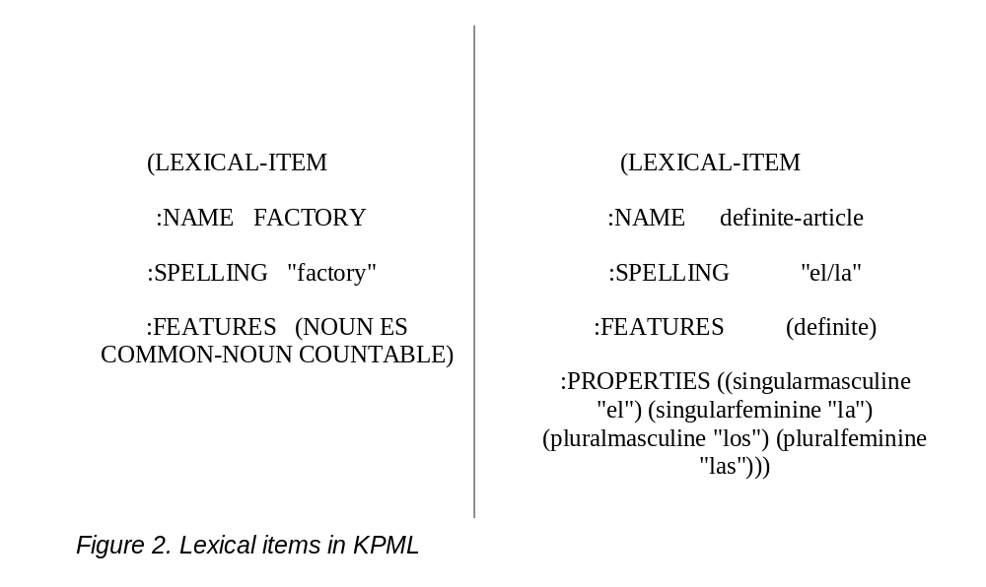
Overview of KPML
Storage of lexical items (Fig. 2)

Slide 8
The algorithm for the detection of errors.
General working principles
It tries to determine the grammatical features that differentiate the right answer from the user’s input
The result is a pair of grammatical features in meaningful opposition. One corresponds to the right answer, the other to the user’s input

Slide 9
The algorithm for the detection of errors.
Example
He got married ___ 1985
Collection of features for in 1985:
(groups-phrases prepositional-phrase nonwh-phrase prepositional-phrase-simplex minirange-thing spatio-temporal-process location-process temporal-process unordered strong-inclusive)

Slide 10
Example
User’s input: on
Who can lexify on: weak-inclusion, on
Show path to...
  Weak-inclusion (temporal-process location-process prepositional-phrase groups-phrases spatio-temporal-process unordered weak-inclusion) 5 features in common
  On (spatial-process rest-process nonorientation-axis prepositional-phrase groups-phrases spatio-temporal-process location-process one-two-dimensions) 4 features in common

Slide 11
Example
Divergent features in meaningful opposition:
  ON: (temporal-process location-process prepositional-phrase groups-phrases spatio-temporal-process unordered weak-inclusion)
  IN: (groups-phrases prepositional-phrase nonwh-phrase prepositional-phrase-simplex minirange-thing spatio-temporal-process location-process temporal-process unordered strong-inclusive)
  Fig. 5

Slide 12
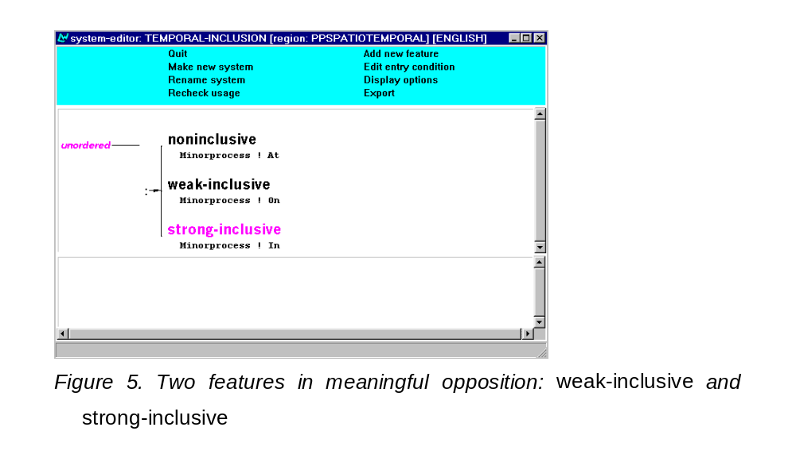

Slide 13
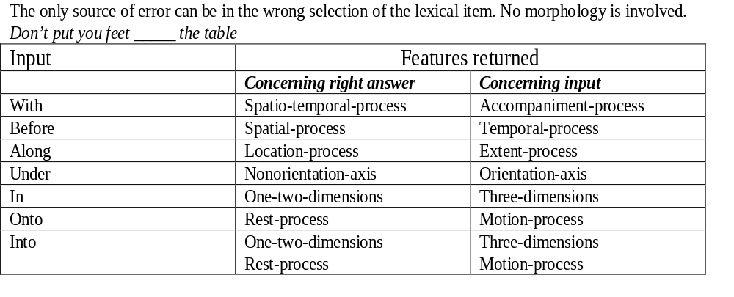
Examples of diagnosis
EXERCISES BASED ON LEXICAL CHOICE

Slide 14
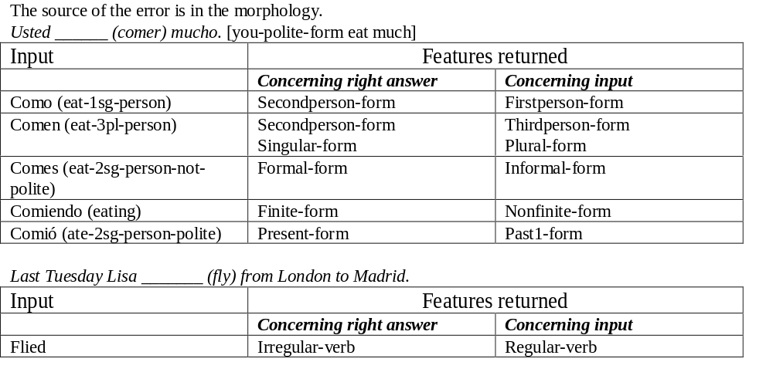
Examples of diagnosis
EXERCISES BASED ON INFLEXION

Slide 15
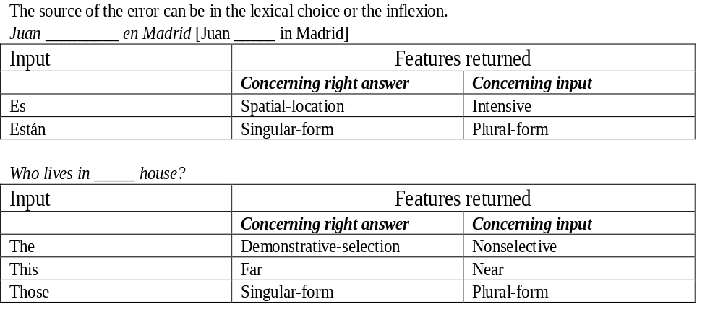
Examples of diagnosis
EXERCISES BASED ON LEXICAL CHOICE AND INFLEXION

Slide 16
Examples of feedback from the features obtained
Negative: “The preposition you need does not express motion”
Positive: “The preposition you need is used with three dimensional objects”
Contrastive: “You used the third person of the verb, but the context requires the second person”

Slide 17
Conclusions and future work
Adequacy of systemic-functional generators for error diagnosis
Possibility of covering a wide range of errors with a single algorithm - no need to write lists of anticipated errors
Future work:
  extend analysis to complete sentences
  detect errors that are not grammar-based
  detect errors resulting from transfer

