Slide 1

Artificial Companions
(and CALL?)
Yorick Wilks
Computer Science, University of Sheffield
and
Oxford Internet Institute, Balliol College
InSTILL/ICALL2004, Venezia, June 2004

Slide 2
Plan of the talk:
Old problems about CALL (grammar)
Remaining problems about CALL (dialogue)
Remaining problems about AI/Knowledge
Reasons for optimism with practically motivated dialogue systems
A note on a Language Companion

Slide 3
Why CALL found it hard to progress beyond very controlled slot filling exercises (with nice multimedia).
Parsers never worked till recently, and now only statistically implemented ones do (Charniak about
85% and those are partial S parses).
Exception: Seneff’s combination of parser and corpus examples at MIT based on intensive experience in a micro-domain (weather and flights).
Is this the way forward? (if so hard work ahead!!!)

Slide 4
Attempts to use serious grammar in CALL are unlikely to succeed:
Grammars with fancy initials don’t have evaluated parsing track records
Even 85% success means three in 20 student corrections are wrong over free student input
Local consistency checks don’t propagate to S level in many systems

Slide 5
Menzel’s example:
(1) *Der Goetter zuernen
Der Goetter is genitive ------should be
Die Goetter (nominative) but this cannot be seen when propagated up in a constraint system.
Cf. Klenner’s (der1 [case,gen.num][nom,mas, sg]) in
(2) Das Licht der Sonne (=fem and gen)
(3) Das Licht des Mondes (=mas and gen)
Where in his paper (2) will be deemed an error (for “die”) and no propagation will take place because locally the (genitive) case cannot be seen, but simple gender errors will be deemed genitives as in (1)

Slide 6
Are we sure how much grammar we want to teach (at least in English)?
What happened to communicative skills?
Authors at this meeting make every kind of error we are discussing WITHOUT IT MATTERING IN THE LEAST!!
Faux amis--->
“Obviously, these heuristics are partly contradictory and the outcome crucially depends on which one is taking preference”
(= precdence )

Slide 7
Even well-know news papers (in English) make grammar errors without impeding communication:
What this situation requires is that someone is prepared to look at the broader picture and to act in the belief that although this week’s disgraceful scenes are not football’s fault, even if football, in a gesture of supreme self-sacrifice, should begin corrective action.
Which is ill-formed because the “although” and “even if” clauses are not closed/balanced; but did that impede your understanding (not much?!)

Slide 8
Grammar and Communication
The machine parsable is often incomprehensible
Remember Winograd’s famous sentence:

Slide 9
Does the little block that the hatched pyramid’s support supports support anything black?

Slide 10
Remember, too, the old CL issue of correctness vs. resources and the center-embedding rule.
S --> a (S) b
Has always been deemed to be a correct rule of English grammar but known to be subject to resource/processing constraints.
Many believed such sentences did not occur naturally for more than a single iteration of S:

Slide 11
As in:
“Isnt it true that the cat the dog the rat bit caught died?”
Which no one can understand.
Isn't it true that P
P = [the cat (that X) died]
X = [the dog (that Y ) caught]
Y = [the rat bit]

Slide 12
Which is formally identical to:
« Isn’t it more likely that example sentences that people that you know produce are more likely to be accepted »
Isn't it true that P
P = [example sentences X are more likely to be accepted]
X = [that people Y produce]
Y = [that you know]
De Roeck, A.N., R.L. Johnson, M. King, M. Rosner, G. Sampson and N.Varile, "A Myth about Centre-Embedding", in Lingua, Vol 58., 1982

Slide 13
Which suggests that many ordinary sentences cannot be understood on the basis of parsing:
« Isn’t it more likely that example sentences that people that you know produce are more likely to be accepted »
So is it semantics or world knowledge that allows their understanding?

Slide 14
“mal rules” and semantics:
Dog cat chases
My micro experiment in Venice (3 non-native non-linguist informants) suggests this is understood as:
The dog chases the cat
But yesterday “Dog the cat chases”
Was “corrected” to “The/a dog the cat chases”
On the assumption it meant:
“The cat chases the dog”
My world knowledge goes the other way---don’t we need experiments on what non-native speakers take things to mean or how can an interlingual meaning extractor work on ill-formed text?

Slide 15
If you doubt me try interpreting:
Cow the grass eats
Same mal-rule should correct this to:
The cow the grass eats
Taken as meaning
The grass eats the cow!!!!!
The mal-rule is NOT semantics based correction but syntax, and maybe the wrong syntax?

Slide 16
Problems about knowledge bases
A paper in this meeting relies on knowing that:
Dogs in gardens
and not
Gardens in dogs
You wont get that from a knowledge base any time soon (remember Bar Hillel and MT!)
Only corpus methods could help with this, but the processing overheads are huge.

Slide 17
What the rest of the talk contains:
Two natural language technologies I work within:
  Information extraction from the web
  Human dialogue modelling, based on Information Extraction of content and Machine learning
Dialogue systems embodied in Conversational agents as essential for
  personalizing the web
  making it tractable
  Companions for the non-technical as a cosier kind of agent
  Perhaps as language teaching agents

Slide 18
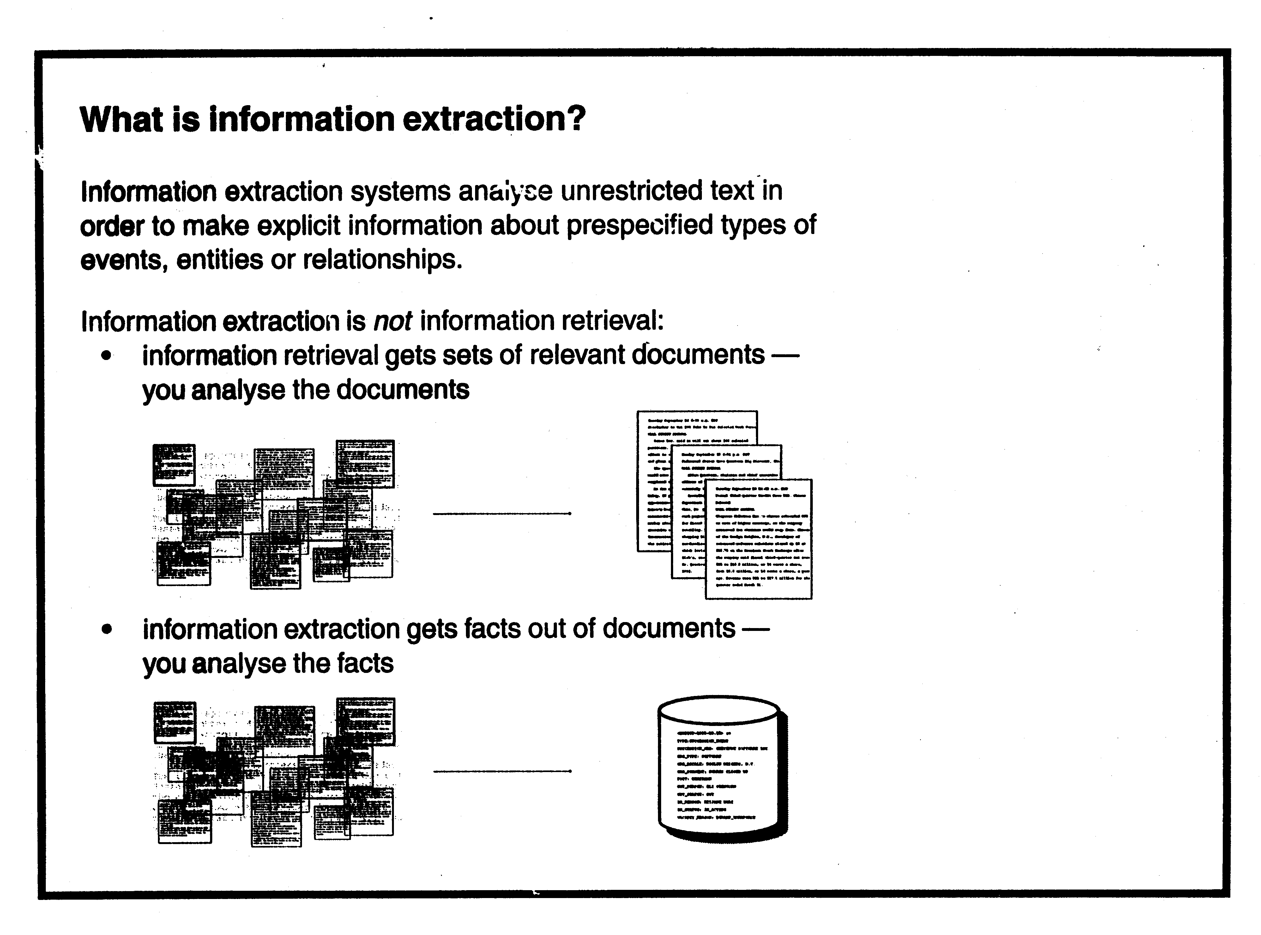

Slide 19
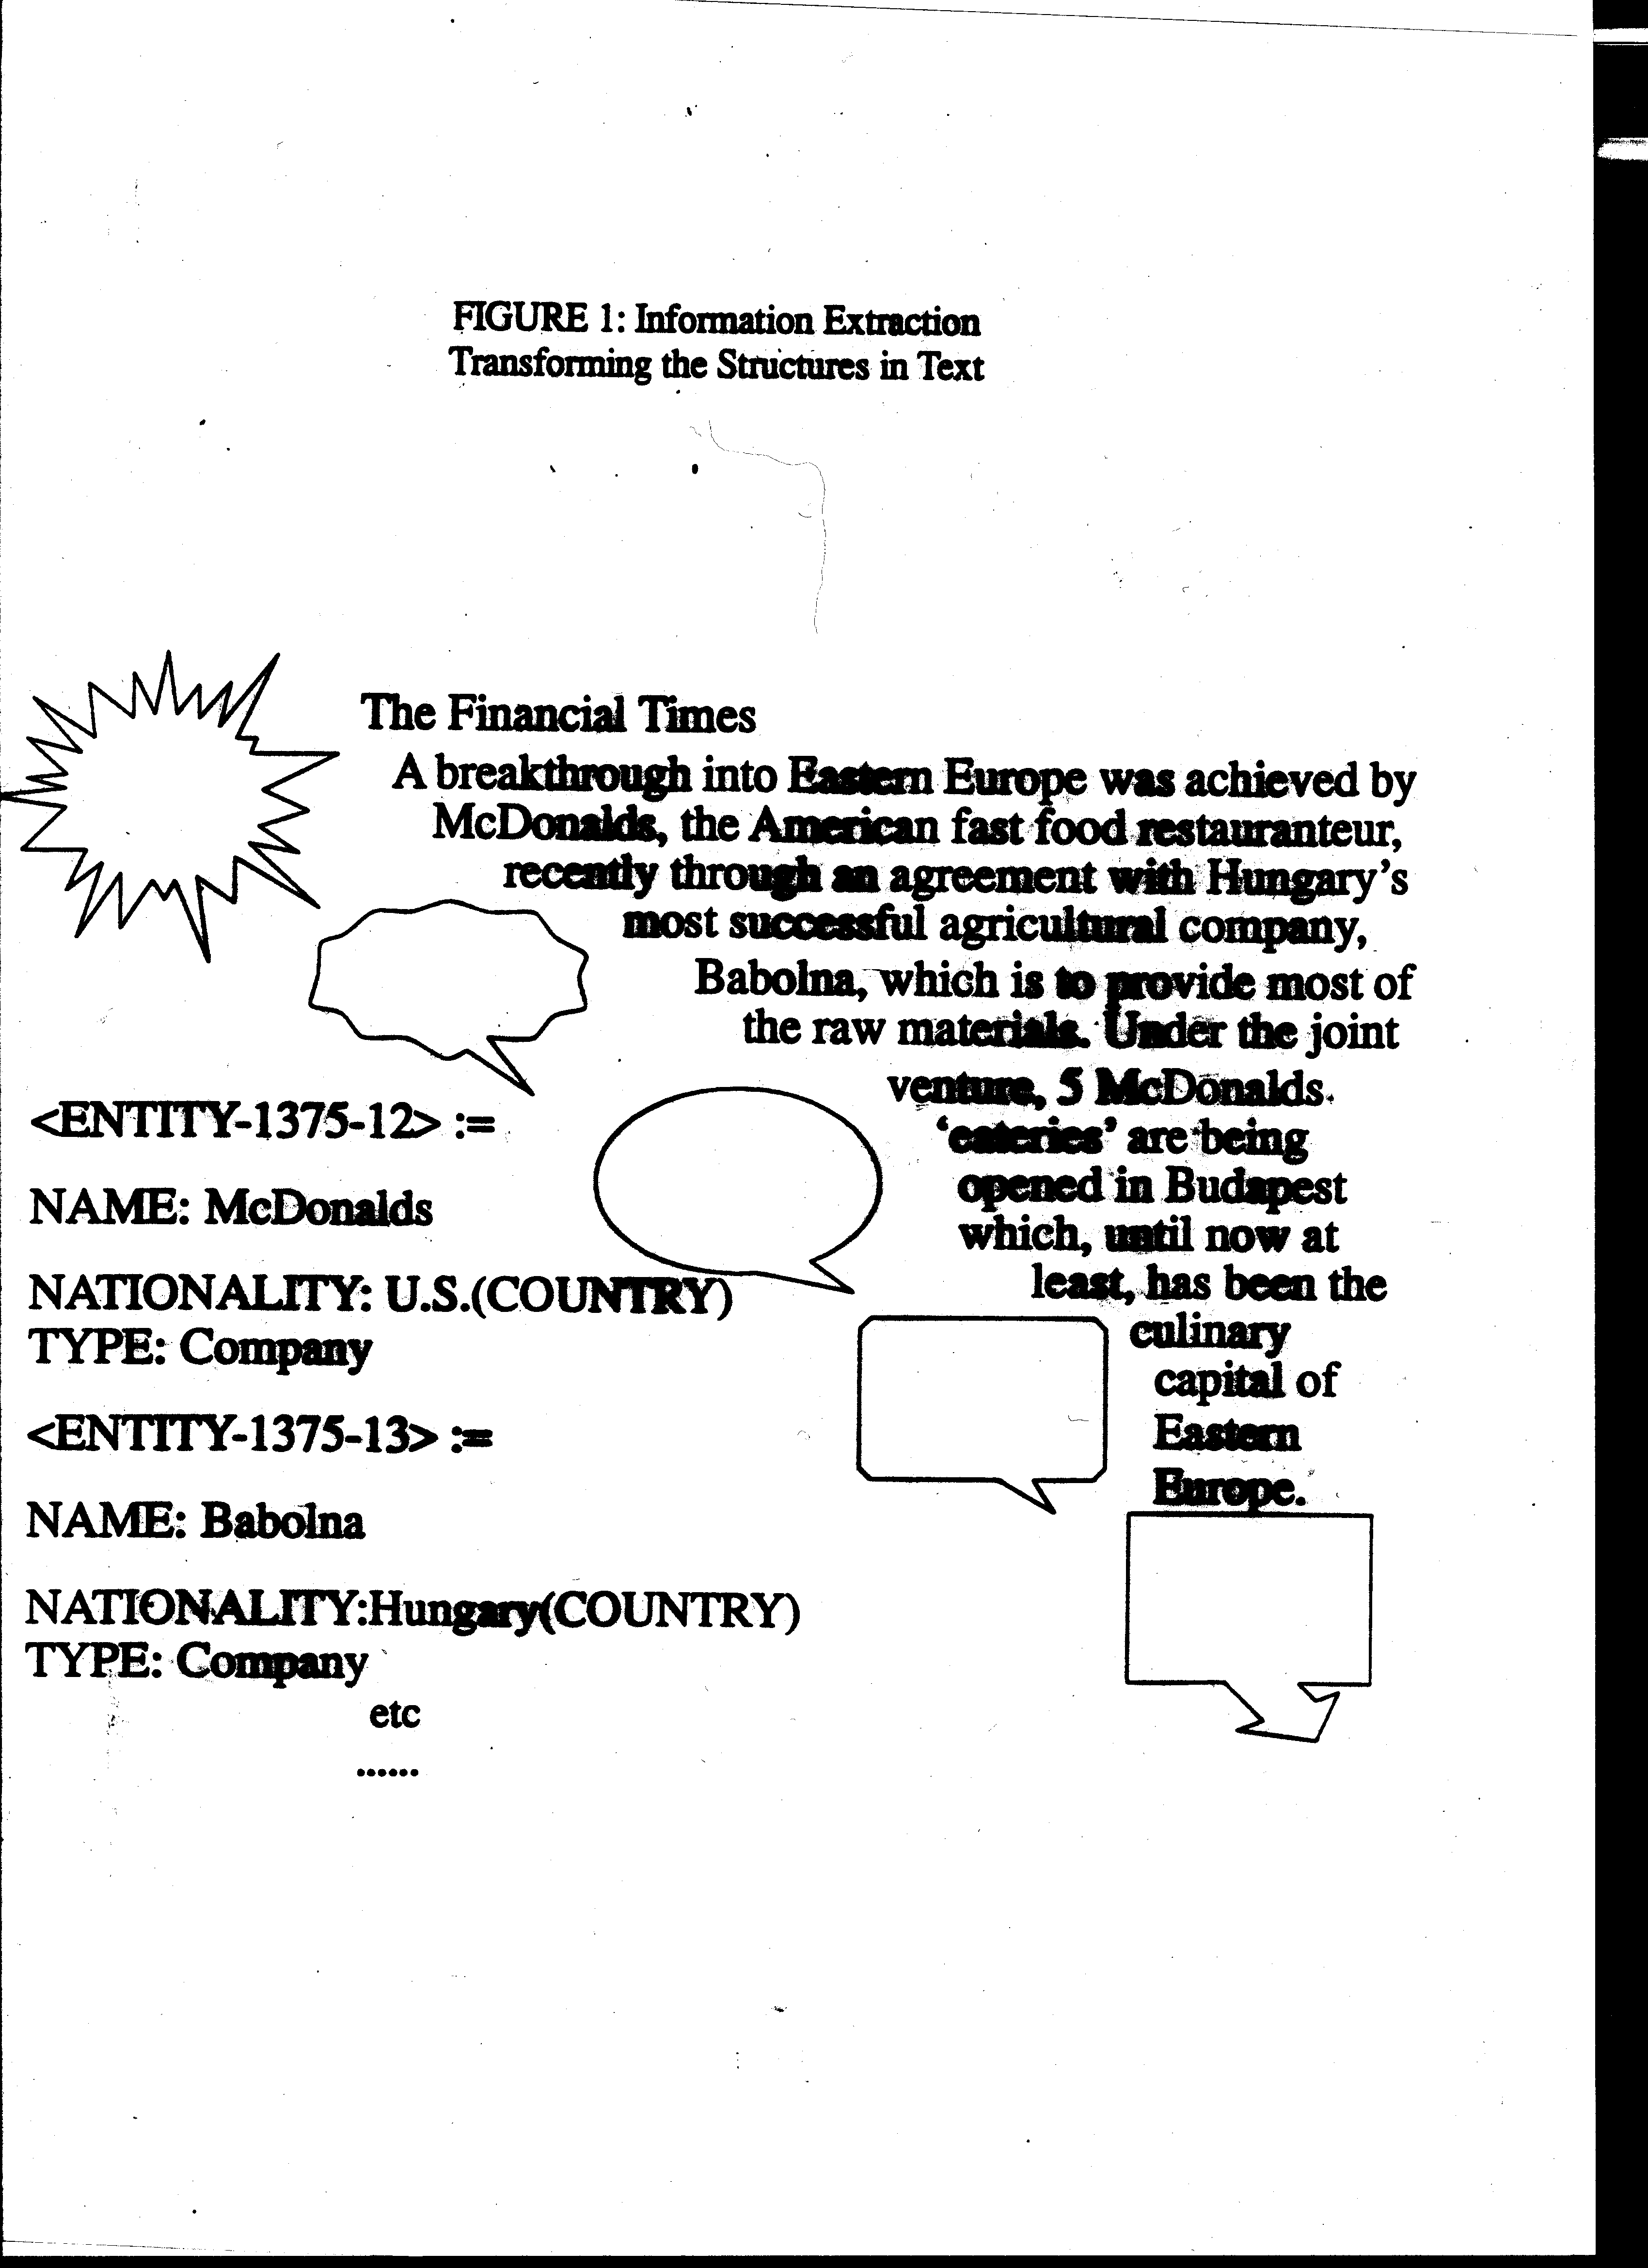

Slide 20
What then is Information Extraction (which we have adapted as a good content extractor for dialogue)?
  getting information from content of huge document collections by computer at high speed
  looking not for key words but information that fits some template pattern or scenario.
  delivery of information as a structured database of the template fillers (usually pieces of text)
  the technology has now moved on to one based on machine learning (ML) rather than people writing these patterns down out of their heads.
  it has fused with machine Question-Answering.
  it is a technology created since 1990 by the US Defense Department

Slide 21
Machine dialogue: problems with theory
It can be vacuous: ‘dialogues are systems of turn-taking’
Speech act analysis initially has led to implausibly deep levels of reasoning.
For some researchers, dialogue theory is still a question of how best to deploy logic

Slide 22
Two important historical systems have all the modern traits and functionalities in miniature
Colby’s PARRY (Stanford, 1971)
Perrault, Cohen, Allen’s speech act system (Toronto, 1979)

Slide 23
Colby’s PARRY
Perhaps best ever performance, many users, robust, but not a normal subject (I.e. a paranoid)
primitive individual models, some control of dialogue process; but it had lots to say!
Primitive simulation of intentionality
not syntax analysis but fast pattern matching
Far better than ELIZA

Slide 24
PARRY conversation
Have you been hospitalized before?
THIS IS THE FIRST TIME
How long have you been there?
ABOUT TWO WEEKS
Any headaches?
MY HEALTH IS FINE
Are you have memory difficulties?

Slide 25
More PARRY
NO
Then can you tell me who is the President of the US?
NIXON IS PRESIDENT
And what day is today?
TODAY IS THURSDAY--CAN WE GET ON WITH THE INTERVIEW?

Slide 26
How is this achieved in PARRY?
WHAT IS YOUR MAIN PROBLEM _______________________________
WHAT BE YOU MAIN PROBLEM
BE YOU MAIN PROBLEM
WHAT BE MAIN PROBLEM
WHAT BE YOU PROBLEM ←
WHAT BE YOU MAIN

Slide 27
Perrault, Cohen, Allen system
Based on speech act reasoning
User must have one of two goals, meeting or catching a train
Passenger/User: Do you know when the Windsor train arrives?
This is labelled as a REQUEST not a REQUEST-INFORM (Y/N) because the system knows the user knows it knows!

Slide 28
Perrault et al. At Toronto
System has domain knowledge and reasoning power
was the first to assign speech act labels to dialogue items
But speech act reasoning is often implausible: “Can you pass the salt?”
It has a simple rigid model of nested belief
but virtually no performance

Slide 29
Fixed nested beliefs: passenger’s view of system’s view of passenger’s beliefs.
passenger
system
passenger

Slide 30
1970’s division of approaches to machine conversation.
Domain-dependent systems with coded world knowledge and some parsing and reasoning VERSUS
Wide shallow systems with little knowledge and high performance
Published AI academic systems all in first group
Only the second group performed at all

Slide 31
Academic systems have moved towards performance
Best is Traum’s TRAINS system--descendant of Allen’s work (Toronto-Rochester tradition)
Semi-empiricist: uses corpora but retains reasoning
gone to the movies in California!!
Also TRINDIKIT at Gothenburg/Edinburgh; uses a large rule base
Pressure from the Loebner competition to perform?

Slide 32
TRAINS CORPUS
David Traum (Rochester)
utt1 : s: hello <sil> can I help you
utt2 : u: yeah I want t- I want to determine the maximum number of boxcars of oranges <sil> by seven a.m. <sil> tomorrow morning
utt3 : so <brth> hm <sil>
so I guess all the boxcars will have to go through oran- <sil> through Corning because that’s where the orange juice <brth> orange factory is
utt4 : so from Corning to Bath how far is that
utt5 : s: two hours
utt6 : u: and it’s gonna take us also an hour to load <sil> boxcars right
utt7 : s: right + +
utt8 : u: + okay + so <sil> hm so <sil> every trip will take at least <sil> three hours <sil> then
utt9 : um
utt10 : s: right we can unload any amount of cargo onto a train in one hour
utt11 : so we can + <sil> so a maximum of three + boxcars in an hour

Slide 33
AI people join the performers: the Loebner Competition
Well designed competition over the last ten years---essentially a modified Turing test.
Domain dependent entries till 1997, then domain free.
The game is for journalists to separate and rank human and machine partners
Search ‘Loebner’ on web for full transcripts

Slide 34
Loebner 1994
NEW JUDGE
150 Judge 1
Do you think the country is headed generally in a more conservative or more liberal direction right now?
151 Terminal
Didn’t you say would you discribe that old texas billionaire as a conservative?? Answer me one question – why are liberals portrayed as donkees? Are you a caring person? You’re not really talking about me, are you?
152 Judge 1
I’ve got the feeling I’ve heard these answers before. Is our nation swinging leftward or rightward right now?
Terminal
We are at the beginning of a strong and wonderful economic recovery, and we can thank the liberals!

Slide 35
Sheffield University/Intelligent Systems won in 1997!
The CONVERSE program pretended to be Catherine, a 34-year old British journalist living in New York (to explain any usage problems).
She could talk about 80 appropriate topics
(80=domain free???) clothes, shopping, food, abortion, fitness, sex….etc.

Slide 36
Loebner Competition 1997---Sheffield’s winning entry!
PROGRAM[10:18:04]Hi, my name is Catherine, what’s yours?
JUDGE04[10:18:32]My name is Elliott.
PROGRAM[10:18:34]Well, it’s nice to meet you, Elliott.
PROGRAM[10:18:48]Did you see that story on CNN last night about the lesbian
PROGRAM[10:19:04]couple who came out at a White House party on Sunday?
JUDGE04[10:19:55]Yes, I did. I think it may all be a publicity stunt for Ellen.
PROGRAM[10:20:01]Ellen Degeneres was one of them – she was kissing her lover
PROGRAM[10:20:11]in front of Bill Clinton. Do you think he was very
PROGRAM[10:20:25]embarrassed?
JUDGE04[10:21:00]I think he want the gay vote. He will do anything to get it and keep it.
JUDGE04[10:21:15]He does not have a conservative base.
PROGRAM[10:21:21]
PROGRAM[10:21:21]Are you still a Friend of Bill Clinton?

Slide 37
The CONVERSE prototype 1997
Push-me-pull-you architecture
strong driving top-down scripts (80+) in a re-enterable network with complex output functions
bottom-up parsing of user input adapted from statistical prose parser
minimal models of individuals
contained Wordnet and Collins PNs
some learning from past Loebners + BNC
It owed something to PARRY, nothing to Toronto.

Slide 38
Why the dialogue task is still hard
« Where am I » in the conversation => what is being talked about now, what do they want?
Does topic stereotopy help or are just Finite-State pairs enough (VoiceXML!)?
How to gather the beliefs/knowledge required , preferably from existing sources?
Are there distinctive procedures for managing conversations?
How to learn the structures we need--assuming we do---and how to get and annotate the data?
Some of this is the general NLP empiricist problem.

Slide 39
Dimensions of conversation construction: the Sheffield view:
Resources to build/learn world knowledge structures and belief system representations
Quasi-linguistic learnable models of dialogue structure, scripts, finite state transitions etc.
Effective learnable surface pattern matchers to dialogue act functions (an IE approach to dialogue)
A stack and network structure that can be trained by reinforcement.
Ascription of belief procedures to give dialogue act & reasoning functionality

Slide 40
VIEWGEN:a belief model that computes agents’ states
Not a static nested belief structure like that of Perrault and Allen.
Computes other agents’ RELEVANT states at time of need
Topic restricted search for relevant information
Can represent and maintain conflicting agent attitudes
See Ballim and Wilks “Artificial Believers”, Erlbaum 1991.

Slide 41
VIEWGEN as a knowledge basis for reference/anaphora resolution procedures
Not just pronouns but grounding of descriptive phrases in a knowledge basis
Reconsider finding the ground of: ”that old Texas billionaire” as Ross Perot, against a background of what the hearer may assume the speaker knows when he says that.

Slide 42
System_Admin
protect(file_directory)
System_Admin
Goal
delete(file_directory) not(file_directory)
System_Admin
Goal
A stereotype for System Administrations
Remedial Situation
perform(Action) undesirable_effect
performed(Speaker,Action)
is(Hearer,expert)
Speaker
Belief
Hearer
performed(Speaker,Action)
Belief
Speaker
¬ undesirable_effect
Goal
Typical attitudes for an interlocuter in a remedial dialogue
Question-Answer
Hearer
Prop
Belief
Speaker
Goal
Speaker
answer(Speaker,Hearer,Prop)
Intent
performed(question(Hearer,Speaker,Prop))
Speaker
Prop
Belief
A stereotype for question answering

Slide 43
What is the most structure that might be needed and how much of it can be learned?
Steve Young (Cambridge) says learn it all and no a priori structures (cf MT history and Jelinek at IBM)
Availability of data (dialogue is unlike MT)?
Learning to partition the data into structures.
Learing the semantic + speech act interpretation of inputs alone has now reached a (low) ceiling (75%).

Slide 44
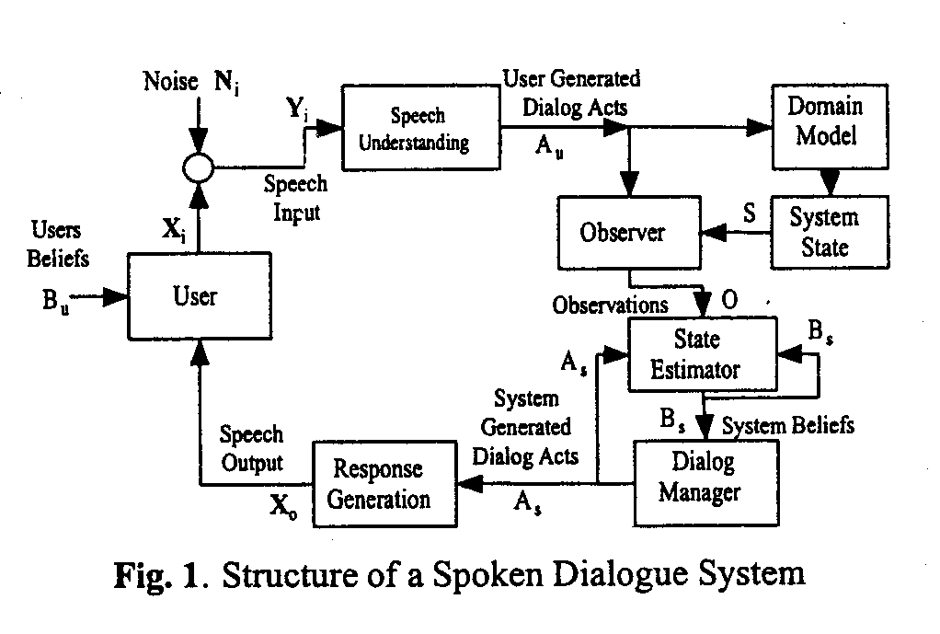

Slide 45
Young’s strategy not like Jelinek’s MT strategy of 1989!
Which was non/anti-linguistic with no intermediate representations hypothesised
Young assumes rougly the same intermediate objects as we do but in very simplified forms.
The aim to to obtain training data for all of them so the whole process becomes a single throughput Markov model.

Slide 46
There are now four not two competing approaches to machine dialogue:
Logic-based systems with reasoning (Old AI and still unvalidated by performance)
Extensions of speech engineering methods, machine learning and no real structure (New)
Simple handcoded finite state systems in VoiceXML (Chatbots and commercial systems)
Rational hybrids based on structure and machine learning (our money is on this one!)

Slide 47
We currently build parts of the dialogue system for three EU-IST projects:
AMITIES (EU+DARPA): machine learning and IE system for dialogue act and semantic content fusion.
COMIC (EU-5FP): dialogue management
FaSIL (EU-5FP): adaptive management of information content

Slide 48
The Companions: a new economic and social goal for dialogue systems

Slide 49
An idea for integrating the dialogue research agenda in a new style of application...
That meets social and economic needs
That is not simply a product but everyone will want one if it succeeds
That cannot be done now but could in six years by a series of staged prototypes
That modularises easily for large project management, and whose modules cover the research issues.
Whose speech and language technology components are now basically available

Slide 50
A series of intelligent and sociable COMPANIONS
Dialogue partners that chat and divert, and are not only for task-related activities
Some form of persistent and sympathetic personality that seems to know its owner
Tamagotchi showed that people are able and willing to attribute personality to the simplest devices.

Slide 51
The Senior Companion
  The EU will have more and more old people who find technological life hard to handle, but will have access to funds
  The SC will sit beside you on the sofa but be easy to carry about--like a furry handbag--not a robot
  It will explain the plots of TV programs and help choose them for you
  It will know you and what you like and don’t
  It wills send your messages, make calls and summon emergency help
  It will debrief your life.

Slide 52
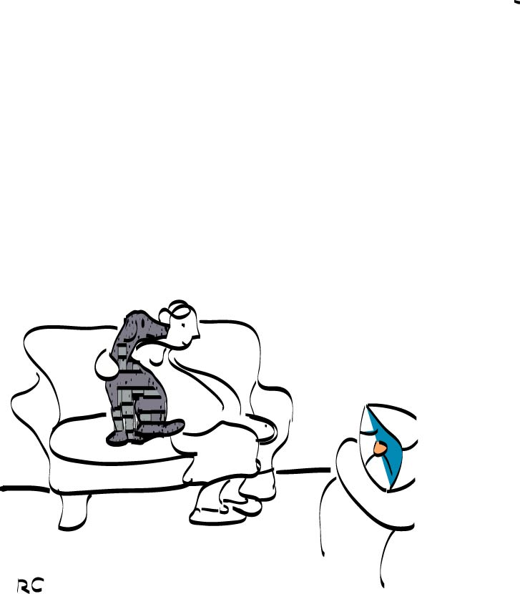

Slide 53
The Senior Companion is a major technical and social challenge
It could represent old people as their agents and help in difficult situations e.g. with landlords, or guess when to summon human assistance
It could debrief an elderly user about events and memories in their lives
It could aid them to organise their life-memories (this is now hard!)(see Lifelog and Memories for Life)
It would be a repository for relatives later
Has « Loebner chat aspects » as well as information--it is to divert, like a pet, not just inform
It is a persistent and personal social agent interfacing with Semantic Web agents

Slide 54
Could a Companion like this be a language teacher as well?
A language teacher should be long term if possible (see Ayala paper for similar perspective)
A persistent personality with beliefs would know something of what you know
The « initiative mix » in dialogue has to be with the teacher in language learning, and dialogue systems always perform best when they have the initiative.
The problem remains that of teaching language communication versus correctness outside local domains.
But a Companion would already be a mass of local domains--though not necessarily the ones where language instruction is wanted.

Slide 55
Conclusion
Many NLP technologies remain theoretically seductive but unevaluated and possibly unevaluable (3&4 letter grammars, dialogue theories, universal knowledge bases)
They are still 70s TOY AI
Dialogue performance is only partially evaluable
Grammar has low ceilings outside small areas that combine with (differently risky) corpus methods
Therefore problems remain about teaching correctness outside constrained drills
Companions with personality might be a medium term goal as a vehicle for language teaching

