Slide 1

Te Kaitito
A dialogue system for CALL
Peter Vlugter, Alistair Knott, and Victoria Weatherall
Department of Computer Science
School of Māori, Pacific, and Indigenous Studies

Slide 2
Outline of the talk
  Overview of the Te Kaitito system
  Error diagnosis in the grammar
  Error diagnosis in the dialogue system
  Interactions between grammatical errors and dialogue

Slide 3
Te Kaitito
The Te Kaitito system
  Te Kaitito means ‘the improvisor’ or ‘the extempore speaker’.
  Te Kaitito is a dialogue system, translation system, and CALL application for Māori, the indigenous language of Aotearoa New Zealand.
  We suggest that mixed-initiative human-computer dialogue seems like a good medium for CALL and that CALL can also be seen as a good domain for human-computer dialogue.

Slide 4
Overview of Te Kaitito
  A collection of natural language processing modules:
    sentence parser (LKB)
    uses a combined Māori and English grammar
    dialogue attachment module
    computes how semantic representations could be incorporated into the dialogue context
    disambiguation module
    chooses the most appropriate representation
    dialogue manager
    updates the discourse context and creates a response
    sentence generator (LKB)
    uses the same grammar as the parser

Slide 5
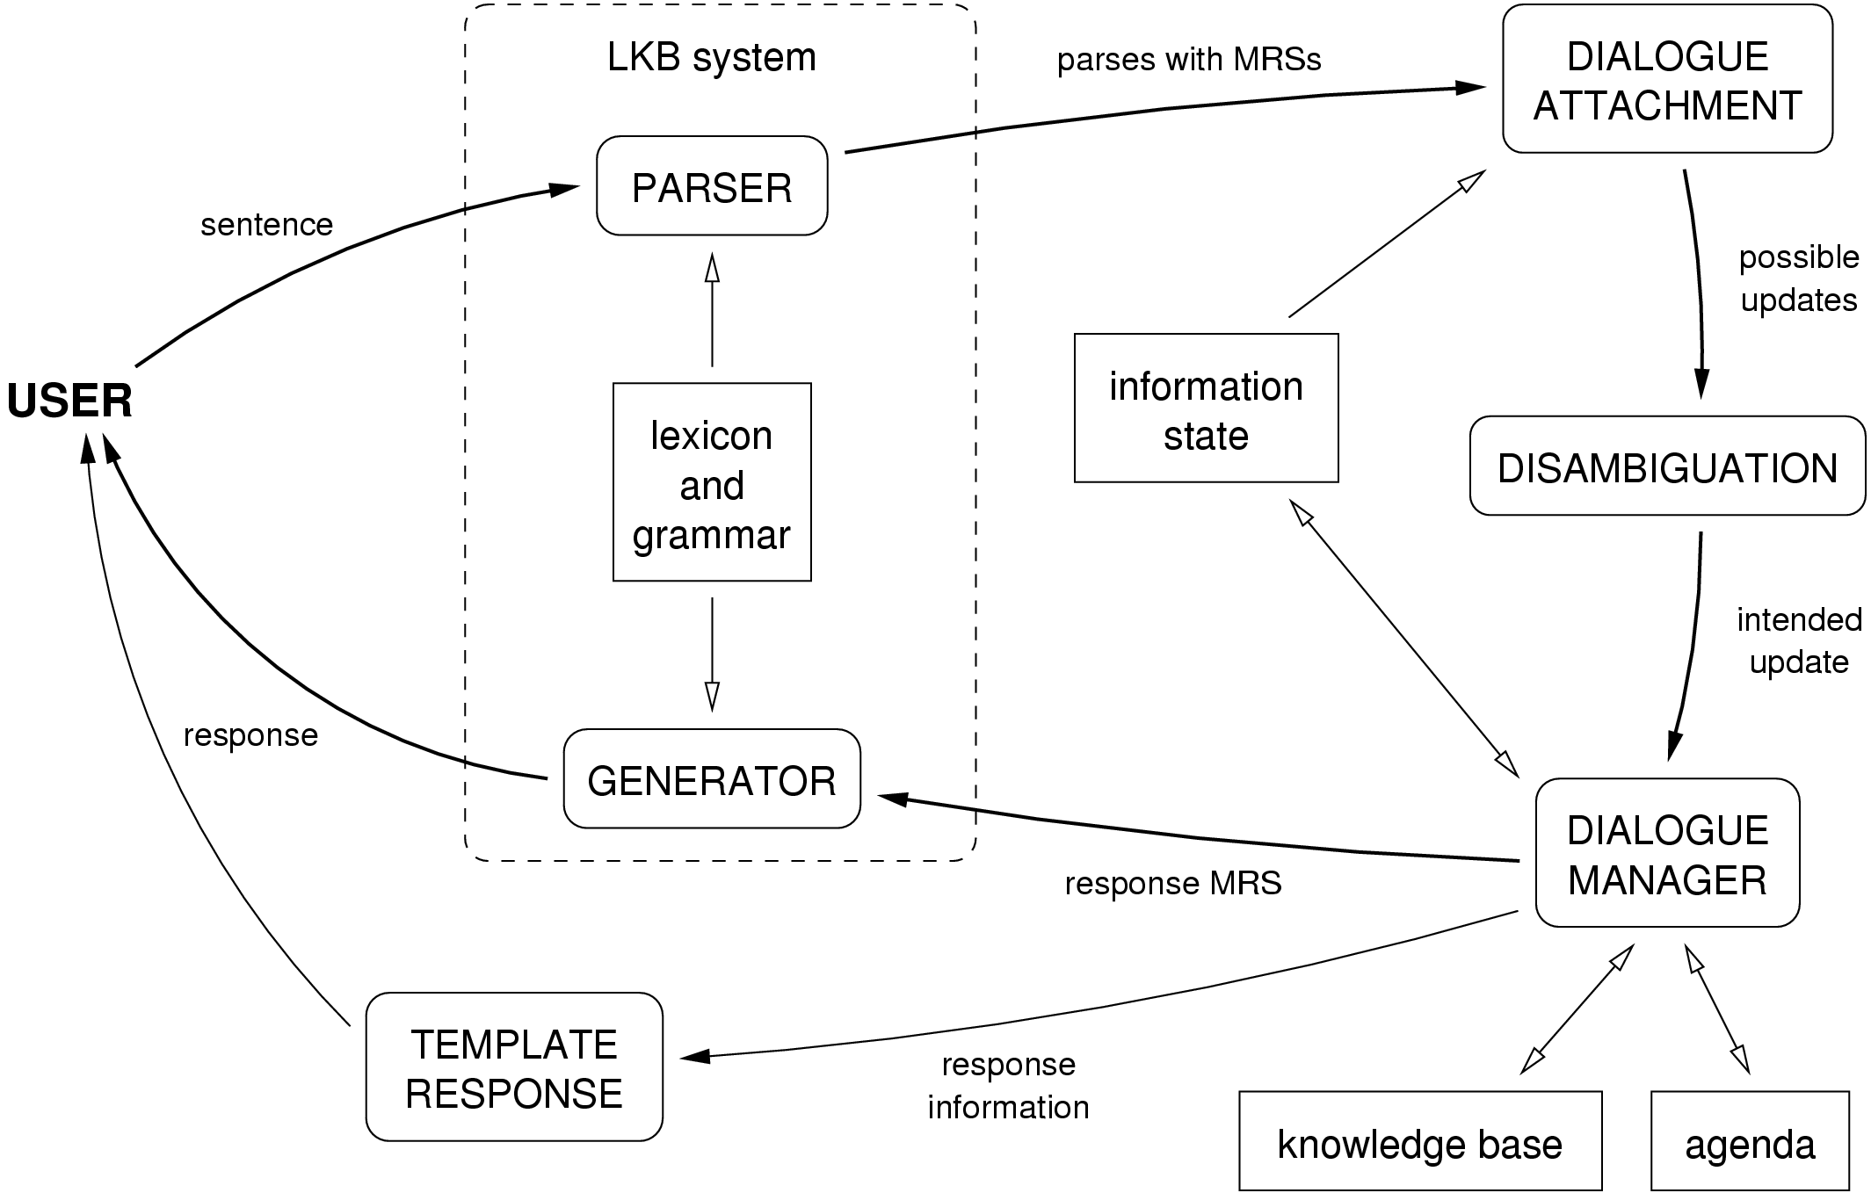
Overview of Te Kaitito

Slide 6
CALL application
A CALL application for Māori
    aligned with an introductory course in conversational Māori at the University of Otago
    coverage of the grammar and dialogue system are based on the course textbook
    treatment of errors based on a study of student errors in coursework and exams
    focus on written conversation with future possibilities of speech and talking heads
    author mode and student mode

Slide 7
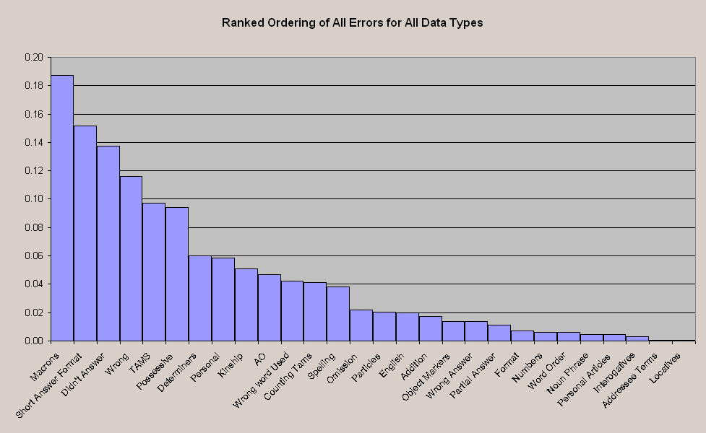
Error analysis
A CALL application for Māori

Slide 8
The Māori-English grammar
The grammar
  The syntactic formalism used in LKB is Head-Driven Phrase Structure Grammar (HPSG).
  We use a bilingual grammar, in which words and rules have a LANGUAGE feature whose value is either MAORI or ENGLISH. Agreement of this feature is required throughout a sentence.
  This allows the system to:
    accept sentences in either language
    recognise which language a given sentence is in
    restrict generation to either language

Slide 9
Error diagnosis in the grammar
Grammatical errors
  For CALL the system needs to:
    deal robustly with ill-formed input
    recognise and diagnose grammatical errors
    derive the intended meaning of ill-formed sentences
  Our approach is to augment the grammar with mal-rules which allow ill-formed sentences to be parsed but are associated with well-formed semantics.
  A boolean sub-feature of the LANGUAGE feature is defined for each independent error.

Slide 10
Mal-rule example
Grammatical errors
Accusative Māori NPs require a case-marking particle “i”:
  Kei te whai te kurī i te ngeru.
  TAM chase the dog ACC the cat.
  “The dog is chasing the cat.”
The case-marker “i” is often left out:
  (2) *Kei te whai te kurī te ngeru.
The mal-rule which allows this mistake will have an error sub-feature set to true: CASE-MARKER-ERROR = TRUE

Slide 11
Semantic representations
What are the semantic representations used?
  LKB delivers semantic representations in a language called Minimal Recursion Semantics (MRS).
  For dialogue processing, we convert MRS representations into a format related to presuppositional Discourse Representation Theory (DRT).
  To demonstrate here’s an example with simplified representations…

Slide 12
Dialogue example
Example of a question and answer dialogue
Consider this simple question and answer dialogue:
  Te Kaitito: Nō hea koe?
  (Where are you from?)
  Student: Nō Ōtepoti ahau.
  (I’m from Ōtepoti.)

Slide 13
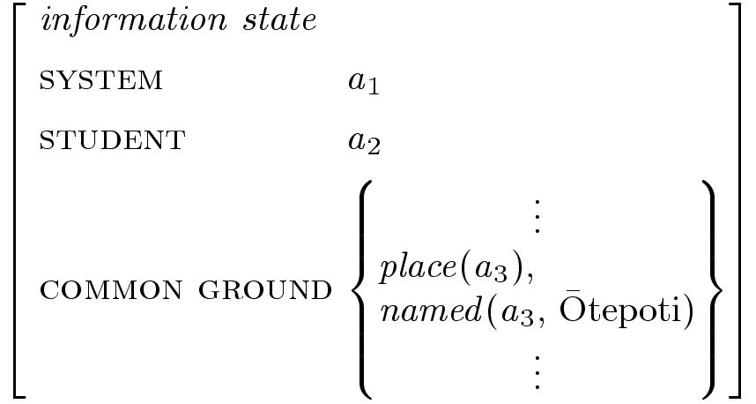
Example of a question and answer dialogue
The information state before this dialogue occurs.
The system is represented by a discourse entity a₁, the student by a₂, and within the common ground there is an entity a₃ which is a place named Ōtepōti.

Slide 14
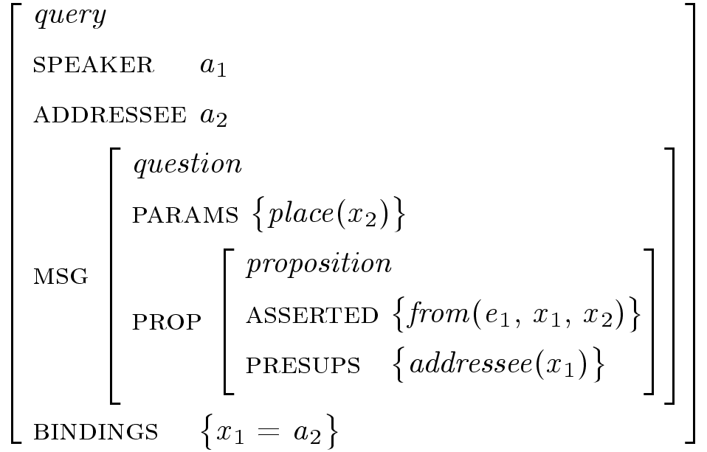
Example of a question and answer dialogue
  Te Kaitito: Nō hea koe?
  (Where are you from?)

Slide 15
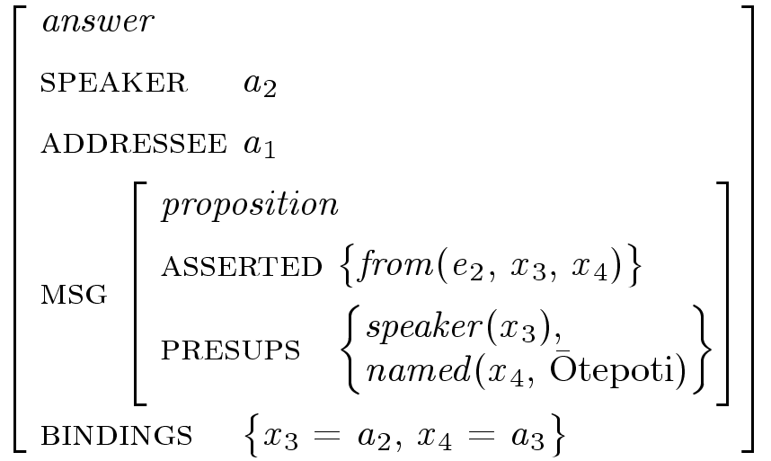
Example of a question and answer dialogue
Student: Nō Ōtepoti ahau.
(I’m from Ōtepoti.)

Slide 16
Example of a question and answer dialogue
Nō hea koe?
(Where are you from?)
Nō Ōtepoti ahau.
(I’m from Ōtepoti.)
To check that the answer is a proper answer we match the question and answer.

Slide 17

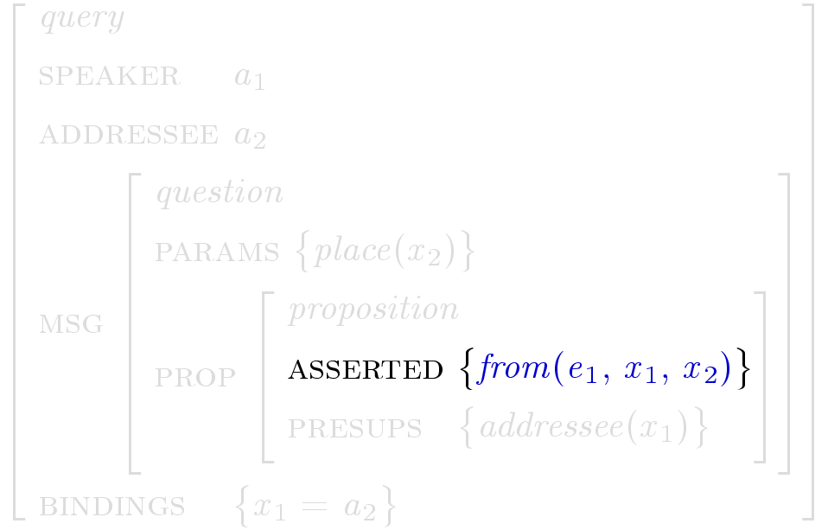
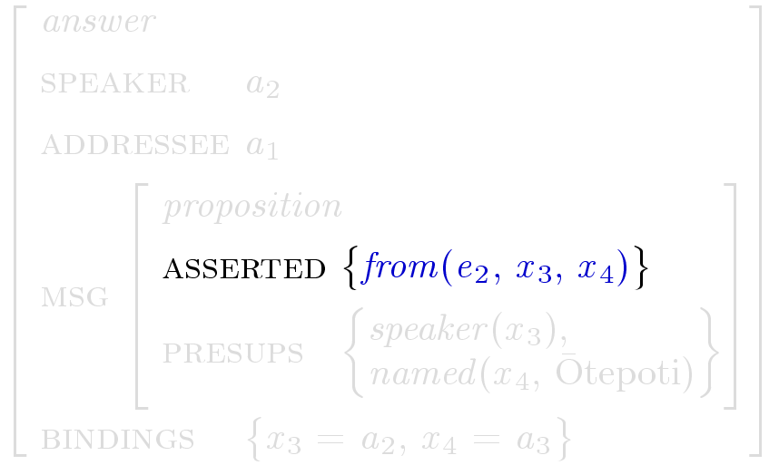
Example of a question and answer dialogue
Nō hea koe?
(Where are you from?)
Nō Ōtepoti ahau.
(I’m from Ōtepoti.)
First matching the asserted parts of each proposition…

Slide 18
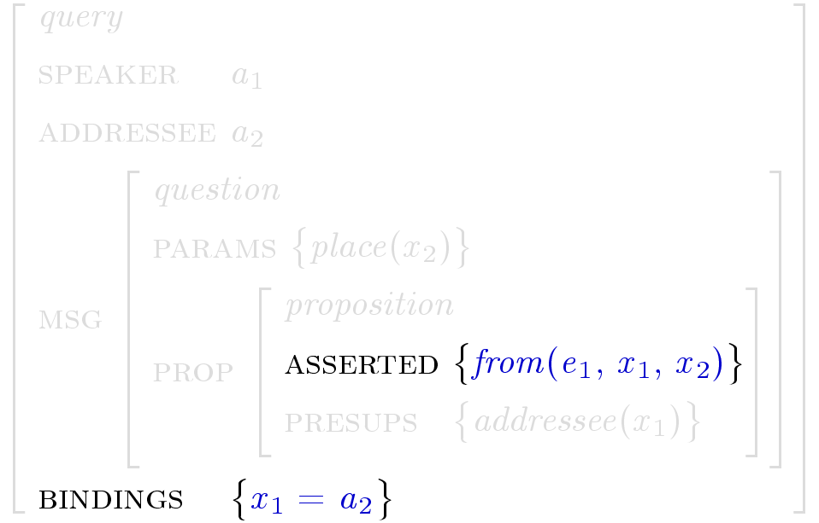
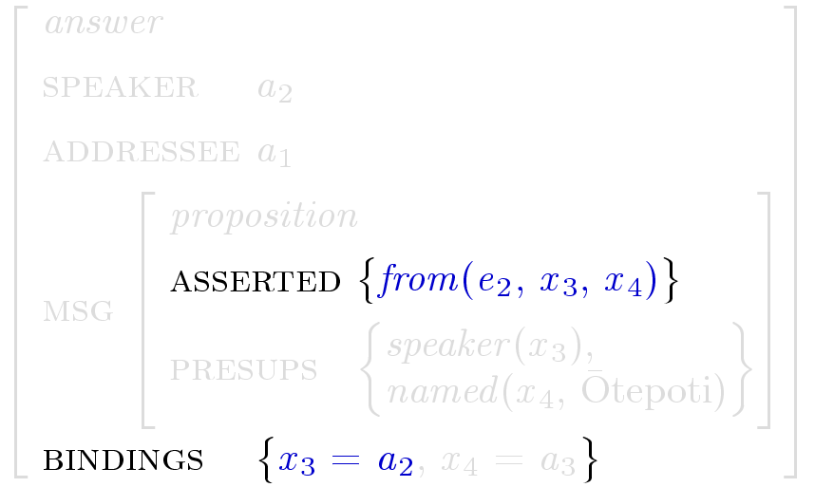
Example of a question and answer dialogue
Nō hea koe?
(Where are you from?)
Nō Ōtepoti ahau.
(I’m from Ōtepoti.)
… then checking that the corresponding bindings for any presupposed information also match…

Slide 19
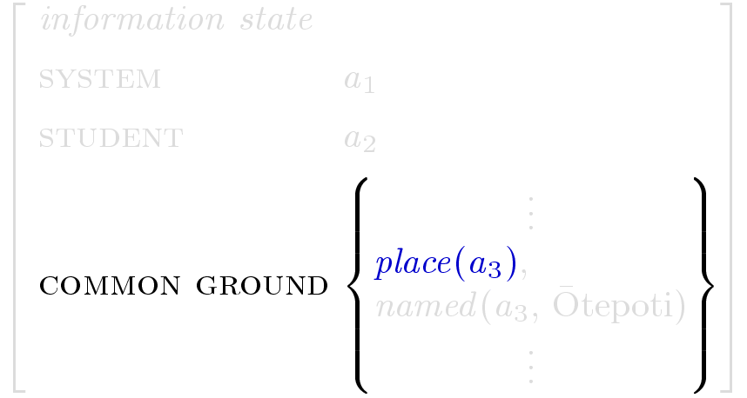
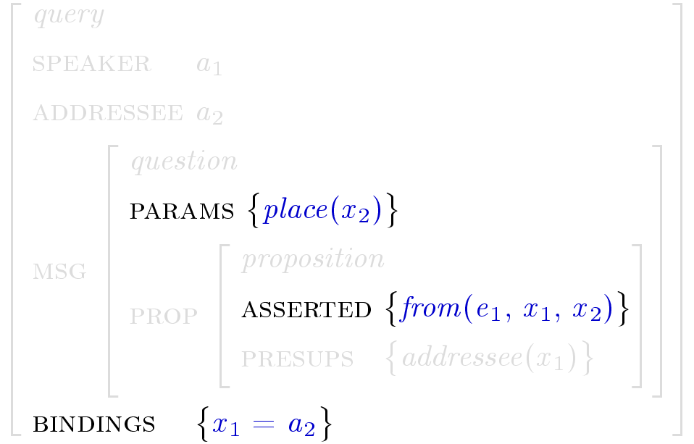
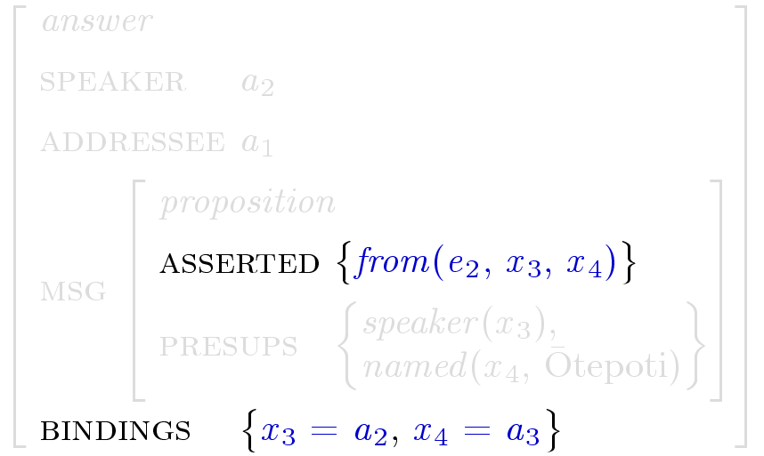
Example of a question and answer dialogue
Nō hea koe?
(Where are you from?)
Nō Ōtepoti ahau.
(I’m from Ōtepoti.)
… then checking that the answer is appropriate to the parameters of the question.

Slide 20
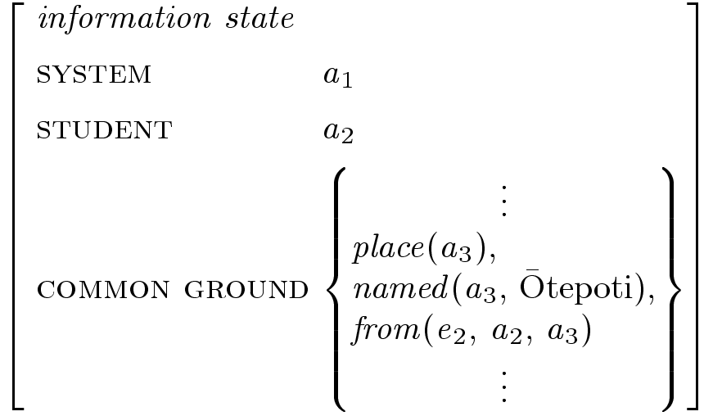
Example of a question and answer dialogue
If the question is a genuine question (the speaker is asking for new information) then the asserted part of the proposition is grounded.

Slide 21
Error diagnosis in the dialogue manager
Errors that are grammatically correct
Sometimes a student will make a mistake but actually use a syntactically correct sentence. Consider some additional possible answers to the previous example:
  Q: Nō hea koe? (Where are you from?)
  A1: Nō Ōtepoti ahau. (I’m from Ōtepoti.)
  A2: #Nō Ōtepoti koe. (You’re from Ōtepoti.)
  A3: #Kei Ōtepoti ahau. (I’m at Ōtepoti.)
We can recognise these mistakes by relaxing the constraints on how answers are matched back to questions.

Slide 22
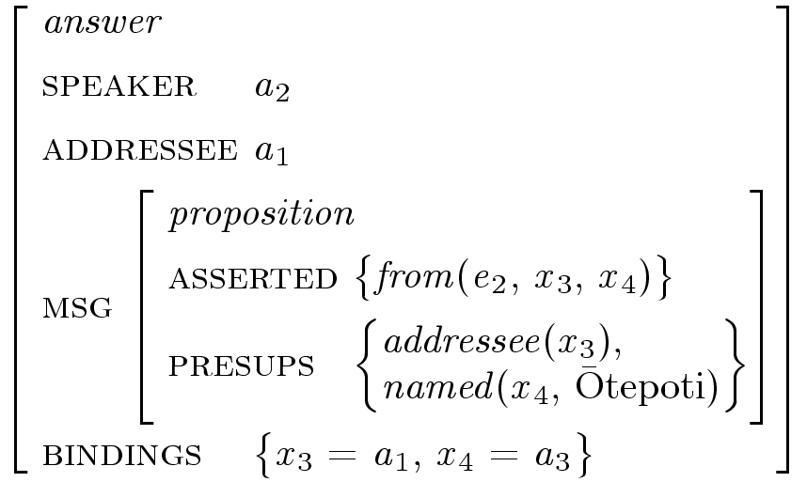
Errors that are grammatically correct: example 1
Example 1
  Q: Nō hea koe?
  (Where are you from?)
  A2: #Nō Ōtepoti koe.
  (You’re from Ōtepoti.)
The student has used the same personal pronoun (“you”) as used in the question.

Slide 23
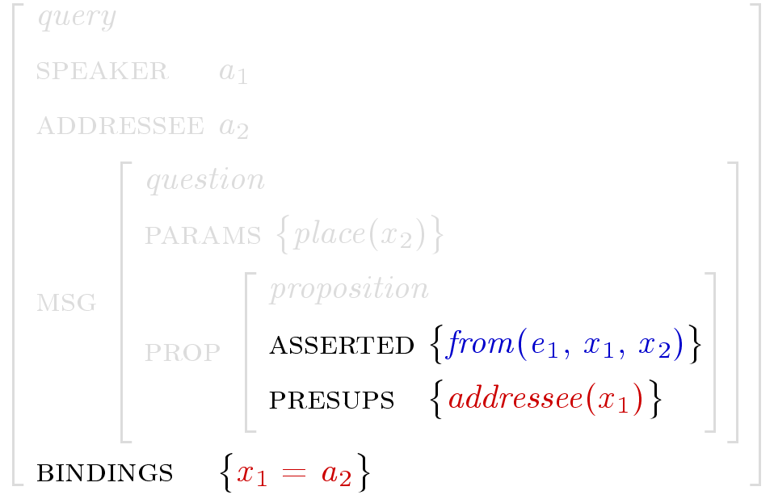
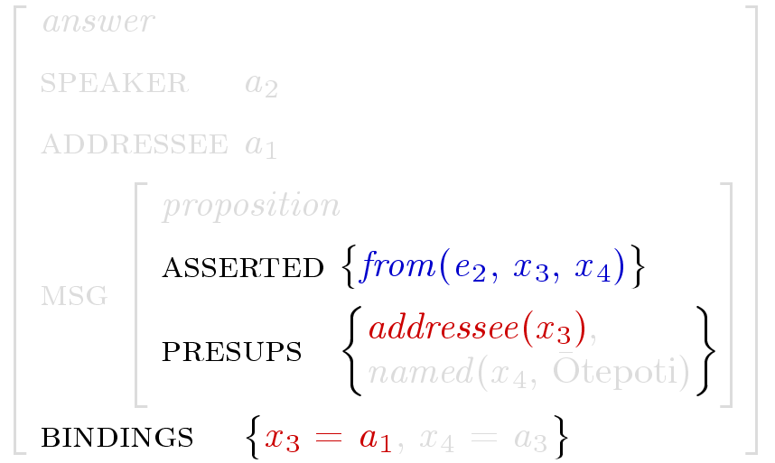
Errors that are grammatically correct: example 1
Example 1
Relaxing the constraints involves allowing a mismatch between the bindings made by the question and the answer.
The system can also recognise this error as a mimicking error.

Slide 24
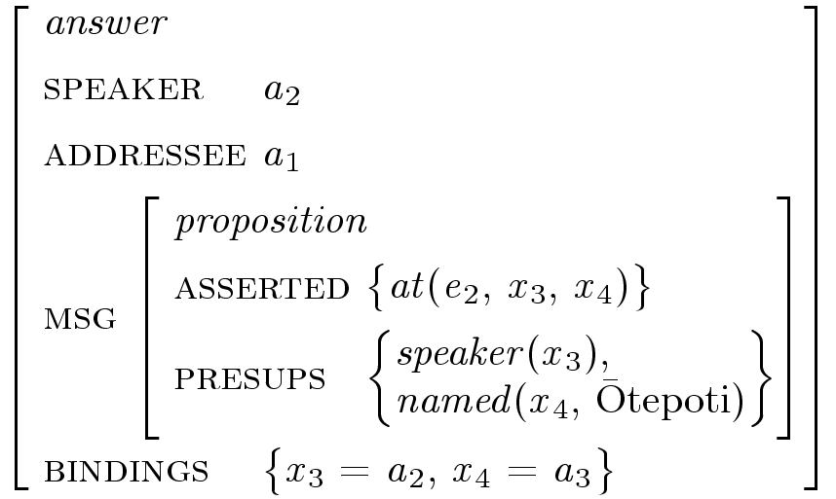
Errors that are grammatically correct: example 2
Example 2
  Q: Nō hea koe?
  (Where are you from?)
  A3: #Kei Ōtepoti ahau.
  (I’m at Ōtepoti.)
The student has selected the correct pronoun but is answering a slightly different question.

Slide 25
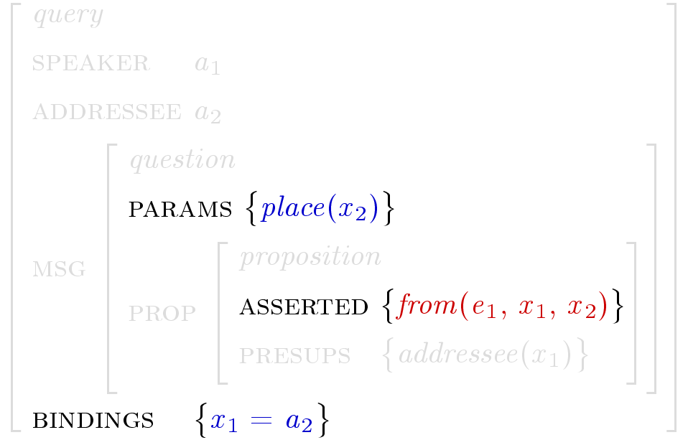
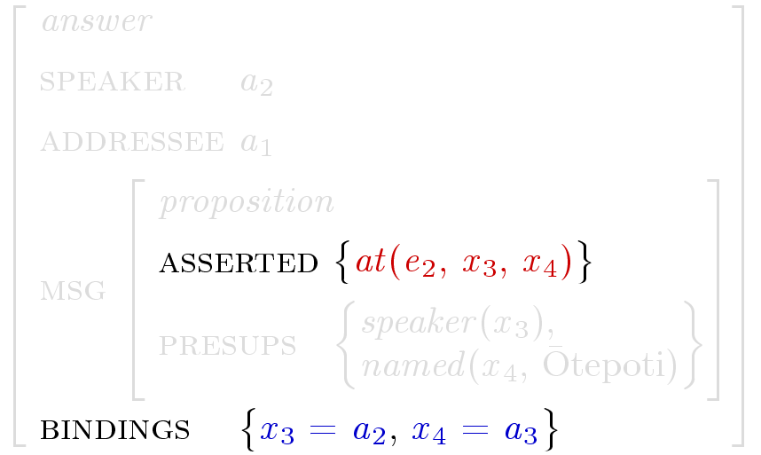
Errors that are grammatically correct: example 2
Example 2
Relaxing the constraints involves allowing a mismatch in the identity of the predicates from and at.

Slide 26
Parse disambiguation
Which representation?
  Utterances can be ambiguous in several ways:
    multiple syntactic readings
    multiple presupposition resolutions
    multiple dialogue interpretations
  Two main disambiguation mechanisms:
    parse ranking using a stochastic grammar
    ease of dialogue attachment: for instance, the system prefers interpretations which contain resolvable presuppositions and prefers appropriate dialogue acts

Slide 27
Interactions between grammatical errors and dialogue attachment
Interactions between grammatical errors and dialogue attachment
Sometimes the error grammar detects that an error has been made but there is ambiguity as to what error.
In order to work out what error has been made, information about dialogue attachment is needed.
In these cases, the dialogue attachment module can select the most likely reading from the alternative interpretations, just as it does in ordinary dialogue processing.

Slide 28
Some background
Interactions between grammatical errors and dialogue attachment
In Māori locative sentences the order of the subject and object DPs is free (the object is identified with the case marker “i”).
  Kei roto te kurī i te māra.
  TAM in the dog ACC the garden.
  Kei roto i te māra te kurī.
  TAM in ACC the garden the dog.
Both these sentences mean “The dog is in the garden.”

Slide 29
Interaction example
Interactions between grammatical errors and dialogue attachment
Consider the following question and ill-formed answer:
  Q: Kei hea te kurī? (Where is the dog?)
  A: *Kei roto te māra te kurī.
There are two ways to correct this mistake:
  A: Kei roto i te māra te kurī. (The dog is in the garden.)
  A: Kei roto te māra i te kurī. (The garden is in the dog.)
The former interpretation can be considered an answer to the question. The latter cannot.

Slide 30
Future work
    large scale Māori resource grammar for machine translation (compatible with the ERG)
    multi-speaker dialogue with the system ‘playing’ several characters – this would allow practice of Māori pronouns and addressee terms
    evaluation of the CALL system
    comparison with a multimedia-based CALL system being developed for the same university course
    extendability to other languages

Slide 31
Conclusion
    mixed-initiative human-computer dialogue seems like a good medium for CALL
    mal-rules in conjunction with a detailed error analysis could provide a useful error correction system for beginner L2 learning
    dialogue-based error recognition allows the system to extend the range of errors it can correct. There are limitations to this approach (literal matching), however the constraints of the domain support it
    disambiguation techniques often play an essential role in error recognition

