Slide 1
Combining Knowledge-based Methods and Supervised Learning for Effective
Word Sense Disambiguation
Pierpaolo Basile, Marco de Gemmis,
Pasquale Lops and Giovanni Semeraro
Department Of Computer Science
University of Bari (ITALY)

Slide 2
Outline
Word Sense Disambiguation (WSD)
  Knowledge-based methods
  Supervised methods
Combined WSD strategy
Evaluation
Conclusions and Future Works

Slide 3
Word Sense Disambiguation
Word Sense Disambiguation (WSD) is the problem of selecting a sense for a word from a set of predefined possibilities
  sense inventory usually comes from a dictionary or thesaurus
  knowledge intensive methods, supervised learning, and (sometimes) bootstrapping approaches

Slide 4
Knowledge-based Methods
Use external knowledge sources
  Thesauri
  Machine Readable Dictionaries
Exploiting
  dictionary definitions
  measures of semantic similarity
  heuristic methods

Slide 5
Supervised Learning
Exploits machine learning techniques to induce models of word usage from large text collections
  annotated corpora are tagged manually using semantic classes chosen from a sense inventory
  each sense-tagged occurrence of a particular word is transformed into a feature vector, which is then used in an automatic learning process

Slide 6
Problems & Motivation
Knowledge-based methods
  outperformed by supervised methods
  high coverage: applicable to all words in unrestricted text
Supervised methods
  good precision
  low coverage: applicable only to those words for which annotated corpora are available

Slide 7
Solution
Combination of Knowledge-based methods and Supervised Learning can improve WSD effectiveness
  Knowledge-based methods can improve coverage
  Supervised Learning can improve precision
  WordNet-like dictionaries as sense inventory

Slide 8
JIGSAW
Knowledge-based WSD algorithm
Disambiguation of words in a text by exploiting WordNet senses
Combination of three different strategies to disambiguate nouns, verbs, adjectives and adverbs
Main motivation: the effectiveness of a WSD algorithm is strongly influenced by the POS-tag of the target word

Slide 9
JIGSAW_nouns
Based on Resnik algorithm for disambiguating noun groups
Given a set of nouns N={n₁,n₂, ... ,n_{n}} from document d:
  each n_{i} has an associated sense inventory
  S_{i}={s_{i1}, s_{i2}, ... , s_{ik}} of possible senses
Goal: assigning each w_{i} with the most appropriate sense s_{ih}∈S_{i}, maximizing the similarity of n_{i} with the other nouns in N

Slide 10
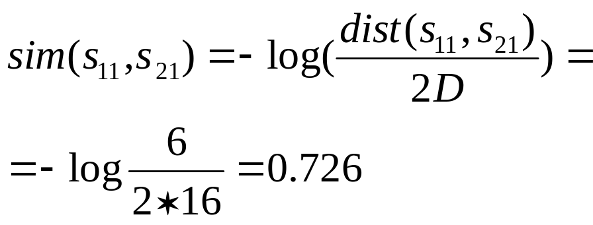
JIGSAW_nouns
N=[ n₁, n₂, … n_{n} ]={cat,mouse,…,bat}
[s₁₁ s₁₂ … s_{1k}]
[s₂₁ s₂₂ … s_{1h}]
[s_{n1} s_{n2} … s_{nm}]
MSS
Placental mammal
mouse#1
cat#1
Carnivore
Rodent
Feline, felid
Mouse
(rodent)
Leacock-Chodorow measure
Cat
(feline mammal)

Slide 11
JIGSAW_nouns
W=[ w₁, w₂, … w_{n} ]={cat,mouse,…,bat}
[s₁₁ s₁₂ … s_{1k}]
[s₂₁ s₂₂ … s_{1h}]
[s_{n1} s_{n2} … s_{nm}]
0.726
0.726
+0.726
mouse#1
cat#1
bat#1
MSS=Placental mammal
bat#1 is hyponym of MSS
increase the credit of bat#1

Slide 12
JIGSAW_verbs
Try to establish a relation between verbs and nouns (distinct IS-A hierarchies in WordNet)
Verb w_{i} disambiguated using:
  nouns in the context C of w_{i}
  nouns into the description (gloss + WordNet usage examples) of each candidate synset for w_{i}

Slide 13
JIGSAW_verbs
For each candidate synset s_{ik} of w_{i}
  computes nouns(i, k): the set of nouns in the description for s_{ik}
  for each w_{j} in C and each synset s_{ik} computes the highest similarity max_{jk}
  max_{jk} is the highest similarity value for w_{j} wrt the nouns related to the k-th sense for w_{i} (using Leacock-Chodorow measure)

Slide 14
JIGSAW_verbs
I play basketball and soccer
w_{i}=play
C={basketball, soccer}
(70) play -- (participate in games or sport; "We played hockey all afternoon"; "play cards"; "Pele played for the Brazilian teams in many important matches")
(29) play -- (play on an instrument; "The band played all night long")
…
nouns(play,1): game, sport, hockey, afternoon, card, team, match
nouns(play,2): instrument, band, night
…
nouns(play,35): …

Slide 15
JIGSAW_verbs
w_{i}=play
C={basketball, soccer}
nouns(play,1): game, sport, hockey, afternoon, card, team, match
game₁
basketball₁
game
game₂
…
basketball
…
basketball_{h}
game_{k}
sport₁
MAX_{basketball} = MAX_{i} Sim(w_{i},basketball)
w_{i}∈nouns(play,1)
sport
sport₂
…
sport_{m}

Slide 16
JIGSAW_others
Based on the WSD algorithm proposed by Banerjee and Pedersen (inspired to Lesk)
Idea: computes the overlap between the glosses of each candidate sense (including related synsets) for the target word to the glosses of all words in its context
  assigns the synset with the highest overlap score
  if ties occur, the most common synset in WordNet is chosen

Slide 17
Supervised Learning Method (1/2)
Features:
  nouns: the first noun, verb or adjective before the target noun, within a window of at most three words to the left and its PoS-tag
  verbs: the ﬁrst word before and the ﬁrst word after the target verb and their PoS-tag
  adjectives: six nouns (before and after the target adjective)
  adverbs: the same as adjectives but adjectives rather than nouns are used

Slide 18
Supervised Learning Method (2/2)
K-NN algorithm
  Learning: build a vector for each annotated word
  Classification
    build a vector v_{f} for each word in the text
    compute similarity between v_{f} and the training vectors
    rank the training vectors in decreasing order according to the similarity value
    choose the most frequent sense in the first K vectors

Slide 19
Evaluation (1/3)
Dataset
  EVALITA WSD All-Words Task Dataset
  Italian texts from newspapers (about 5000 words)
  Sense Inventory: ItalWordNet
  MultiSemCor as annotated corpus (only available semantic annotated resource for Italian)
    MultiWordNet-ItalWordNet mapping is required
Two strategy
  integrating JIGSAW into a supervised learning method
  integrating supervised learning into JIGSAW

Slide 20
Evaluation (2/3)
Integrating JIGSAW into a supervised learning method
  supervised method is applied to words for which training examples are provided
  JIGSAW is applied to words not covered by the first step

Slide 21
Evaluation (3/3)
Integrating supervised learning into JIGSAW
  JIGSAW is applied to assign a sense to the words which can be disambiguated with a high level of confidence
  remaining words are disambiguated by the supervised method

Slide 22
Evaluation: results
Run | Precision | Recall | F
1st sense | 58,45 | 48,58 | 53,06
Random | 43,55 | 35,88 | 39,34
JIGSAW | 55,14 | 45,83 | 50,05
K-NN | 59,15 | 11,46 | 19,20
K-NN+1st sense | 57,53 | 47,81 | 52,22
K-NN+JIGSAW | 56,62 | 47,05 | 51,39
K-NN+JIGSAW (ϕ>0.90) | 61,88 | 26,16 | 36,77
K-NN+JIGSAW (ϕ>0.80) | 61,40 | 32,21 | 42,25
JIGSAW+K-NN (ϕ>0.90) | 61,48 | 27,42 | 37,92
JIGSAW+K-NN (ϕ>0.80) | 61,17 | 32,59 | 42,52
JIGSAW+K-NN (ϕ>0.70) | 59,44 | 36,56 | 45,27

Slide 23
Conclusions
PoS-Tagging and lemmatization introduce error (~15%)
  low recall
MultiSemCor does not contain enough annotated words
MultiWordNet-ItalWordNet mapping reduces the number of examples
Gloss quality affects verbs disambiguation
No other Italian WSD systems for comparison

Slide 24
Future Works
Use the same sense inventory for training and test
Improve pre-processing step
  PoS-Tagging, lemmatization
Exploit several combination methods
  voting strategies
  combination of several unsupervised/supervised methods
  unsupervised output as feature into supervised system

Slide 25
Thank you!
Thank you for
your attention!

