Slide 1
Addressing the Resource Bottleneck to Create Large-Scale Annotated Texts
Jon Chamberlain, Udo Kruschwitz,
Massimo Poesio
www.anawiki.org
www.phrasedetectives.org

Slide 2
Web collaboration for annotation
Taking advantage of the number of web users who may be willing to collaborate in scientific / resource creation enterprises (or play games) may make it possible to create large-scale annotated resources
It is also a way for collecting linguistic judgments
How to do this? Two approaches:
  The Wikipedia approach: rely on experts
  The ESP approach: have them play games
  In AnaWiki we are trying both

Slide 3
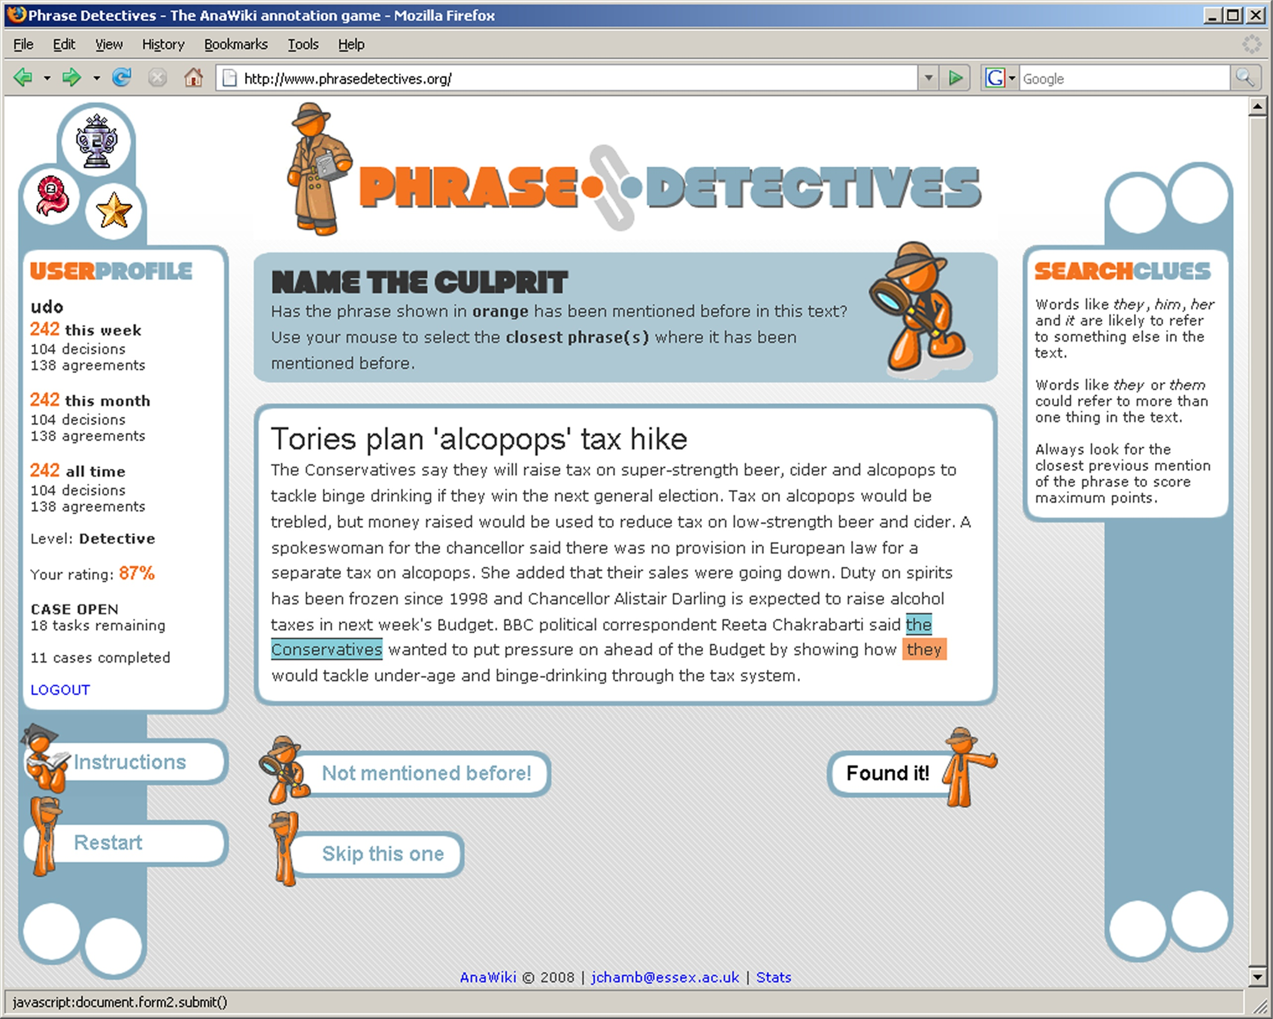
The game interface
www.phrasedetectives.org

Slide 4
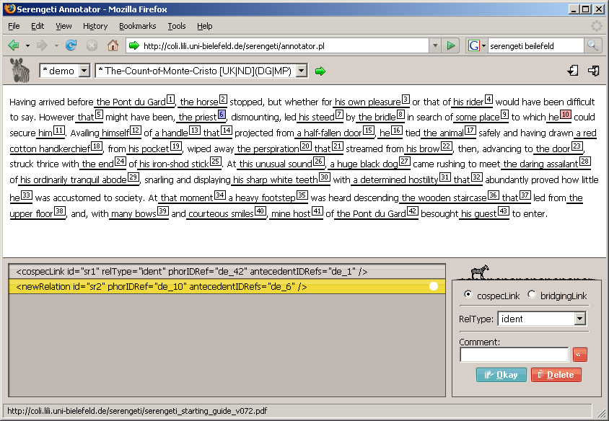
The expert annotation interface: Serengeti
www.text-technology.de/Sekimo

Slide 5
Some issues
Data selection
  Copyright
Text preparation

Slide 6
Data we are annotating
Narrative text from Project Gutenberg
  Sherlock Holmes, Aesop, Huckleberry Finn, Alice in Wonderland, Count of Montecristo…
Wikipedia
Text from the Open American National Corpus:
  Berlitz
  Slate
CAN WE ANNOTATE 100 MILLION WORDS?

Slide 7
The Conversion Process
Preparing 100M words for annotation (Mark Schellhase):
  Format-specific filters to normalize into ASCII
  Open NLP tokenizer / sentence detector
  Berkeley Parser
  Output converted into MAS-XML by scripts developed by Olivia Sanchez-Graillet and Mijail Kabadjov
  MAS-XML converted into SGF (Serengeti format) by scripts developed by Nils Diewald and Maik Stührenberg
(Under development) Correction via game and expert annotation
Preserving information about original text: TEI-style headers

Slide 8
JOIN IN!!
PLAY at www.phrasedetectives.org!
ANNOTATE or CORRECT at www.anaphoricbank.org!

Slide 9
Acknowledgments
Mark Schellhase and Olivia Sanchez-Graillet (Uni Essex)
Mijail Kabadjov (Uni Edinburgh)
The Uni Bielefeld SEKIMO project: Daniela Goecke, Nils Diewald, Maik Stührenberg

