Slide 1


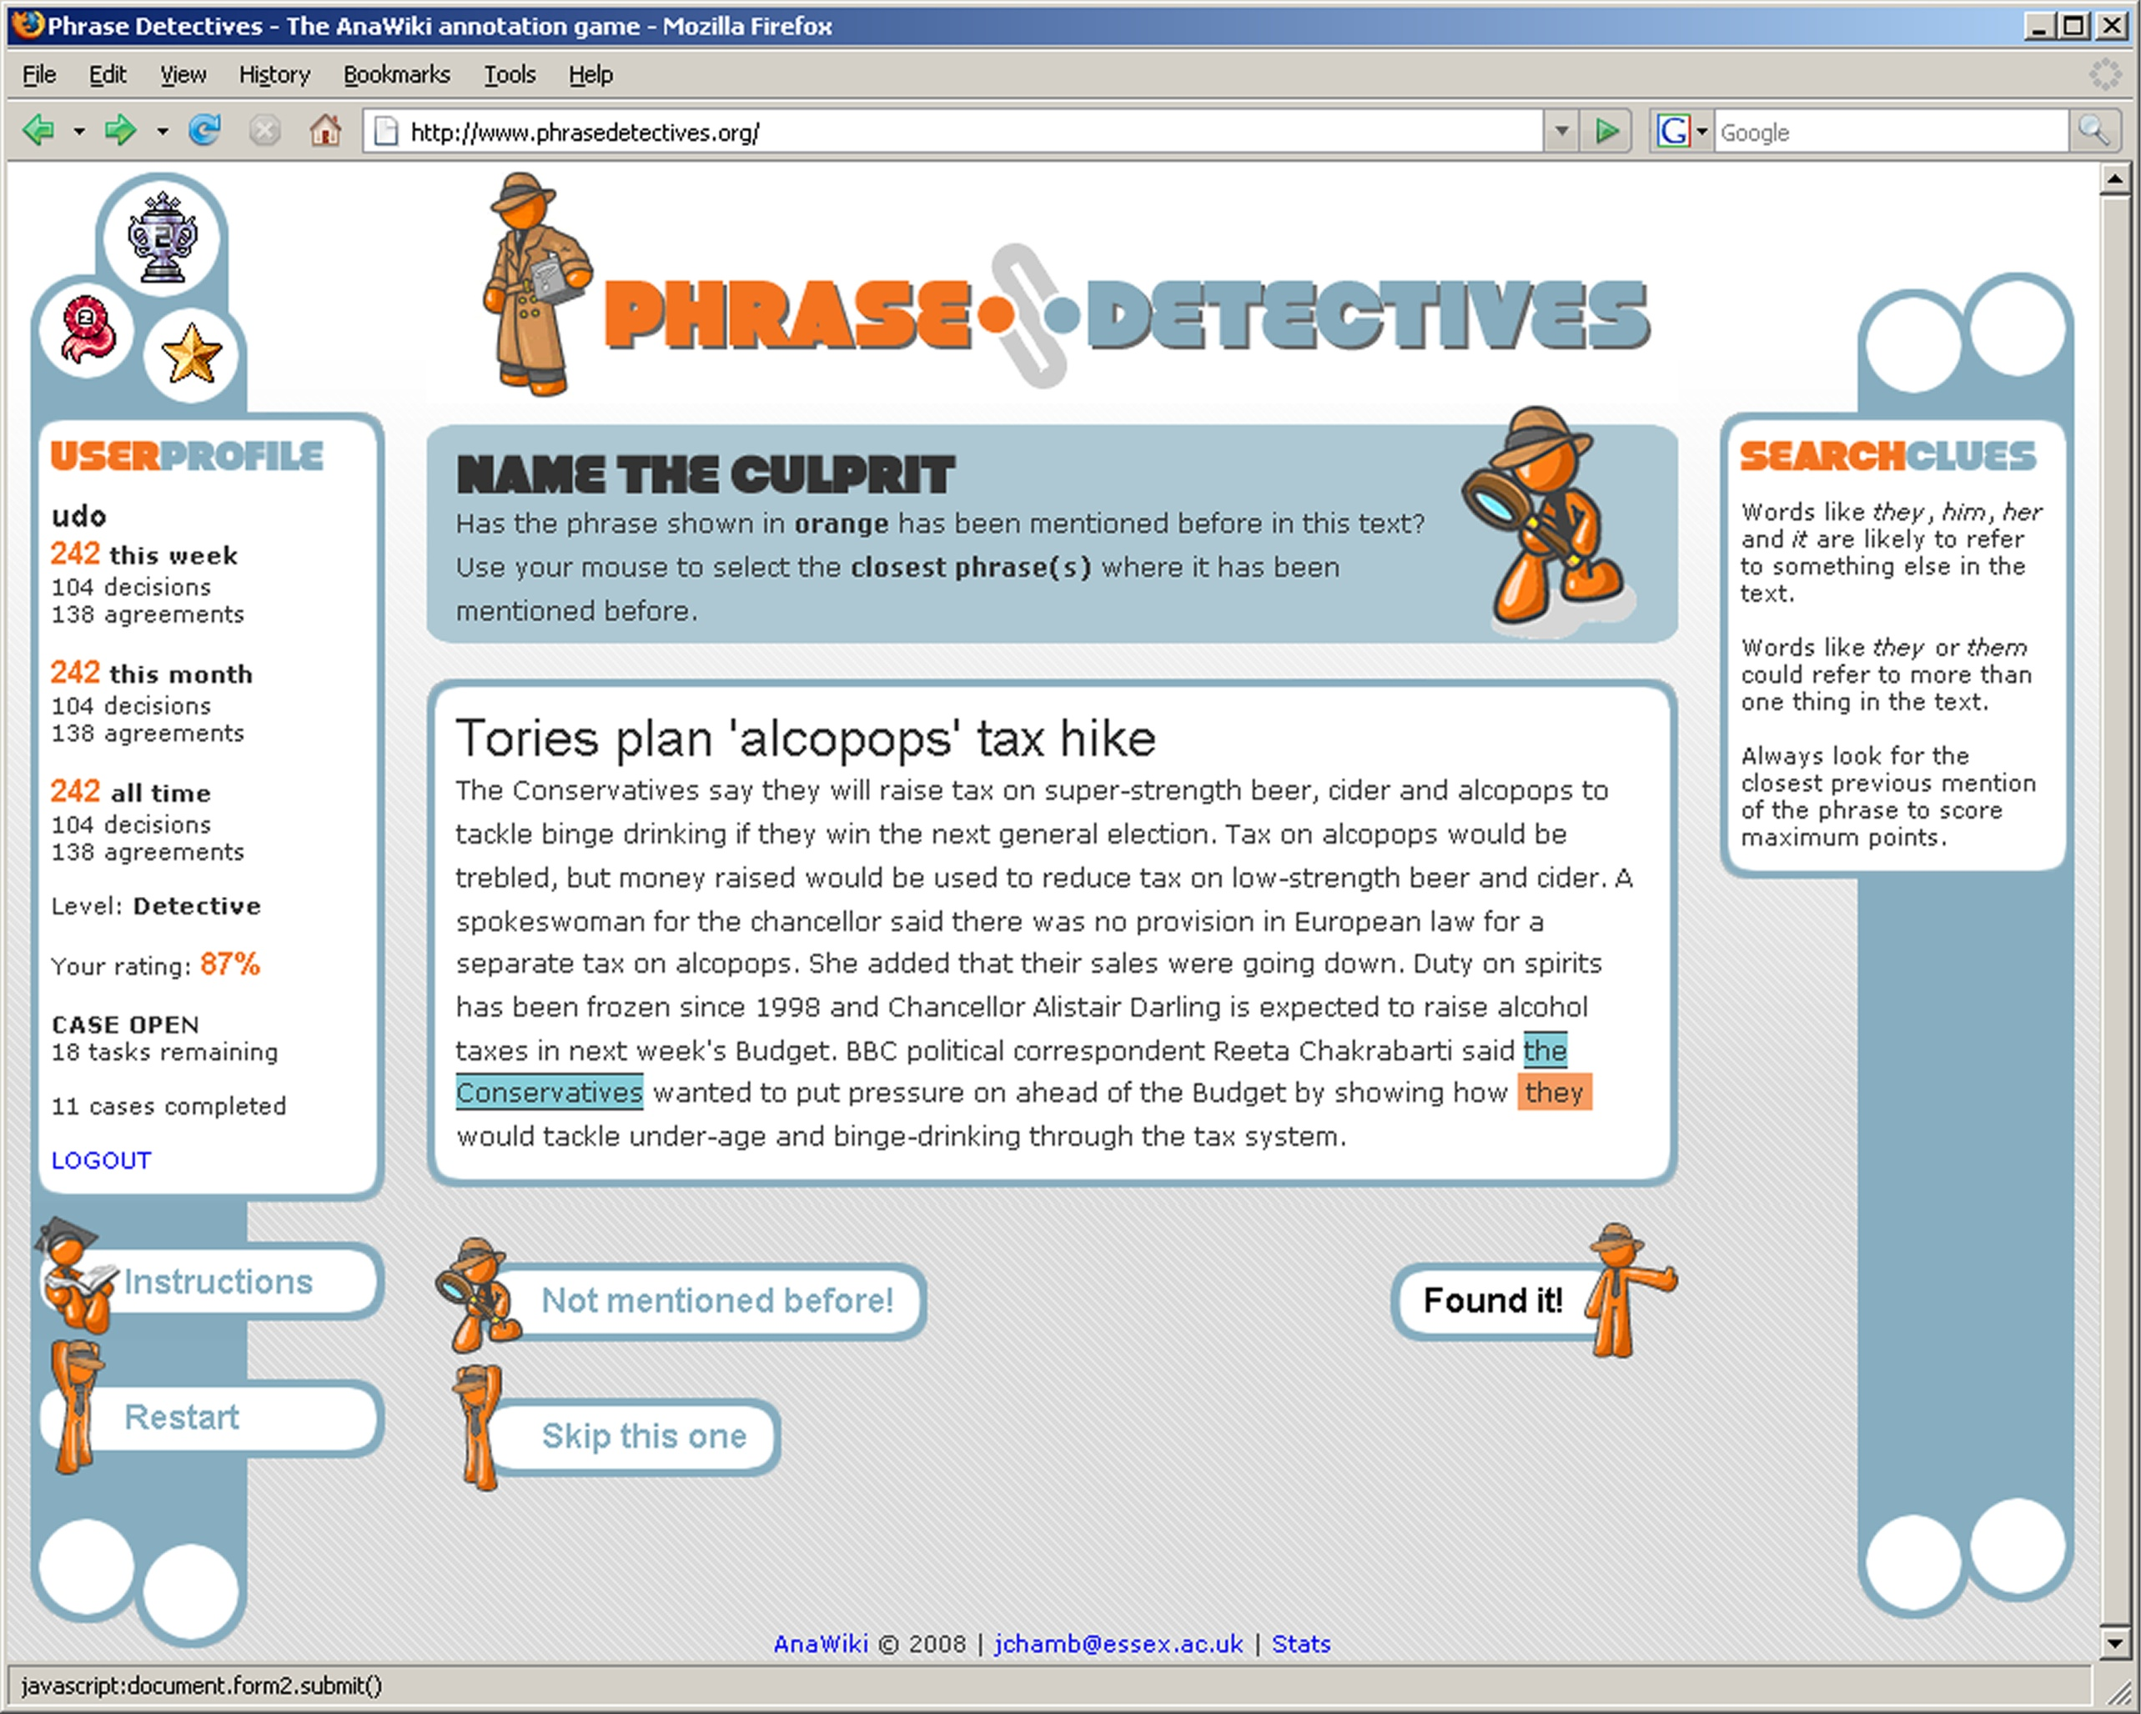
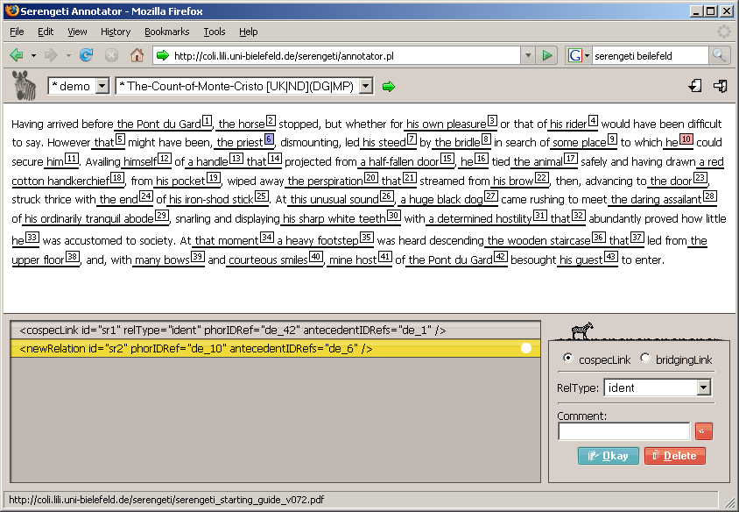
Addressing the Resource Bottleneck to Create Large-Scale Annotated Texts
Massimo Poesio, Udo Kruschwitz, Jon Chamberlain
www.anawiki.org
1. Semantic Interpretation: The Resource Bottleneck
Large-scale linguistically annotated resources have become available in recent years. This is partly due to sophisticated automatic and semi-automatic approaches that work well on specific tasks such as part-of-speech tagging. For more complex linguistic phenomena like anaphora resolution there are no tools that result in high-quality annotations without massive user intervention. Annotated corpora of the size needed for modern computational linguistics research cannot however be created by small groups of hand annotators.
2. AnaWiki: Objective
The AnaWiki project strikes a balance between collecting high-quality annotations from experts and applying a game-like approach to collecting linguistic annotation from the general Web population.
More generally, AnaWiki is a project that explores to what extend expert annotations can be substituted by a critical mass of non-expert judgements.
3. Web Collaboration
Collective resource creation on the Web offers a different way to the solution of this problem.
Wikipedia is perhaps the best example of collective resource creation, but it is not an isolated case. The willingness of Web users to volunteer on the Web extends to projects to create resources for Artificial Intelligence.
One example is the Open Mind Commonsense project, a project to mine commonsense knowledge (Singh, 2002) to which 18,000 participants contributed nearly 800,000 sentences.
A more recent, and perhaps more intriguing, development is the use of interactive game-style interfaces to collect knowledge such as Phetch, Verbosity and Peekaboom (von Ahn et al., 2006). Perhaps the best known example of this approach is the ESP game, a project to label images with tags through a competitive game (von Ahn, 2006); 13,500 users played the game, creating 1.3M labels in 3 months.
If we managed to attract 15,000 volunteers, and each of them were to annotate 10 texts of 700 words, we would get a corpus of the size of the BNC.
4. Expert and Game Annotation
It is expected that different types of volunteers will prefer different types of interface, and we plan at least two.
Game Interface We are developing and testing a game-like interface called Phrase Detectives to appeal to a large group of Web volunteers.
Expert Annotation A more conventional interface of the type familiar from annotation tools is being developed for (computational) linguists who want to cooperate in the effort of creating such resources on the Web, through the University of Bielefeld’s Serengeti software.
6. The Anaphoric Bank
AnaWiki is part of an effort to overcome difficulties in securing funding for annotation efforts, particularly in Europe, by creating the Anaphoric Bank – a multi-lingual anaphorically annotated corpus – through the collaboration of a number of sites each of which has been carrying out a limited amount of annotation.
The Anaphoric Bank will be organized as a ’club’ which can be entered by paying a ’fee’ of a certain amount of data annotated using one of the compatible formats and annotation schemes; membership will then give access to the rest of the annotated resources.
From a technical point of view, the Anaphoric Bank is made possible by the development of so-called ‘pivot’ standoff XML formats such as Potsdam’s Paula, into which data annotated with one of the several existing tools (MMAX, PALINKA, etc) can be imported and subsequently exported.
7. URLS
AnaWiki:
www.anawiki.org
Phrase Detectives:
www.phrasedetectives.org
Anaphoric Bank:
www.anaphoricbank.org
ARRAU:
dces.essex.ac.uk/Research/nle/arrau/
SEKIMO:
www.text-technology.de/Sekimo
PAULA:
www.sfb632.unipotsdam.de/~d1/
paula/doc/PAULA_intro.html
8. Acknowledgments
This research is supported by UK EPSRC, grant EP/F00575X/1. Thanks to the participants in the Anaphoric Bank consortium; the SEKIMO project at Uni Bielefeld: Daniela Goecke, Nils Diewald, Maik Stührenberg, and Dieter Metzing; Ron Artstein (USC / ICT, Los Angeles)
5. Ambiguous Annotation
AnaWiki builds on the proposals for marking anaphoric information allowing for ambiguity developed in ARRAU (Poesio and Artstein, 2005) and previous projects.
using numerous annotators (up to 20 in some experiments) leads to a much more robust identification of the major interpretation alternatives (although outliers are also frequent).
the identification of alternative interpretations is much more frequently a case of implicit ambiguity (each annotator identifies only one interpretation, but these are different) than of explicit ambiguity (annotators identifying multiple interpretations).
The ARRAU project also developed methods to analyze collections of such alternative interpretations and to identify outliers via clustering.
ASK US FOR A DEMO!
or try the game at:
www.phrasedetectives.org

