Slide 1
Analyzing the explanation structure of procedural texts: dealing with Advice and Warnings
Lionel Fontan, Patrick Saint-Dizier
IRIT – CNRS
Toulouse, France

Slide 2
Features of a procedural text
Project goal: to answer How-to questions: response is a wff text fragment + hints (advices, warnings).
Definition: a procedural text is a set of instructions designed to reach a goal, often expressed in the titles,
Large variety of forms (from injunctive to advices), domains: teaching texts, medical notices, social behavior recommendations, directions for use, assembly notices, do-it-yourself notices, itinerary guides, advice texts, cooking recipes , video games solutions.
Additional structures: pre-requisites, warnings, advices, and also: summaries, images, non-procedural information, etc.
→ Skeleton: goal/plan to which are associated a large number of useful structures to help/guide/evaluate/warn etc. the user.

Slide 3
Analysing procedural texts: situation
Several works in psychology, cognitive ergonomics, and didactics, (Mortara et ali. 1988), (Adam 1987), (Greimas 1983), (Kosseim 2000) to cite just a few.
Several facets, such as temporal and argumentative structures have then been subject to general purpose investigations in linguistics, but they need to be customized to this type of text. Same e.g. for action theory in AI.
There is very little work done in Computational Linguistics circles around explanation and argumentation structures.

Slide 4
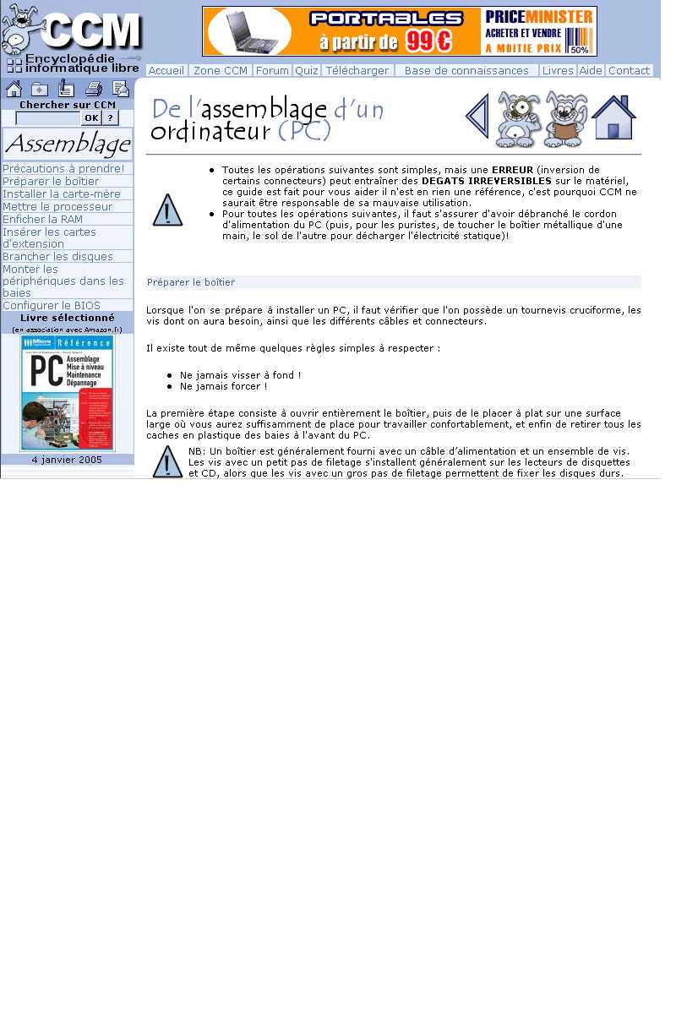
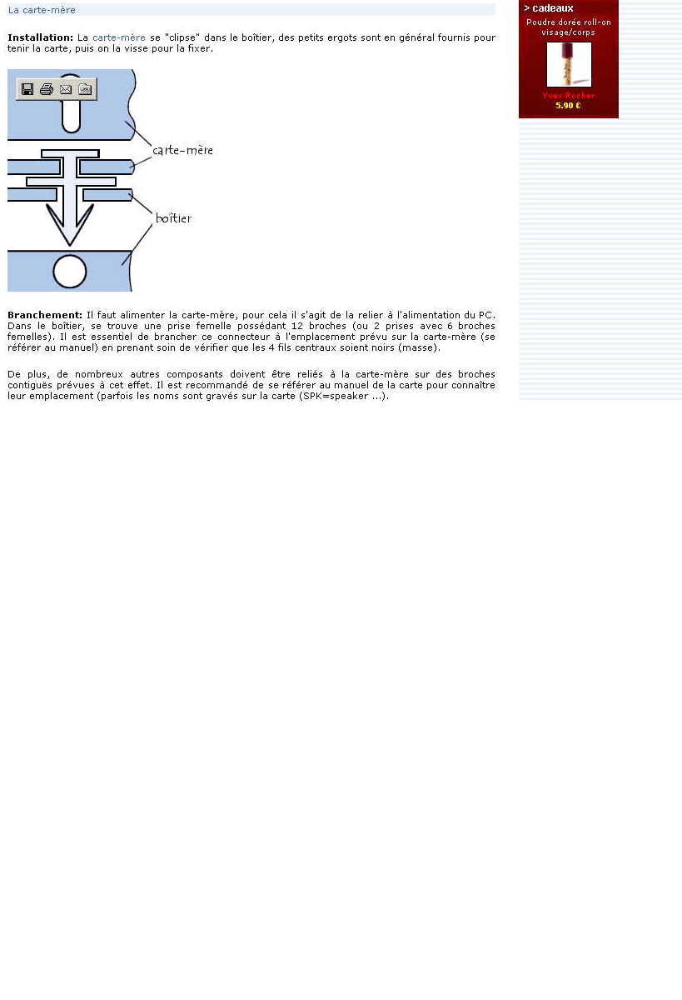
Title: main goal
warning
summary
subgoals
Notes:
Here is a text in french of how to construct a computer. We can see that this text has a complex structure. Blablabla
To the left
Let’s look more precisely to those instruction sequences.

Slide 5
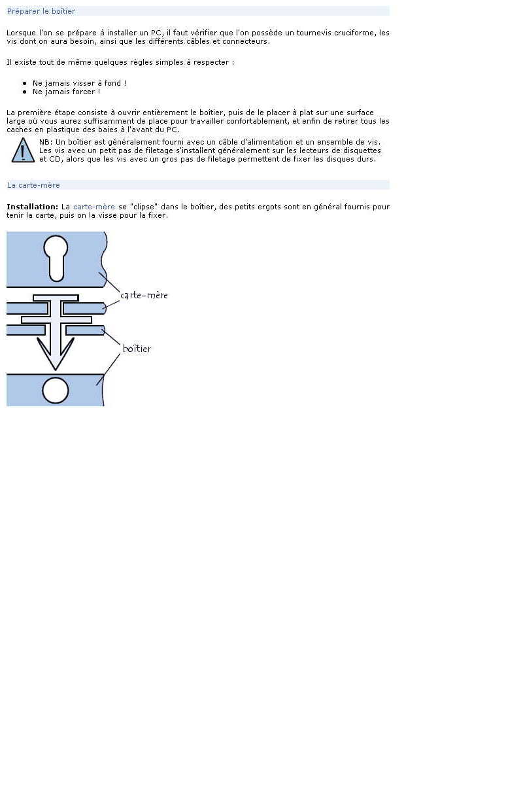
2 subgoals
Notes:
They are of an imperative type. And contains 2 instructions which have a complex structure.
If we concentrate on those instructions.

Slide 6
Title
Prerequisites
warnings
Title
Instructional compounds
image
Notes:
We can see that it’s a perfect exemple of recursion. Each complex instruction is viewed as an objective by itself.
Let’s focus now on the first instruction sequence.

Slide 7
1. The linguistic and conceptual parameters
Procedural aspects:
Titles (denoting main goals, used for question matching in most cases)
Instructional compounds: complex units containing organized sets of instructions + arguments, etc.
Pre-requisites.
Explanations and user support:
the goal/instruction is ‘supported’ by the explanation structure.

Slide 8
The linguistic parameters of Instructional compounds
motivation: instructions in isolation: too small a unit, too difficult to recognize (ellipsis, coordination, etc.),
Instructions in isolation do not correspond to an autonomous unit
Instructional compound: Instructions associated with:
Causal structures: intend to: push the button to start the engine, instrumental, facilitation, continue, etc.
Conditions
Goal structures: to …, for …, in order to….
Argumentation structures: justification, etc.
Rethorical structures: motivation, circonstance, elaboration, instrument, precaution, manner.
and, within instructions:
Deontic marks: obligatory / optional / forbidden / autonomous,
Illocutionary force marks: advised, recommended, to be avoided, etc.
→ These obey in general to relatively strict scoping relations

Slide 9
A dependency analysis
[if you wish to leave some blanks on the sheet of paper,]
conditional
[prepare a piece of rag to suck the paint or
Main instructions
In alternance
Hide portions of your paper with liquid gum.]
facilitation
[you must go slightly beyond the zone you want to hide:
Explanation (advice)
Color may diffuse inside by capilarity.]

Slide 10
A more complex case
[In the bedroom it is necessary to clean curtains. justification]
[Dust is removed by using a vacuum cleaner, instruction]
[then curtains can be, if they are in cotton, put in the washing machine at 60°. instruction]
[if they are white,[it is recommended illocutionaryF] to add a little bit of bleech
[to make them whiter goal]
elaboration/advice].
[With some starch, these curtains are much easier to iron . advice]]

Slide 11
The explanation structure
Facilitation (How-to ?):
(1) user help, with: hints, evaluations and encouragements, and
(2) controls on instruction realization, with two cases:
(2.1) controls on actions: guidance, focusing, expected result and elaboration and
(2.2) controls on user interpretations: definitions, reformulations, illustrations and also elaborations.
Argumentation: (why do X ?) questions.
(1) a positive orientation with the author involvement (promises) or not (advices and justifications) or
(2) a negative orientation with the author involvement (threats) or not (warnings).
Carefully plug in your mother card otherwise you will damage the connectors.

Slide 12
Argumentation in procedural texts
The general form of an argument is :
Conclusion (instruction) ’because’ Support
avoid to spray any chemical product on your trees when it is too cold, because this may burn their buds
Supports can themselves receive supports :
don’t add natural fertilizer,
this may attract insects,
which will damage your young plants.
A conclusion may get a warning and an advices
Arguments are isolated: no attack, contradictions, etc.
Scope of an argument: the instructional compound in which it occurs

Slide 13
A generalized view for procedural texts within action theory
Goal G realized by means of a sequence of instructions A_{i}
Any A_{i} is associated with a support S_{i} (possibly not realized):
G (iff):
A₁ S₁
A₂ S₂
….
A_{i} S_{i}
….
A_{i}: instructions or instructional compounds

Slide 14
success of G
To each pair A_{i} S_{i} is associated a vector:
(p_{i}, g_{i}, d_{i}, t_{i})
Where:
p_{i}: penalty on G if A_{i} not correctly executed
g_{i}: gain on quality of G when advices are executed
d_{i}: intrinsic difficulty of an instruction (evaluated via marks + lexical semantics)
t_{i} : degree of explicitness of an A_{i} (evaluated w.r.t. contents).

Slide 15
Penalty: > 0 when
A_{i} S_{i} (=empty) not correctly realized or
(2) when A_{i} W_{i} (warning) not correctly realized.
Pb: concrete evaluation of penalty ?
Gain: when A_{i} S_{i}, S_{i} is an advice, A_{i} executed.
Include user performance for each action, modelled by: μ_{i}, τ_{i}
Two independent measures;
Penalties on G = ∑(i=1,n) (p_{i} x μ_{i})
Gains on G = ∑(i=1,n) (g_{i} x τ_{i})
Do not compensate each other.

Slide 16
Representing penalties and gains : a simple solution
Use a three place vector representing quality of execution, reflecting thus penalty costs:
(good, average, failure), 4 prototypes of actions
Essential action : (0, N, infinite)
Important action: (0, 1, N)
Useful action: (0,0,1) Optionnal action: (0,0,0).
Same for gains:
Important advice : (0, 1, M)
Useful if done completely : (0, 0, 1)
No advice (0, 0, 0).

Slide 17
Measuring the intrinsic difficulty of an action
Some parameters:
- complex manners (very slowly),
- technical complexity of the verb used,
- length of execution (the longer the more difficult),
- synchronization between actions
- uncommon tools,
- presence of evaluation statements.
Importance to be evaluated by means of psycholinguistic experiments
The higher d is the more risky the instruction is

Slide 18
Measuring the explicitness of an instruction
Characterizes the degree of precision of an instruction:
- when appropriate: existence of means or instruments,
- length of action explicit when appropriate,
- list of items as explicit and low level as possible
- existence of an argument.
Those criteria are highly dependent of the domain !
The higher t is, then the instruction has more chances to succeed

Slide 19
2. The system and its implementation
Architecture, main steps:
(1) entry: cleaning web pages, while keeping relevant tags and tagging relevant constituents via the TreeTagger,
(2) segmentation: of main constituents: titles, prerequisites, intructions and instructional compounds, arguments,
(3) grammar level: kind of X-bar syntax transposed to discourse level.

Slide 20
Identifying arguments
Investigate argument structure: in procedural texts they seem to follow quite precise forms (so that they can easily be recognized and understood)
It is then possible to define a set of patterns that recognize instructions (conclusions) and their related supports.
Realized from a development corpus of about 1700 texts from various domains (cooking, do it yourself, gardening, video games, social advices, etc.).
Implemented as perl scripts (with internal automata), executed sequentially
Tags arguments in texts (in addition to other marks).

Slide 21
warnings
Conclusions:
(1) ’prevention verbs like avoid’ NP / to VP (avoid hot water)
(2) do not / never / ... VP(infinitive) ... (never put this cloth in the sun)
(3) it is essential, vital, ... to never VP(infinitive).
Supports :
(1) via connectors such as: otherwise, under the risk of, etc. or via verbs expressing consequence,
(2) via negative expressions of the form: in order not to, in order to avoid, etc.
(3) via specific verbs such as risk verbs introducing an event (you risk to break). In general the embedded verb has a negative polarity.
(4) via the presence of very negative terms, such as: nouns: death, disease, etc., adjectives, and some verbs and adverbs. We have a lexicon of about 200 negative terms found in our corpora.
Never use hot water, otherwise this will burn the spot

Slide 22
advices
Conclusions:
(1) advice or preference expressions followed by an instruction. Expressions may be a verb or a more complex expression: is advised to, prefer, it is better, preferable to…
(2) expression of optionality or of preference followed by an instruction: our suggestions: ..., or expression of optionality within the instruction (use preferably a sharp knife).
Supports:
(1) Goal exp + (adverb) + positively oriented term.
(2) goal expression with a positive consequence verb (favour, encourage, save, etc.), or a facilitation verb (improve, optimize, facilitate, embellish, help, contribute, etc.),
(3) the goal expression in (1) and (2) above can be replaced by the verb ’to be’ in the future: it will be.
To clean your leathers, use professional products, and prefer them colorless, they will contribute to their maintenance, add beauty and do minor repairs.

Slide 23
Sortie_ARG.html
{Composé Instructionnel {Instruction Utilisez une vis d' un diamètre adapté à la cheville utilisée . }
{Instruction {Argument {Conclusion(Avertissement) Décalez les clous par rapport au fil du bois } {Support(Avertissement) pour ne pas ouvrir une ligne de faiblesse , ce qui fragiliserait le bois et risquerait de le fendre } } } }
{Composé Instructionnel {Instruction Toutes les surfaces à peindre doivent être parfaitement préparées , propres et sèches ( lessivage , ponçage ... }
{Instruction {Argument {Conclusion(Avertissement) N' oubliez pas de protéger le sol . } {Support ( il pourrait être taché ) } } } }

Slide 24
evaluation
We carried out an indicative evaluation (e.g. to get improvement directions) on a corpus of 66 texts over various domains, containing 302 arguments, including 140 advices and 162 warnings.
This test corpus was collected from a large collection of texts from our study corpus. Domains are in 2 categories: cooking, gardening and do it yourself, which are very prototypical, and 2 other domains, far less stable: social recommendations and video game solutions (e.g. status of instruction-advices and arguments less clear).
Comparison between manually annotated texts and system performance.

Slide 25
Warnings:
Advices:
Conclusion recognition | Support recognition | Conclusions well delimited | Supports well delimited
88% | 91% | 95% | 95%
Conclusion recognition | Support recognition | Conclusions well delimited | Supports well delimited | Correct correlation
79% | 84% | 92% | 91% | 91%

Slide 26
Conclusion
Fully implemented, simple implementation, but results are satisfactory for instruction, title and argument extraction.
Procedural texts contain a large variety of arguments of much interest for AI investigations, however, arguments appear in isolation, not as chains attacking each other.
Future:
- evaluate illocutionary force of arguments (but very user dependent),
- evaluate portability to other types of texts where argumentation is present (news, editorials, legal texts, didactics, etc.)
- construct a textual database of hints on a given domain.

