Slide 1
Evaluation of Freely Available Speech Synthesis Voices for Halef
Martin Mory, Patrick Lange, Tarek Mehrez, and David Suendermann-Oeft
NLPCS 2014, Venice, 28 October 2014

Slide 2
Agenda
About Myself
Halef
Experimental Setup
Results
Conclusion
Future Work
Q/A

Slide 3
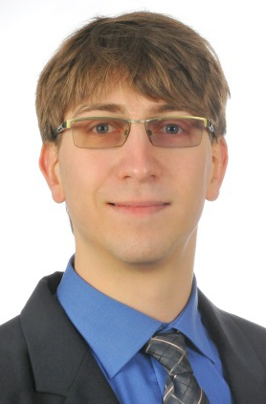


About Myself
10/11 – 09/14 Studying Applied Computer Science at DHBW Stuttgart, Germany within the HP DualStudy Program of Hewlett-Packard Germany
From 10/14 Studying IT Security at TU Darmstadt within the Master@HP Program of Hewlett-Packard Germany

Slide 4
Halef
Distributed Spoken Dialog System
Main features: - open source - virtual-server-based - distributed - telephony-based - industry-standard-compliant
Protocols: JSGF, MRCP, RTP, SIP, VoiceXML

Slide 5
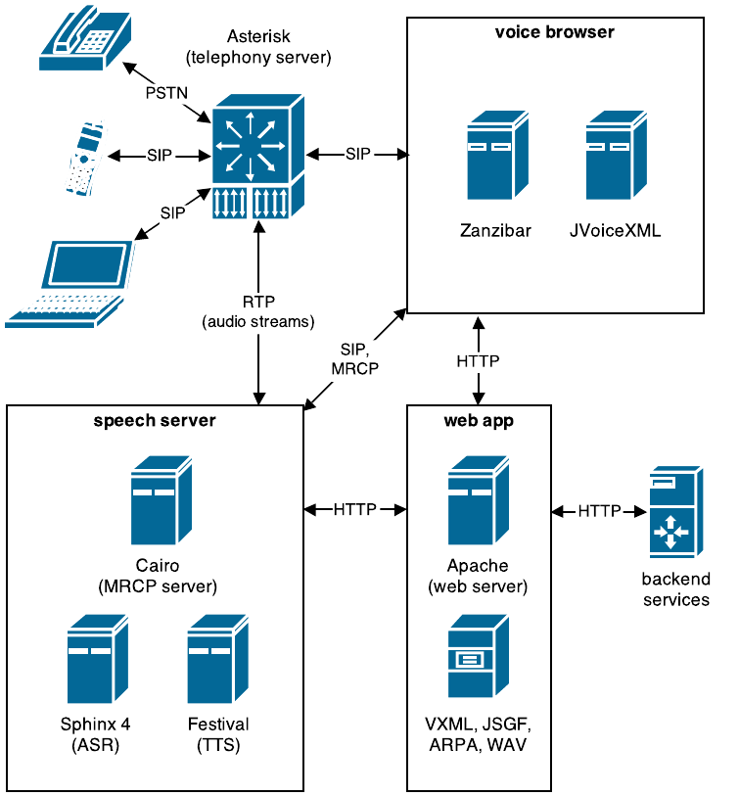

Slide 6
TTS Engines in Halef
Replaced obsolete FreeTTS by Festival and Mary TTS, following the Blizzard Challenge results
Issue: TTS voices of the Blizzard Challenge not publicly available
Therefore conducting own studies to determine which of the publicly available voices are rated best

Slide 7
Publicly Available TTS Voices
Voice | System | Technique
cmu-bdl-hsmm | Mary | HSMM
cmu-rms-hsmm | Mary | HSMM
cmu-slt-hsmm | Mary | HSMM
cmu_us_awb_cg | Festival | Clustergen
cmu_us_clb_arctic_clunits | Festival | Cluster Unit Selection
cmu_us_rms_cg | Festival | Clustergen
cmu_us_slt_arctic_hts | Festival | HMM
dfki-obadiah-hsmm | Mary | HSMM

Slide 8
Publicly Available TTS Voices (II)
Voice | System | Technique
dfki-obadiah | Mary | Unit Selection
dfki-poppy-hsmm | Mary | HSMM
dfki-poppy | Mary | Unit Selection
dfki-prudence-hsmm | Mary | HSMM
dfki-prudence | Mary | Unit Selection
dfki-spike-hsmm | Mary | HSMM
dfki-spike | Mary | Unit Selection
kal_diphone | Festival | Diphone Unit Selection

Slide 9
Experimental Setup
Test audience consisting of 36 persons
Participants with and without knowledge about speech processing
Six-point Likert scale: ’utterly bad’ (1), ’poor’ (2), ’okay’ (3), ’fine’ (4), ’good’ (5) and ’excellent’ (6)
Reference Text: “This is some example speech to evaluate the quality of available Festival and Mary voices”
Significance test: Welch’s t test

Slide 10
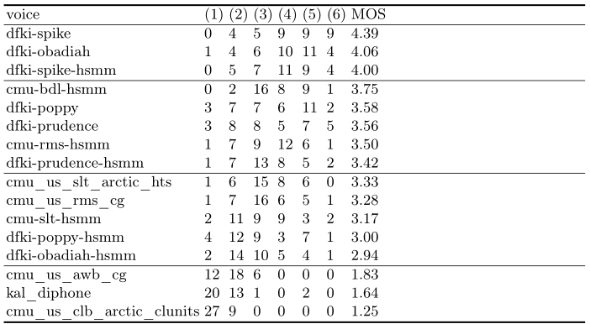
Results - Overview

Slide 11
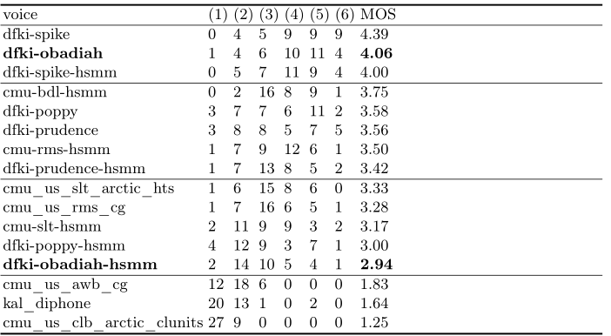
Results – HSMM vs Unit Selection

Slide 12
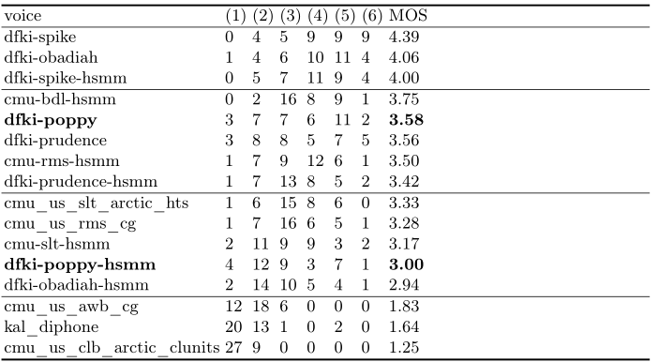
Results – HSMM vs Unit Selection

Slide 13
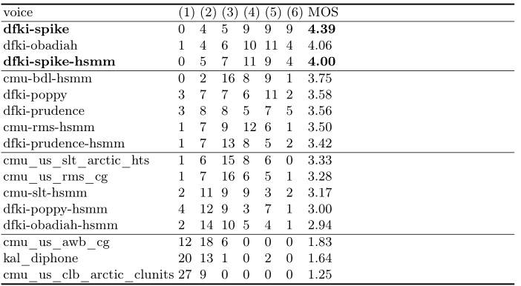
Results – HSMM vs Unit Selection

Slide 14
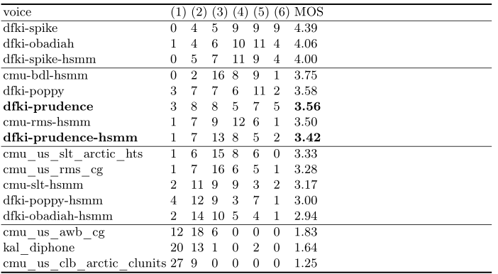
Results – HSMM vs Unit Selection

Slide 15
Conclusion
Unit selection voices rated better than HSMM counterparts
Mary voices outperformed Festival voices in the test field

Slide 16
Future Work
Evaluate promising candidates in actual operation within Halef

Slide 17
Q/A

