Slide 1
How to Make Right Decisions Based on Corrupt Information and Poor Counselors
Tuning an Open-Source Question Answering System

Slide 2
The Authors
Michael Muck
Former student at the DHBW Stuttgart, Germany
Working for Tesat-Spacecom in Backnang, Germany
David Suendermann-Oeft
Educational Testing Service, Director of Research in San Francisco, USA

Slide 3
Structure
Introduction
Reflections on the test set
Architecture of OpenEphyra
Evaluation
System Combination
Conclusion and Future Work
Notes:
IV. In the Evaluation we tried to replace the commercial API with a web search for free

Slide 4
I. Introduction
QA is a growing domain
Watson Deep QA from IBM, Siri, Google now, Wolfram Alpha, …
Open-source software OpenEphyra
compare different QA systems by means of a test set

Slide 5
II. Reflections on the test set
Test set contains questions and canonical answers
NIST-TREC11 corpus (500 entries)
Multiple issues with a static test set

Slide 6
IIa. Time Dependence
Answers may be obsolete
Who is the governor of Colorado?
- John Hickenlooper
- Bill Ritter

Slide 7
IIb. Missing Answers
Multitude of terms referring to the same phenomenon
What is the fear of lightning called?
- astraphobia
- astrapophobia
- brontophobia

Slide 8
IIc. Scientific Ambiguity
Different studies may provide different results
How fast does a cheetah run?
- 70 mph (discovery.com)
- 75 mph (Wikipedia.com)

Slide 9
IId. Degree of Detail
No clear specification how detailed an answer should be
How did Eva Peron die?
- death
- disease
- cervical cancer
Where are the British Crown jewels kept?
- Great Britain
- London
- Tower of London

Slide 10
IIe. Partial Answers
Not all parts of the answer are necessary
Who was the first woman to run for president?
- Victoria Claflin Woodhull
- Victoria Woodhull
- Victoria
- Woodhull

Slide 11
IIf. Different units
Differences in physical units
How high is Mount Kinabalu?
- 4095 meter
- 4.095 kilometer
- 13,435 feet

Slide 12
IIg. Effect on the results
Accuracy gain from 37.6% to 55.8%
Not comparable to tests from before
Comparison does not need a 100% correctness of a test set

Slide 13
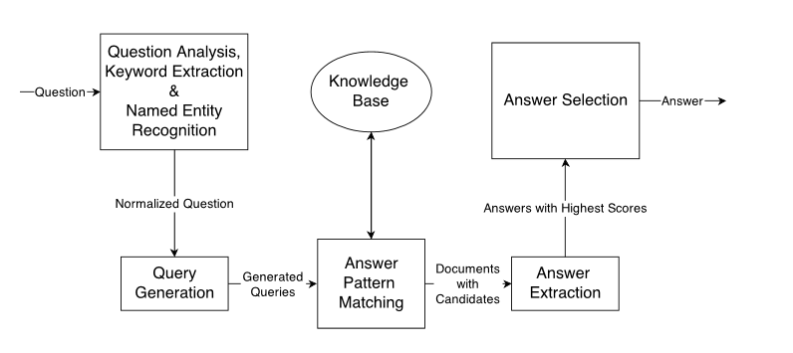
III. Architecture of OpenEphyra
Notes:
- Knowledge Base are APIs in the standard implementation (not free so we tried to replace it with free web searches like google…)

Slide 14
IIIa. Concrete Example of OpenEphyra
Question
When was Albert Einstein born?
Queries
Albert Einstein was born in X
Albert Einstein was born at X
Documents
Wikipedia.com/Einstein
Einstein.com
Answers
14.03.1879 (Score 0.875)
18.04.1955 (Score 0.12)
Answer type = “date”
Notes:
Also recognizes that the answers is from the type “date”

Slide 15
IV. Evaluation
Search engines (Bing, Ixquick, BingW, Google)
Tried to replace the commercial API with a free of charge web search
Number of queries
Number of documents
Answer type

Slide 16
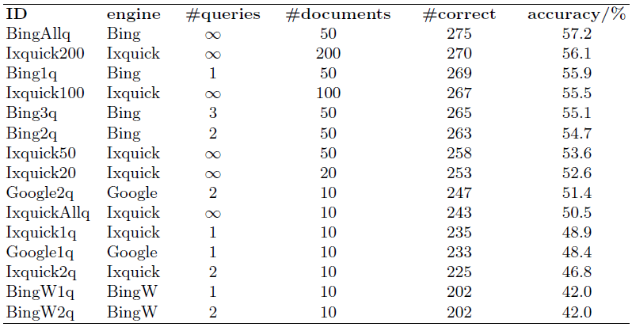
IVa. Systems used
Notes:
What means q and a number without a q

Slide 17
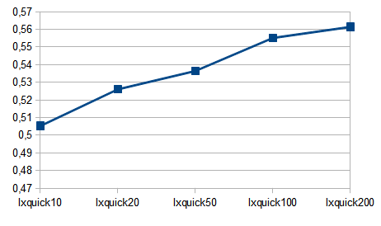
IVb. Number of Documents

Slide 18
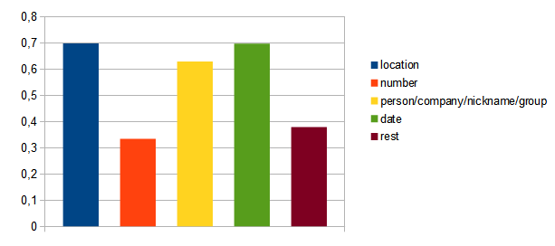
IVc. Answer Types
Notes:
Location and date are the best. Location because of a database with contries and cities. Date because of a specific pattern of the answer.

Slide 19
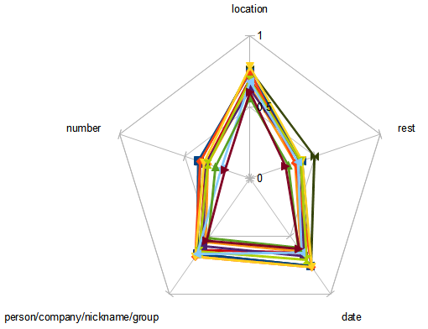
IVd. Overview of the Results
Notes:
- Behavior while changing the knowledge base is quite the same (-> main problem is the parser, not a bad knowledge base)

Slide 20
V. System Combination
Performance gain through combining systems
Merge the best answers of the systems together
The systems get a weight
Answer match:
newValue = p*Asys1+(1-p)*Asys2

Slide 21
Va. System Combination
Who is president of the United States?
System 1 (p = 0.7)
- Bush (0.8)
- Obama (0.6)
- Clinton (0.4)
System 2 (1-p = 0.3)
- Obama (0.7)
- Eminem (0.3)
- Clinton (0.2)

Slide 22
Va. System Combination
Who is president of the United States?
System 1 (p = 0.7)
- Bush (0.8)
- Obama (0.6)
- Clinton (0.4)
System 2 (1-p = 0.3)
- Obama (0.7)
- Eminem (0.3)
- Clinton (0.2)
Merged System
- Bush (0.56)
0.7*0.8+(0.3*0)

Slide 23
Va. System Combination
Who is president of the United States?
System 1 (p = 0.7)
- Bush (0.8)
- Obama (0.6)
- Clinton (0.4)
System 2 (1-p = 0.3)
- Obama (0.7)
- Eminem (0.3)
- Clinton (0.2)
Merged System
- Obama (0.63)
- Bush (0.56)
0.7*0.6+(0.3*0.7)

Slide 24
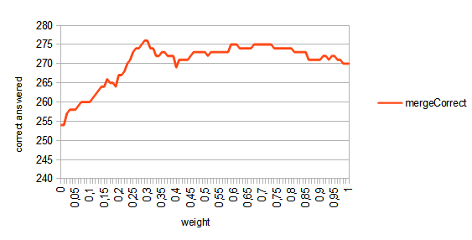
Vb. System Combination
Ixquick20
Ixquick200
Notes:
Optimizing the p-value

Slide 25
VI. Conclusion and Future Work
Conclusion
Shown problems with outdated test set
Replaced the commercial APIs with standard web search
Tuning a QA system
Future work
Tuning underperforming answer types
Break the rest group down into multiple sub-groups

Slide 26
The End
Thanks for your attention

