Slide 1

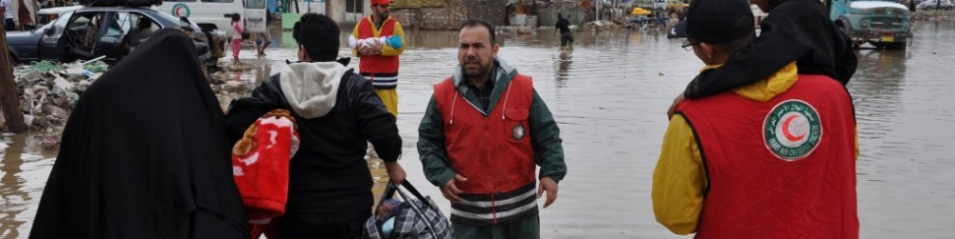
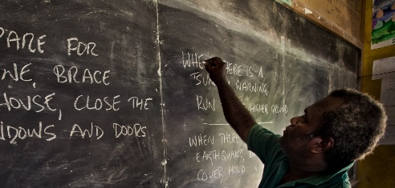
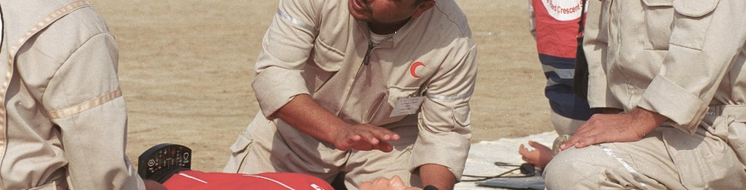

ISD Long-term Recovery Theory of Change
Concept of operations, Cross-cutting programming principles, Theory of change

Slide 2
Long-term Recovery Assumptions and Concept of Operations:
National Society requests ISD and Movement support
Funding is available for recovery operation through grants and public donations, likely as a result of international media attention for the disaster
Affected populations’ immediate disaster-caused needs are being met by response effort
Verifying assumptions
Decision points: 1. Which interventions align with ToC; 2. Where to implement them; 3. How to sequence interventions; 4. How to allocate finances
Coordinate with actors in the humanitarian sector and identify opportunities to fill gaps and add value
Understand and integrate into NS and Federation plan
Consider work done in the response (relief and early recovery) phase
Understand needs of community through secondary data review and consultations with response team
Assess American Red Cross local assets to inform operational modality decision
Determine Scope and Scale of Recovery Support
Decide on operational modality (one or a combination of the options below)
Determine Operational Modality
Strengthen bilateral relationship with host National Society
Contribute to Movement recovery coordination options
When scope of disaster exceeds capacity of the Movement, formalize external partnerships to engage complementary skills and access local knowledge
Community assessments and intervention design
Notes:
Though we have adopted the name from the domestic program essentials doctrine, we’ve long had this element in our ToC to capture the key operational considerations when setting up a recovery program and deciding what AmCross’s role will be. We’ve decided to capture these considerations in a sequential step-by-step way. The first step is verifying assumptions. Assumptions are a critical element in theories of change and it’s important at the beginning of any new recovery program to review these to determine if they hold true or not. If one or more are not true, then we will not be able to move forward with a recovery program. There are dozens of assumptions that could be listed, but we’ve had hours of discussion to narrow them down to four key, high-level assumptions. They are… [read them all].
If all four assumptions hold true, then we advance to step 2: determine scope and scale of recovery support. This step captures four key activities we need to complete to bring us to four decision points. We need to… [read activity boxes]. Which will allows us to make decisions on… [read decision points]
Then we move to step 3 where we determine AmCross’s operational modality. The options are 1) strengthen the bilateral relationship with the host national society, 2) contribute to Movement recovery coordination options, and 3) if the scope of the disaster exceeds the capacity of the host national society, we will formalize partnerships to engage complementary skills and access local knowledge.
Then we go to step 4 where we begin community assessments and design the interventions.

Slide 3
ISD Cross-cutting Programming Principles
Program assessment, design, and implementation are guided by an approach that focuses on effective engagement with, and accountability to, affected populations while ensuring that vulnerable populations are meaningfully included in decision-making and protected from harm, and pursuing data-driven decision-making and continuous learning.
Protection, Gender, and Inclusion (PGI)
Community Engagement and Accountability (CEA)
Data-driven decision making and continuous learning
Identify, understand, and respond to people with access and functional needs
Build upon community strengths
Pursue community- and owner-driven solutions
Reinforce self-coping mechanism
Data literacy
Organizational learning and knowledge management
Research community conflict dynamics
Follow the IFRC PGI guidance
Follow the IFRC CEA guidance:
Listen to and act on community needs and feedback
Provide information as aid
Support behavioral change and social change communication
Support communities to speak out
Step 5: Implementation of the Recovery Theory of Change
Notes:
This slide captures the critical elements of programming that should be a part of all our recovery projects. Throughout our discussions to build out the ToC, it became apparent that we needed an element in the ToC to capture critical pieces of programming that should be consistently implemented across all projects, regardless of sector or ultimate outcome sought. We decided on inclusion, which is now being call PGI in the Movement, and CEA. We have taken them a step further by adding boxes underneath that capture exactly what we will do in PGI and CEA. The third box: data-driven decision making and continuous learning came out of other discussions across the wider department and we included it in order to align ourselves with ISD-wide thinking.

Slide 4
Communities enabled to recover
Communities prepared for future disasters
Expanded Movement capacity and reach
Notes:
Three visualization ideas to convey interplay among objectives

Slide 5
ISD
Long-Term
Recovery
Theory of Change
Objective 1: Expanded Movement capacity and reach
Expected impact:
A reduction in deaths, injuries and economic losses caused by disasters in countries supported by the American Red Cross
Developed national society (NSD)
Expanded recovery capacity and reach of Movement
Affected Red Cross or Red Crescent societies and the Movement have improved and expanded capacity and reach in recovery efforts, and in future national preparedness and response readiness.
Objective 2: Communities enabled to recover
Objective 3: Communities prepared for future disasters
Affected individuals have access to safe and connected housing and living conditions (shelter and settlements)
Affected individuals have re-established a sense of place
Affected individuals have the means to recover their livelihoods after a disaster
Affected individuals are able to manage disaster-caused health risks and access recovered health systems
Communities are self-organized and connected for recovery
Communities understand local risks and capacities
Communities are self-organized
Communities are connected with external entities to access additional areas of expertise
Communities implement preparedness actions
Affected individuals have re-established a sense of place and have the means and resources to recover; and affected communities are inclusive, connected and taking action for their collective well-being.
Affected households and communities are aware of their disaster vulnerabilities and risks and can take action to reduce losses during recurring shocks and hazards, as well as future disasters.
ISD Recovery Pillar Goal: Improved lives for individuals and families, safer and more resilient communities, a response-ready national society, and reduced losses during future disasters.
Notes:
We have matched the format and colors of the preparedness pillar’s ToC. This slide summarizes at a high level the content in the recovery ToC.

Slide 6
Strategic Objective 1: Movement Capacity and Readiness
Affected Red Cross or Red Crescent societies and the Movement have improved and expanded capacity and reach in recovery efforts, and in future national preparedness and response readiness.
Expanded recovery capacity and reach of Movement
Developed national society (NSD)
Movement recovery operations are supported
Movement-wide learning and continuous improvement of recovery programming is supported
Enhanced Movement coordination for recovery
NS is supported to scale up and scale down recovery operations
Standing of NS is enhanced through recovery operations
NS recovers/builds back stronger after disaster
NS is prepared for effective response
NS has strong institutional capacities
Enhance ability to engage with government, communities, and Movement
Asset replacement
Policy, strategy, and standards
Analysis and planning
Organizational minimum standards
Contribute financial, technical, or material assistance
Influence and align with Movement-wide recovery tools and guidance
Participate in recovery working group
Supplement financial and technical capacity of NS to meet recovery needs and be an auxiliary to the government
Advocate for an efficient and effective coordination mechanism
Operational capacity
Movement and external coordination
Influence Movement approach to safe living conditions (shelter and settlements) based on AmCross experience and expertise
Contribute to relevant global reports and compendiums
Operations support
Organizational capacity assessments and improvements
Notes:
This slide is a deep dive into the content of strategic objective 1. The different levels are: overall strategic objective (at the top), primary outcomes (in orange), secondary outcomes (in light orange), and activity boxes (in grey). The arrows show the connection and causality between the boxes. When we’re setting up new recovery programs, we need details about what activities we do in recovery to reach our high-level outcomes and objectives.
Here we have the two primary outcomes under this objective: expanded recovery capacity and reach of Movement, and NSD. The next two levels are the secondary outcomes in light orange and the activity boxes in grey, which capture specifically how we contribute to these two outcomes in recovery. You’ll see we don’t include the full breadth of NSD, but we call out what NSD looks like a recovery program.

Slide 7
Strategic Objective 2: Enabled to Recover
Affected individuals have re-established a sense of place and have the means and resources to recover; and affected communities are inclusive, connected and taking action for their collective well-being.
SO3 links to this
Affected individuals have access to safe and connected housing and living conditions (shelter and settlements)
Affected individuals have re-established a sense of place
Affected individuals have the means to recover their livelihoods after a disaster
Affected individuals are able to manage disaster-caused health risks and access recovered health systems
Communities are self-organized and connected for recovery
Links to SO3
Affected individuals have access to safe and adequate housing
Affected individuals have access to safe community infrastructure and essential services
Affected individuals have access to psychological first aid
Affected individuals have access to community support groups and resources
Cultural activities have resumed
Affected individuals are connected to social safety net support
Affected individuals have a diverse range of employment and income opportunities
Affected individuals have access to an effective range of financial tools and services (formal or informal)
Preventative health and hygiene behaviors are adopted
Affected individuals have access to basic healthcare
Communities are connected with external actors
Links to SO3
Disaster-caused emerging health needs are addressed
Create or reinforce pathways
Psychosocial support training
Support government with beneficiary registration
Income-generating activities
Hire local
Groups have identified priorities and acted on them for the common good
Rental solutions
Advocate for safe settlements and well-planned built environments
Financial literacy training
Preventative health and hygiene education
Retrofit/new construction
Natural resource management
Rehabilitation and Repairs
Market and supply chain mapping
Support clinical services
Security of tenure
Support set up and training of digital payment systems
Training and equipping of community health assets
Municipal & Transportation (ex. roads, walkways, drainage)
Savings and credit services
Support and enhance construction supply chain
Complement capacity of municipal authorities
Skills training based on market demand
Productive asset replacement
Community groups are supported or formed
Camp self-management
Support and training for ongoing maintenance and operations
Construct or rehabilitate health facilities
Support government health campaigns
Voluntary relocation from high-risk areas
Schools, public spaces, and amenities
Safe construction training
Safe water and sanitation systems and facilities
Notes:
*Pre-disaster preparedness activities and post-disaster relief efforts contribute to reaching this strategic objective. Since this is the long-term objective for a community’s recovery, the outcomes and activities detailed here should be referenced during the relief phase.*
This slide is a deeper dive into the content of strategic objective 1. To provide an example of how the activity boxes connect to higher outcomes: Take the “Affected individuals have access to safe community infrastructure and essential services” secondary outcome, which leads to the shelter and settlements primary outcome, - there are lots of ways this secondary outcome can be accomplished, which we’ve called out in our activity boxes. One of them is the “safe water and sanitation systems and facilities” box. That is an aspect of safe community infrastructure and essential services, as is indicated by the arrow, but it also contributes to other outcomes, namely access to safe housing and adopting preventative health and hygiene behaviors. By using arrows we’re able to indicate that specific activities can contribute to different outcomes. We want to reinforce the multi-sectoral and interconnected nature of recovery interventions.
It’s also worth calling out on this slide that we have called out, using the arrows, how some activities under SO2 lead to preparedness outcomes, and how preparedness activities lead to SO2 outcomes.
Tags for five primary outcomes:
Shelter and settlements
Economic recovery or livelihoods
Health
Sense of place
Community organization

Slide 8
Strategic Objective 3: Communities prepared for future disaster
Affected households and communities are aware of their disaster vulnerabilities and risks and can take action to reduce losses during recurring shocks and hazards, as well as future disasters.
Communities understand local risks and capacities
Communities are self-organized
Communities are connected with external entities to access additional areas of expertise
Communities implement preparedness actions
Participatory community assessments
Awareness campaigns
Community trainings
Preparedness committees
Household, school, and business preparedness plans
Local response teams
Evacuation routes
Micro-mitigation measures
Macro-mitigation measures
Early warning systems
Notes:
*See the Disaster Preparedness theory of change for more detail.*
'Lite' adaptation of Preparedness Pillar ToC content for recovery

