Slide 1
Video with Netcat Backdoor
Seems a video, but……
DEMO

Slide 2
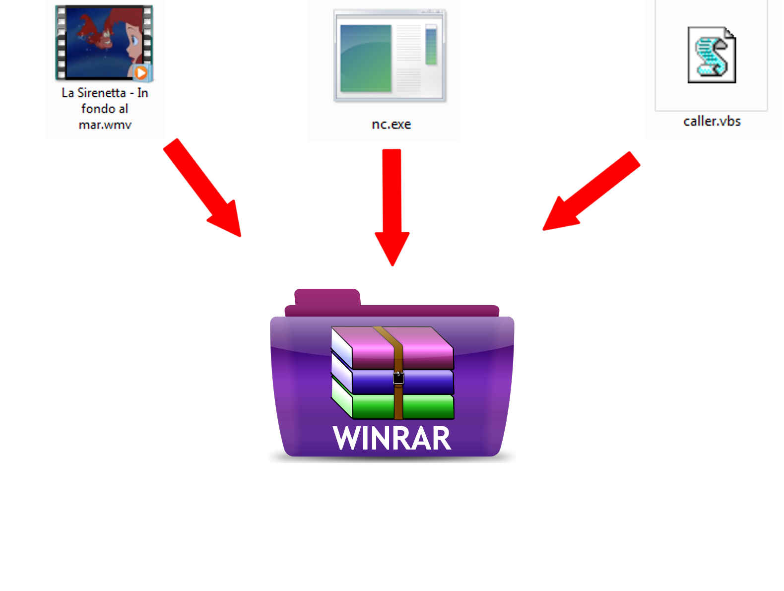
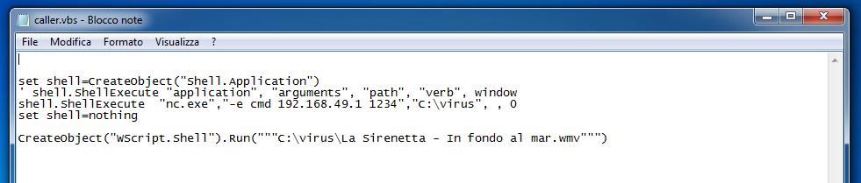
“It’s dangerous, so dangerous”
The file is a Self Extracting WinRar(SFX) archive containing:
  Video
  Netcat
  Caller.vbs: when launched, run Netcat on a specific port opening a shell on the attacker side. Finally, open the video

Slide 3
Creation of the archive
“Compression method”: select “Store”
“Archiving option”: check “Create SFX archive
On tab “Advanced” → “SFX options”
  On tab “General” → “Path to Extract”: “C:\virus” and tick “Absolute path”
  On tab “Setup” → “Setup program/Run after extraction”: “caller.vbs”
  On tab “Modes” → “Silent mode”: tick “Hide all”
  On tab “Update” → “Overwrite mode”: tick “Skip existing files”
  On tab “Text and icon” → “Load SFX icon from the file”: select a .ico file containing the video icon.

Slide 4
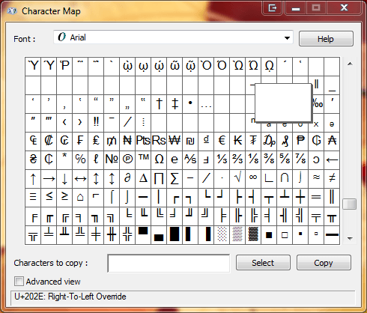


Extension Spoofing
Use the Unicode “U+202E: Right-To-Left Override” character.

Slide 5
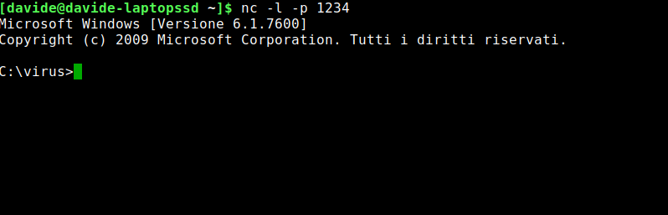
Attacker side
Run netcat on listen mode on the specific port
Wait until the victim play the fake video

Slide 6
Detection and block rules
Snort rules to detect prompt commands on Windows:
  drop tcp any any -> any any (msg:"Dir Command - Possible Remote Shell"; content:"dir"; sid:10000001;)
  drop tcp any any -> any any (msg:"Dir Command - Possible Remote Shell"; content:"DIR"; sid:10000002;)
  drop tcp any any -> any any (msg:"Dir Command - Possible Remote Shell"; content:"<DIR>"; sid:10000003;)
  alert tcp any any -> any any (msg:"Cd Command - Possible Remote Shell"; content:"cd "; sid:10000004;)
  alert tcp any any -> any any (msg:"Cd Command - Possible Remote Shell"; content:"Cd "; sid:10000005;)
  alert tcp any any -> any any (msg:"Cd Command - Possible Remote Shell"; content:"cD "; sid:10000006;)
  alert tcp any any -> any any (msg:"Cd Command - Possible Remote Shell"; content:"CD "; sid:10000007;)
  alert tcp any any -> any any (msg:"MKDIR Command - Possible Remote Shell"; content:"mkdir "; sid:10000008;)
  alert tcp any any -> any any (msg:"Del Command - Possible Remote Shell"; content:"del "; sid:10000009;)
  alert tcp any any -> any any (msg:"Erase Command - Possible Remote Shell"; content:"erase "; sid:10000010;)
  alert tcp any any -> any any (msg:"Format Command - Possible Remote Shell"; content:"format "; sid:10000011;)
Rule to block on Ubuntu in IPS mode: “drop tcp any any -> any any (msg:"Startup Shell - Possible Remote Shell"; content:"Microsoft Windows ["; sid:10000000;)”

