Slide 1
Intellidog
Intelligent Observability & Event Watchdog
FastAPI | Redis | SQLite | Grafana | Claude LLM
github.com/rondomondo/intellidog

Slide 2
The Problem with Static Rules
Threshold rules are predictable -- but blind to anything you didn't think to write a rule for.
- error_rate >= 80% => fire alert. That's it.
- No awareness of which service caused it, or what propagated from it.
- A DB pool exhaustion causing JWT failures on unrelated services looks like two separate incidents.
- On-call engineers spend minutes stitching logs together to find the causal chain.
- The more services, the worse the signal-to-noise ratio.

Slide 3
The Core Thesis: LLM Anomaly Detection
Two layers work together. Rules catch what you know. Claude catches what you don't.
Static Alert Rules Fast, deterministic Threshold / rate conditions YAML-configured Fires on known patterns
Claude LLM Analyser Rolling event window -> Claude API Cross-service correlation Causal chain reasoning Finds what rules miss
vs
Both layers write alerts to SQLite. Both surface in Grafana. One API key separates them.

Slide 4
MockLLMAnalyser vs Real Claude
Zero-config convenience vs production insight
MockLLMAnalyser (no API key)
Real Claude -- first live run findings
- High error rate (>40% critical/high)
- Latency spike (duration_ms > 3000ms)
- Source burst (>5 events from one service)
- Random ambient anomaly on quiet traffic
[critical] Simultaneous error storm across ALL services
[critical] DB connection pool exhausted
[high] Payment timeouts propagating beyond payment-svc
[high] JWT failures on non-auth services
[medium] Latency inconsistent with reported errors
The mock flags symptoms. Claude identifies the causal chain: DB exhaustion -> payment timeouts -> JWT failures on unrelated services -- a cross-service cascade no static rule could detect.

Slide 5
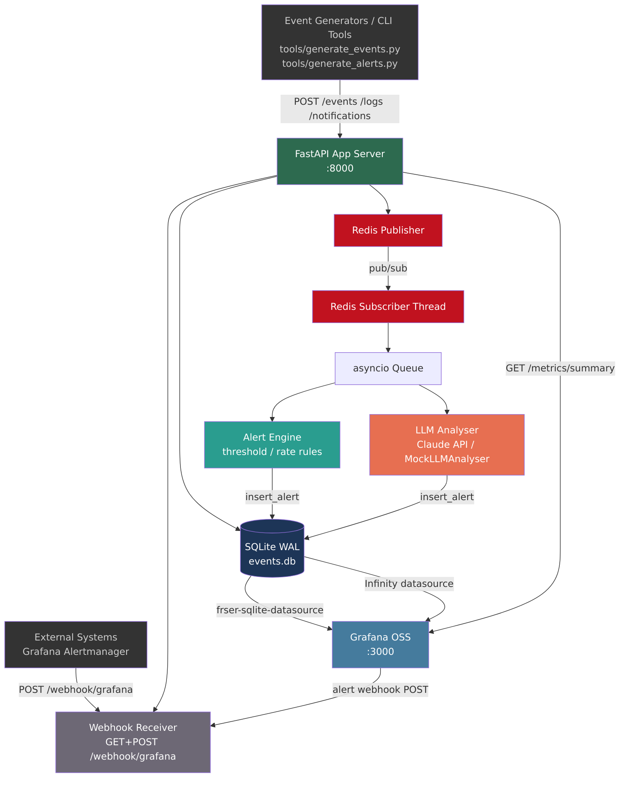
Architecture

Slide 6
Components
- FastAPI -- ingest, query, alerts, metrics, webhook
- Redis pub/sub -- decoupled event fan-out
- Alert Engine -- YAML threshold/rate rules
- LLM Analyser -- Claude API / MockLLMAnalyser
- SQLite WAL -- single-file, WAL mode, 30d compaction
- Grafana -- SQLite datasource + Infinity datasource
- Provisioned alert rules -- error rate, LLM burst
- Webhook receiver -- Grafana -> /webhook/grafana loop

Slide 7
Quick Start
Three commands to a running system
git clone git@github.com:rondomondo/intellidog.git && cd intellidog make up # builds images, starts API :8000 + Grafana :3000 + Redis make install # install local dev tools (generate/query scripts) make generate # POST 20 synthetic events make generate-spike # POST 60 critical events -- triggers alert rules open http://localhost:8000 # mission control index open http://localhost:3000 # Grafana (admin / admin)

Slide 8
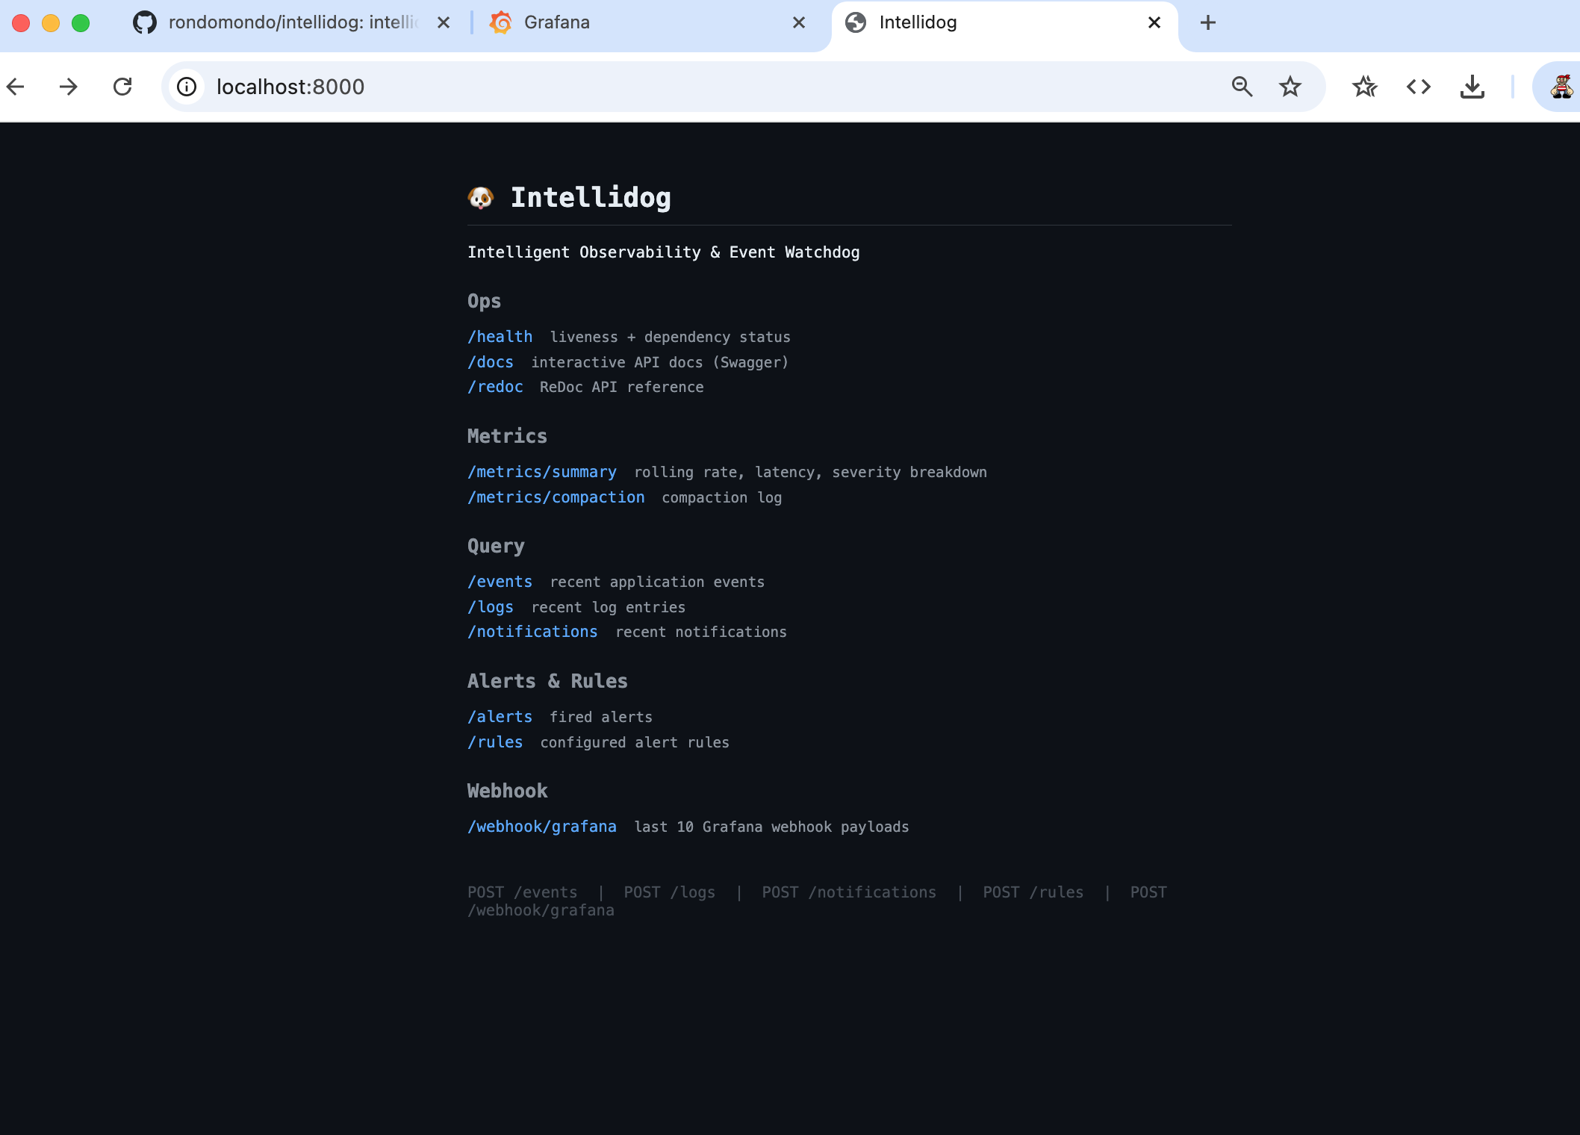
Mission Control: localhost:8000
The API root is a dark-themed HTML index -- the first stop after make up. If it loads, the API and DB are up. Navigate directly to /health, /docs, /metrics/summary, or any query endpoint.

Slide 9
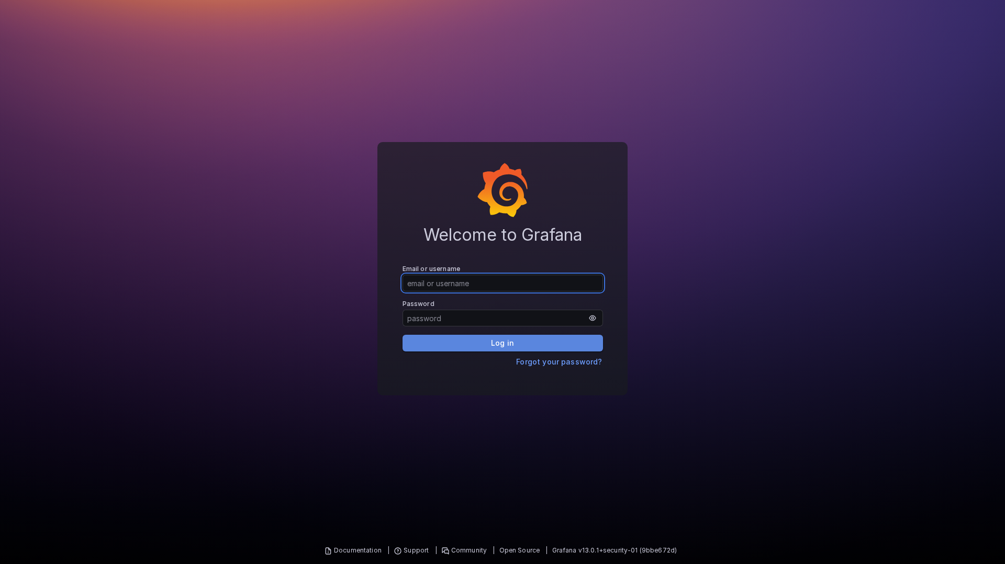
Grafana Dashboard
Fully provisioned -- no manual setup
- Event Rate over time
- Error Rate %
- Severity breakdown
- P95 latency
- Recent alerts table
- LLM anomaly count

Slide 10
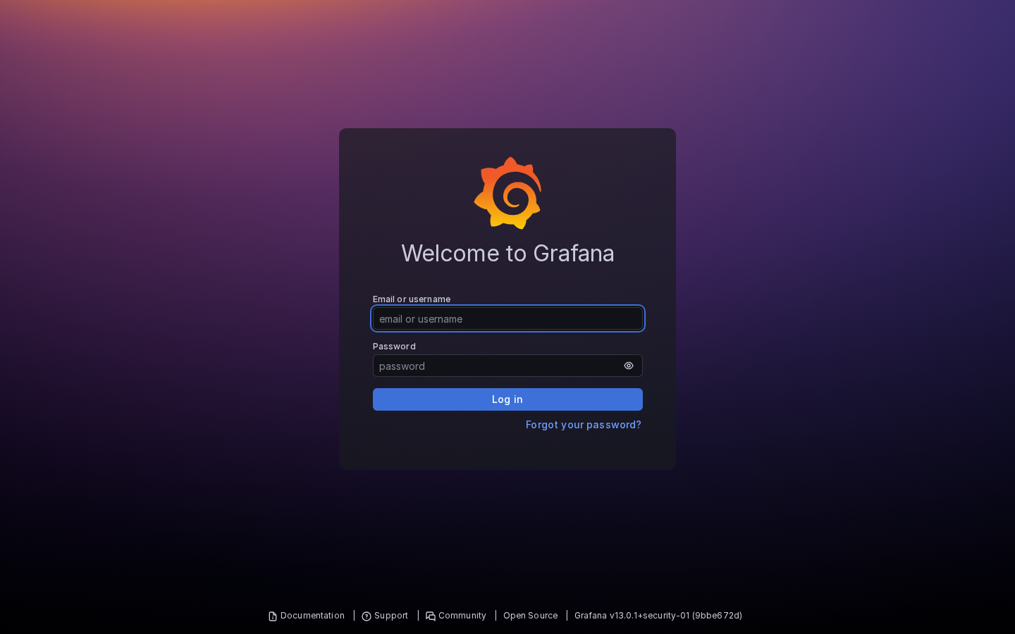
End-to-End Alert Pipeline
- Events ingested via POST /events -- written to SQLite, published to Redis
- Alert Engine evaluates YAML rules on every event (threshold, rate, window)
- LLM Analyser runs every 60s -- sends rolling window to Claude, stores findings
- Grafana queries /metrics/summary via Infinity datasource (server-side eval)
- Grafana fires alert -> POST /webhook/grafana -> stored, visible at GET /webhook/grafana
- Provisioned rules: error_rate_pct > 80% | llm_anomalies_last_hour > 10

Slide 11
Testing
92% coverage, 116 tests, zero external dependencies
- pytest-asyncio + httpx.AsyncClient -- full in-process FastAPI testing
- All Redis, SQLite, and Anthropic API calls mocked in tests
- MockLLMAnalyser exercises the full alert pipeline in CI without an API key
- make test | make ci (format + lint + typecheck + test)
api/health.py -- 100%
api/ingest.py -- 100%
bus/publisher.py -- 100%
db/connection.py -- 100%
api/metrics.py -- 97%
api/query.py -- 94%
bus/subscriber.py -- 93%
engine/alert_engine.py -- 91%
engine/llm_analyser.py -- 88%
db/repository.py -- 89%

Slide 12
Intellidog
Self-hosted observability with real LLM anomaly intelligence
- Drop-in event ingestion -- any service, any language, one POST
- YAML alert rules -- no code, no redeploy
- MockLLMAnalyser works out of the box -- add a key to go real
- Full Grafana integration -- dashboard, alerts, and webhook loop provisioned
- 92% test coverage -- CI-ready from day one
make up | make generate | open http://localhost:8000

