Slide 1
Image Classification with Deep Learning
Dmitrii Timoshenko

Slide 2
Project Overview
Problem: image classification of different type of sports
Data: obtained from Kaggle. Consists of 110 samples for 100 sport activities
Solutions: pretrained CNN models with various modifications
Results: ResNet50 without any improvements showed the best result: 96% accuracy

Slide 3
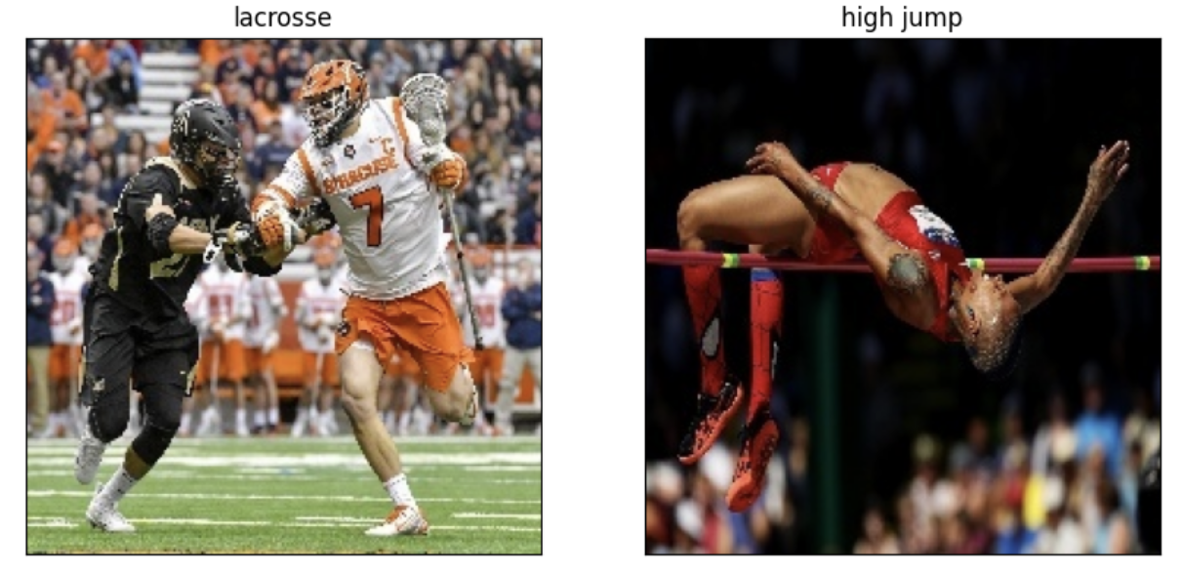
Short Data Overview
Figure 1. Example of sport images

Slide 4
Approach 1: Pretrained CNN

Slide 5
Approach 2: Pretrained CNN with Augmentation

Slide 6
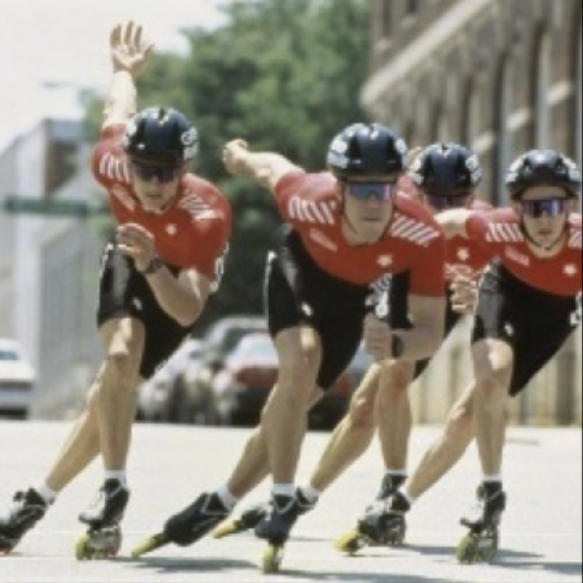
Approach 3: Pretrained CNN with Deep Classifier
. . .
. . .
prediction
ResNet
(feature extraction)
classifier

Slide 7

Approach 4: Pretrained CNNs with Boosting
. . .
ResNet50
Softmax
(100 features)
. . .
prediction
. . .
AlexNet
Softmax
(100 features)

Slide 8
. . .
. . .
prediction
ResNet
(feature extraction)
classifier

Slide 9
. . .
ResNet50
Softmax
(100 features)
. . .
prediction
. . .
AlexNet
Softmax
(100 features)

