Slide 1

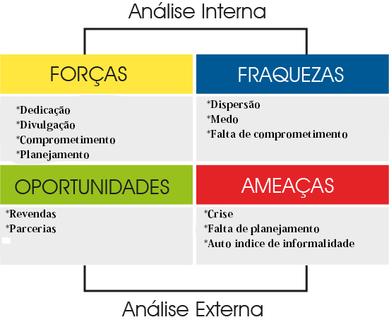

Slide 2


(21)966660896
Floresbella027@gmail.com

