Slide 1
Investigating the Relationship Between Adult Salmon Count and Dissolved Gas At Bonneville Dam Over the Last Decade

Slide 2
Scientific Background
The typical salmon life cycle:
Salmon are born in the river and grow up there.
After growing up, they move to the ocean for a few years.
At the end of their lives, they return to their place of birth to lay and fertilize eggs.
Bonneville Dam is located on the Columbia River and is to the east of Vancouver, Washington.
The water in Columbia River flows into the Pacific Ocean.

Slide 3
Question and Hypothesis
The question
What is the relationship between the daily adult salmon count of Chinook, Coho, and Sockeye salmon and the daily dissolved gas at Bonneville Dam over the last decade?
The hypothesis
For all salmon species, the daily counts of adults would decrease exponentially when the daily amounts of gas dissolved increases and vice versa. Increased dissolved gas would make it difficult for departing adult salmon to survive because the river temperature increases leading to a decrease in food and fertility rate.

Slide 4
Data Information
Daily adult salmon count data and daily dissolved gas data at Bonneville Dam are provided by the Columbia Basin Research.
Specifically collected by the US Army Corps of Engineers
The daily adult salmon count is collected by on-site counting during the day and video at night from the beginning of April 1 to the end of October and video from the beginning of November to the end of March 31.
Because the counting is done by humans, a limitation of this data is that some adult salmon may be missed during on-site counting.
The daily dissolved gas is collected by a Water Quality Monitoring Station.

Slide 5
Data Processing and Analysis
The yearly daily adult salmon counts data and daily river environment data from 2012 through 2022 were downloaded in CSV format.
The daily adult salmon counts data for each year was loaded as a pandas DataFrame and were combined to obtain the daily adult salmon counts data over the last decade for the Chinook, Coho, and Sockeye. The same for the daily river environment data to obtain the daily dissolved gas data over the last decade.
Any daily adult salmon count of -1 was replaced by the numpy nan value.
The time series plots of the daily adult salmon counts over the last decade and the daily dissolved gas over the last decade compare the trend in daily adult salmon counts and the trend in daily dissolved gas changes over time.
The scatter plots of the daily adult salmon counts and daily dissolved gas over the last decade show how daily adult salmon counts changes as the daily dissolved gas changes

Slide 6
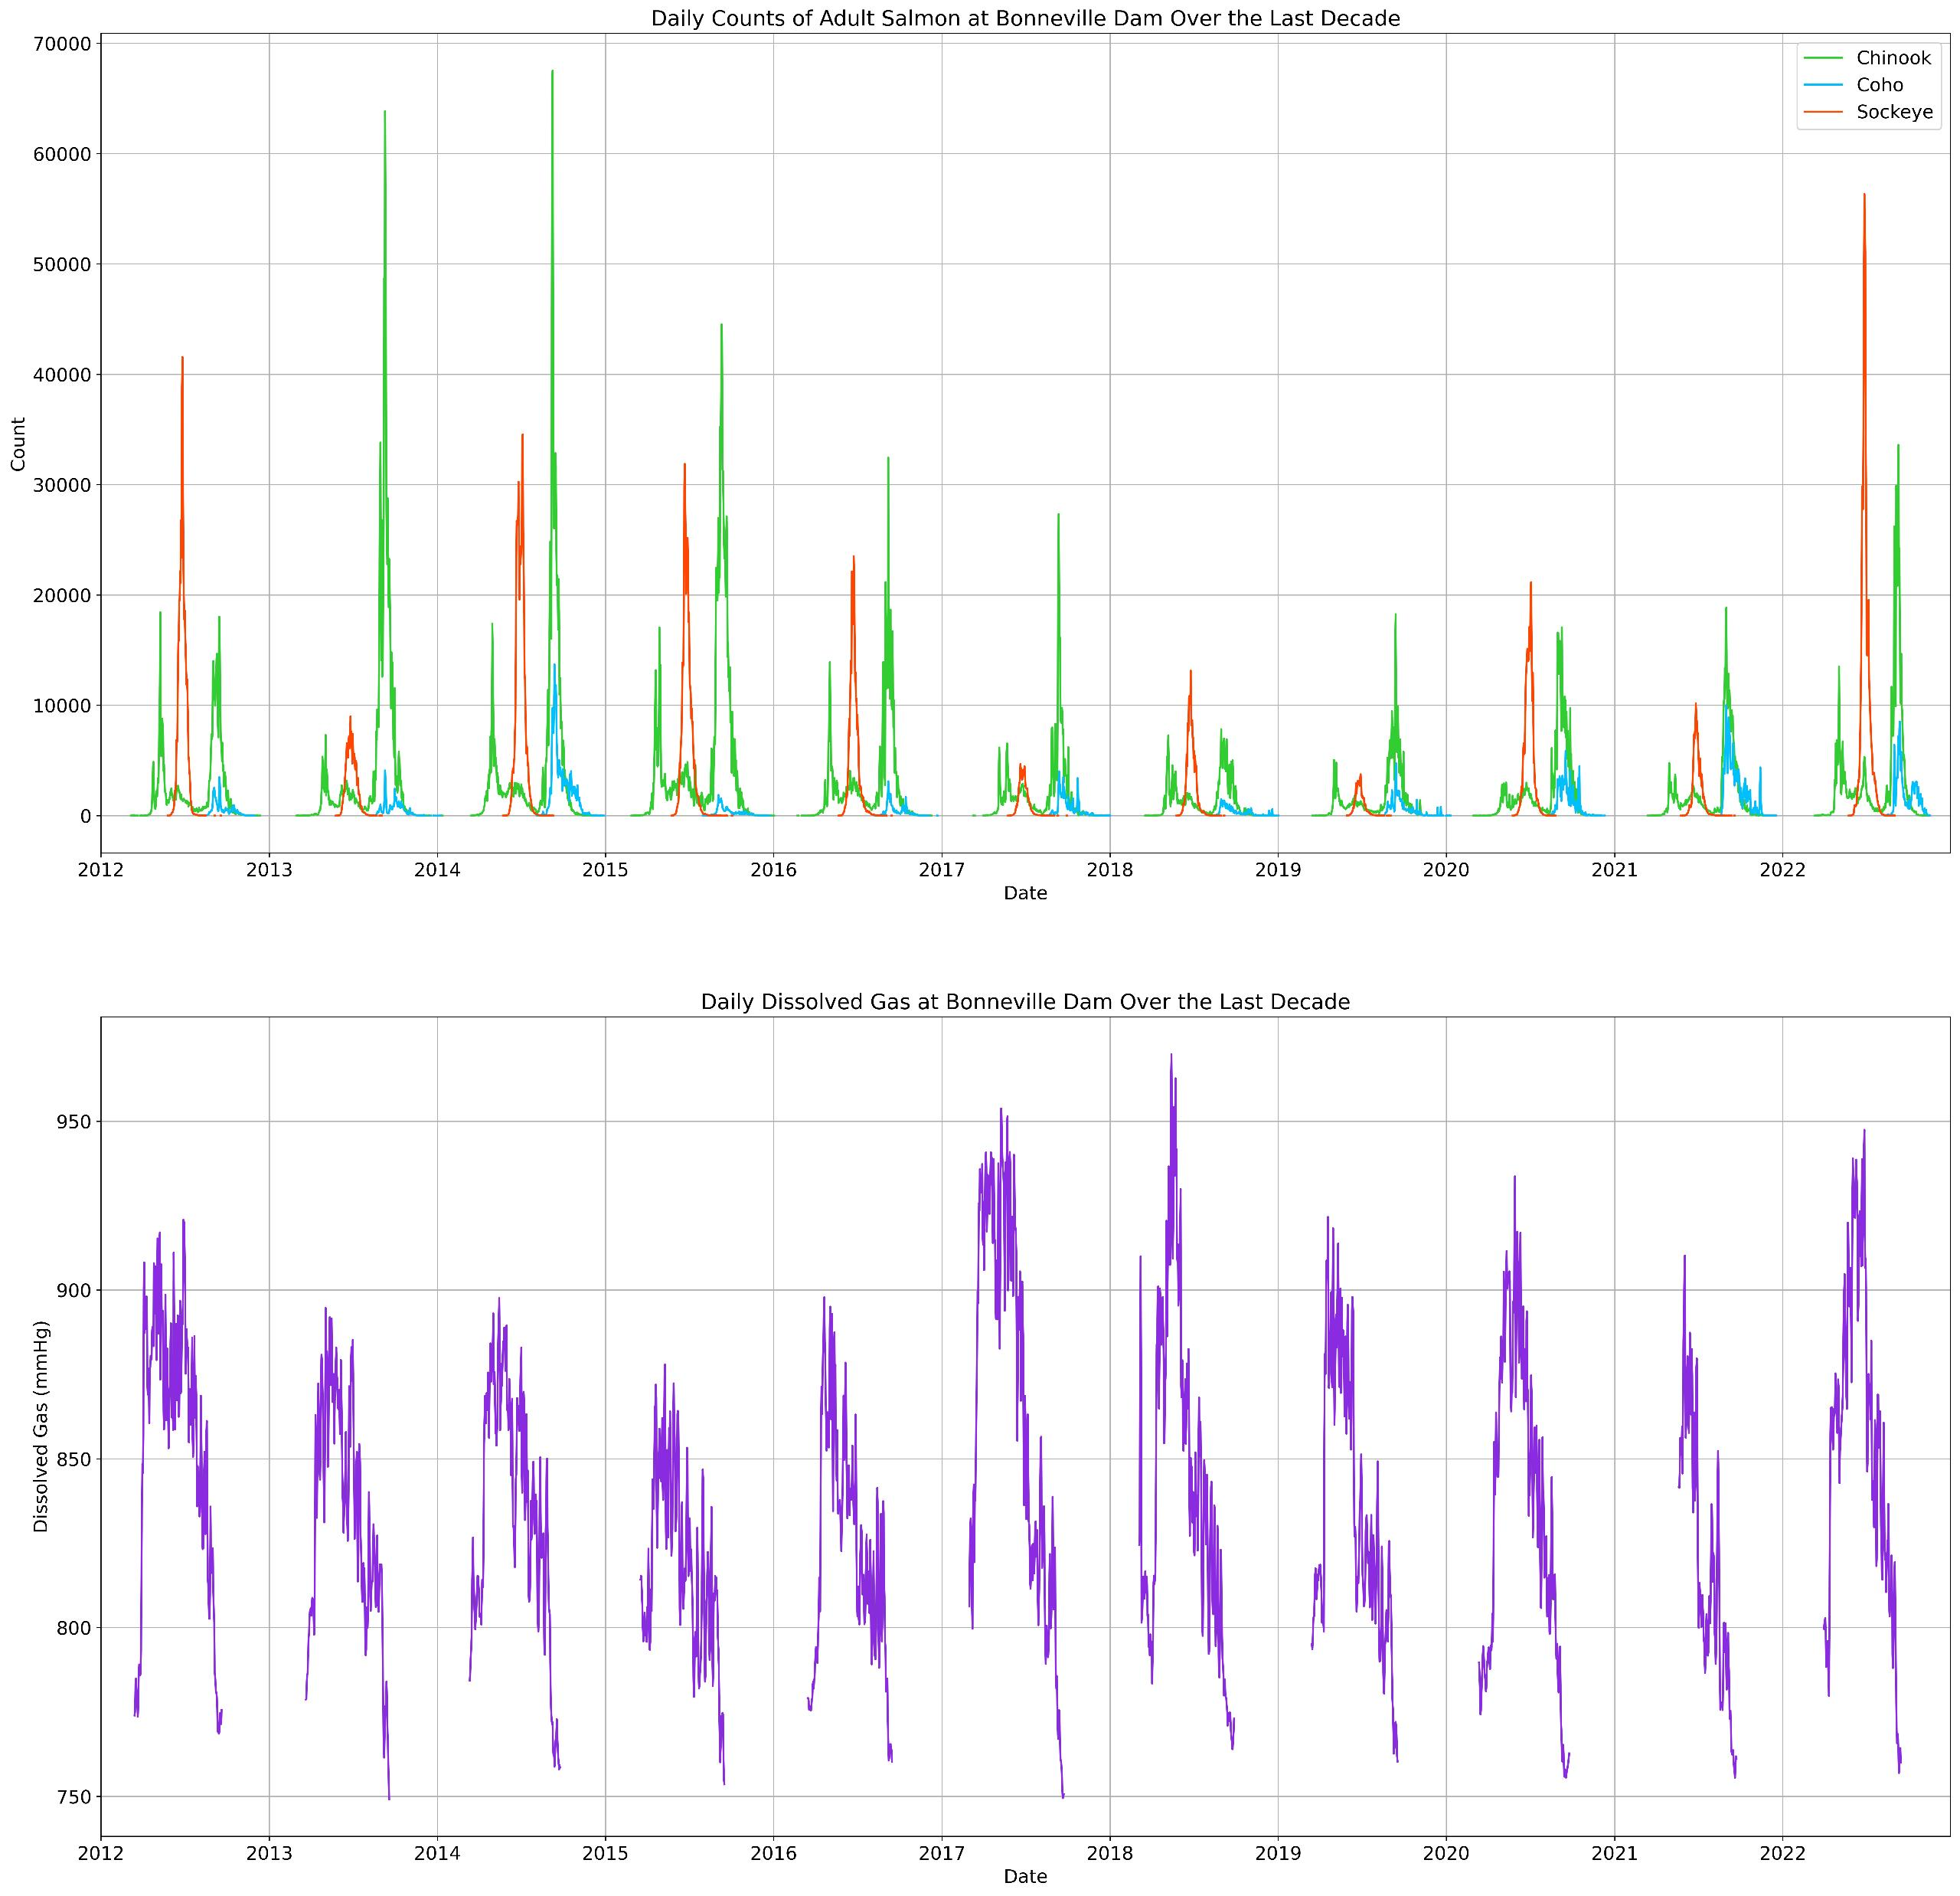
Results
The trend of the daily counts of adult Chinook salmon seems the opposite of the trend of the daily dissolved gas. The same is true for the trend of the daily counts of adult Coho salmon.
The trend of the daily counts of adult Sockeye Salmon seem weakly the same as the trend of the daily dissolved gas.

Slide 7
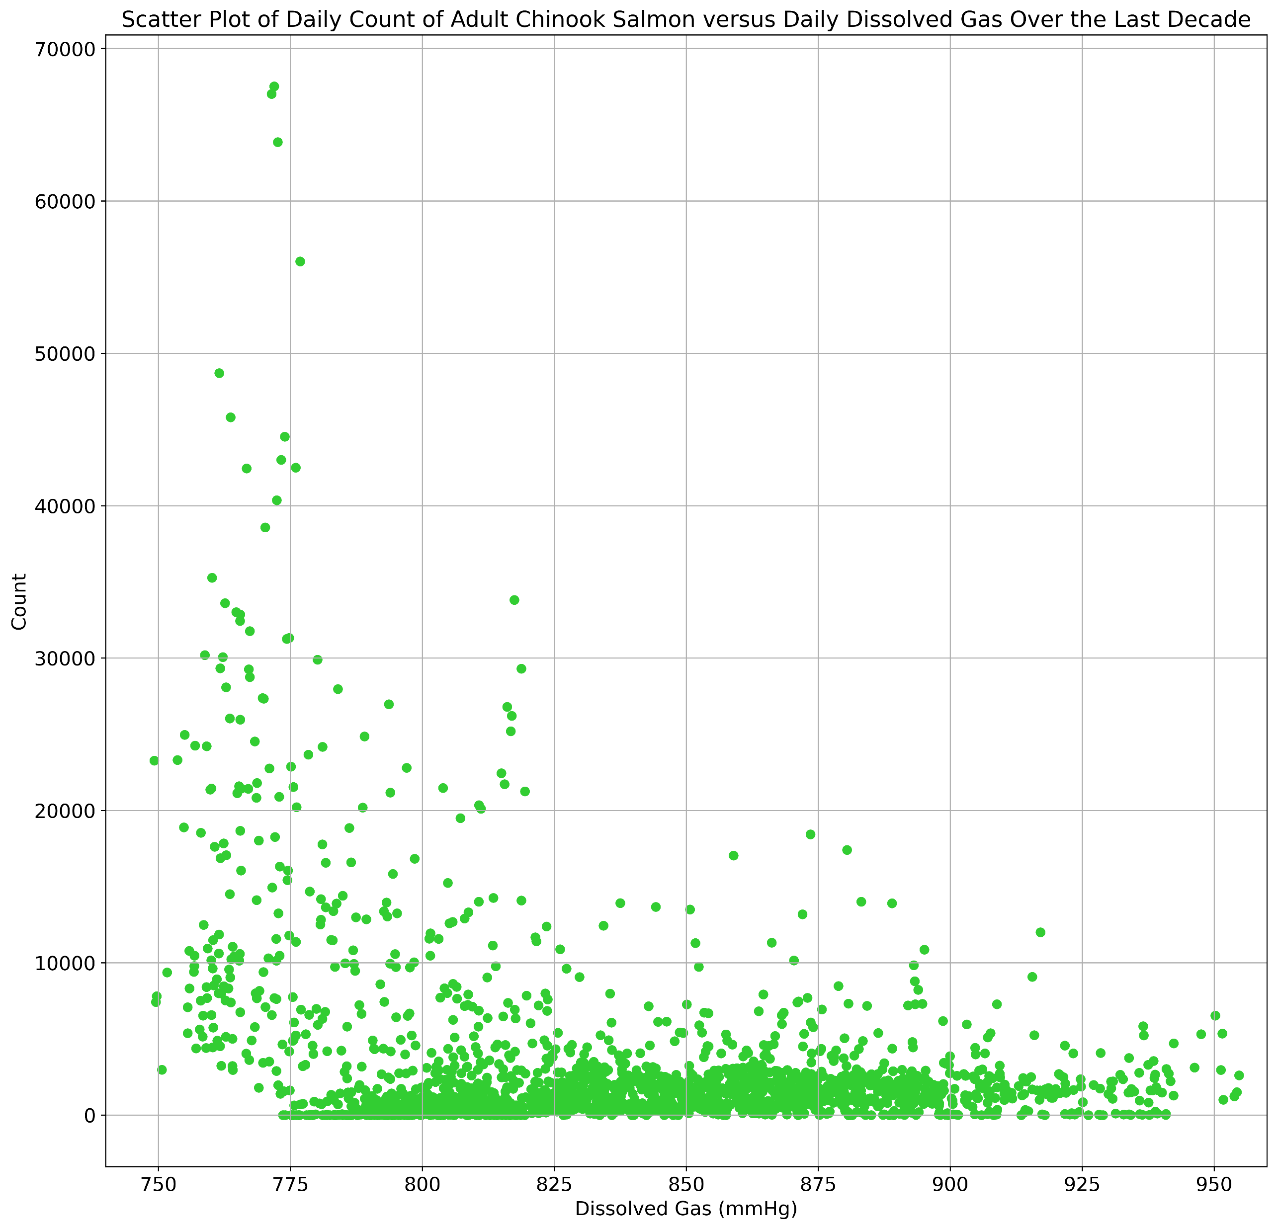
Results
The relationship between the daily count of adult Chinook salmon and the daily dissolved gas seems to be strongly exponentially decreasing.
The proposed hypothesis for the relationship between daily count of adult Chinook salmon and daily dissolved gas strongly leans to not rejected.

Slide 8
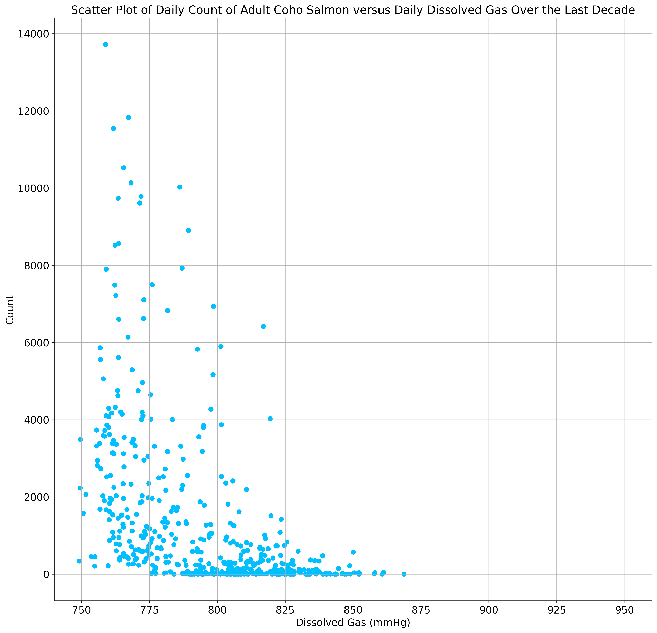
Results
The relationship between the daily count of adult Coho salmon and the daily dissolved gas seems to be somewhat exponentially decreasing.
The proposed hypothesis for the relationship between daily count of adult Coho salmon and daily dissolved gas somewhat leans to not rejected

Slide 9
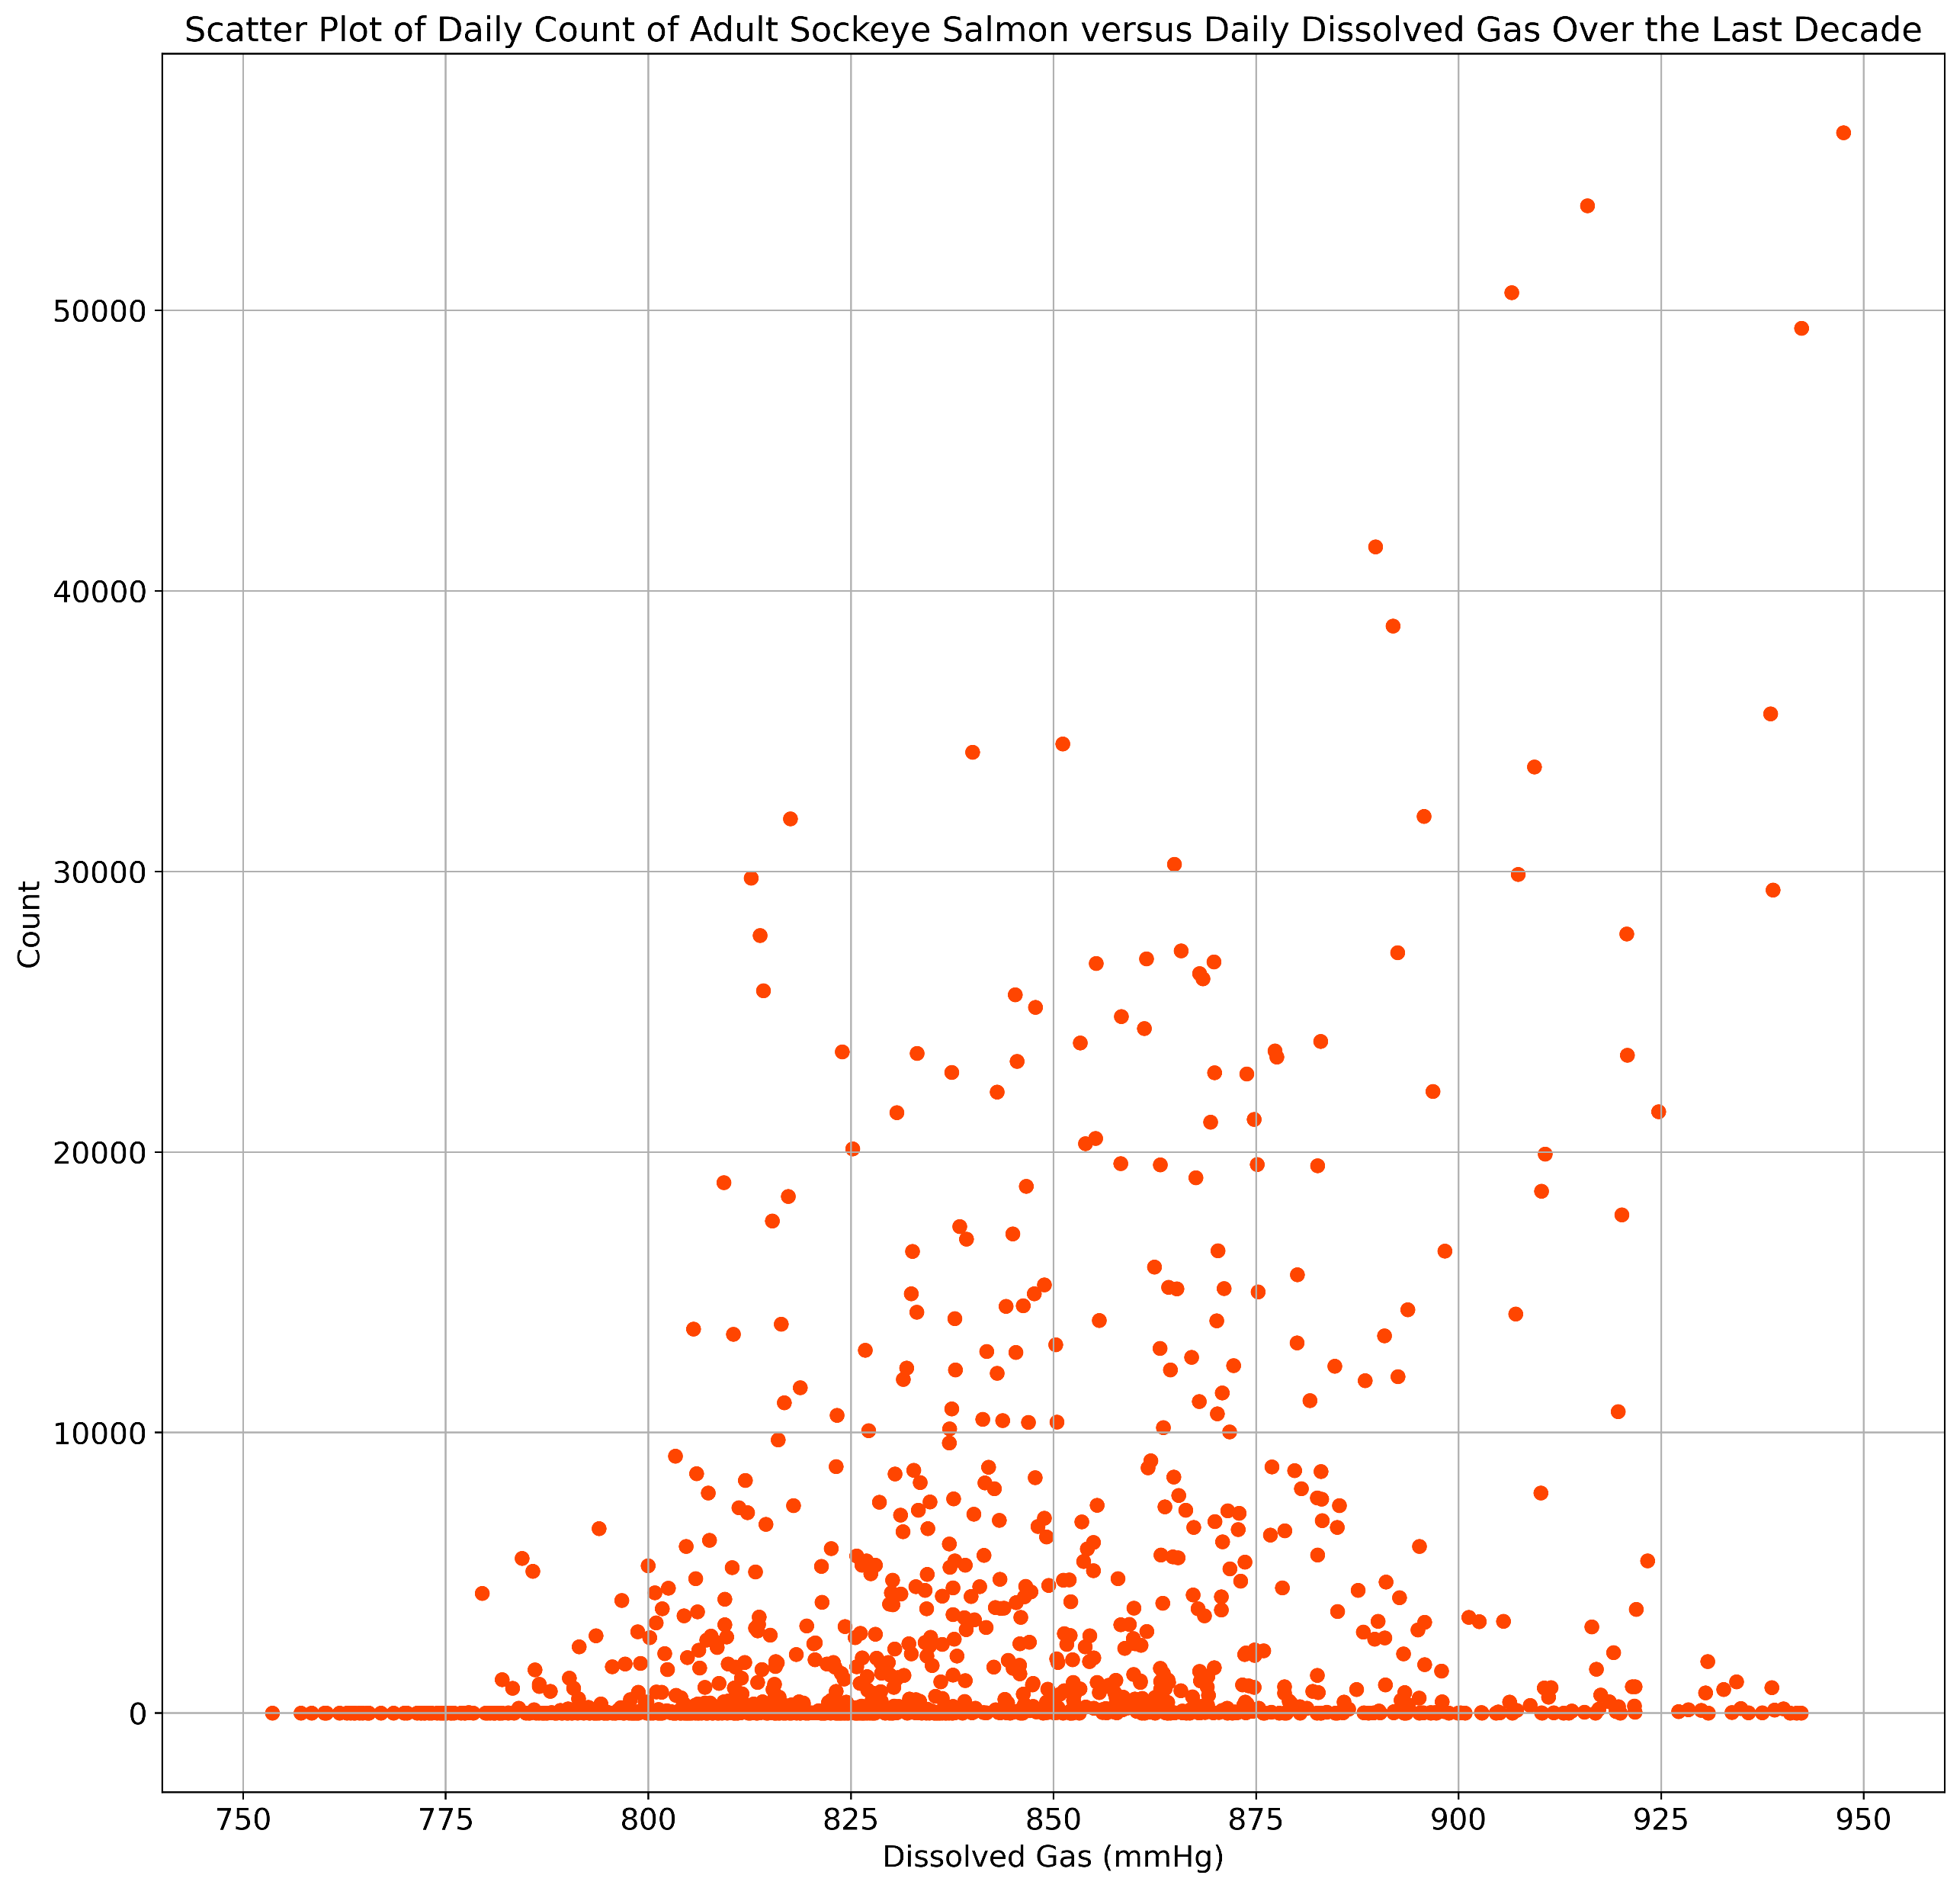
Results
There seems to be no relationship between the daily count of adult Sockeye salmon and the daily dissolved gas seems to be weakly exponentially increasing.
The proposed hypothesis for the relationship between daily count of adult Sockeye salmon and daily dissolved gas strongly leans to rejected.

