Slide 1
Experience project in data science
Dataset: Adult Income Census
Ohad Lavie - 209805787
Ronen Hristoforov - 318639028

Slide 2



About the Data
The data was extracted from a 1994 database on adult income, showing data on individuals, including if their annual salary was less or more than 50k.
The information on the individuals included: age, workclass, education, marital status, hours per week and more.
We will dive into specific data in the EDA process.

Slide 3
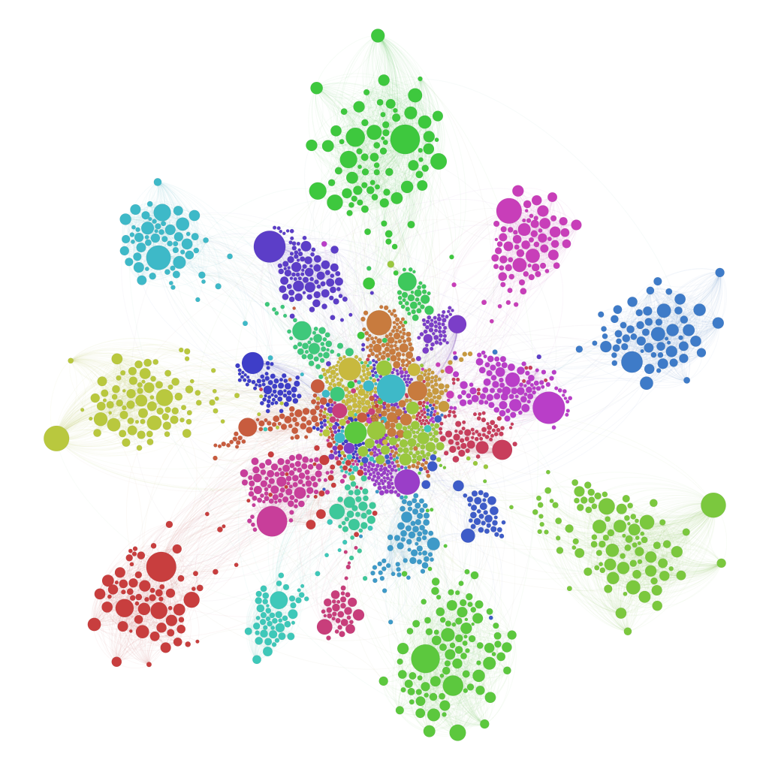
Research question
“How can clustering analysis be applied to population data to form meaningful groups based on employment patterns and education level?”

Slide 4
Workflow
Import
EDA
Visualization
Feature Engineering
Clustering Algorithms
Conclusions

Slide 5
EDA
Exploratory Data Analysis

Slide 6
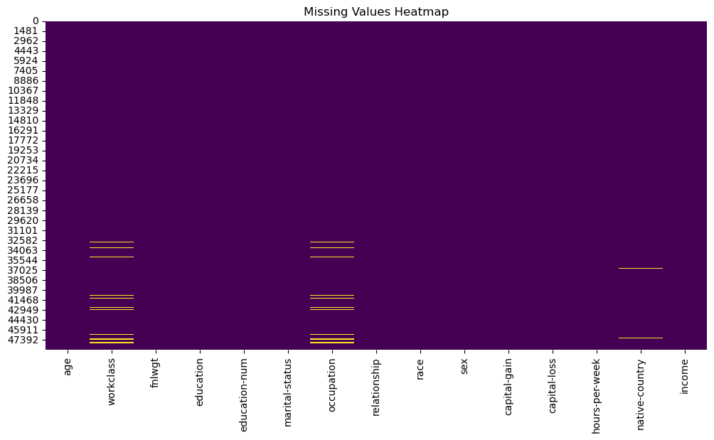
Exploratory Data Analysis
In our Data we have 48842 entries.
We started off by seeing what null values we have.
We could see null values in 3 columns :
Workclass – 963 (~ 1.97%)
Occupation – 966 (~ 1.97%)
Native Country – 274 (~ 0.56%)
We decided to replace those values with ‘missing’ so we could still work on that data , and maybe later infer meaningful insights from the ‘missing’ bucket.

Slide 7
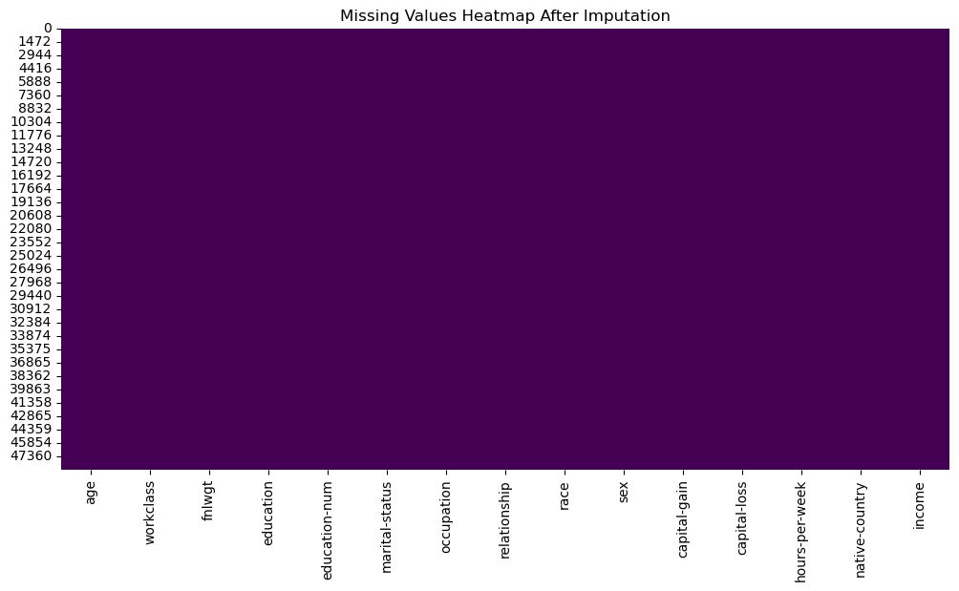
Exploratory Data Analysis
After doing so, we have no null values.

Slide 8
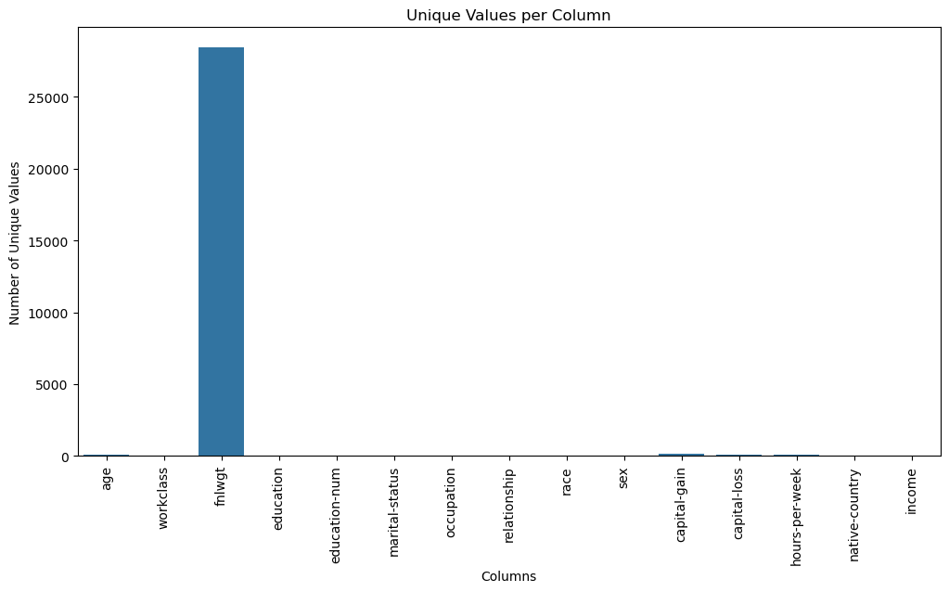
We saw that the column "fnlwgt" looks odd - it has 28k unique value, and after further investigating of it, we decided to drop this column, as we cannot attain meaningful insights from it.

Slide 9
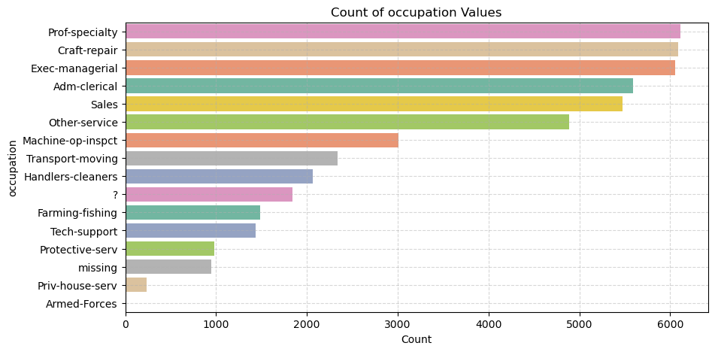
We went to further check the Data for weird values, Most of which were ‘?’.
We didn’t found anomalies like negative age .
Imputing ‘?’ values as ‘missing’

Slide 10
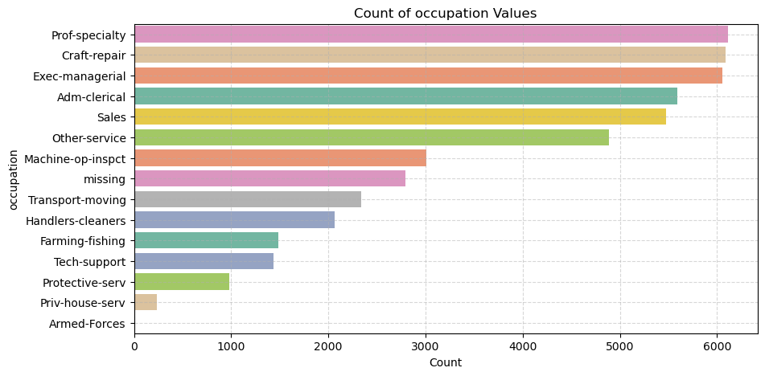
We went to further check the Data for weird values, Most of which were ‘?’.
We didn’t found anomalies like negative age .
Imputing ‘?’ values as ‘missing’

Slide 11
Observations :
Top Three Occupations Are Almost Tied :
Prof-specialty (~6,200), Craft-repair (~6,100), and Exec-managerial (~6,000) are the most frequent categories, each appearing in roughly 6 K of the ~48 K rows.
Together, those three alone make up about 37 % of all records.
In other words, more than third of the dataset works in professional specialties, crafts/repairs, or executive/managerial roles.
- Mid‐Tier Occupations:
• Adm-clerical (~5,500) and Sales (~5,300) also appear very often (each roughly 5.5–5.3 K).
• Other-service (~4,800) rounds out the “top six” occupations, meaning nearly half of everyone falls into these six job categories.
- Long Tail of Less Common Jobs
• After “Other-service,” counts drop sharply

Slide 12
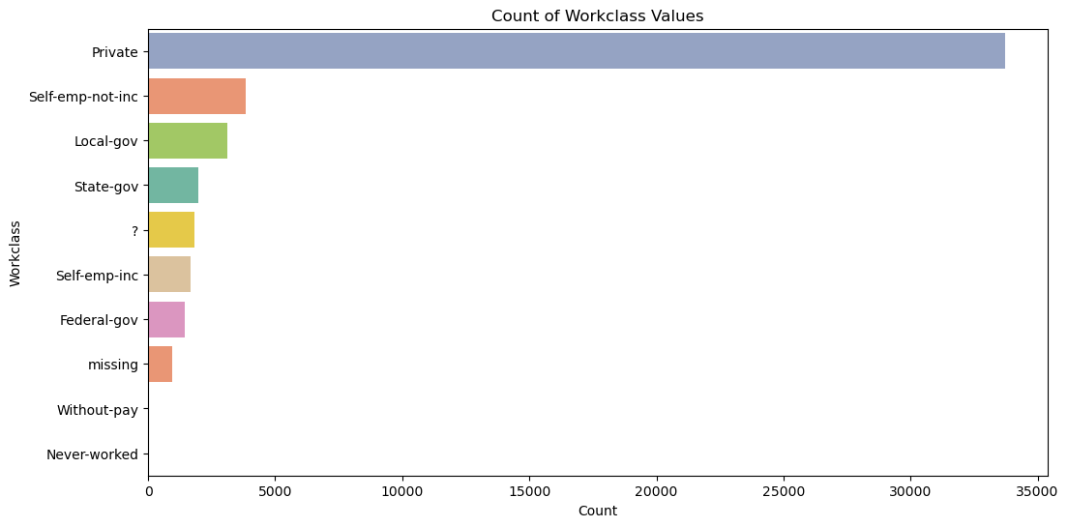
Imputing ‘?’ values as ‘missing’

Slide 13
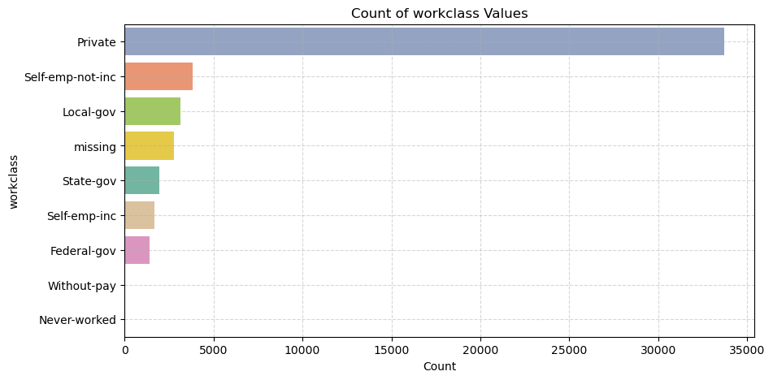
Imputing ‘?’ values as ‘missing’
Observations:
Dominance of the Private Sector : Roughly 70% of records list “Private” employment.
“Government” comes second at about 12–14% of the data.
~2,800 “missing” entries (~6% of the Data).
- “Without-pay” and “Never-worked” are extremely scarce (<1%).

Slide 14
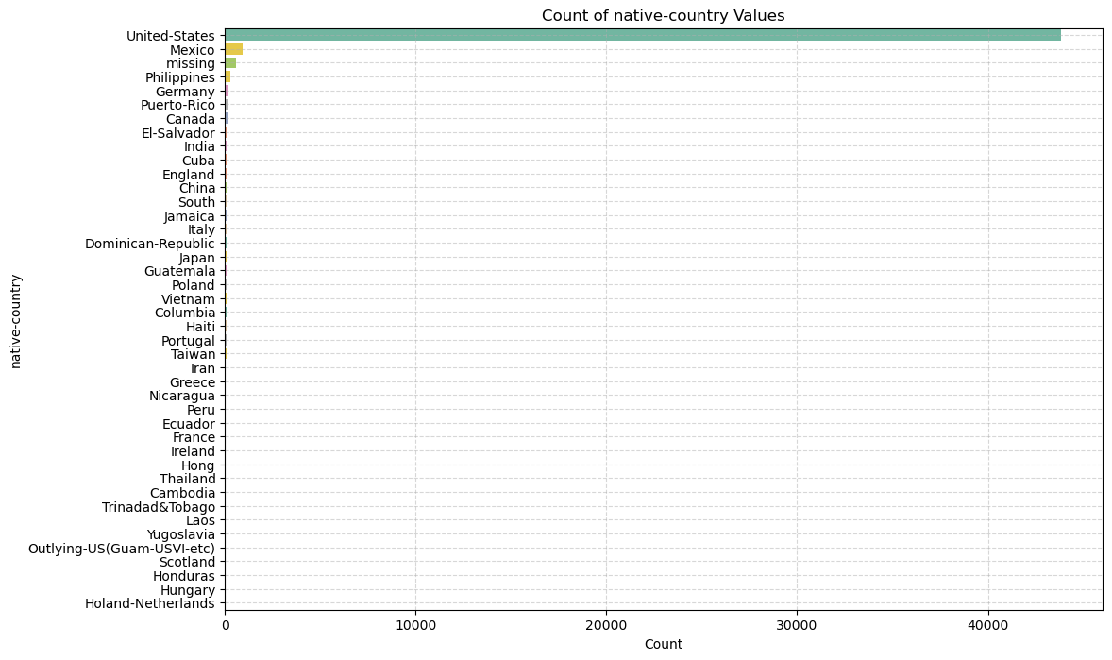


Native Country
Observation :
~91% of the data consists of people from the US
~2% of the data consists of people from Mexico
The rest of the countries have less than 0.6% each of the data.

Slide 15
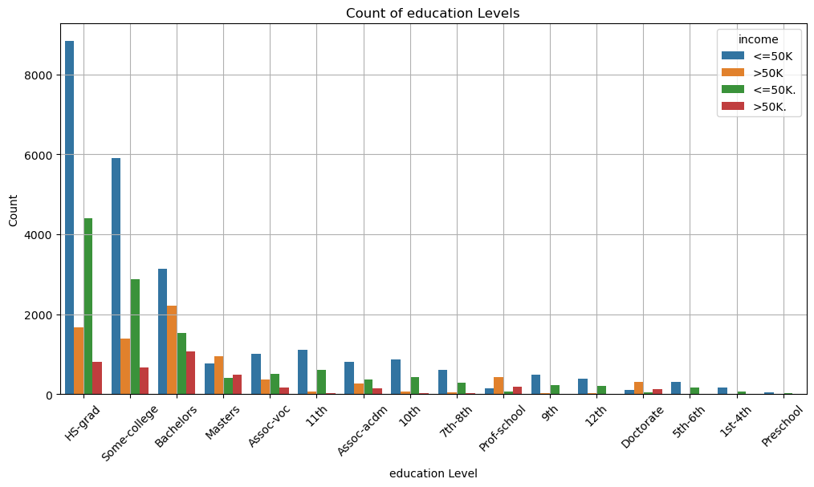
Education

Slide 16


