Slide 1
Experience project in data science
Ohad Lavie – 209805787
Ronen Hristoforov – 318639028
Dataset: Adult Income Census

Slide 2
About the data
The data was extracted from a 1994 database on adult income, showing data on individuals, including if their annual salary was less or more than 50k.
The information on the individuals included: age, workclass, education, marital status, hours per week and more.
We will dive into specific data in the EDA process.

Slide 3

Research question
“How can clustering analysis be applied to population data to form meaningful groups based on employment patterns and education level?”

Slide 4
Workflow
Import
EDA
Visualization
Feature
Engineering
Clustering Algorithms
Conclusion

Slide 5
EDA
Exploratory Data Analysis

Slide 6
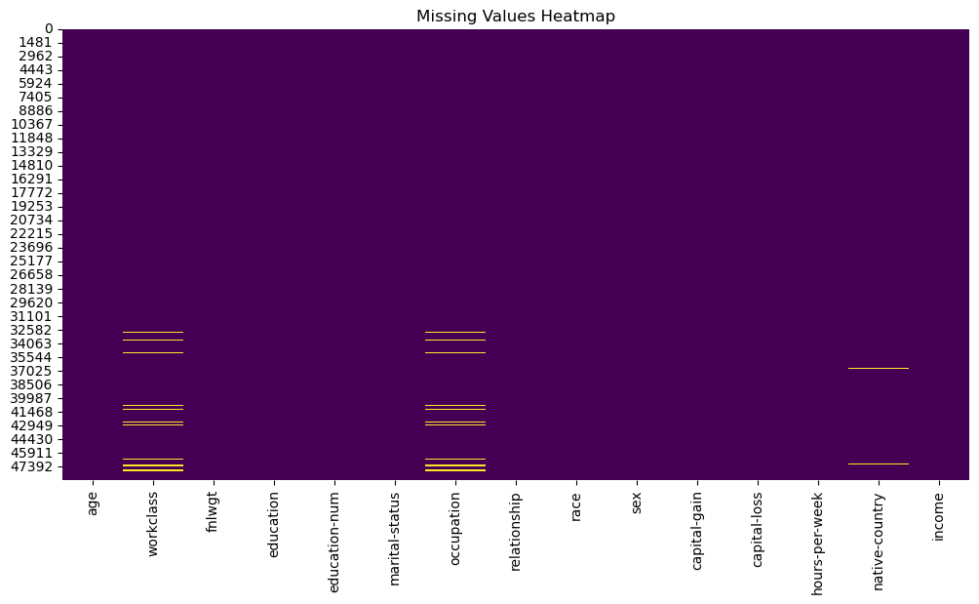
Exploratory Data Analysis
In our Data we have 48842 entries.
We started off by seeing what null values we have.
We could see null values in 3 columns :
Workclass – 963 (~ 1.97%)
Occupation – 966 (~ 1.97%)
Native Country – 274 (~ 0.56%)
We decided to replace those values with ‘missing’ so we could still work on that data , and maybe later infer meaningful insights from the ‘missing’ bucket.

Slide 7
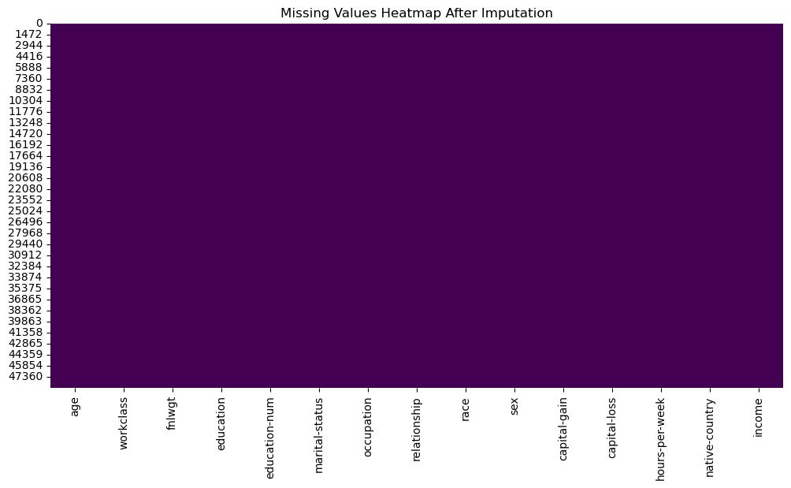
Exploratory Data Analysis
After doing so, we have no null values.

Slide 8
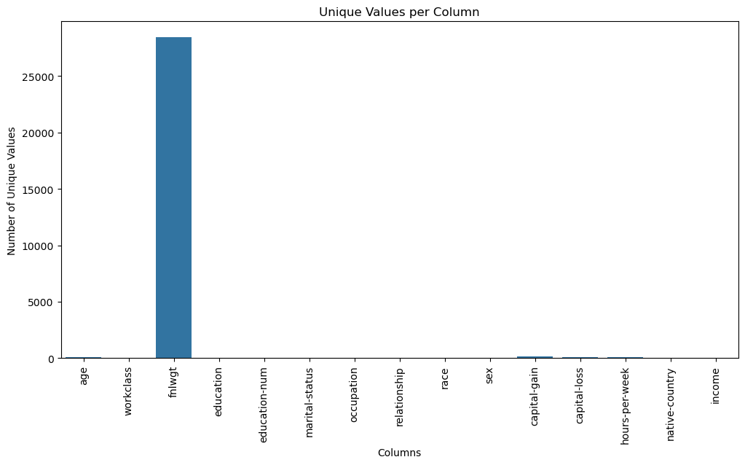
We saw that the column "fnlwgt" looks odd - it has 28k unique value, and after exploring more of it, we decided to drop it as we cannot attain meaningful insights from it.

Slide 10


