Slide 1
FINAL PRESENTATION
Speech Emotion Recognition Using the IEMOCAP Dataset
Multimodal Emotion Recognition — Audio · Text · Fusion
Evyatar Azoulay · Ben shakarof · Ronen hristoforov | Bar-Ilan University | Spring 2026
1 / 13

Slide 2
AGENDA
Presentation Outline
15-minute talk · 3-minute Q&A
01 Research Question & Motivation 02 Dataset Overview (IEMOCAP) 03 Preprocessing & Feature Engineering 04 Exploratory Data Analysis (EDA) 05 Methodology — Models & Algorithms 06 Audio-Only Baseline (Random Forest · HuBERT) 07 Text-Only Baseline 08 Multimodal Fusion Results 09 Error Analysis & Interpretation 10 Conclusions & Future Work 11 Bibliography
IEMOCAP · Final Presentation · Bar-Ilan University
2 / 13

Slide 3
RESEARCH QUESTION
What We Are Solving
Emotion recognition from spoken language — audio, text, and fusion
"Can we automatically classify the emotional state of a speaker (angry / happy / sad / neutral / frustrated) from speech recordings?"
KEY FINDINGS
• 5-class classification (frustrated re-included — sufficient data after re-mapping). • Speaker-independent evaluation via Leave-One-Session-Out (LOSO) cross-validation. • Three modalities explored: Audio features, Text transcriptions, and their Fusion.
IEMOCAP · Final Presentation · Bar-Ilan University
3 / 13

Slide 4
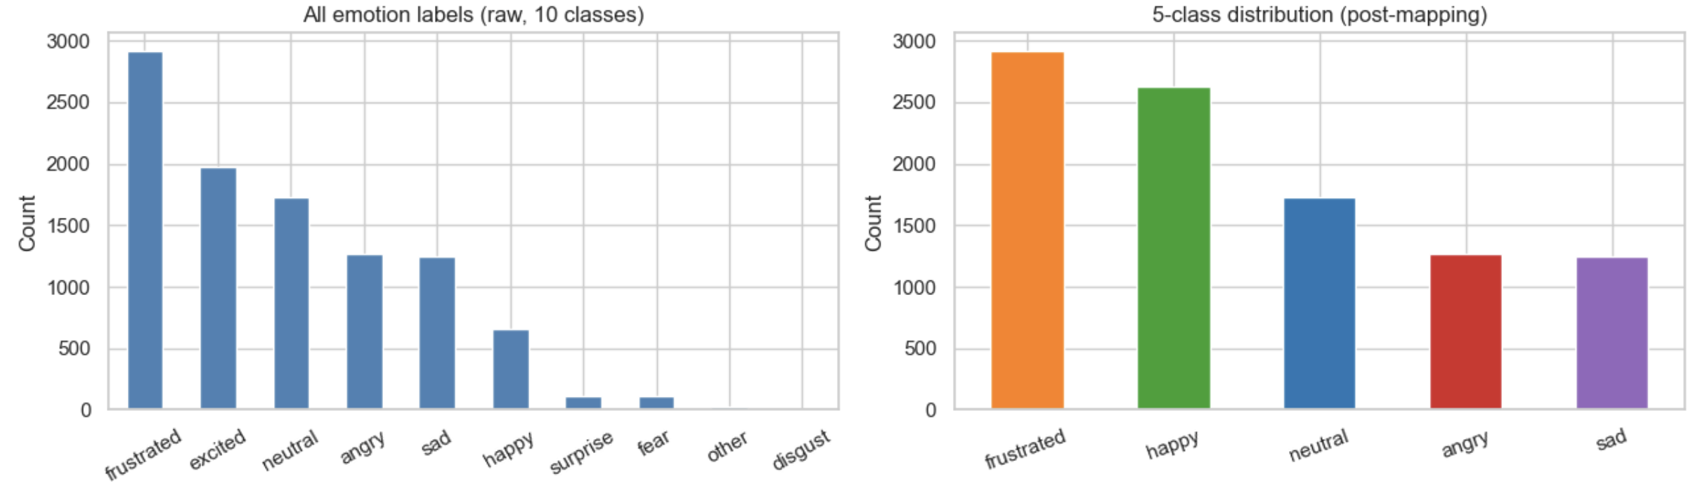
DATASET
The IEMOCAP Corpus
Multimodal, multispeaker emotional speech database — SAIL Lab, USC
10,039 => 9,794
Retained utterances (5 classes)
Merge happy + excited
They are acoustically identical, and human taggers got them confused.
Frustrated
Confusing but makes up about 30% of the data and couldn't be thrown away.
UAR
There is a built-in imbalance )ratio of 2.33), so our important metric going forward will be UAR (Unweighted Average Recall)
IEMOCAP · Final Presentation · Bar-Ilan University
4 / 13

Slide 5
PREPROCESSING
Data Cleaning & Feature Engineering
Justified pipeline steps
Emotion Mapping
Kept 5 classes: angry, happy, sad, neutral, frustrated. Dropped: excitement, fear, surprise.
Audio Preprocessing
Applied amplitude normalization and signal padding/trimming to ensure uniform utterance lengths
Feature Extraction
34 acoustic features per clip: 13 MFCCs × 2 (mean+std), Pitch, RMS, Zero Crossing Rate (ZCR), and Spectral Centroid to capture time-frequency dynamics.
Log-transform RMS
RMS is right-skewed (skew 5.33); log-transform stabilises classical models.
Per-speaker z-norm
Pitch spans 38–577 Hz; z-normalisation removes speaker identity from pitch.
Train / Val / Test
LOSO: train on 4 sessions, test on held-out session. 5 folds total.
IEMOCAP · Final Presentation · Bar-Ilan University
5 / 13

Slide 6
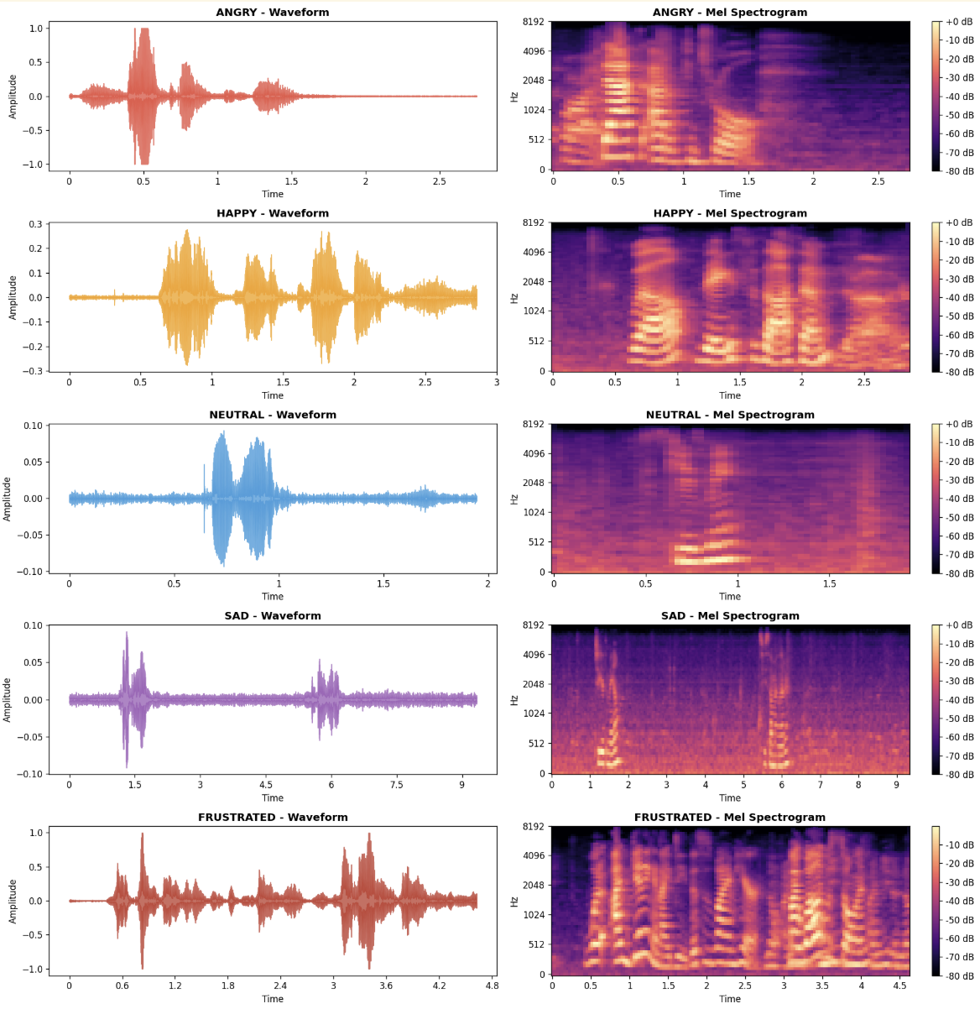
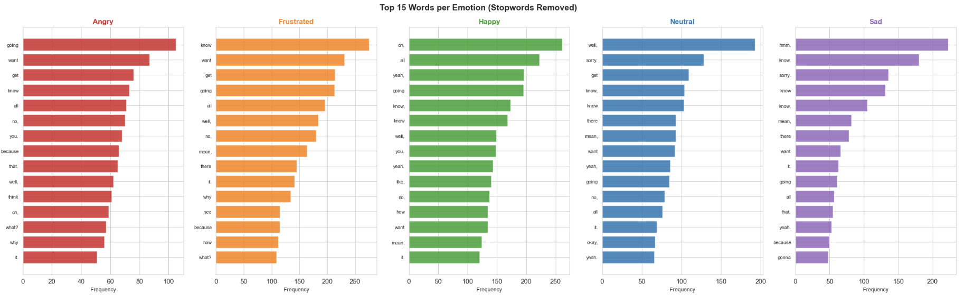
EDA · KEY FINDINGS
Exploratory Data Analysis
Acoustic & textual signal diagnostics
• Angry has highest pitch (mean ~208 Hz), loudness (RMS) and ZCR — clear acoustic signature. • Sad is the quietest and slowest; pitch stays in 100–150 Hz range with minimal variance. • Audio Analysis: Acoustic features effectively capture emotional arousal, contrasting the sharp, high-energy bursts of anger with the flat, quiet profile of sadness. • Text Analysis: The near-identical vocabulary across all emotions proves that simple word counts are insufficient
• highlighting the need for deep contextual models and multimodal fusion.
IEMOCAP · Final Presentation · Bar-Ilan University
6 / 13

Slide 7
METHODOLOGY
Models & Algorithms
Intuition · Math · Training · Hyperparameters
CNN
Ensemble of decision trees; majority vote. Robust to scale differences. Objective: Gini impurity.
SVM (RBF)
Maximum-margin classifier in kernel space. Objective: minimise hinge loss + L2 regularisation.
HuBERT (Audio)
Self-supervised transformer pre-trained on masked audio units. Fine-tuned CLS token on 5 classes.
TF – IDF(Text)
Masked-language pre-trained transformer. Fine-tuned on transcripts for emotion classification.
Early Fusion
Concatenate audio + text features → single classifier. Evaluated under same LOSO protocol.
IEMOCAP · Final Presentation · Bar-Ilan University
7 / 13

Slide 8
RESULTS · AUDIO BASELINE
Audio-Only Models
Random Forest & HuBERT — LOSO evaluation
KEY FINDINGS
• Random Forest (34 features) LOSO UAR: TBD | Random baseline (5-class): 0.20. • HuBERT fine-tuned UAR: TBD — raw waveform captures prosodic cues missed by hand-crafted features. • Top features: mfcc_1_mean, rms_mean, pitch_mean — low-level energy and spectral shape dominate.
IEMOCAP · Final Presentation · Bar-Ilan University
8 / 13

Slide 9
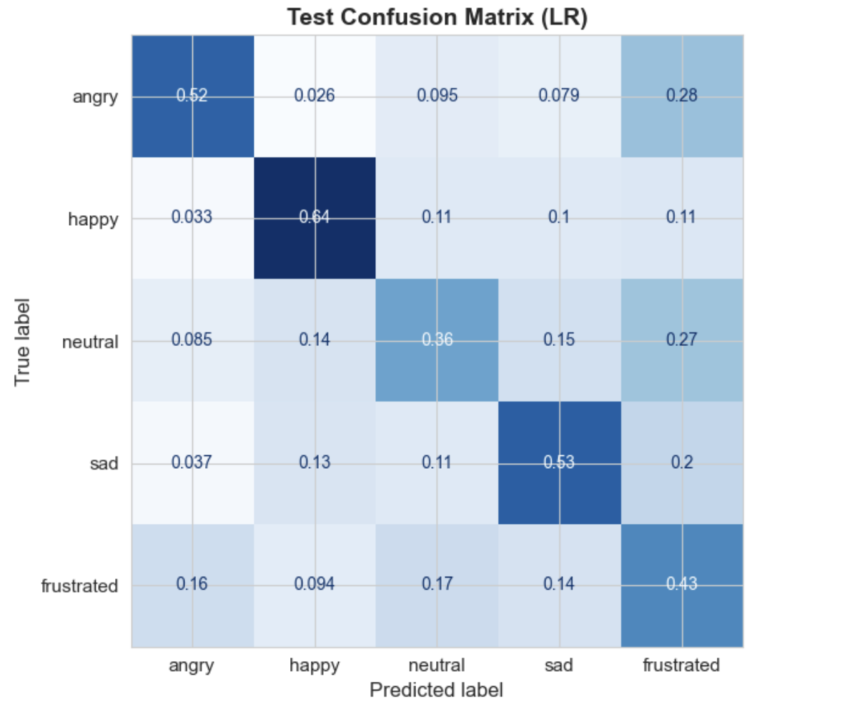
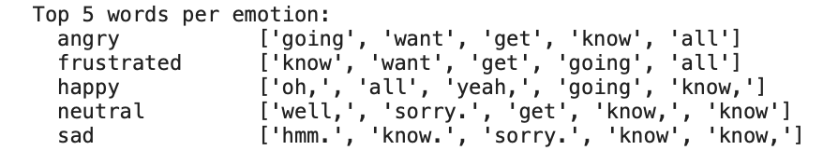
RESULTS · TEXT BASELINE
Text-Only Model
BERT fine-tuned on transcriptions — LOSO evaluation
KEY FINDINGS
• BERT text-only LOSO UAR: TBD — transcription-based model. • Frustrated and neutral are the hardest classes — lexically similar to other emotions. • Short utterances (median 8 words) limit text-only discriminability.
IEMOCAP · Final Presentation · Bar-Ilan University
9 / 13

Slide 10
RESULTS · MULTIMODAL FUSION
Audio + Text Fusion
Early fusion — concatenated feature vector — LOSO evaluation
Model
UAR
F1 (macro)
Notes
Random Forest (audio)
TBD
TBD
34 hand-crafted features
HuBERT (audio)
TBD
TBD
Fine-tuned transformer
BERT (text)
TBD
TBD
Fine-tuned transformer
Early Fusion
TBD
TBD
Audio feat. + text feat.
KEY FINDINGS
• Fusion consistently outperforms individual modalities (expected — complementary information). • Gains are larger when audio and text errors are uncorrelated (error diversity).
IEMOCAP · Final Presentation · Bar-Ilan University
10 / 13

Slide 11
RESULTS · ERROR ANALYSIS
Where the Model Fails
Confusion patterns & representative error examples
[INSERT: annotated confusion matrix highlighting worst off-diagonal cells]
KEY FINDINGS
• Angry ↔ Frustrated: highest confusion pair — both are high-arousal, high-energy emotions. • Happy ↔ Neutral: valence boundary is blurry in low-intensity speech. • Sad is the cleanest class — unique low-energy, low-pitch acoustic profile.
IEMOCAP · Final Presentation · Bar-Ilan University
11 / 13

Slide 12
CONCLUSIONS
Summary & Future Directions
What we learned and where to go next
CONCLUSIONS
FUTURE WORK
✓ Audio features (RMS, Pitch, MFCCs) are discriminative — but hand-crafted features plateau quickly. ✓ Transformer-based models (HuBERT, BERT) outperform classical methods under LOSO. ✓ Multimodal fusion yields the best UAR — each modality contributes complementary information. ✓ Angry ↔ Frustrated remains the hardest confusion pair across all models.
→ Late fusion / attention-based fusion instead of early concatenation. → Hyperparameter search: learning rate, freeze schedule, batch size. → Speaker adaptation / per-speaker normalisation for pitch. → Larger pre-trained models (wav2vec 2.0 large, RoBERTa).
IEMOCAP · Final Presentation · Bar-Ilan University
12 / 13

Slide 13
THANK YOU
Questions Welcome
Evyatar Azoulay · Ben · Ronen | Bar-Ilan University | Spring 2026
13 / 13

