Slide 1
SPRINT 2
Speech Emotion Recognition
on the IEMOCAP Corpus
sprint 2 Progress Report
Bar-Ilan University · Ben Shakarof · Evyatar Azoulay · Ronen Hristoforov

Slide 2
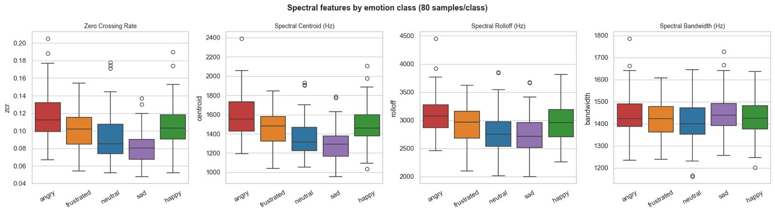
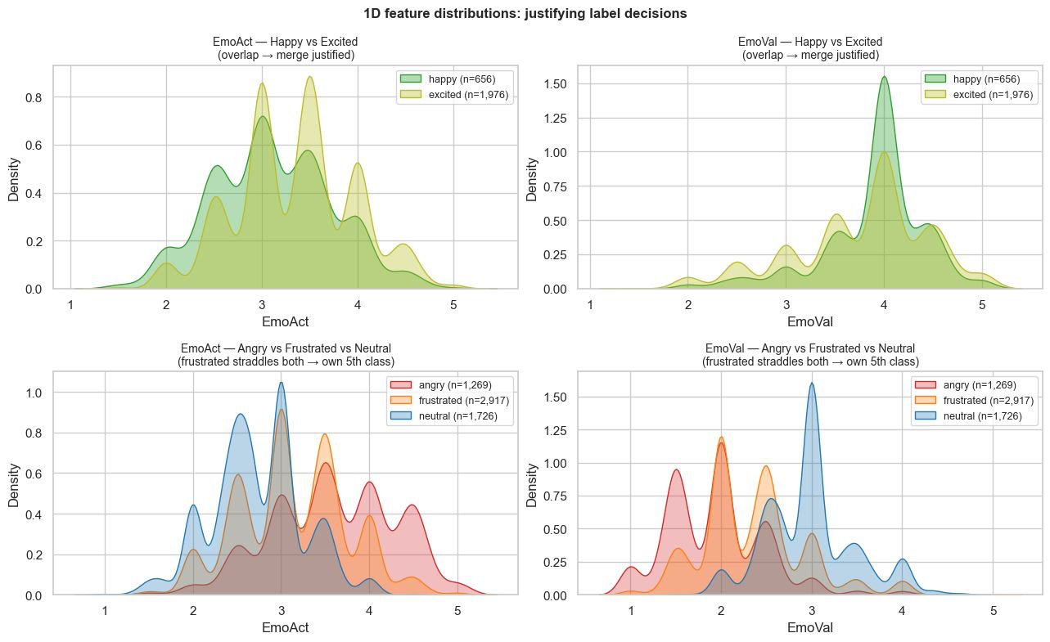
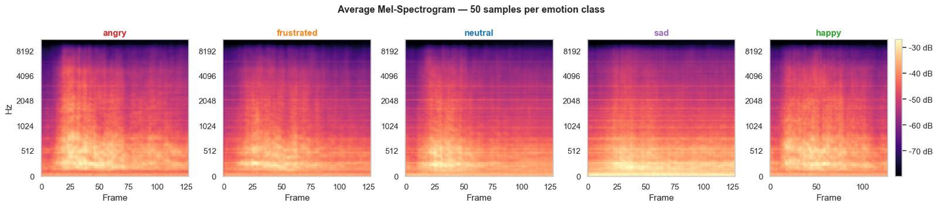
DATASET OVERVIEW
Addressing Feedback & Updated EDA
Reintroducing 'Frustrated': Based on feedback and the large sample volume, we restored the 'Frustrated' class.
5-Class Target: We are now classifying across 5 emotions: Neutral, Sad, Angry, Happy, and Frustrated.
1 Extended EDA: Generated correlation matrices to thoroughly analyze feature relationships and dependencies.
IEMOCAP · Sprint 2 · Bar-Ilan University
2 / 10

Slide 3
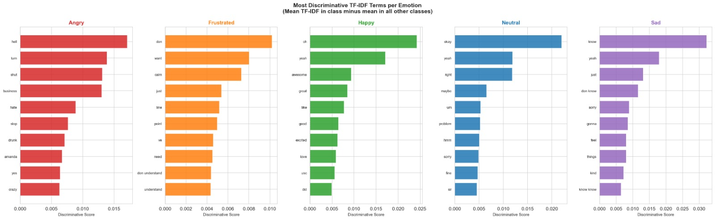
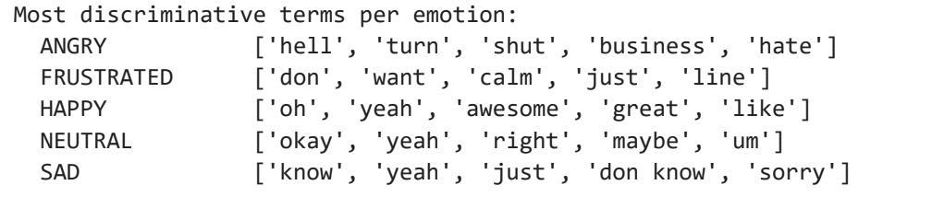
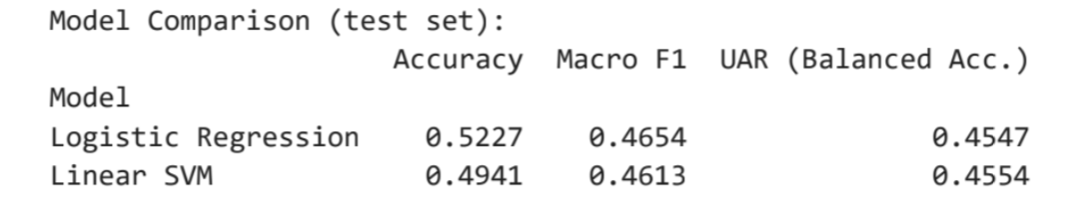
EDA · DISTRIBUTIONS
Textual Modality (NLP)
KEY FINDINGS
- Transcription: Converted audio recordings into text transcripts by wisper.
- Feature Extraction: Applied TF-IDF (Term Frequency-Inverse Document Frequency) to assign weights to significant words.
- Initial Results: The text-based classification model achieved approximately 45.5% accuracy.
IEMOCAP · Sprint 2· Bar-Ilan University
4 / 10

Slide 4
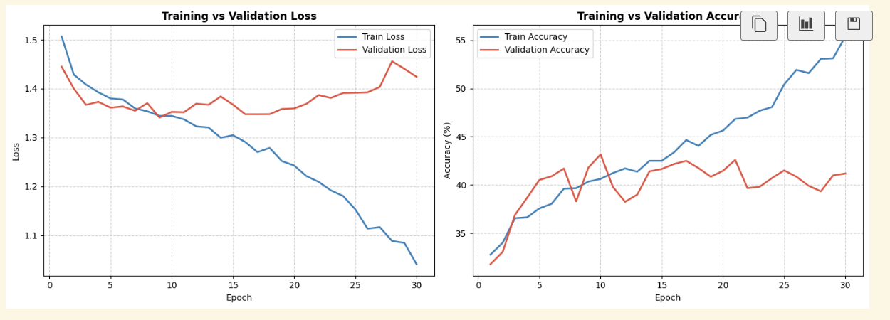
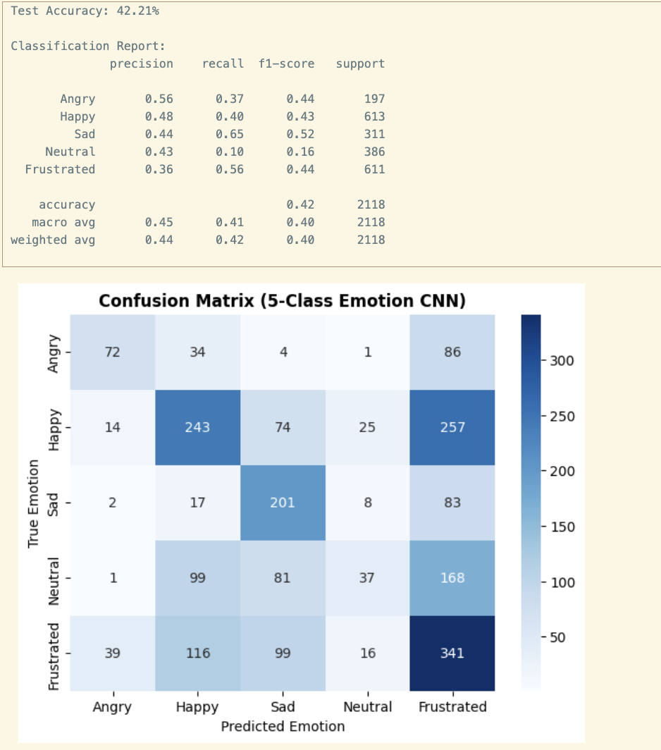
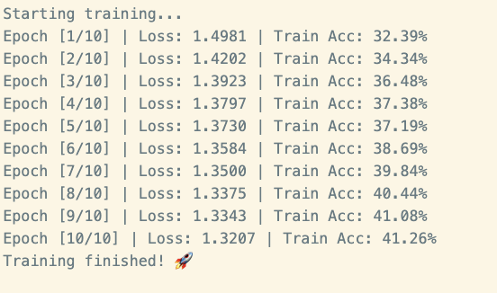
Train
Audio-Visual Modality – Spectrograms & CNN
KEY FINDINGS
• Data Transformation: Converted audio files into spectrograms (frequency heatmaps).
• Model Architecture: Trained a Convolutional Neural Network (CNN) to extract emotional features from these images.
• Evaluation & Accuracy: Monitored the training process to prevent overfitting; achieved 42.21% accuracy, matching the textual baseline.
•overfitting
IEMOCAP · Sprint 2· Bar-Ilan University
5 / 10

Slide 5
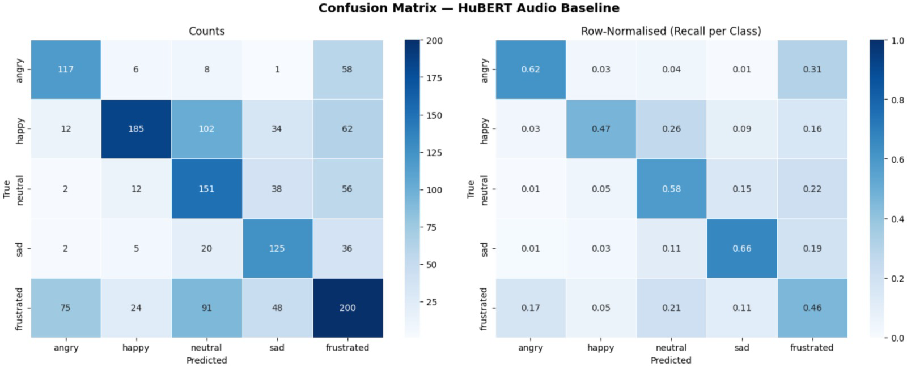
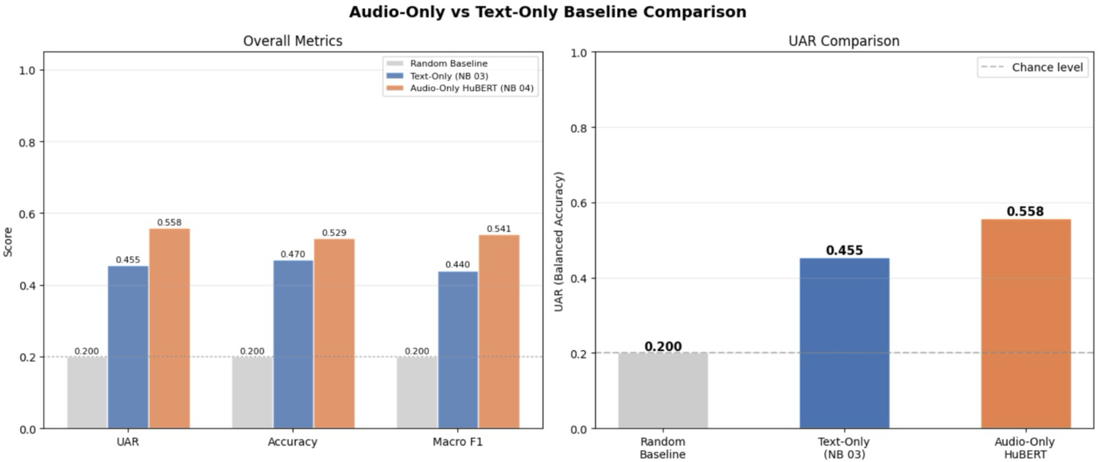
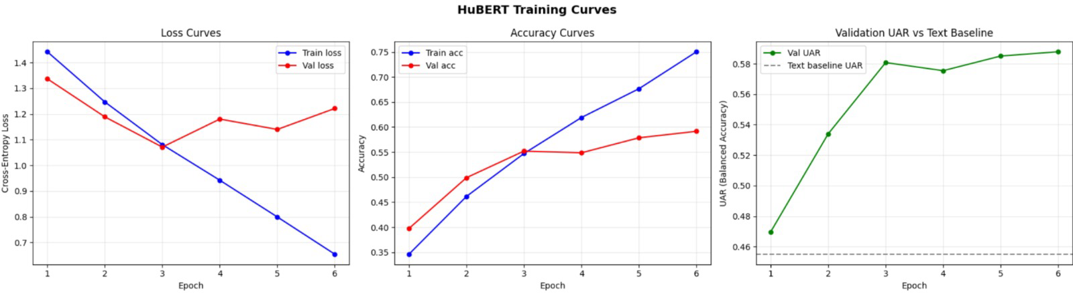
Raw Audio Signal Processing (Work in Progress)
KEY FINDINGS
1.⁠ ⁠*Audio vs. Text Baseline Comparison:* The HuBERT audio model outperformed the text-only baseline (UAR 0.558 vs. 0.455), demonstrating that speech signals contain important emotional information beyond transcript content.
2.⁠ ⁠*Training Curves:* The model learned effectively during training, while early stopping prevented overfitting by selecting the best-performing checkpoint based on validation performance.
3.⁠ ⁠*Confusion Matrix:* The model recognized Angry and Sad emotions most accurately, while Frustrated remained the most difficult class due to its acoustic similarity to other emotions such as Angry and Neutral.
6 / 10

Slide 6
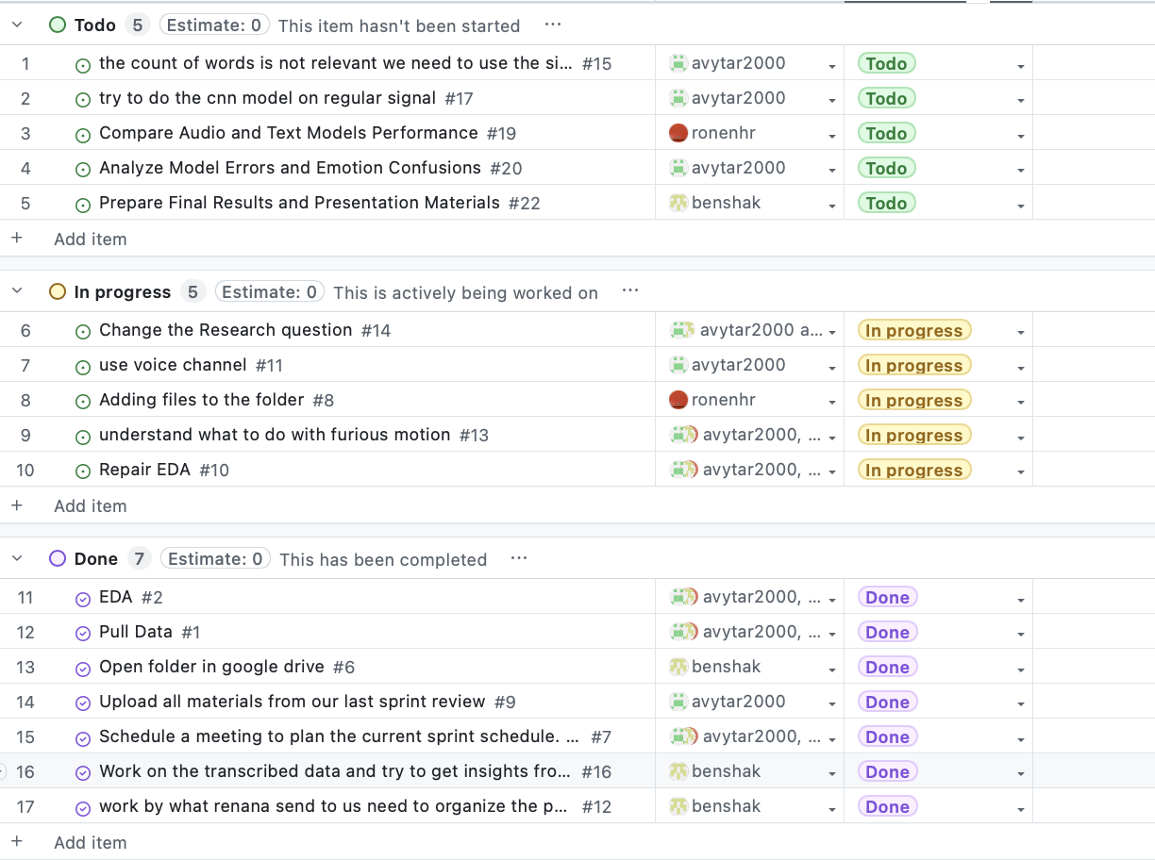
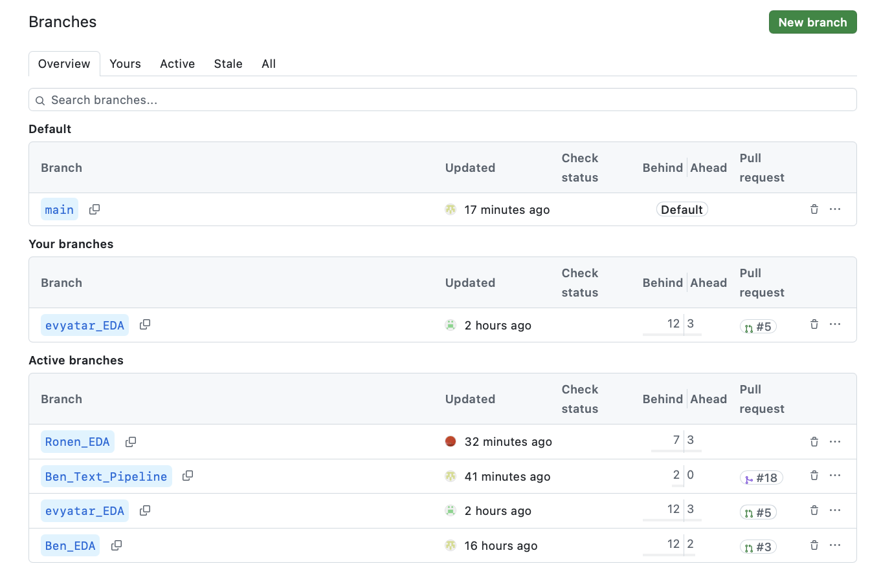
Workflow & Git Collaboration
- Parallel Development: Managed simultaneous work on different models using Git.
- Branching Strategy: Created dedicated branches for specific tasks (e.g., text model branch, CNN branch).
- Version Control: Conducted structured merges to prevent code overrides and ensure smooth integration.
IEMOCAP · Sprint 2· Bar-Ilan University
7 / 10

Slide 7
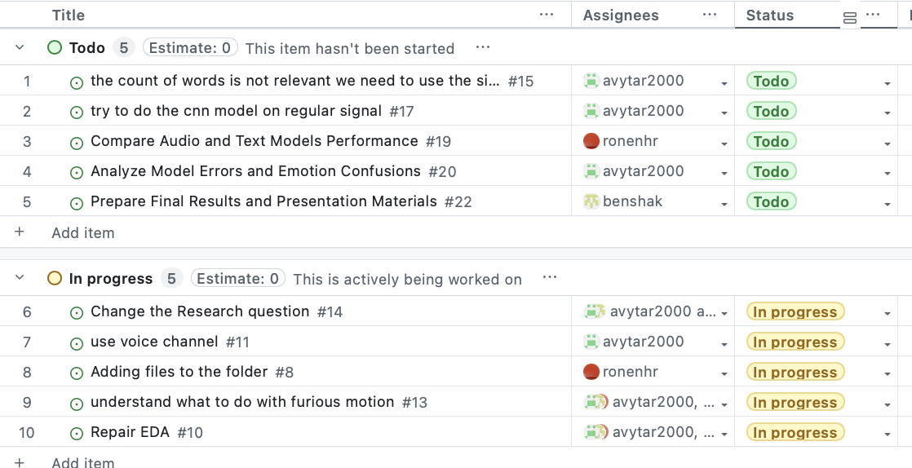
Next Steps & Task Allocation
Ronen: Finalize raw signal processing runs and evaluate raw audio model performance.
Evyatar: Research and implement early/late fusion techniques (Ensemble) to combine Text and CNN models.
Ben: Perform hyperparameter tuning and model optimization to push accuracy beyond the 50% baseline.
IEMOCAP · Sprint 2· Bar-Ilan University
8 / 10

