Slide 1
Computer Architecture Final Project Presentation
2-Level Coherent Directory Based Cache Hierarchy
Anna Barcai
Ronen Miller

Slide 2

Overview
2 Level Inclusive Cache
Multiple L1 instances and a single L2 instance
Use of MSI Coherency protocol
Coherency is kept using directory, based in L2 cache
Support of a generic number of CPUs
Interfaces with CPUs and memory
Replacement policy – FIFO
Addressing :

Slide 3
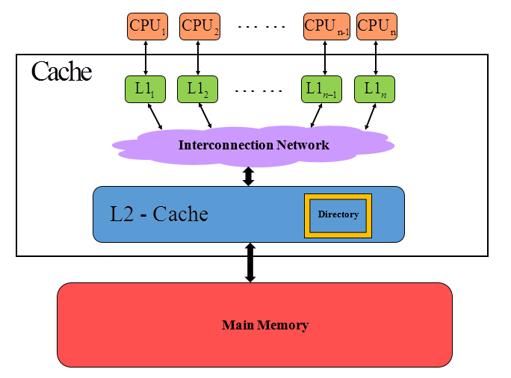
Block Diagram

Slide 4
L1 Cache
Owned by a single CPU – each L1 cache is assigned a logical ID
Interfaces:
With CPU - 32 bit granularity
With L2 – 32 Byte granularity
For each block contains:
Data
Tag
State (Invalid/Modified/Shared)
Blocking cache

Slide 5
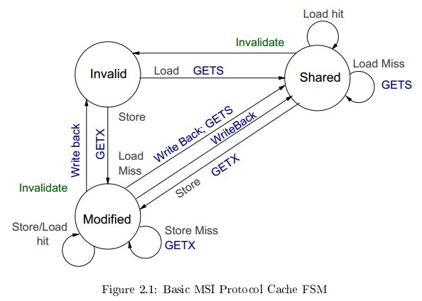
L1 Coherency
CPU requests:
Ld (GETS)
St (GETX)
L2 Requests:
Invalidate
Get modified
Swap Out (Write Back)
Legend:
Blue– requests from L1 to L2
Gray – L1 cache event
GETS – request following read miss
GETX – request following write miss
Invalidate while modified causes WB request

Slide 6
L2 Cache
One instance of L2, communicates with all L1 caches
Interfaces:
With L1- 32 Byte granularity
With main memory – 32 Byte granularity
For each block contains:
Data
Tag
Dirty bit
Blocking cache
L1 Requests for Rd/Wr

Slide 7
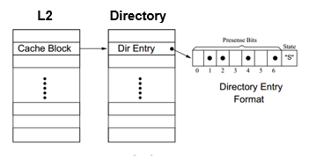
L2 Cache - Directory
Each line contains:
Coherency state in L1 caches (Invalid/Modified/Shared)
Presence bit vector (1 bit for each L1)

Slide 8
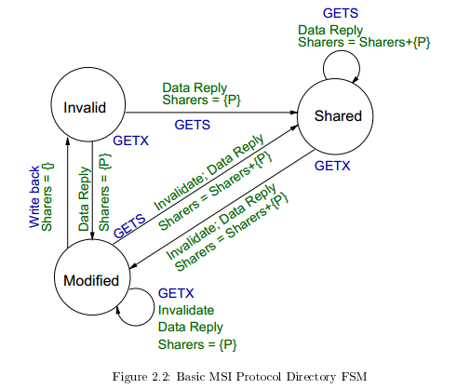
L2 Cache – Directory Coherency
Legend:
Green – Directory action / Data reply
Blue – requests from L1 to L2 / WB to memory
* There can be WB for SO from L1 to L2.

Slide 9
mkProject
Main module (wrapper)
Connects L1 caches to L2 cache
Exposes processor-side interfaces to L1 caches
Exposes Memory interface to L2 cache
Input : number of L1 caches (CPUs)
An Arbiter is responsible for synchronization of requests from L1 caches to L2

Slide 10
Dilemmas
Inclusive or Exclusive?
Blocking or Non-Blocking?
Swap out policy
FIFO
LRU, Second Chance
Hardware design vs. software design

Slide 11
Dilemma #1 - Inclusive or Exclusive?
Inclusive:
Exclusive:
Advantages (+) | Disadvantages (-)
For L1 miss and L2 hit, only need a simple copy from L2 to L1 | Contains less blocks
For swap out, only search L2 | For swap out from L2, need to swap out from L1 -> more power needed, L1 miss rate increases
Allows different sizes of blocks for L1 and L2, such that L2 blocks will be bigger. As a result, less bits for tag will be needed -> save memory space | A limitation on L2 associativity : number of L2 ways must be equal/bigger than the sum of all the L1 ways. Otherwise inefficiency, high miss rate
Implemented :
Inclusive
Advantages (+) | Disadvantages (-)
Contains more blocks. This is significant when L2 is much larger than L1 | For L1 miss and L2 hit, need to swap out a block, complicated operation
For swap out from L2, no need to swap out from L1 | For swap out search L2 and L1 -> more power needed

Slide 12
Dilemma #2 – Blocking or Non-Blocking?
Non-blocking cache
allows the cache to preform other actions while handling a miss
Preferable in time and throughput
Complicated to implement
blocking cache
Simple to implement
Implemented :
Blocking

