Slide 1
Background
Https://www.thingiverse.com/ is a website where anyone can upload it’s 3D models for the benefit of community and share what he created
Each model behaves like a "post" and contains the model’s name, photos, description (print instructions also come out), tags, the user who uploaded the files, and more
Each "post" can be liked or get commented on by other users
The research question is: In order to get the most likes for the new post - what information to add when upload a new model

Slide 2
technologies
Selenium libary: Selenium is a plugin that allows you to create manual scenario and rerun it many times in order to click buttons on WEB sites, send commands to the site and more
Pandas library: A library created for the purpose of performing data analysis and enabling tabular data arrangement and more
Numpy Library: Shortcut of NumericalPython. A library designed to perform numeric operations on data sets
Plotly, WordCloud, Matplotlib Libraries: Libraries Designed for Visualizing Data

Slide 3



תהליך העבודה
Canceling mergers and consolidating data
Computerized learning to draw conclusions
2.
4.
Data Integration
Machine Learning
1.
3.
5.
Data Acquisition
EDA
Results
Mining the data from the site by performing crewling
Data visualization
Reciving conclusions about the data
The site has a built-in API, but it is limited to retrieving only the last 30 objects, so after trial and error I decided not to work with the API but to perform crewling only.

Slide 4
Data Acquisition

Slide 5
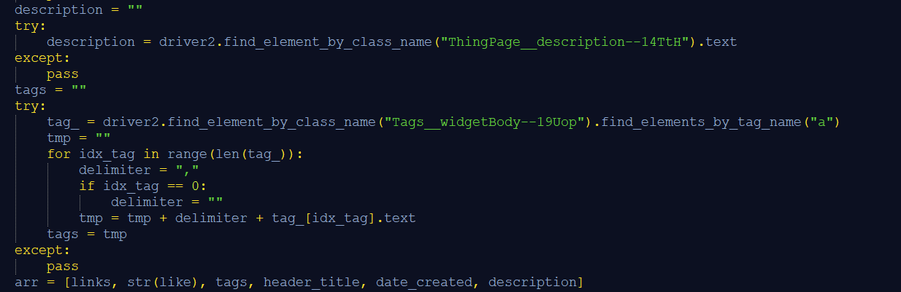
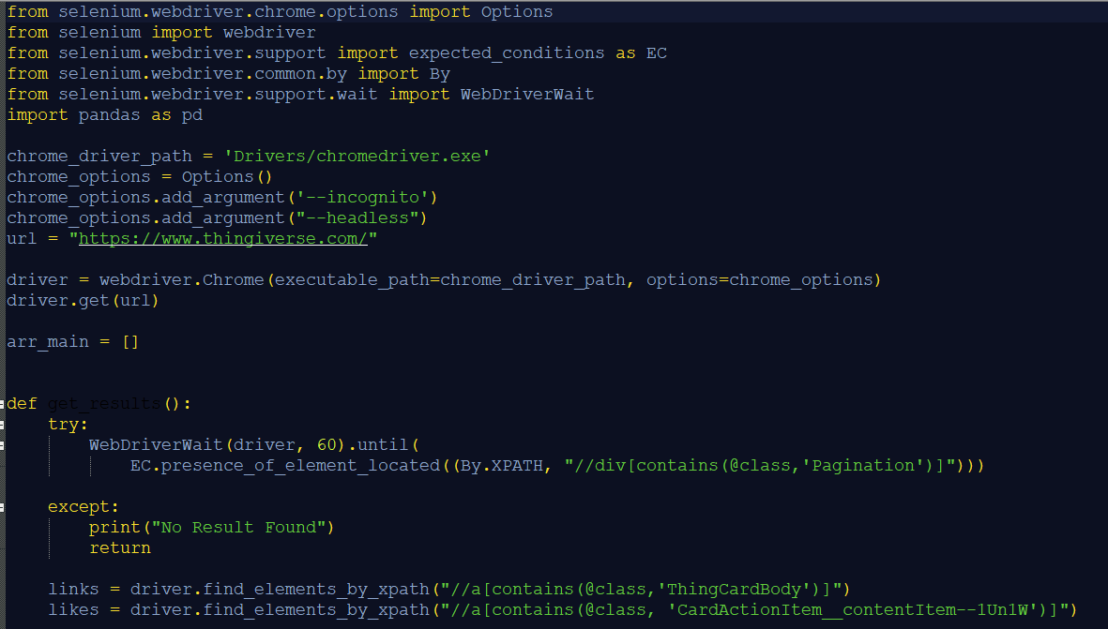
The site has about 200 pages of 3D models
Each page has 20 models
The data mining was done as follows: 1. “bot.py” file: configuration script for the data mining phase (fields required to be taken from the site, skeleton for the data structure, drivers and more)
2. “main.py” file:
A script that actually performs data mining by the Selenium library in Python The script uses a skeleton built in a "bot.py" file

Slide 6
Data Integration

Slide 7
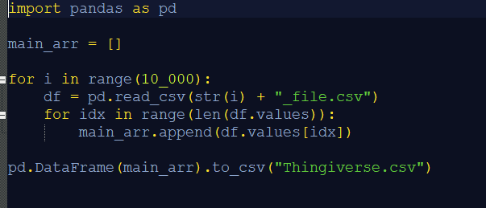
"Verifydta.py" file
Merges all the individual files that were cut into one file that unites them all * The code is written so that during the data mining phase, a new file is written each time so that if the session falls, all the data will not be lost.

Slide 8
Exploratory Data Analysis

Slide 9
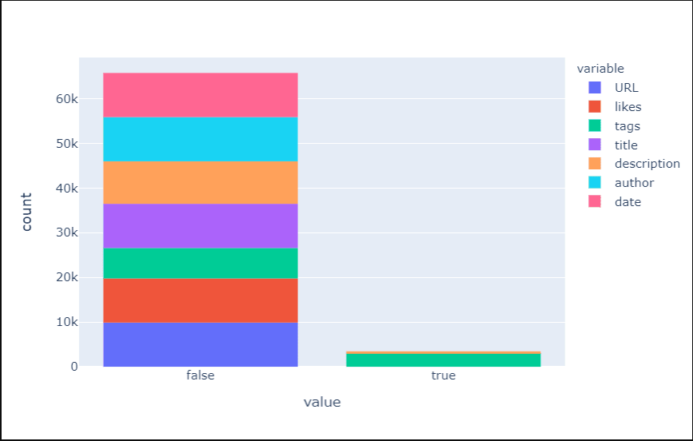
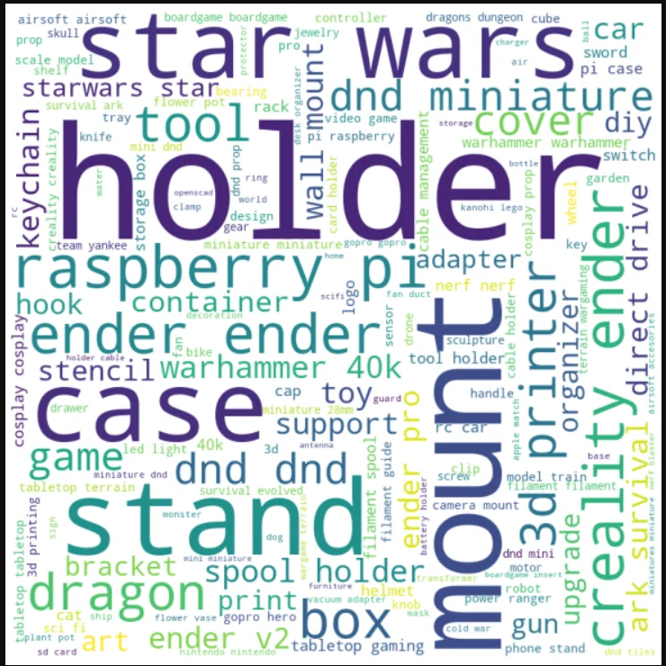
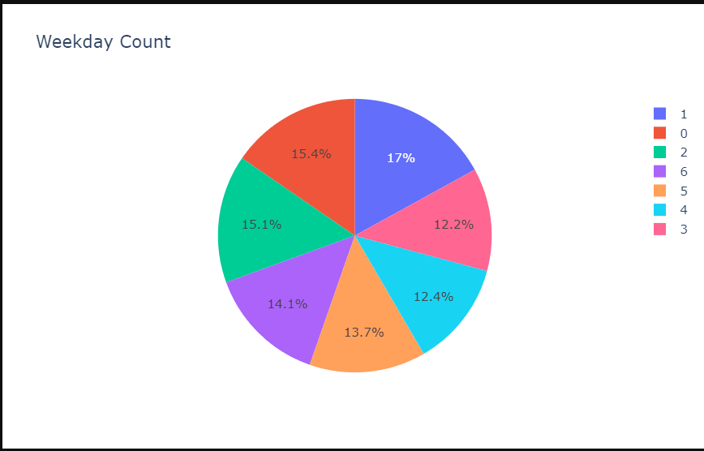
A histogram showing the amount of null values. you can see that the value "tags" has the highest number of null values
A histogram showing the most common words in tags
A histogram that shows the difference in the time the posts are uploaded (0 is Sunday)

Slide 10
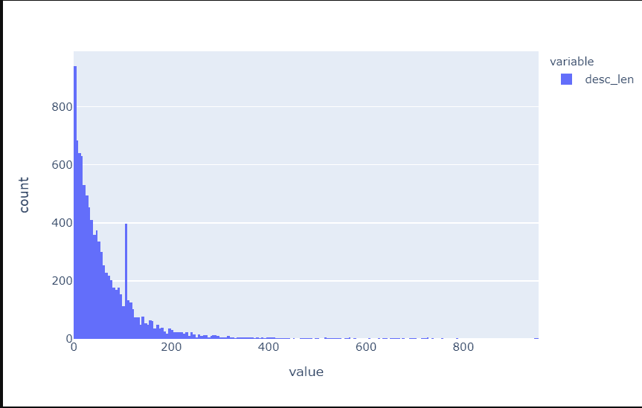
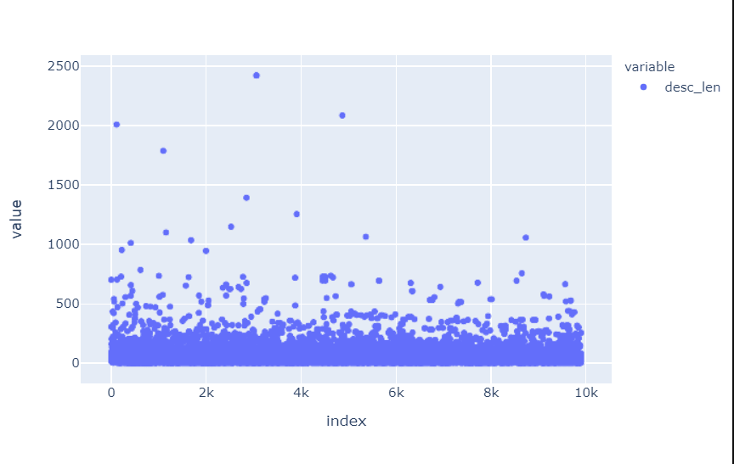
A vertical histogram that shows the figure of the amount of text in the "description". You can see that also here the top has a small amount of data
A histogram that shows the amount of text in the model "description". It can be seen that most models have a low value of the amount of text

Slide 11
Machine Learning

Slide 12
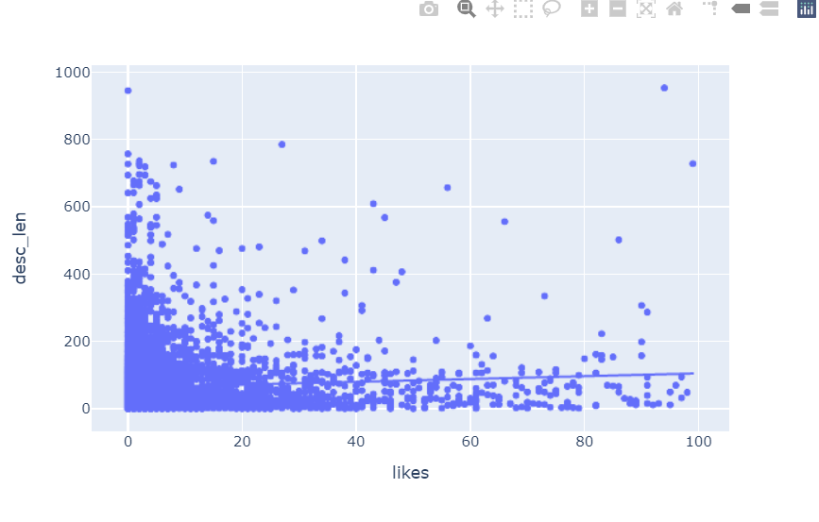
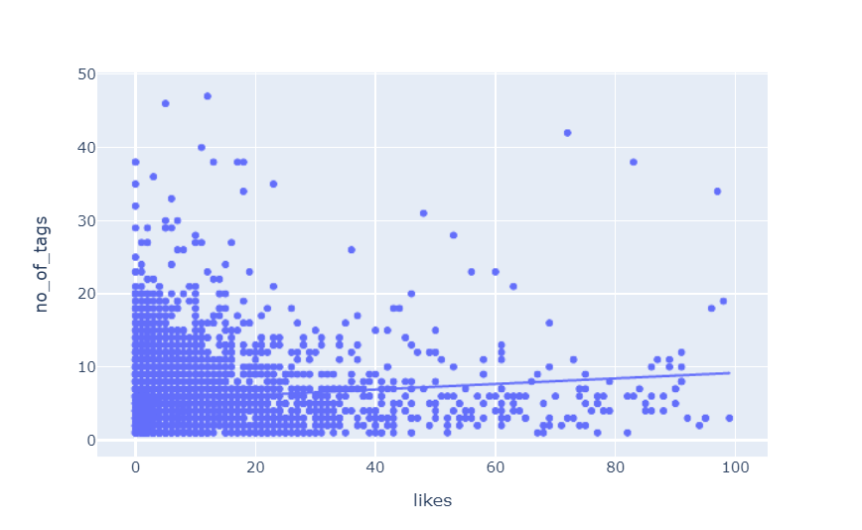
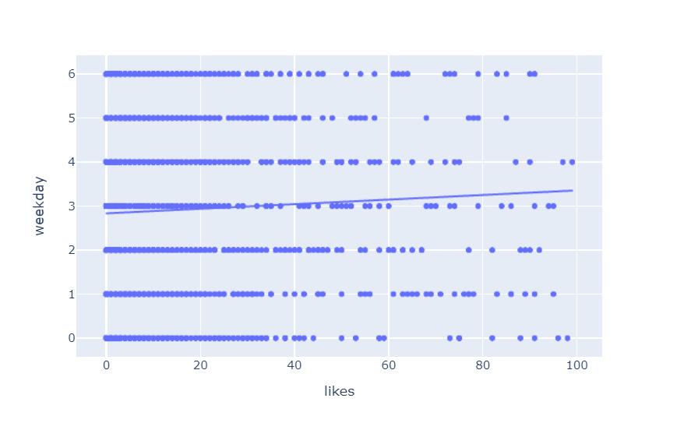
The “main.ipynb” file is from JUPITER, which performs the data analysis and inference phase.
"Upload time"
You can see that as you progress towards Saturday, the number of likes increases. Hence the conclusion is that to upload at the weekend brings a greater amount of likes
“Number of words in description" The square value of the description is low (0.003) and therefore its effect on the number of likes is low
“Number of tags used“ The square value of the number of tags is high (0.3) and therefore its effect on the number of likes is high

Slide 13
Results
The data was sufficient to make inferences such as:
The likes are directly proportional to the number of tags used. More number of tags will not only help better reach of the post but also impact the SEO of the post in a positive manner.
The days on which a post is uploaded also impacts the number of likes it gets. Posts uploaded on Saturday will gain slightly more number of like than the ones uploaded on Sundays.
The description length though has a positive correlation with the number of likes but the change was not very significant and hence could be omitted.

