Slide 1

BugTriageAI
AI FOR SOFTWARE DELIVERY
Automating bug triage for faster, smarter resolution.
Presented by Erin Schaverien & Ron Ness
Bug triage is critical yet time-consuming. Misclassification and delays raise development costs and slow releases - automation delivers faster resolution and higher productivity.

Slide 2
The business problem
BACKGROUND & NEEDS
How it shows up in practice
The goal
Bugs queue up waiting for manual review and routing
Misrouted tickets bounce between teams before reaching an owner
Triage depends on a few experts - a single point of failure
BugTriageAI automates bug triage, using machine-learning models to classify each incoming bug and route it to the right team or developer, efficiently and consistently.
Today, triage is manual, slow, and dependent on a handful of senior engineers - a bottleneck that scales badly as bug volume grows.
Why it matters - value & ROI
Faster resolution → shorter, more predictable release cycles
Less senior-engineer time lost to manual sorting
Fewer misassignments → lower rework and support cost

Slide 3
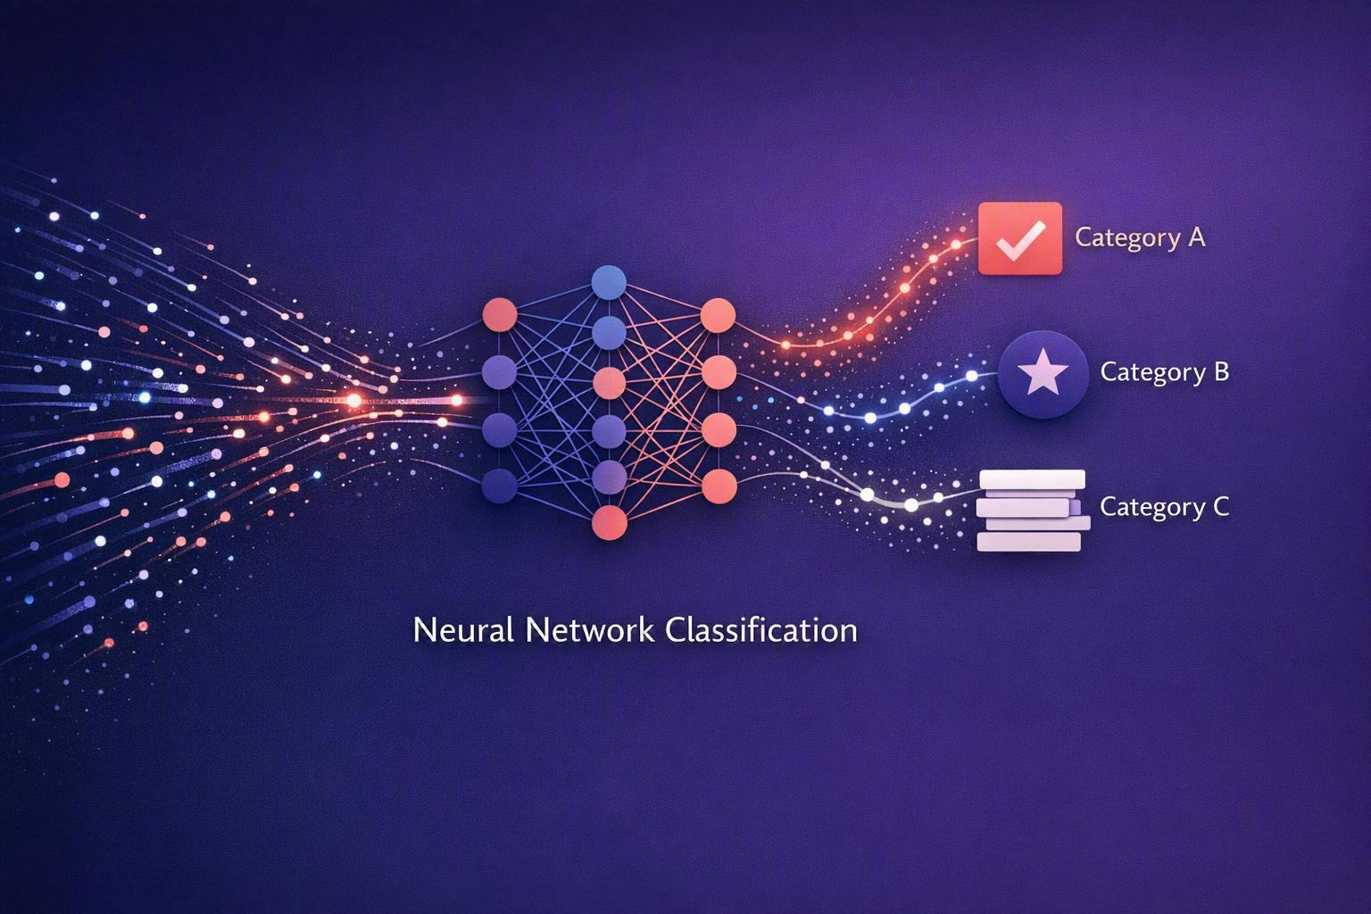
What BugTriageAI does
THE SOLUTION
1
Ingests
2
Classifies
Pulls every new bug report - title, description, logs and metadata - the moment it lands.
Labels each bug by component, type and severity using trained ML models.
3
Assigns
4
Prioritizes
Predicts the best-fit team or developer and routes the ticket automatically.
Ranks the queue so the highest-impact issues surface first.
From noisy backlog to sorted, owned work
It replaces slow, manual routing with instant, consistent, data-driven assignment.

Slide 4
How it works, end to end
PROCESS DIAGRAM
01
02
03
›
›
Data sources
Processing
Insights & routing
Bug tracker (Jira / GitHub Issues), stack traces, logs and ticket metadata.
Text is embedded, then ML models predict component, severity and best-fit owner.
Auto-assigned, prioritized tickets plus dashboards for the team.
Under the hood
Bug text is vectorized using embedding processes; a fine-tuned classifier predicts component and severity, and a matching model ranks candidate owners by fit and load.

Slide 5
What is needed to run it
WHAT IT TAKES TO RUN
1
What it needs
2
Activation
3
How it runs
Historical, labeled bug data for training
A live feed of incoming bug reports
Team & component ownership map
API read access to the bug tracker
A trained, validated model in place
Integration hook for auto-assignment
Ongoing: scores, priority, and role assignment for every new bug in real time
Periodic retraining (e.g. monthly)
Human override always available

Slide 6
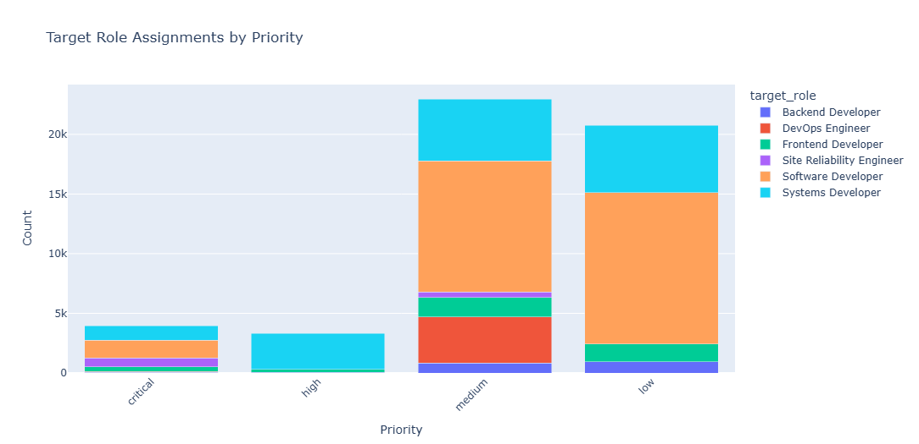
Results & key metrics
RESULTS OBTAINED
Accuracy vs. manual baseline
>2 min
median time-to-assignment
down from 6.5 hrs
9%
reassignment rate
down from 24%
~70%
less manual triage time
freed for engineering

Slide 7
The product in action
INTERFACE & LIVE DEMO
BugTriageAI · Triage Queue
Today
Bug | Component | Severity | Assigned to | Priority | Escalation | Conf.
RECOMMENDERS-467951 | Core | 2 | Backend Developer | Low | Standard | 0.708157
EQUINOX-530069 | Compendium | 2 | Software Developer | Low | Standard | 0.636735
NATTABLE-422482 | Core | 2 | Backend Developer | Medium | Standard | 0.469583
WTP_JAVA_EE_TOOLS-116294 | jst.j2ee | 3 | Systems Developer | HIgh | Same-Day | 0.953736
PDT-165702 | Code Assist | 2 | Software Developer | Low | Standard | 0.465392
100’s
bugs triaged
91%
auto-assigned
0.64
avg. confidence
2 min
avg. to owner
Every incoming bug is scored, labeled and routed in seconds - with a confidence score and one-click human override.

Slide 8
Strengths, limits & what's next
ADVANTAGES & CHALLENGES
Key advantages
Current limitations
Instant, consistent triage - around the clock
Frees senior engineers from manual routing
Learns from history and improves over time
Transparent confidence scores keep humans in control
Needs enough labeled history to train well
Accuracy dips on brand-new components
Rare or edge-case bugs still need human review
Requires monitoring to guard against drift
What we can improve next
Duplicate detection and fix suggestions · expand to feature requests and support tickets · an active-learning loop that trains on engineer feedback.

Slide 9
From pilot to production
NEXT STEP
Readiness: the core model is validated in offline evaluation - ready for a controlled pilot, not yet full production.
1
Pilot
2
Integrate
3
Test & roll out
Run in shadow mode on one team; compare AI suggestions against human triage.
Wire auto-assignment into the tracker with human override and confidence gates.
Monitor accuracy and drift, tune thresholds, then expand team by team.
~4 WEEKS
~4–6 WEEKS
ONGOING

Slide 10
What we built
SUMMARY
An ML system that classifies and routes bugs automatically
Cutting manual triage, speeding resolution and shortening release cycles
Validated in evaluation and ready for a controlled pilot
Turning bug triage from a bottleneck into an automated, data-driven advantage.
Erin Schaverien & Ron Ness · BugTriageAI

