Slide 1
Untitled
Roney Fraga Souza

Slide 2
R Markdown
This is an R Markdown presentation. Markdown is a simple formatting syntax for authoring HTML, PDF, and MS Word documents. For more details on using R Markdown see http://rmarkdown.rstudio.com.
When you click the Knit button a document will be generated that includes both content as well as the output of any embedded R code chunks within the document.

Slide 3
Slide with Bullets
  Bullet 1
  Bullet 2
  Bullet 3

Slide 4
Slide with R Output
summary(cars)
## speed dist
## Min. : 4.0 Min. : 2.00
## 1st Qu.:12.0 1st Qu.: 26.00
## Median :15.0 Median : 36.00
## Mean :15.4 Mean : 42.98
## 3rd Qu.:19.0 3rd Qu.: 56.00
## Max. :25.0 Max. :120.00

Slide 5
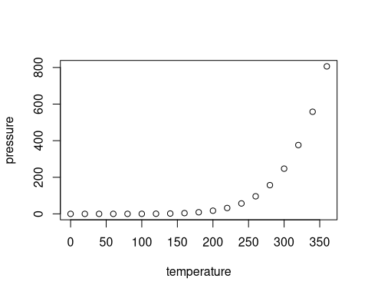
Slide with Plot

