Slide 1
Homework 2 explanation
NCKU CSIE DICLAB

Slide 2
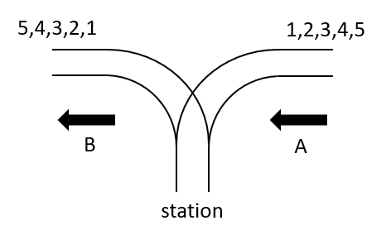

Introduction
Every train arrives at the station from direction A, and departs the station from direction B.
The arriving trains will be numbered in ascending order from 1 to N. ($3≤N≤10$)
Given a departure order d1, d2, . . . , dN, the circuit has to determine if the trains can leave the station in the required order.
For any train, there is no limit to its arrival time and staying time at the station.

Slide 3
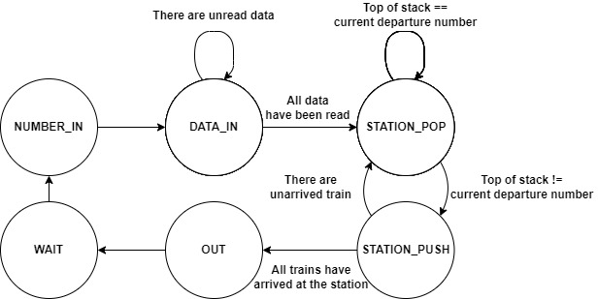
Finite State Machine
NUMBER_IN：Read the number of coming trains
DATA_IN：Read the sequence of departure order
STATION_POP：Examine whether the top of stack is equal to current departure number
STATION_PUSH：Push number into the stack
OUT：Output determination result
WAIT：Reset registers and go back to the initial state (NUMBER_IN)

Slide 4
Data Registers
num：record the number of coming trains
index：index of sequence of departure order
order：data array to store departure order
station_index：index of the stack
station：data array that acts as the stack
sequence_index：count of arrived train
index | 0 | 1 | 2 | 3 | 4 | 5 | 6 | 7 | 8 | 9
data
order
num: 0
sequence_index: 1
index | 0 | 1 | 2 | 3 | 4 | 5 | 6 | 7 | 8 | 9
data
stack

Slide 5
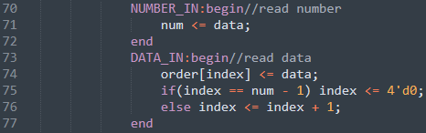
NUMBER_IN & DATA_IN
index | 0 | 1 | 2 | 3 | 4 | 5 | 6 | 7 | 8 | 9
data | 4 | 3 | 2 | 5 | 1
order
num: 5
sequence_index: 1
index | 0 | 1 | 2 | 3 | 4 | 5 | 6 | 7 | 8 | 9
data
stack

Slide 6
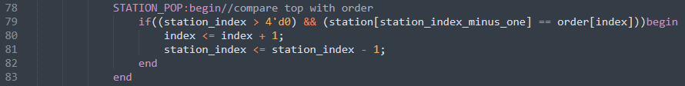
STATION_POP
station_index == 0，the stack is empty
go to STATION_PUSH state
index | 0 | 1 | 2 | 3 | 4 | 5 | 6 | 7 | 8 | 9
data | 4 | 3 | 2 | 5 | 1
order
num: 5
sequence_index: 1
index | 0 | 1 | 2 | 3 | 4 | 5 | 6 | 7 | 8 | 9
data
stack

Slide 7

STATION_PUSH
Train 1 arrives at the station, push 1 into the stack.
index | 0 | 1 | 2 | 3 | 4 | 5 | 6 | 7 | 8 | 9
data | 4 | 3 | 2 | 5 | 1
order
num: 5
sequence_index: 2
index | 0 | 1 | 2 | 3 | 4 | 5 | 6 | 7 | 8 | 9
data | 1
stack

Slide 8
STATION_POP
The top of stack != current departure number
go to STATION_PUSH state
index | 0 | 1 | 2 | 3 | 4 | 5 | 6 | 7 | 8 | 9
data | 4 | 3 | 2 | 5 | 1
order
num: 5
sequence_index: 2
index | 0 | 1 | 2 | 3 | 4 | 5 | 6 | 7 | 8 | 9
data | 1
stack

Slide 9
STATION_PUSH
Train 2 arrives at the station, push 2 into the stack.
index | 0 | 1 | 2 | 3 | 4 | 5 | 6 | 7 | 8 | 9
data | 4 | 3 | 2 | 5 | 1
order
num: 5
sequence_index: 3
index | 0 | 1 | 2 | 3 | 4 | 5 | 6 | 7 | 8 | 9
data | 1 | 2
stack

Slide 10
STATION_POP
The top of stack != current departure number
go to STATION_PUSH state
index | 0 | 1 | 2 | 3 | 4 | 5 | 6 | 7 | 8 | 9
data | 4 | 3 | 2 | 5 | 1
order
num: 5
sequence_index: 3
index | 0 | 1 | 2 | 3 | 4 | 5 | 6 | 7 | 8 | 9
data | 1 | 2
stack

Slide 11
STATION_PUSH
Train 3 arrives at the station, push 3 into the stack.
index | 0 | 1 | 2 | 3 | 4 | 5 | 6 | 7 | 8 | 9
data | 4 | 3 | 2 | 5 | 1
order
num: 5
sequence_index: 4
index | 0 | 1 | 2 | 3 | 4 | 5 | 6 | 7 | 8 | 9
data | 1 | 2 | 3
stack

Slide 12
STATION_POP
The top of stack != current departure number
go to STATION_PUSH state
index | 0 | 1 | 2 | 3 | 4 | 5 | 6 | 7 | 8 | 9
data | 4 | 3 | 2 | 5 | 1
order
num: 5
sequence_index: 4
index | 0 | 1 | 2 | 3 | 4 | 5 | 6 | 7 | 8 | 9
data | 1 | 2 | 3
stack

Slide 13
STATION_PUSH
Train 4 arrives at the station, push 4 into the stack.
index | 0 | 1 | 2 | 3 | 4 | 5 | 6 | 7 | 8 | 9
data | 4 | 3 | 2 | 5 | 1
order
num: 5
sequence_index: 5
index | 0 | 1 | 2 | 3 | 4 | 5 | 6 | 7 | 8 | 9
data | 1 | 2 | 3 | 4
stack

Slide 14
STATION_POP
The top of stack == current departure number
Pop an element from stack and stay at STATION_POP state
Increase the index of order array
index | 0 | 1 | 2 | 3 | 4 | 5 | 6 | 7 | 8 | 9
data | 4 | 3 | 2 | 5 | 1
order
num: 5
sequence_index: 5
index | 0 | 1 | 2 | 3 | 4 | 5 | 6 | 7 | 8 | 9
data | 1 | 2 | 3 | 4
stack

Slide 15
STATION_POP
The top of stack == current departure number
Pop an element from stack and stay at STATION_POP state
Increase the index of order array
index | 0 | 1 | 2 | 3 | 4 | 5 | 6 | 7 | 8 | 9
data | 4 | 3 | 2 | 5 | 1
order
num: 5
sequence_index: 5
index | 0 | 1 | 2 | 3 | 4 | 5 | 6 | 7 | 8 | 9
data | 1 | 2 | 3
stack

Slide 16
STATION_POP
The top of stack == current departure number
Pop an element from stack and stay at STATION_POP state
Increase the index of order array
index | 0 | 1 | 2 | 3 | 4 | 5 | 6 | 7 | 8 | 9
data | 4 | 3 | 2 | 5 | 1
order
num: 5
sequence_index: 5
index | 0 | 1 | 2 | 3 | 4 | 5 | 6 | 7 | 8 | 9
data | 1 | 2
stack

Slide 17
STATION_POP
The top of stack != current departure number
go to STATION_PUSH state
index | 0 | 1 | 2 | 3 | 4 | 5 | 6 | 7 | 8 | 9
data | 4 | 3 | 2 | 5 | 1
order
num: 5
sequence_index: 5
index | 0 | 1 | 2 | 3 | 4 | 5 | 6 | 7 | 8 | 9
data | 1
stack

Slide 18
STATION_PUSH
Train 3 arrives at the station, push 3 into the stack.
index | 0 | 1 | 2 | 3 | 4 | 5 | 6 | 7 | 8 | 9
data | 4 | 3 | 2 | 5 | 1
order
num: 5
sequence_index: 6
index | 0 | 1 | 2 | 3 | 4 | 5 | 6 | 7 | 8 | 9
data | 1 | 5
stack

Slide 19
STATION_POP
The top of stack == current departure number
Pop an element from stack and stay at STATION_POP state
Increase the index of order array
index | 0 | 1 | 2 | 3 | 4 | 5 | 6 | 7 | 8 | 9
data | 4 | 3 | 2 | 5 | 1
order
num: 5
sequence_index: 6
index | 0 | 1 | 2 | 3 | 4 | 5 | 6 | 7 | 8 | 9
data | 1 | 5
stack

Slide 20
STATION_POP
The top of stack == current departure number
Pop an element from stack and stay at STATION_POP state
Increase the index of order array
index | 0 | 1 | 2 | 3 | 4 | 5 | 6 | 7 | 8 | 9
data | 4 | 3 | 2 | 5 | 1
order
num: 5
sequence_index: 6
index | 0 | 1 | 2 | 3 | 4 | 5 | 6 | 7 | 8 | 9
data | 1
stack

Slide 21
STATION_POP
station_index == 0，the stack is empty
go to STATION_PUSH state
index | 0 | 1 | 2 | 3 | 4 | 5 | 6 | 7 | 8 | 9
data | 4 | 3 | 2 | 5 | 1
order
num: 5
sequence_index: 6
index | 0 | 1 | 2 | 3 | 4 | 5 | 6 | 7 | 8 | 9
data
stack

Slide 22

STATION_PUSH
Push 6 into the stack.
sequence_index == num + 1，
go to OUT state
index | 0 | 1 | 2 | 3 | 4 | 5 | 6 | 7 | 8 | 9
data | 4 | 3 | 2 | 5 | 1
order
num: 5
sequence_index: 6 + 1
index | 0 | 1 | 2 | 3 | 4 | 5 | 6 | 7 | 8 | 9
data | 6
stack

Slide 23

OUT
Pull up valid to 1
index == 5，result = 1
index | 0 | 1 | 2 | 3 | 4 | 5 | 6 | 7 | 8 | 9
data | 4 | 3 | 2 | 5 | 1
order
num: 5
sequence_index: 7
index | 0 | 1 | 2 | 3 | 4 | 5 | 6 | 7 | 8 | 9
data | 6
stack

Slide 24
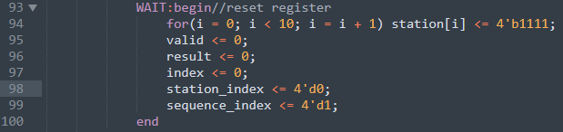
WAIT
Pull down valid to 0
Reset registers
index | 0 | 1 | 2 | 3 | 4 | 5 | 6 | 7 | 8 | 9
data
order
num: 5
sequence_index: 1
index | 0 | 1 | 2 | 3 | 4 | 5 | 6 | 7 | 8 | 9
data
stack

