Slide 1
Homework 3 explanation
NCKU CSIE DICLAB

Slide 2
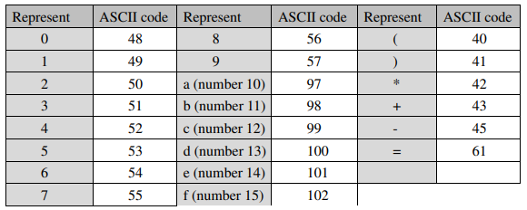
Introduction
Design an circuit with addition, subtraction, and multiplication functions
The input only consists of numbers 0 to 15, four operators: +, -, *, =, and paratheses
The inputs are represented in ASCII codes
The input expression string will not exceed 16 characters
It’s difficult for computers to comprehensively process and handle the entire equation
Converting the notation of the expression from infix to postfix

Slide 3
Finite State Machine
BUFFER：Read input string and store it into buffer
IN2POS：Convert the input string to postfix
POP：Pop out remaining operators in the buffer
CALCULATE：Calculate results according to the postfix expression
RESULT：Pull up ‘valid’ signal and output calculation result
RESET：Pull down ‘valid’ signal and go back to ‘BUFFER’ state

Slide 4
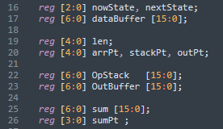
Data Registers
dataBuffer: used to store input string
OpStack: store operators while converting expression to postfix
OutBuffer: store converted postfix output string
sum: buffer for calculation

Slide 5
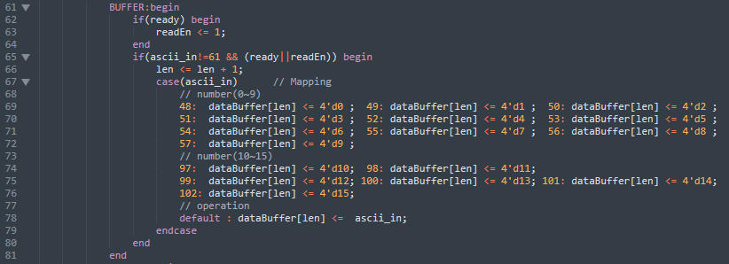
BUFFER
Decode ASCII code to numbers
The codes for operators are directly stored into ‘dataBuffer’

Slide 6
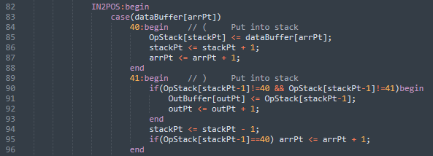
IN2POS
arrPt：index used to scan ‘dataBuffer’
stackPt：index of ‘OpStack’
If the current token of ‘dataBuffer’ is 40 (‘(’), push it to ‘OpStack’
Store the value of ‘dataBuffer[arrPt]’ to OpStack[stackPt]
Increase the value of ‘stackPt’ by 1 (Push operation)
Increase the value of ‘arrPt’ by 1 (Scan the next token)

Slide 7
IN2POS
If the current token of ‘dataBuffer’ is 41 (‘)’), pop tokens from ‘OpStack’ until a left parenthesis is found
If the top token of ‘OpStack’ is not parenthesis, pop out it from stack and append it to output string
Line 91 & 92: append a value to ‘OutBuffer’ and increase its index (outPt) by 1
No matter whether the top token of ‘OpStack’ is a left parenthesis, it should be popped out (Line 94)
If the top token of ‘OpStack’ is a left parenthesis, scan the next token from the input string (Line 95)

Slide 8
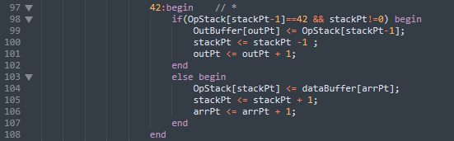
IN2POS
If the current token of ‘dataBuffer’ is 42 (‘*’), pop tokens from ‘OpStack’ until the precedence of the top token is lower than that of the current token
If the top token of ‘OpStack’ is ‘*’, pop out the top token and append it to the output string (Line 98 ~ 102)
Otherwise, push the current token onto ‘OpStack’ (Line 103 ~ 107), and scan the next token from the input string (Line 106)

Slide 9
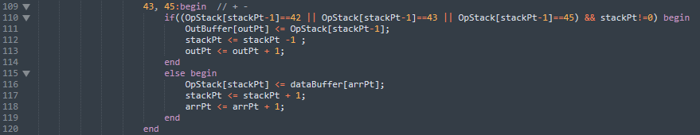
IN2POS
If the current token of ‘dataBuffer’ is 43 or 45 (‘+’ or ‘-’), pop tokens from ‘OpStack’ until the precedence of the top token is lower than that of the current token
If the top token of ‘OpStack’ is ‘+’、 ‘-’ 、‘*’, pop out the top token and append it to the output string (Line 110 ~ 114)
Otherwise, push the current token onto ‘OpStack’ (Line 115 ~ 119), and scan the next token from the input string (Line 118)
The pop operation will stop only when a left parenthesis is found or the stack becomes empty

Slide 10

IN2POS
If the current token of ‘dataBuffer’ is a number (0~15), append it to the output string

Slide 11
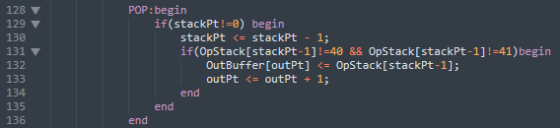
POP
If ‘OpStack’ has remaining tokens, pop them out append them to the output string
Line 129：Judge if ‘OpStack’ is empty
Line 130：Pop operation
Line 131：Ignore parenthesis while appending
Line 132 & 133：append the top token of ‘OpStack’ to ‘OutBuffer’, and increase the index of ‘OutBuffer’ by 1

Slide 12
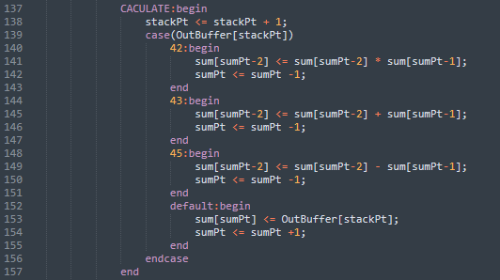
CALCULATE
Use stack ‘sum’ for calculation
If the current token of ‘OutBuffer’ is a number, push it onto the stack (Line 152 ~ 155)
Otherwise, pop out two tokens from the stack and calculate, store the calculation results back into the stack (Line 140 ~ 151)

Slide 13
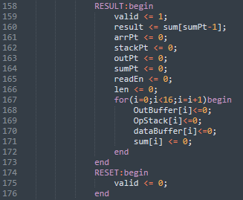
RESULT & RESET
Pull up the ‘valid’ signal (Line 159), and reset registers (Line 160 ~ 172)
Pull down the ‘valid’ signal at the next cycle (Line 175)

Slide 14
Example
Given an expression in infix notation “3 + 4 * (2 - 1)”, convert it to postfix and calculate the result
len = 9
arrPt | 0 | 1 | 2 | 3 | 4 | 5 | 6 | 7 | 8 | 9 | 10 | 11 | 12 | 13 | 14 | 15
data | 3 | + | 4 | * | ( | 2 | - | 1 | )
dataBuffer
stackPt | 0 | 1 | 2 | 3 | 4 | 5 | 6 | 7 | 8 | 9 | 10 | 11 | 12 | 13 | 14 | 15
data
OpStack
outPt | 0 | 1 | 2 | 3 | 4 | 5 | 6 | 7 | 8 | 9 | 10 | 11 | 12 | 13 | 14 | 15
data
OutBuffer

Slide 15
Example
dataBuffer[0] = 3, append it to the output string (Line 121 ~ 125)
len = 9
arrPt | 0 | 1 | 2 | 3 | 4 | 5 | 6 | 7 | 8 | 9 | 10 | 11 | 12 | 13 | 14 | 15
data | 3 | + | 4 | * | ( | 2 | - | 1 | )
dataBuffer
stackPt | 0 | 1 | 2 | 3 | 4 | 5 | 6 | 7 | 8 | 9 | 10 | 11 | 12 | 13 | 14 | 15
data
OpStack
outPt | 0 | 1 | 2 | 3 | 4 | 5 | 6 | 7 | 8 | 9 | 10 | 11 | 12 | 13 | 14 | 15
data | 3
OutBuffer

Slide 16
Example
dataBuffer[1] = ‘+’. ‘OpStack’ is empty, push ‘+’ onto ‘Opstack’ (Line 115 ~ 119)
len = 9
arrPt | 0 | 1 | 2 | 3 | 4 | 5 | 6 | 7 | 8 | 9 | 10 | 11 | 12 | 13 | 14 | 15
data | 3 | + | 4 | * | ( | 2 | - | 1 | )
dataBuffer
stackPt | 0 | 1 | 2 | 3 | 4 | 5 | 6 | 7 | 8 | 9 | 10 | 11 | 12 | 13 | 14 | 15
data | +
OpStack
outPt | 0 | 1 | 2 | 3 | 4 | 5 | 6 | 7 | 8 | 9 | 10 | 11 | 12 | 13 | 14 | 15
data | 3
OutBuffer

Slide 17
Example
dataBuffer[2] = 4, append it to the output string (Line 121 ~ 125)
len = 9
arrPt | 0 | 1 | 2 | 3 | 4 | 5 | 6 | 7 | 8 | 9 | 10 | 11 | 12 | 13 | 14 | 15
data | 3 | + | 4 | * | ( | 2 | - | 1 | )
dataBuffer
stackPt | 0 | 1 | 2 | 3 | 4 | 5 | 6 | 7 | 8 | 9 | 10 | 11 | 12 | 13 | 14 | 15
data | +
OpStack
outPt | 0 | 1 | 2 | 3 | 4 | 5 | 6 | 7 | 8 | 9 | 10 | 11 | 12 | 13 | 14 | 15
data | 3 | 4
OutBuffer

Slide 18
Example
dataBuffer[3] = ‘*’, the precedence of the top token of ‘OpStack’ is lower, push ‘*’ onto ‘OpStack’ (Line 103 ~ 107)
len = 9
arrPt | 0 | 1 | 2 | 3 | 4 | 5 | 6 | 7 | 8 | 9 | 10 | 11 | 12 | 13 | 14 | 15
data | 3 | + | 4 | * | ( | 2 | - | 1 | )
dataBuffer
stackPt | 0 | 1 | 2 | 3 | 4 | 5 | 6 | 7 | 8 | 9 | 10 | 11 | 12 | 13 | 14 | 15
data | + | *
OpStack
outPt | 0 | 1 | 2 | 3 | 4 | 5 | 6 | 7 | 8 | 9 | 10 | 11 | 12 | 13 | 14 | 15
data | 3 | 4
OutBuffer

Slide 19
Example
dataBuffer[4] = ‘(’, push it onto ‘OpStack’ (Line 84~88)
len = 9
arrPt | 0 | 1 | 2 | 3 | 4 | 5 | 6 | 7 | 8 | 9 | 10 | 11 | 12 | 13 | 14 | 15
data | 3 | + | 4 | * | ( | 2 | - | 1 | )
dataBuffer
stackPt | 0 | 1 | 2 | 3 | 4 | 5 | 6 | 7 | 8 | 9 | 10 | 11 | 12 | 13 | 14 | 15
data | + | * | (
OpStack
outPt | 0 | 1 | 2 | 3 | 4 | 5 | 6 | 7 | 8 | 9 | 10 | 11 | 12 | 13 | 14 | 15
data | 3 | 4
OutBuffer

Slide 20
Example
dataBuffer[5] = 2, append it to the output string (Line 121 ~ 125)
len = 9
arrPt | 0 | 1 | 2 | 3 | 4 | 5 | 6 | 7 | 8 | 9 | 10 | 11 | 12 | 13 | 14 | 15
data | 3 | + | 4 | * | ( | 2 | - | 1 | )
dataBuffer
stackPt | 0 | 1 | 2 | 3 | 4 | 5 | 6 | 7 | 8 | 9 | 10 | 11 | 12 | 13 | 14 | 15
data | + | * | (
OpStack
outPt | 0 | 1 | 2 | 3 | 4 | 5 | 6 | 7 | 8 | 9 | 10 | 11 | 12 | 13 | 14 | 15
data | 3 | 4 | 2
OutBuffer

Slide 21
Example
dataBuffer[6] = ‘-’, the top token of ‘OpStack’ is a left parenthesis, push ‘-’ onto ‘OpStack’ (Line 115 ~ 119)
len = 9
arrPt | 0 | 1 | 2 | 3 | 4 | 5 | 6 | 7 | 8 | 9 | 10 | 11 | 12 | 13 | 14 | 15
data | 3 | + | 4 | * | ( | 2 | - | 1 | )
dataBuffer
stackPt | 0 | 1 | 2 | 3 | 4 | 5 | 6 | 7 | 8 | 9 | 10 | 11 | 12 | 13 | 14 | 15
data | + | * | ( | -
OpStack
outPt | 0 | 1 | 2 | 3 | 4 | 5 | 6 | 7 | 8 | 9 | 10 | 11 | 12 | 13 | 14 | 15
data | 3 | 4 | 2
OutBuffer

Slide 22
Example
dataBuffer[7] = 1, append it to the output string (Line 121 ~ 125)
len = 9
arrPt | 0 | 1 | 2 | 3 | 4 | 5 | 6 | 7 | 8 | 9 | 10 | 11 | 12 | 13 | 14 | 15
data | 3 | + | 4 | * | ( | 2 | - | 1 | )
dataBuffer
stackPt | 0 | 1 | 2 | 3 | 4 | 5 | 6 | 7 | 8 | 9 | 10 | 11 | 12 | 13 | 14 | 15
data | + | * | ( | -
OpStack
outPt | 0 | 1 | 2 | 3 | 4 | 5 | 6 | 7 | 8 | 9 | 10 | 11 | 12 | 13 | 14 | 15
data | 3 | 4 | 2 | 1
OutBuffer

Slide 23
Example
dataBuffer[8] = ‘)’, the top token of ‘OpStack is ‘-’, pop ‘-’ from ‘OpStack’ and append it to the output string (Line 90 ~ 94). ‘arrPt’ = len – 1, next state is ‘POP’
len = 9
arrPt | 0 | 1 | 2 | 3 | 4 | 5 | 6 | 7 | 8 | 9 | 10 | 11 | 12 | 13 | 14 | 15
data | 3 | + | 4 | * | ( | 2 | - | 1 | )
dataBuffer
stackPt | 0 | 1 | 2 | 3 | 4 | 5 | 6 | 7 | 8 | 9 | 10 | 11 | 12 | 13 | 14 | 15
data | + | * | (
OpStack
outPt | 0 | 1 | 2 | 3 | 4 | 5 | 6 | 7 | 8 | 9 | 10 | 11 | 12 | 13 | 14 | 15
data | 3 | 4 | 2 | 1 | -
OutBuffer

Slide 24
Example
stackPt != 0, pop a token from OpStack (Line 130). The token is ‘(’, so it will not be append to the output string. (Line 131)
len = 9
arrPt | 0 | 1 | 2 | 3 | 4 | 5 | 6 | 7 | 8 | 9 | 10 | 11 | 12 | 13 | 14 | 15
data | 3 | + | 4 | * | ( | 2 | - | 1 | )
dataBuffer
stackPt | 0 | 1 | 2 | 3 | 4 | 5 | 6 | 7 | 8 | 9 | 10 | 11 | 12 | 13 | 14 | 15
data | + | *
OpStack
outPt | 0 | 1 | 2 | 3 | 4 | 5 | 6 | 7 | 8 | 9 | 10 | 11 | 12 | 13 | 14 | 15
data | 3 | 4 | 2 | 1 | -
OutBuffer

Slide 25
Example
stackPt != 0, pop a token from OpStack (Line 130). The token is ‘*’, so it will be append to the output string. (Line 132 ~ 133)
len = 9
arrPt | 0 | 1 | 2 | 3 | 4 | 5 | 6 | 7 | 8 | 9 | 10 | 11 | 12 | 13 | 14 | 15
data | 3 | + | 4 | * | ( | 2 | - | 1 | )
dataBuffer
stackPt | 0 | 1 | 2 | 3 | 4 | 5 | 6 | 7 | 8 | 9 | 10 | 11 | 12 | 13 | 14 | 15
data | +
OpStack
outPt | 0 | 1 | 2 | 3 | 4 | 5 | 6 | 7 | 8 | 9 | 10 | 11 | 12 | 13 | 14 | 15
data | 3 | 4 | 2 | 1 | - | *
OutBuffer

Slide 26
Example
stackPt != 0, pop a token from OpStack (Line 130). The token is ‘+’, so it will be append to the output string. (Line 132 ~ 133)
len = 9
arrPt | 0 | 1 | 2 | 3 | 4 | 5 | 6 | 7 | 8 | 9 | 10 | 11 | 12 | 13 | 14 | 15
data | 3 | + | 4 | * | ( | 2 | - | 1 | )
dataBuffer
stackPt | 0 | 1 | 2 | 3 | 4 | 5 | 6 | 7 | 8 | 9 | 10 | 11 | 12 | 13 | 14 | 15
data
OpStack
outPt | 0 | 1 | 2 | 3 | 4 | 5 | 6 | 7 | 8 | 9 | 10 | 11 | 12 | 13 | 14 | 15
data | 3 | 4 | 2 | 1 | - | * | +
OutBuffer

Slide 27
Example
stackPt = 0, no operation. Next state is ‘CALCULATE’
len = 9
arrPt | 0 | 1 | 2 | 3 | 4 | 5 | 6 | 7 | 8 | 9 | 10 | 11 | 12 | 13 | 14 | 15
data | 3 | + | 4 | * | ( | 2 | - | 1 | )
dataBuffer
stackPt | 0 | 1 | 2 | 3 | 4 | 5 | 6 | 7 | 8 | 9 | 10 | 11 | 12 | 13 | 14 | 15
data
OpStack
outPt | 0 | 1 | 2 | 3 | 4 | 5 | 6 | 7 | 8 | 9 | 10 | 11 | 12 | 13 | 14 | 15
data | 3 | 4 | 2 | 1 | - | * | +
OutBuffer

Slide 28
Example
‘StackPt’ is used as index for scanning ‘OutBuffer’, increase ‘stackPt’ by 1 (Line 138)
OutBuffer[0] = 3, push it onto ‘sum’ (Line 152 ~ 155)
outPt = 7
stackPt | 0 | 1 | 2 | 3 | 4 | 5 | 6 | 7 | 8 | 9 | 10 | 11 | 12 | 13 | 14 | 15
data | 3 | 4 | 2 | 1 | - | * | +
OutBuffer
sumPt | 0 | 1 | 2 | 3 | 4 | 5 | 6 | 7 | 8 | 9 | 10 | 11 | 12 | 13 | 14 | 15
data | 3
sum

Slide 29
Example
‘StackPt’ is used as index for scanning ‘OutBuffer’, increase ‘stackPt’ by 1 (Line 138)
OutBuffer[1] = 4, push it onto ‘sum’ (Line 152 ~ 155)
outPt = 7
stackPt | 0 | 1 | 2 | 3 | 4 | 5 | 6 | 7 | 8 | 9 | 10 | 11 | 12 | 13 | 14 | 15
data | 3 | 4 | 2 | 1 | - | * | +
OutBuffer
sumPt | 0 | 1 | 2 | 3 | 4 | 5 | 6 | 7 | 8 | 9 | 10 | 11 | 12 | 13 | 14 | 15
data | 3 | 4
sum

Slide 30
Example
‘StackPt’ is used as index for scanning ‘OutBuffer’, increase ‘stackPt’ by 1 (Line 138)
OutBuffer[2] = 2, push it onto ‘sum’ (Line 152 ~ 155)
outPt = 7
stackPt | 0 | 1 | 2 | 3 | 4 | 5 | 6 | 7 | 8 | 9 | 10 | 11 | 12 | 13 | 14 | 15
data | 3 | 4 | 2 | 1 | - | * | +
OutBuffer
sumPt | 0 | 1 | 2 | 3 | 4 | 5 | 6 | 7 | 8 | 9 | 10 | 11 | 12 | 13 | 14 | 15
data | 3 | 4 | 2
sum

Slide 31
Example
‘StackPt’ is used as index for scanning ‘OutBuffer’, increase ‘stackPt’ by 1 (Line 138)
OutBuffer[3] = 1, push it onto ‘sum’ (Line 152 ~ 155)
outPt = 7
stackPt | 0 | 1 | 2 | 3 | 4 | 5 | 6 | 7 | 8 | 9 | 10 | 11 | 12 | 13 | 14 | 15
data | 3 | 4 | 2 | 1 | - | * | +
OutBuffer
sumPt | 0 | 1 | 2 | 3 | 4 | 5 | 6 | 7 | 8 | 9 | 10 | 11 | 12 | 13 | 14 | 15
data | 3 | 4 | 2 | 1
sum

Slide 32
Example
‘StackPt’ is used as index for scanning ‘OutBuffer’, increase ‘stackPt’ by 1 (Line 138)
OutBuffer[4] = ‘-’
Pop sum[2] and sum[3], push sum[2] – sum[3] back to ‘sum’ (Line 149)
Decrease sumPt by 1 (Line 150)
outPt = 7
stackPt | 0 | 1 | 2 | 3 | 4 | 5 | 6 | 7 | 8 | 9 | 10 | 11 | 12 | 13 | 14 | 15
data | 3 | 4 | 2 | 1 | - | * | +
OutBuffer
sumPt | 0 | 1 | 2 | 3 | 4 | 5 | 6 | 7 | 8 | 9 | 10 | 11 | 12 | 13 | 14 | 15
data | 3 | 4 | 1
sum

Slide 33
Example
‘StackPt’ is used as index for scanning ‘OutBuffer’, increase ‘stackPt’ by 1 (Line 138)
OutBuffer[5] = ‘*’
Pop sum[1] and sum[2], push sum[1] * sum[2] back to ‘sum’ (Line 141)
Decrease sumPt by 1 (Line 142)
outPt = 7
stackPt | 0 | 1 | 2 | 3 | 4 | 5 | 6 | 7 | 8 | 9 | 10 | 11 | 12 | 13 | 14 | 15
data | 3 | 4 | 2 | 1 | - | * | +
OutBuffer
sumPt | 0 | 1 | 2 | 3 | 4 | 5 | 6 | 7 | 8 | 9 | 10 | 11 | 12 | 13 | 14 | 15
data | 3 | 4
sum

Slide 34
Example
‘StackPt’ is used as index for scanning ‘OutBuffer’, increase ‘stackPt’ by 1 (Line 138)
OutBuffer[6] = ‘+’
Pop sum[0] and sum[1], push sum[0] + sum[1] back to ‘sum’ (Line 145)
Decrease sumPt by 1 (Line 146)
stackPt = outPt – 1 (before positive edge of ‘clk’), next state is ‘RESULT’
outPt = 7
stackPt | 0 | 1 | 2 | 3 | 4 | 5 | 6 | 7 | 8 | 9 | 10 | 11 | 12 | 13 | 14 | 15
data | 3 | 4 | 2 | 1 | - | * | +
OutBuffer
sumPt | 0 | 1 | 2 | 3 | 4 | 5 | 6 | 7 | 8 | 9 | 10 | 11 | 12 | 13 | 14 | 15
data | 7
sum

Slide 35
Example
In ‘RESULT’ state
Pull up ‘valid’ signal (Line 159)
Result is sum[0] (Line 160)
Initialized registers (Line 161 ~ 172)
sumPt = 1
sumPt | 0 | 1 | 2 | 3 | 4 | 5 | 6 | 7 | 8 | 9 | 10 | 11 | 12 | 13 | 14 | 15
data | 7
sum

