Slide 1
Homework 4 explanation
NCKU CSIE DICLAB

Slide 2
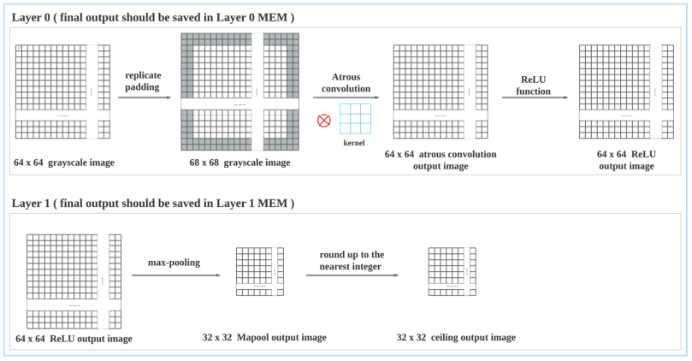
Introduction
Design a two-layered atrous convolution circuit
Layer 0 consists of padding, atrous convolution, and ReLU
Layer 1 consists of max-pooling and rounding up

Slide 3
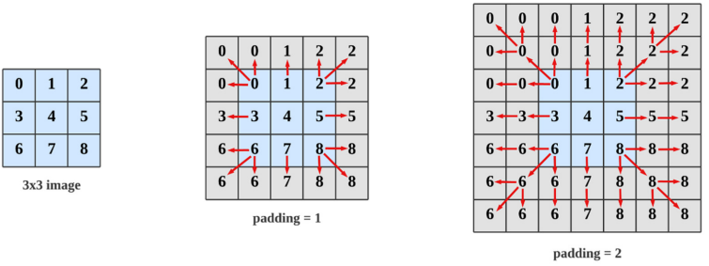
Introduction
To maintain the same image size after atrous convolution, replicate padding is adopted
In this homework, the padding parameter is set as 2
The 64x64 image becomes 68x68 after the replicate padding operation

Slide 4
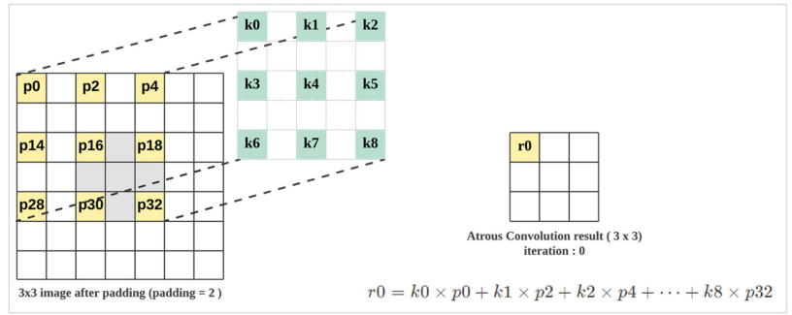
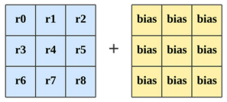

Introduction
The hyperparameter dilation is set as 2, and stride is set as 1
9 pixel values are multiplied with the kernel values and then summed up
The summation results have to be added with bias and pass through ReLU function
Finally, the atrous convolution result for the center pixel is obtained
ReLU：

Slide 5
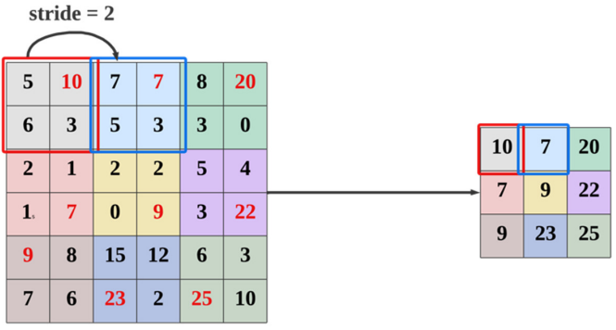
Introduction
The kernel size of max-pooling is 2x2 and the hyperparameter stride is 2
The maximum among the four values will be selected

Slide 6
Finite State Machine
INIT：Wait for ready signal
ATCONV_9PIXELS：Read 9 pixels from IMAGE_MEM and calculate convolution
LAYER0_WRITERELU：Write the results after ReLU operation to LAYER 0 MEM
MAXPOOL_4PIXELS：Read 4 pixels from LAYER 0 MEM and find the maximum
LAYER1_WRITECEILING：Write rounded up results to LAYER 1 MEM
FINISH：Pull down busy signal

Slide 7

Data Registers
center: used to record the coordinate of processing pixel
counter: count the number of read in pixels
convSum: used to accumulate the convolution results

Slide 8
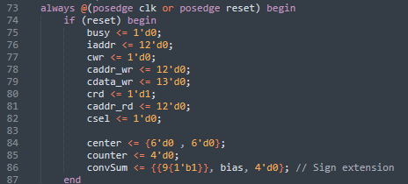
Reset
Pulled down busy to 0
Set cwr as 0 to prevent writing invalid value to MEM
Set center as {6’d0, 6’d0}, which corresponds to the pixel (0, 0)
Initialize counter to 0
Set convSum as {{9{1’b1}}, bias, 4’d0}
{9{1’b1}}：sign extension
bias：pre-add to convSum
4’d0：pad zeros to the fractional part

Slide 9
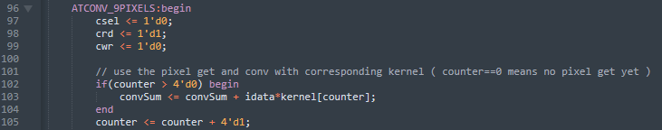
ATCONV_9PIXELS
Execute 10 cycles
1st cycle：start reading pixel from IMAGE_MEM (counter = 0)
2nd to 10th cycles：accumulate convolution result (counter = 1 ~ 9)
crd is set as 1, and cwr is set as 0 (read operation)

Slide 10
ATCONV_9PIXELS
From the 1st to 9th cycles (counter = 0 ~ 8), address of the next pixel has to be assigned
center[11:6] represents y coordinate (row), and center[5:0] represents x coordinate (column)
If the pixel to read is out of bound, replicate padding is adopted
When the center is at (X, 0) or (X, 1), the y coordinate of the 1st row of kernel is set as 0
When the center is at (X, 62) or (X, 63), the y coordinate of the 3rd row of kernel is set as 63
When the center is at (0, X) or (1, X), the x coordinate of the 1st column of kernel is set as 0
When the center is at (62, X) or (63, X), the x coordinate of the 3rd column of kernel is set as 63
Otherwise
The y coordinate of the 1st row of kernel is set as the y coordinate of center minus 2
The y coordinate of the 3rd row of kernel is set as the y coordinate of center plus 2
The x coordinate of the 1st column of kernel is set as the x coordinate of center minus 2
The x coordinate of the 3rd column of kernel is set as the x coordinate of center plus 2

Slide 11
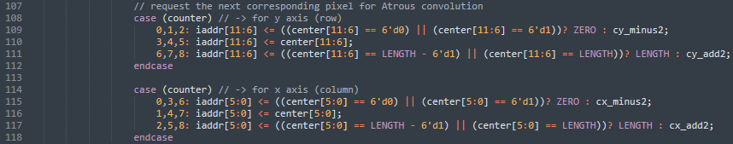
ATCONV_9PIXELS

Slide 12
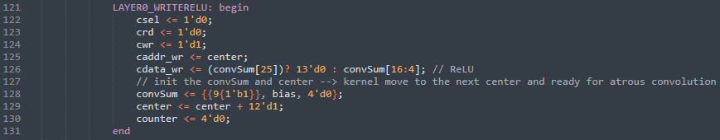
LAYER0_WRITERELU
Select LAYER 0 MEM and pull up cwr signal
caddr_wr is set as center, and the value of center is increased by 1
The value of center will traverse from 0 to 4095
When center[5:0] is 63 (6’b111111), increment it by 1 will change to the next row and go back to column 0
Ex: {000000 111111} + 12’d1 = {000001 000000}
cdata_wr is assigned the result after ReLU operation
convSum[25] = 1：convSum < 0, cdata_wr = 0
convSum[25] = 0：convSum ≥ 0, cdata_wr = convSum[16:4] (The left-most 9 bits and right-most 4 bits are truncated)

Slide 13
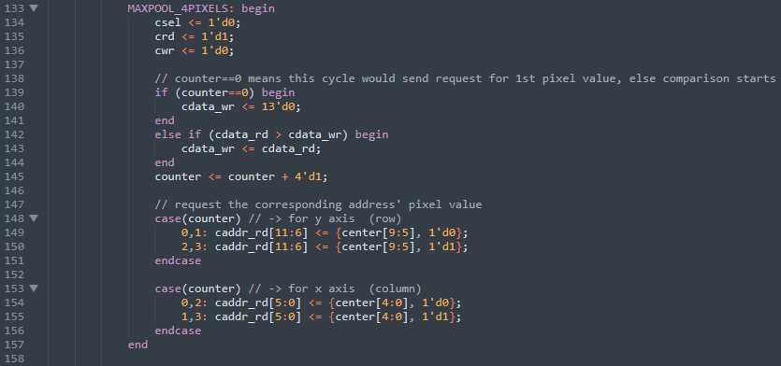
MAXPOOL_4PIXELS
Select LAYER 0 MEM. Pull up crd signal and pull down cwr signal (read operation).
Read convolution results from LAYER 0 MEM
Execute 5 cycles
1st cycle：start reading pixel from LAYER 0 MEM (counter = 0)
2nd to 5th cycles：record the maximum among data read from LAYER 0 MEM (counter = 1 ~ 4)
Cdata_wr is used as the register that records the maximum value, and it is initialized as 0 at 1st cycle

Slide 14
MAXPOOL_4PIXELS
From the 1st to 4th cycles (counter = 0 ~ 3), address of the next pixel has to be assigned
center[9:5] represents y coordinate (row), and center[4:0] represents x coordinate (column)
center is used to record the index of processing pixel
The size of the resulting image after max-pooling is 32x32, so center will traverse from 0 to 1023
However, there are pixels 0~4095 in LAYER 0 MEM
The x, y coordinate have to be multiplied by 2, and offset is used to select requiring pixel
Let processing pixel is (X, Y), pixels (2X, 2Y)、(2X + 1, 2Y)、(2X, 2Y + 1)、 (2X + 1, 2Y + 1) are read from LAYER 0 MEM
counter = 0，caddr_rd = {center[9:5]*2, center[4:0]*2}
counter = 1，caddr_rd = {center[9:5]*2, center[4:0]*2 + 1}
counter = 2，caddr_rd = {center[9:5]*2 + 1, center[4:0]*2}
counter = 3，caddr_rd = {center[9:5]*2 + 1, center[4:0]*2 + 1}

Slide 15
MAXPOOL_4PIXELS

Slide 16
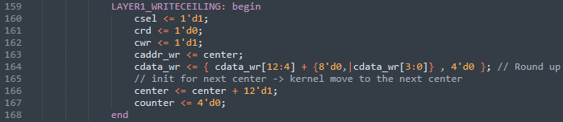
LAYER1_WRITECEILING
Select LAYER 1 MEM and pull up cwr signal
caddr_wr is set as center, and the value of center is increased by 1
The value of center will traverse from 0 to 1023
When center[4:0] is 31 (5’b11111), increment it by 1 will change to the next row and go back to column 0
Ex: {00 00000 11111} + 12’d1 = {00 00001 00000}
cdata_wr is assigned the result that is rounded up
Integer part：
If any bit among cdata_wr[3:0] is 1 -> cdata_wr[12:4] + 9’d1
Else -> cdata_wr[12:4]
Fractional part：4’d0

Slide 17

FINISH
Pull down busy signal
After busy is pulled down, testbench will verify the value in LAYER 0 MEM and LAYER 1 MEM

